Slide 1

Human Anatomy and Physiology
Eleventh Edition
Chapter 25 Part B
The Urinary System
PowerPoint® Lectures Slides prepared by Karen Dunbar Kareiva, Ivy Tech Community College
Copyright © 2019, 2016, 2013 Pearson Education, Inc. All Rights Reserved

Slide 2
25.5 Step 2: Tubular Reabsorption (1 of 2)
Tubular reabsorption quickly reclaims most of tubular contents and returns them to blood
Selective transepithelial process
  Almost all organic nutrients are reabsorbed
  Water and ion reabsorption is hormonally regulated and adjusted
Includes active and passive tubular reabsorption
Substances can follow two routes:
  Transcellular
  Paracellular

Slide 3
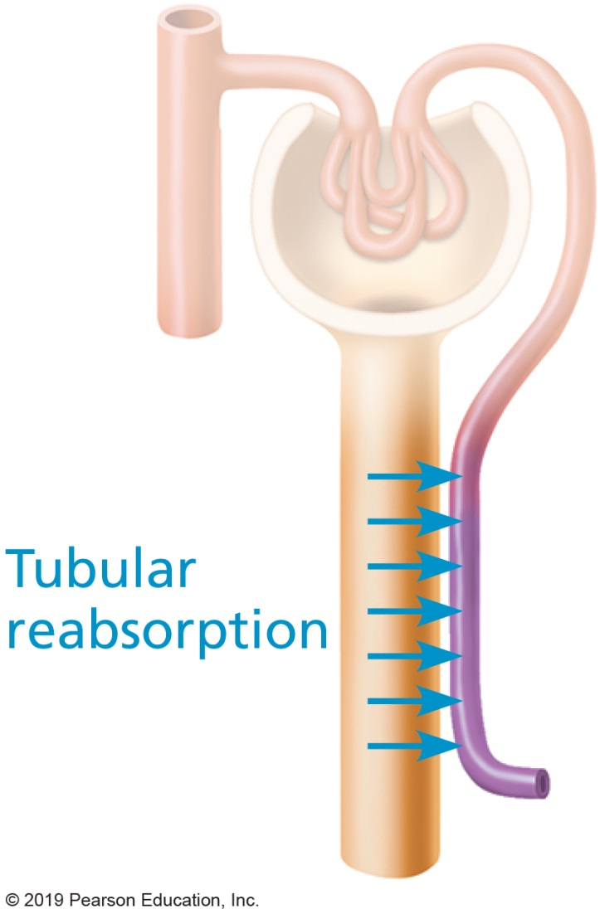
Tubular Reabsorption

Slide 4
25.5 Step 2: Tubular Reabsorption (2 of 2)
  Transcellular route
    Solute enters apical membrane of tubule cells
    Travels through cytosol of tubule cells
    Exits basolateral membrane of tubule cells
    Enters blood through endothelium of peritubular capillaries
  Paracellular route
    Between tubule cells
      Limited by tight junctions, but leaky in proximal nephron
        Water, Ca²⁺, Mg²⁺, K⁺, and some Na⁺ in the PCT move via this route

Slide 5
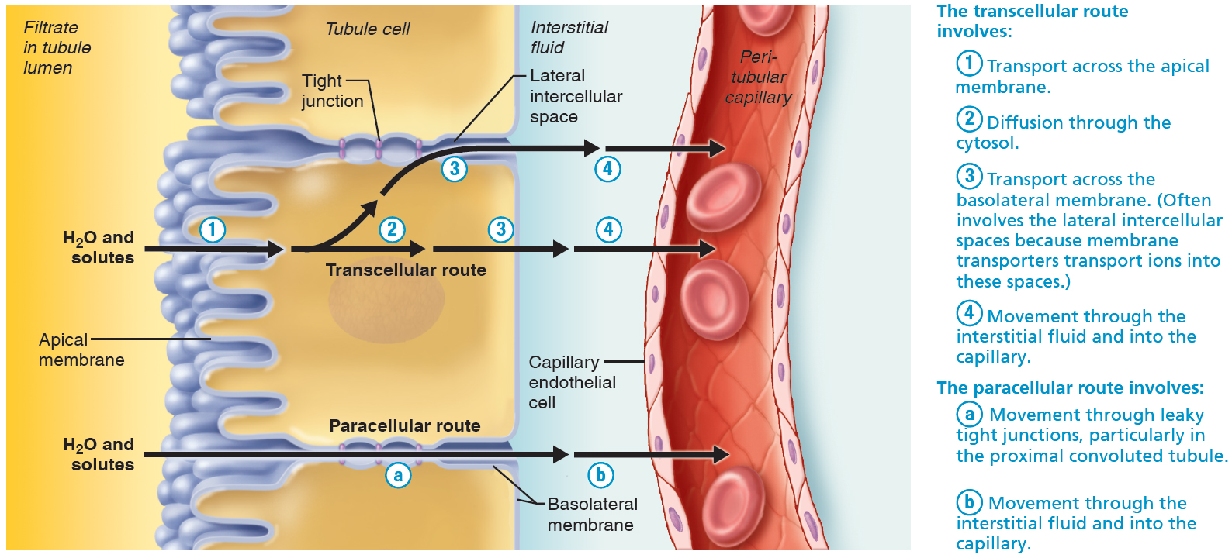
Tubular Reabsorption Occurs by Transcellular and Paracellular Routes (1 of 6)
Figure 25.15 Tubular reabsorption occurs by transcellular and paracellular routes.

Slide 6
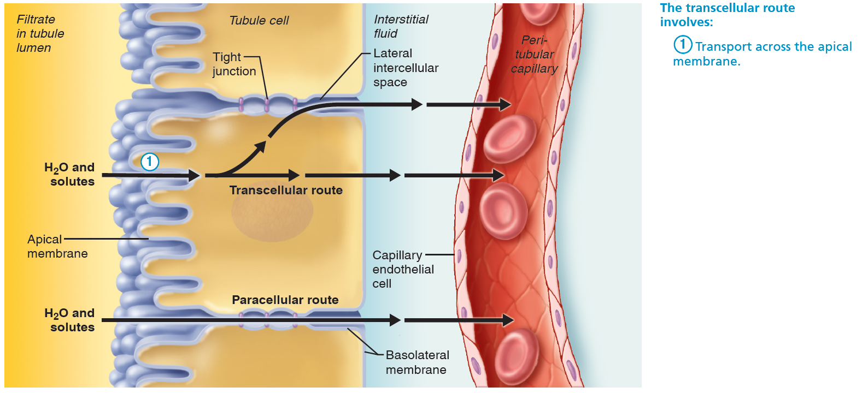
Tubular Reabsorption Occurs by Transcellular and Paracellular Routes (2 of 6)
Figure 25.15 Tubular reabsorption occurs by transcellular and paracellular routes.

Slide 7
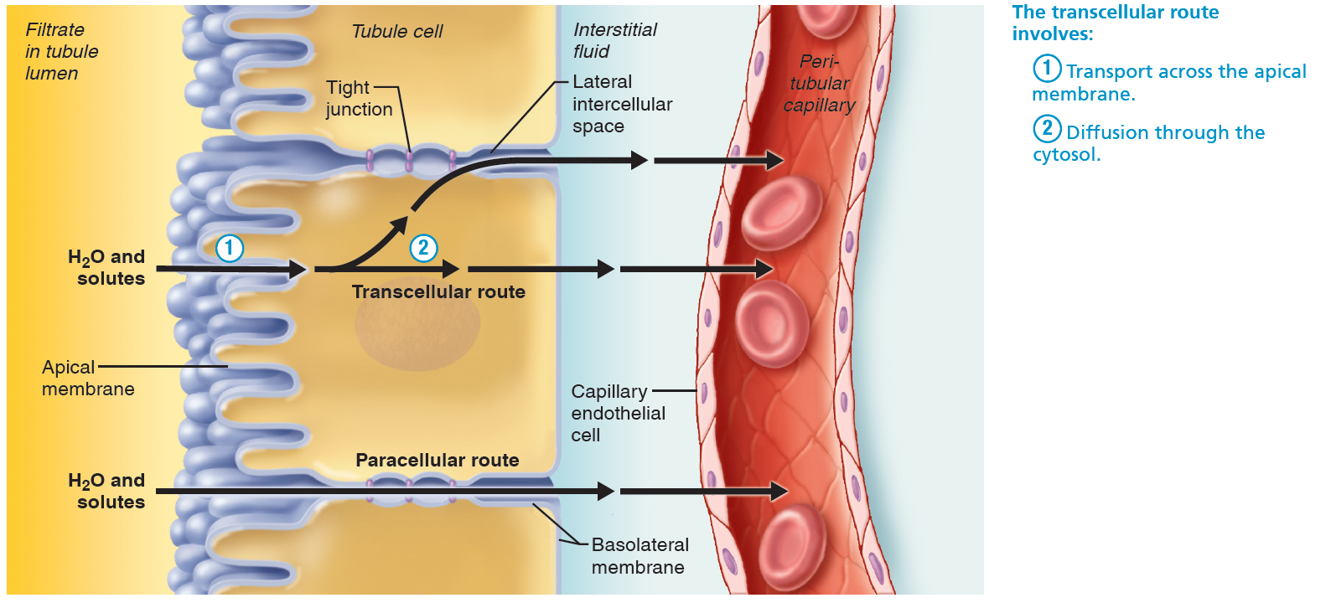
Tubular Reabsorption Occurs by Transcellular and Paracellular Routes (3 of 6)
Figure 25.15 Tubular reabsorption occurs by transcellular and paracellular routes.

Slide 8
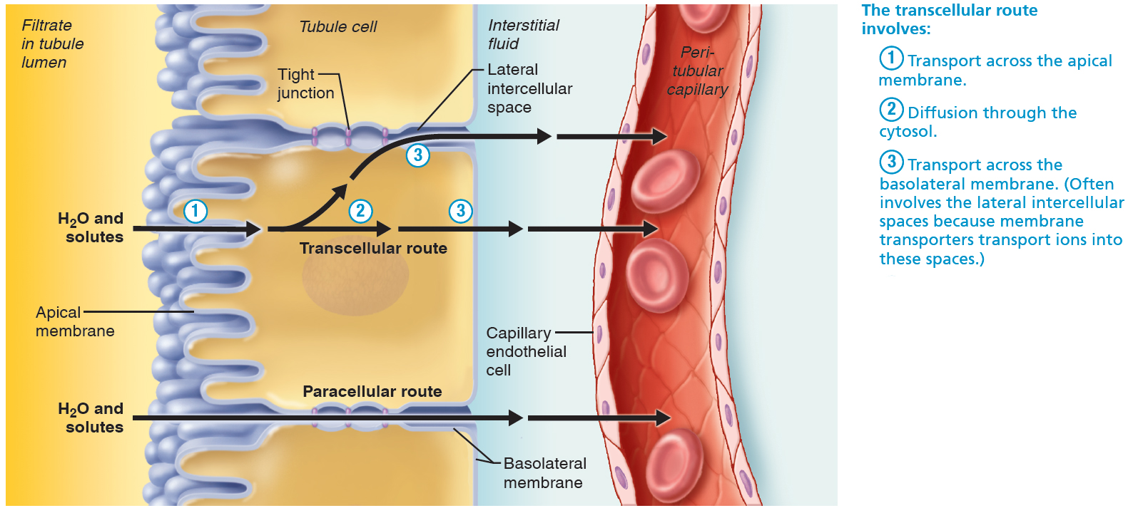
Tubular Reabsorption Occurs by Transcellular and Paracellular Routes (4 of 6)
Figure 25.15 Tubular reabsorption occurs by transcellular and paracellular routes.

Slide 9
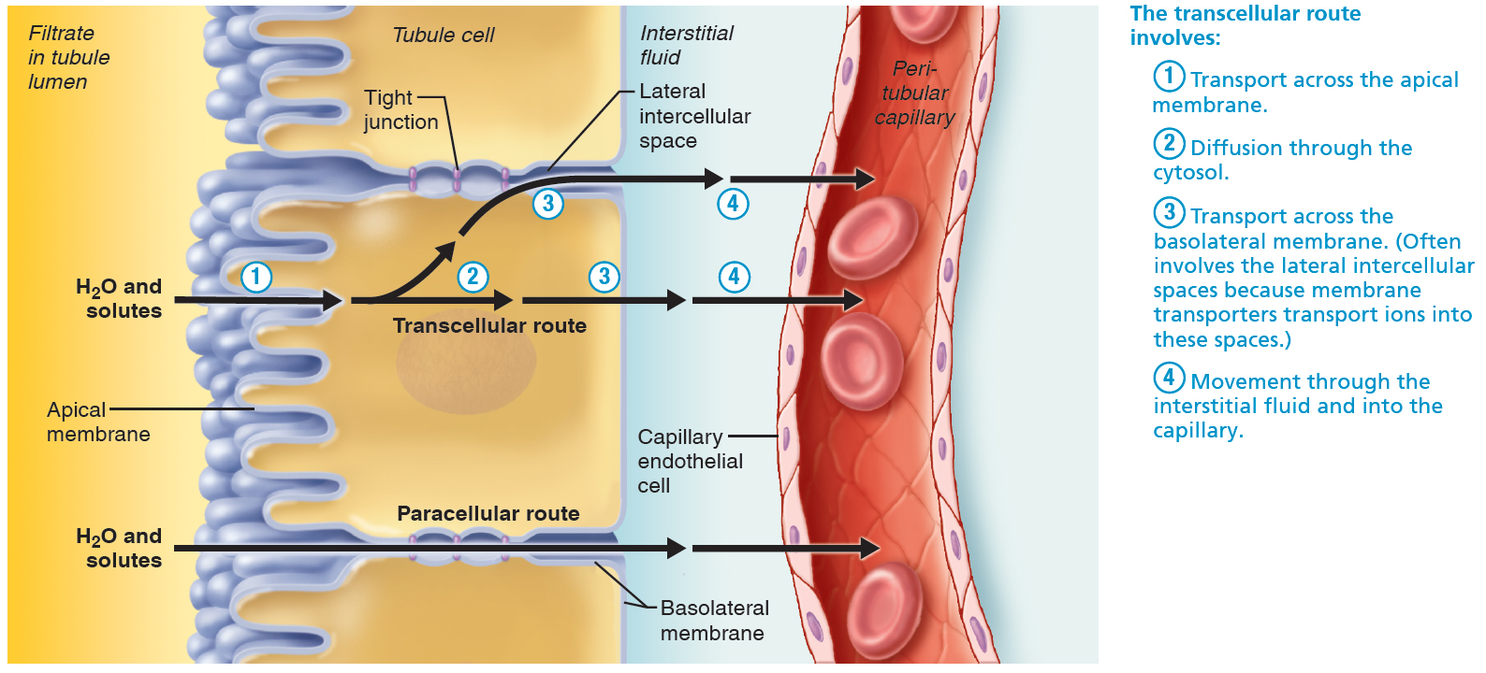
Tubular Reabsorption Occurs by Transcellular and Paracellular Routes (5 of 6)
Figure 25.15 Tubular reabsorption occurs by transcellular and paracellular routes.

Slide 10
Tubular Reabsorption Occurs by Transcellular and Paracellular Routes (6 of 6)
Figure 25.15 Tubular reabsorption occurs by transcellular and paracellular routes.

Slide 11
Tubular Reabsorption of Sodium (1 of 2)
Sodium transport across the basolateral membrane
  Na⁺ is most abundant cation in filtrate
  Transport of Na⁺ across basolateral membrane of tubule cell is via primary active transport
  Na⁺-K⁺ ATPase pumps Na⁺ into interstitial space
  Na⁺ is then swept by bulk flow into peritubular capillaries

Slide 12
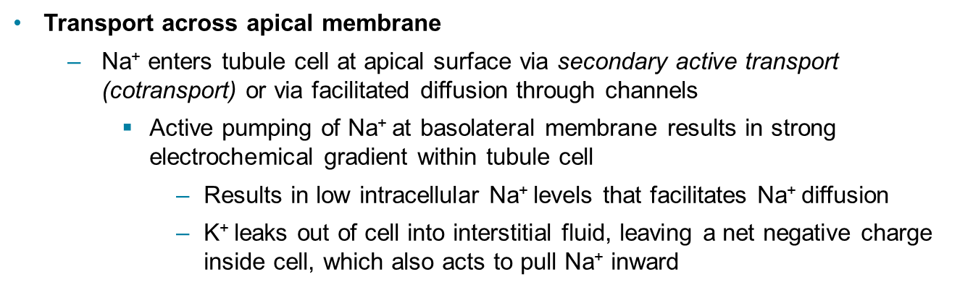
Tubular Reabsorption of Sodium (2 of 2)
Transport across apical membrane
  Na⁺ enters tubule cell at apical surface via secondary active transport (cotransport) or via facilitated diffusion through channels
    Active pumping of Na⁺ at basolateral membrane results in strong electrochemical gradient within tubule cell
      Results in low intracellular Na⁺ levels that facilitates Na⁺ diffusion
      K⁺ leaks out of cell into interstitial fluid, leaving a net negative charge inside cell, which also acts to pull Na⁺ inward

Slide 13
Tubular Reabsorption of Nutrients, Water, and Ions (1 of 3)
Na⁺ reabsorption by primary active transport provides energy and means for reabsorbing almost every other substance
Secondary active transport
  Electrochemical gradient created by pumps at basolateral surface give “push” needed for transport of other solutes
  Organic nutrients reabsorbed by secondary active transport are cotransported with Na⁺
    Glucose, amino acids, some ions, vitamins

Slide 14
Tubular Reabsorption of Nutrients, Water, and Ions (2 of 3)
Passive tubular reabsorption of water
  Movement of Na⁺ and other solutes creates osmotic gradient for water
  Water is reabsorbed by osmosis, aided by water-filled pores called aquaporins
    Obligatory water reabsorption
      Aquaporins are always present in PCT
    Facultative water reabsorption
      Aquaporins are inserted in collecting ducts only if ADH is present

Slide 15
Tubular Reabsorption of Nutrients, Water, and Ions (3 of 3)
Passive tubular reabsorption of solutes
  Solute concentration in filtrate increases as water is reabsorbed
    Creates concentration gradients for solutes, which drive their entry into tubule cell and peritubular capillaries
  Fat-soluble substances, some ions, and urea will follow water into peritubular capillaries down their concentration gradients
    For this reason, lipid-soluble drugs and environmental pollutants are reabsorbed even though it is not desirable

Slide 16
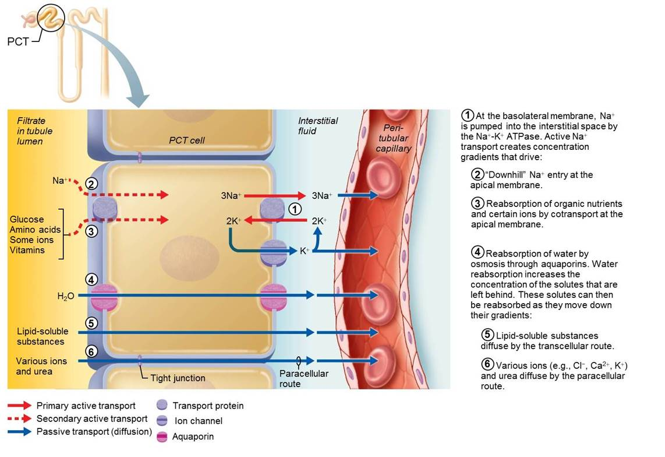
Tubular Reabsorption of Water and Nutrients Uses Active and Passive Transport (1 of 7)
Figure 25.16 Tubular reabsorption of water and nutrients uses active and passive transport.

Slide 17
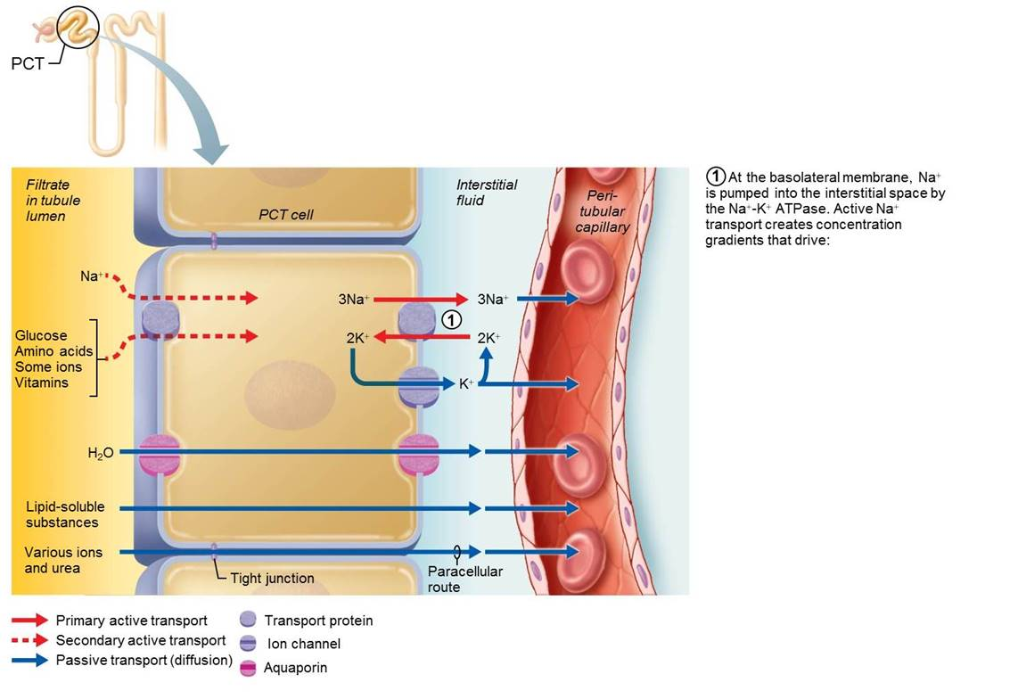
Tubular Reabsorption of Water and Nutrients Uses Active and Passive Transport (2 of 7)
Figure 25.16 Tubular reabsorption of water and nutrients uses active and passive transport.

Slide 18
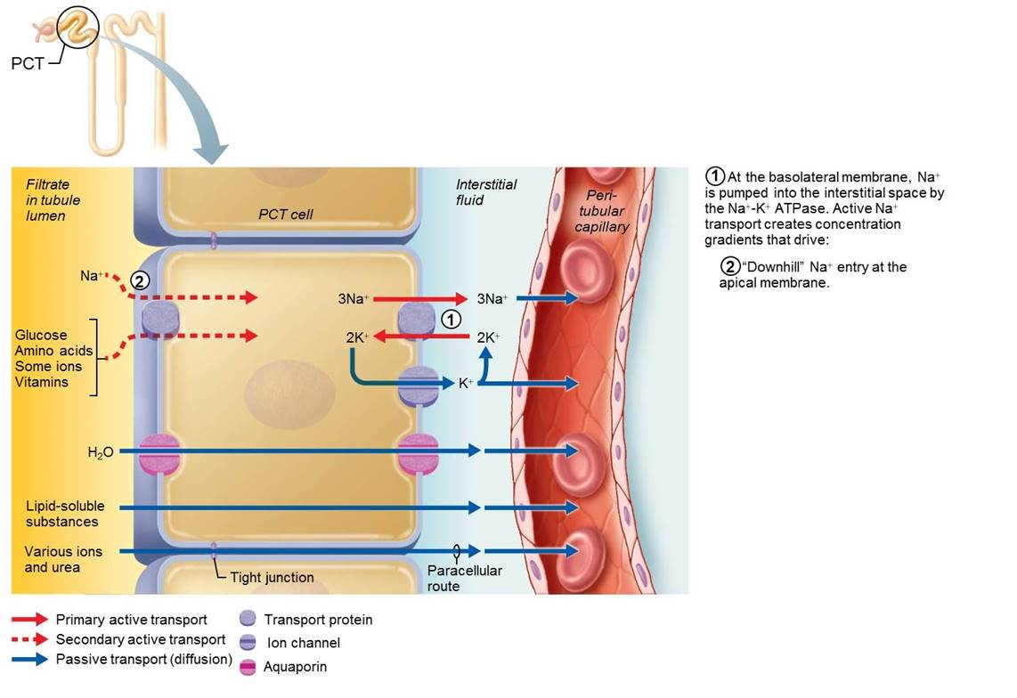
Tubular Reabsorption of Water and Nutrients Uses Active and Passive Transport (3 of 7)
Figure 25.16 Tubular reabsorption of water and nutrients uses active and passive transport.

Slide 19
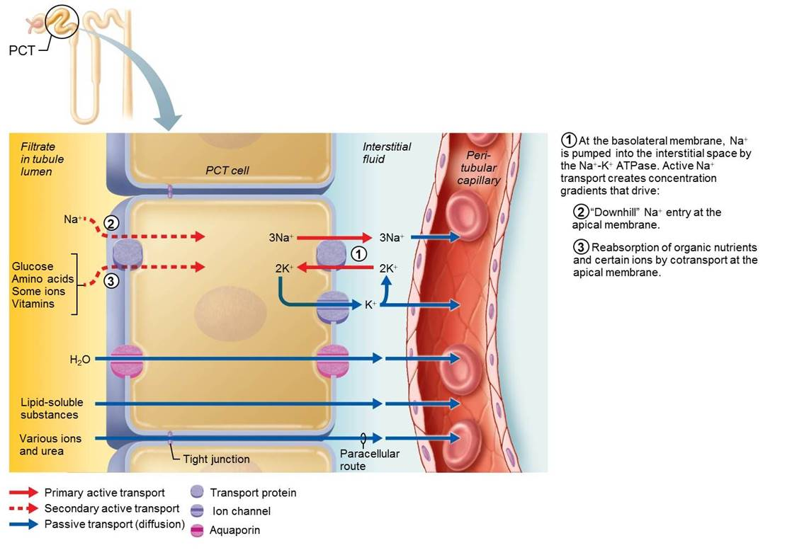
Tubular Reabsorption of Water and Nutrients Uses Active and Passive Transport (4 of 7)
Figure 25.16 Tubular reabsorption of water and nutrients uses active and passive transport.

Slide 20
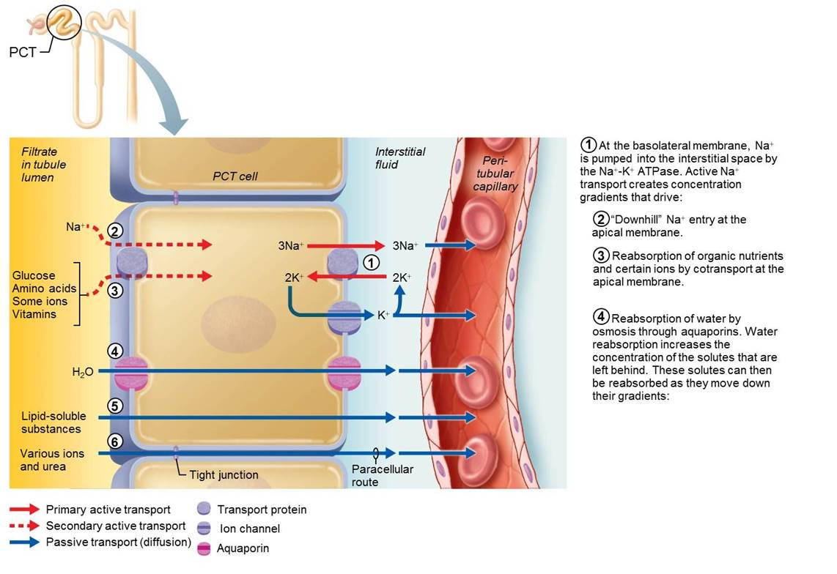
Tubular Reabsorption of Water and Nutrients Uses Active and Passive Transport (5 of 7)
Figure 25.16 Tubular reabsorption of water and nutrients uses active and passive transport.

Slide 21
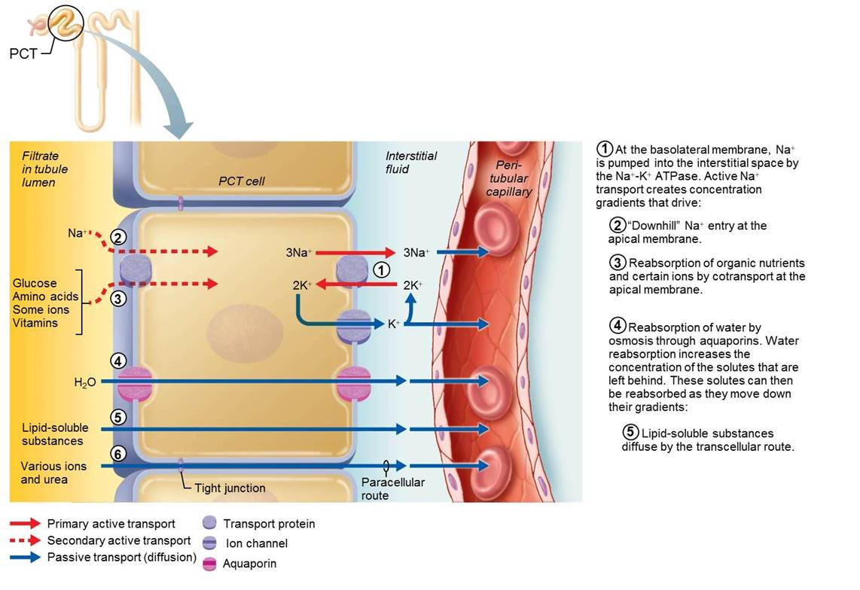
Tubular Reabsorption of Water and Nutrients Uses Active and Passive Transport (6 of 7)
Figure 25.16 Tubular reabsorption of water and nutrients uses active and passive transport.

Slide 22
Tubular Reabsorption of Water and Nutrients Uses Active and Passive Transport (7 of 7)
Figure 25.16 Tubular reabsorption of water and nutrients uses active and passive transport.

Slide 23
Transport Maximum
Transcellular transport systems are specific and limited
  Transport maximum (T_{m}) exists for almost every reabsorbed substance
    Reflects number of carriers in renal tubules that are available
  When carriers for a solute are saturated, excess is excreted in urine
    Example: hyperglycemia leads to high blood glucose levels that exceed T_{m}, and glucose spills over into urine

Slide 24
Reabsorptive Capabilities of Renal Tubules and Collecting Ducts (1 of 5)
Proximal convoluted tubule
  Site of most reabsorption
    All nutrients, such as glucose and amino acids, are reabsorbed
    65% of Na⁺ and water reabsorbed
    Many ions
    Almost all uric acid
    About half of urea (later secreted back into filtrate)

Slide 25
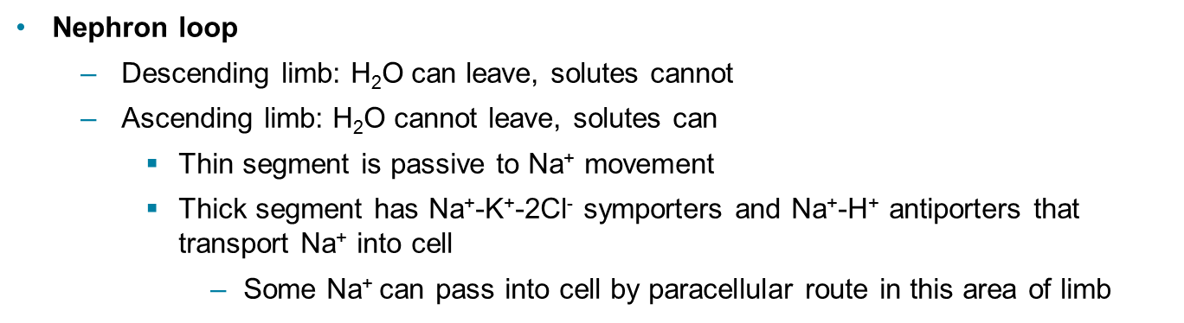
Reabsorptive Capabilities of Renal Tubules and Collecting Ducts (2 of 5)
Nephron loop
  Descending limb: H₂O can leave, solutes cannot
  Ascending limb: H₂O cannot leave, solutes can
    Thin segment is passive to Na⁺ movement
    Thick segment has Na⁺-K⁺-2Cl⁻ symporters and Na⁺-H⁺ antiporters that transport Na⁺ into cell
      Some Na⁺ can pass into cell by paracellular route in this area of limb

Slide 26
Reabsorptive Capabilities of Renal Tubules and Collecting Ducts (3 of 5)
Distal convoluted tubule and collecting duct
  Reabsorption is hormonally regulated in these areas
  Antidiuretic hormone (ADH)
    Released by posterior pituitary gland
    Causes principal cells of collecting ducts to insert aquaporins in apical membranes, increasing water reabsorption
      Increased ADH levels cause an increase in water reabsorption

Slide 27
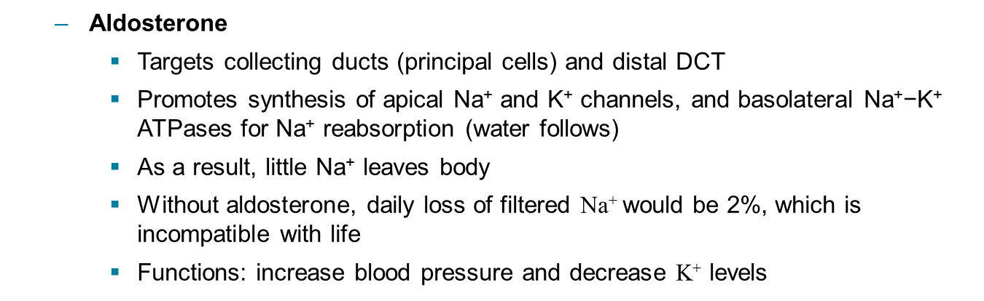
Reabsorptive Capabilities of Renal Tubules and Collecting Ducts (4 of 5)
  Aldosterone
    Targets collecting ducts (principal cells) and distal DCT
    Promotes synthesis of apical Na⁺ and K⁺ channels, and basolateral Na⁺−K⁺ ATPases for Na⁺ reabsorption (water follows)
    As a result, little Na⁺ leaves body
    Without aldosterone, daily loss of filtered Na⁺ would be 2%, which is incompatible with life
    Functions: increase blood pressure and decrease K⁺ levels

Slide 28
Reabsorptive Capabilities of Renal Tubules and Collecting Ducts (5 of 5)
Atrial natriuretic peptide
  Reduces blood Na⁺, resulting in decreased blood volume and blood pressure
  Released by cardiac atrial cells if blood volume or pressure elevated
Parathyroid hormone
  Acts on DCT to increase Ca²⁺ reabsorption

Slide 29
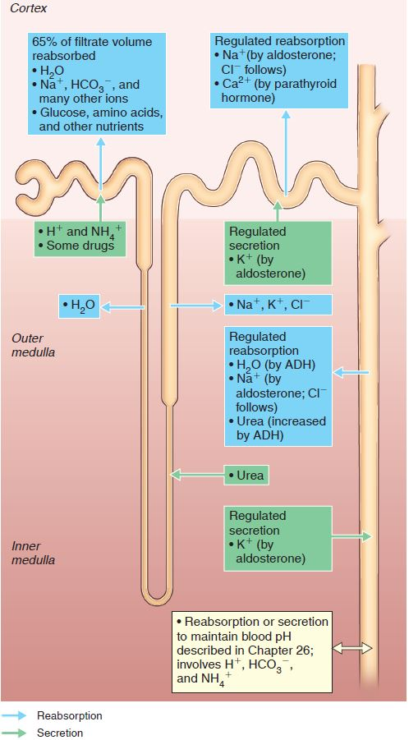
Summary of Tubular Reabsorption and
Secretion (1 of 2)
Figure 25.17 Summary of tubular reabsorption and secretion.

Slide 30
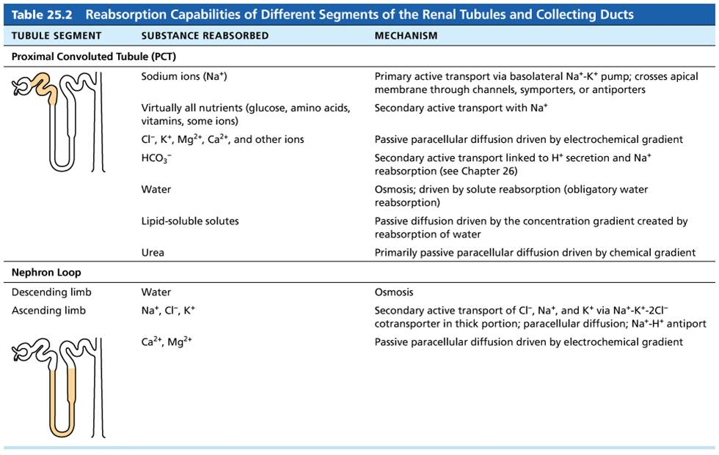
Table 25.2-1 Reabsorption Capabilities of Different Segments of the Renal Tubules and Collecting Ducts (1 of 2)
Table 25.2 Reabsorption Capabilities of Different Segments of the Renal Tubules and Collecting Ducts

Slide 31
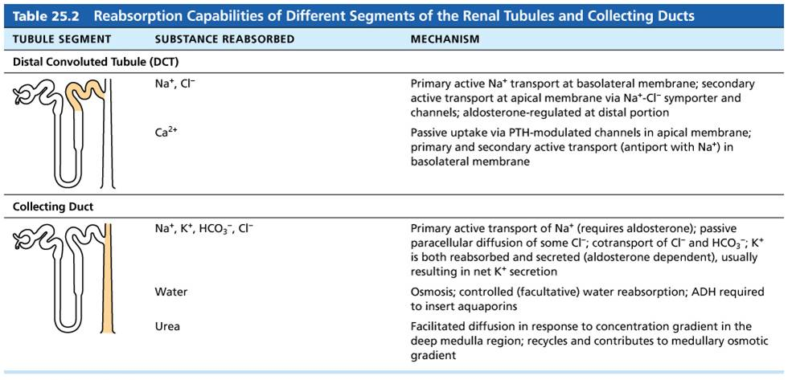
Table 25.2-2 Reabsorption Capabilities of Different Segments of the Renal Tubules and Collecting Ducts (2 of 2)
Table 25.2 Reabsorption Capabilities of Different Segments of the Renal Tubules and Collecting Ducts

Slide 32
25.6 Step 3: Tubular Secretion (1 of 2)
Tubular secretion is reabsorption in reverse
Occurs almost completely in PCT
Selected substances are moved from peritublar capillaries through tubule cells out into filtrate
  K⁺, H⁺, NH₄⁺, creatinine, organic acids and bases
  Substances synthesized in tubule cells also are secreted (example: HCO₃–)

Slide 33
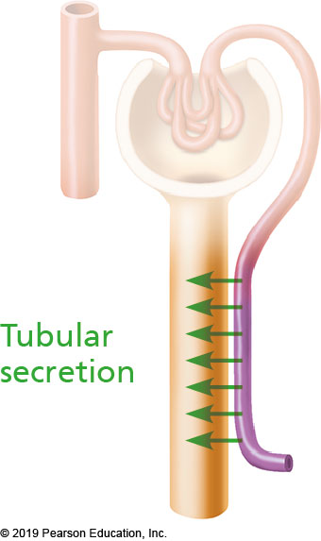
Tubular Secretion

Slide 34
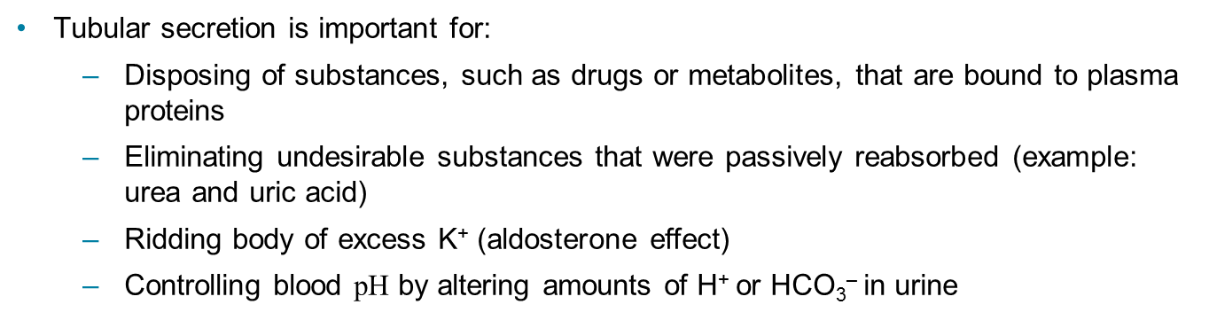
25.6 Step 3: Tubular Secretion (2 of 2)
Tubular secretion is important for:
  Disposing of substances, such as drugs or metabolites, that are bound to plasma proteins
  Eliminating undesirable substances that were passively reabsorbed (example: urea and uric acid)
  Ridding body of excess K⁺ (aldosterone effect)
  Controlling blood pH by altering amounts of H⁺ or HCO₃– in urine

Slide 35
IP2: Tubular Reabsorption & Secretion: Summary
Click here to view ADA compliant video:
IP2: Tubular Reabsorption & Secretion: Summary
https://mediaplayer.pearsoncmg.com/assets/sci-trs-scene-14-summary

Slide 36
Summary of Tubular Reabsorption and
Secretion (2 of 2)
Figure 25.17 Summary of tubular reabsorption and secretion.

Slide 37
25.7 Regulation of Urine Concentration and Volume (1 of 4)
One main function of kidneys is to make any adjustment needed to maintain body fluid osmotic concentration at around 300 mOsm
  Osmolality: number of solute particles in 1 kg of H₂O
    1 osmol = 1 mole of particle per kg H₂O
    Body fluids have much smaller amounts, so expressed in milliosmols (mOsm) = 0.001 osmol

Slide 38
25.7 Regulation of Urine Concentration and Volume (2 of 4)
Kidneys produce only small amounts of urine if the body is dehydrated, or dilute urine if overhydrated
Accomplish this by using countercurrent mechanism
  Fluid flows in opposite directions in two adjacent segments of same tube with hairpin turn

Slide 39
25.7 Regulation of Urine Concentration and Volume (3 of 4)
  Two types of countercurrent mechanisms
    Countercurrent multiplier: interaction of filtrate flow in ascending/descending limbs of nephron loops of juxtamedullary nephrons
    Countercurrent exchanger: blood flow in ascending/descending limbs of vasa recta

Slide 40
25.7 Regulation of Urine Concentration and Volume (4 of 4)
  These two countercurrent mechanisms work together to:
    Establish and maintain medullary osmotic gradient from renal cortex through medulla
      Gradient runs from 300 mOsm in cortex to 1200 mOsm at bottom of medulla
  Countercurrent multiplier creates gradient
  Countercurrent exchanger preserves gradient
  Collecting ducts can then use gradient to vary urine concentration

Slide 41
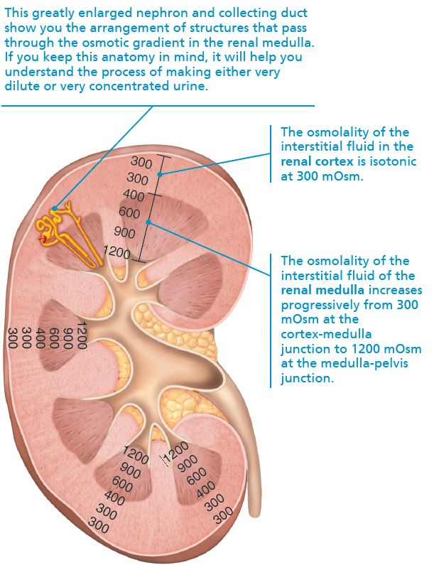
Osmotic Gradient in the Renal Medulla
Figure 25.18 Osmotic gradient in the renal medulla.

Slide 42
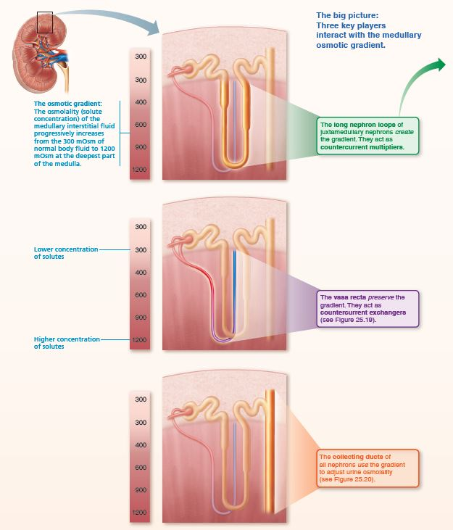
Juxtamedullary Nephrons Create an Osmotic Gradient within the Renal Medulla that Allows the Kidney to Produce Urine of Varying Concentration (1 of 7)
FOCUS FIGURE 25.1 Medullary Osmotic Gradient

Slide 43
Countercurrent Multiplier (1 of 4)
Countercurrent multiplier involves the nephron loop and depends on:
  Filtrate flow in opposite directions (descending/ascending)
  Difference in permeabilities between descending nephron loop and ascending loop
  Active transport of solutes out of ascending limb
Limbs of nephron loop are not in direct contact but are close enough to influence each other’s exchanges with surrounding interstitial fluid

Slide 44
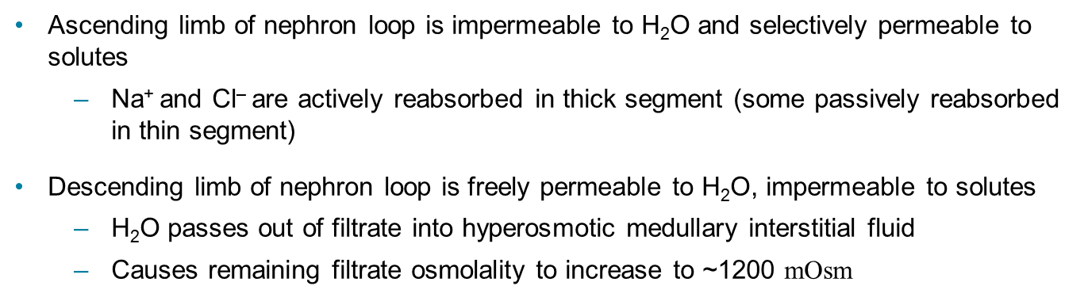
Countercurrent Multiplier (2 of 4)
Ascending limb of nephron loop is impermeable to H₂O and selectively permeable to solutes
  Na⁺ and Cl– are actively reabsorbed in thick segment (some passively reabsorbed in thin segment)
Descending limb of nephron loop is freely permeable to H₂O, impermeable to solutes
  H₂O passes out of filtrate into hyperosmotic medullary interstitial fluid
  Causes remaining filtrate osmolality to increase to ~1200 mOsm

Slide 45
Countercurrent Multiplier (3 of 4)
Countercurrent mechanism:
  The more NaCl the ascending limb actively transports out into interstitial fluid, the more water diffuses out of the descending limb
  The more water that diffuses out of the descending limb, the saltier the filtrate becomes
  Ascending limb then uses salty filtrate to further raise osmolality of medullary interstitial fluid

Slide 46
Countercurrent Multiplier (4 of 4)
Constant difference of 200 mOsm always exists between two limbs of nephron loop and between ascending limb and interstitial fluid
Difference is “multiplied” along length of loop (from 300 to 1200 mOsm = difference of 900 mOsm)

Slide 47
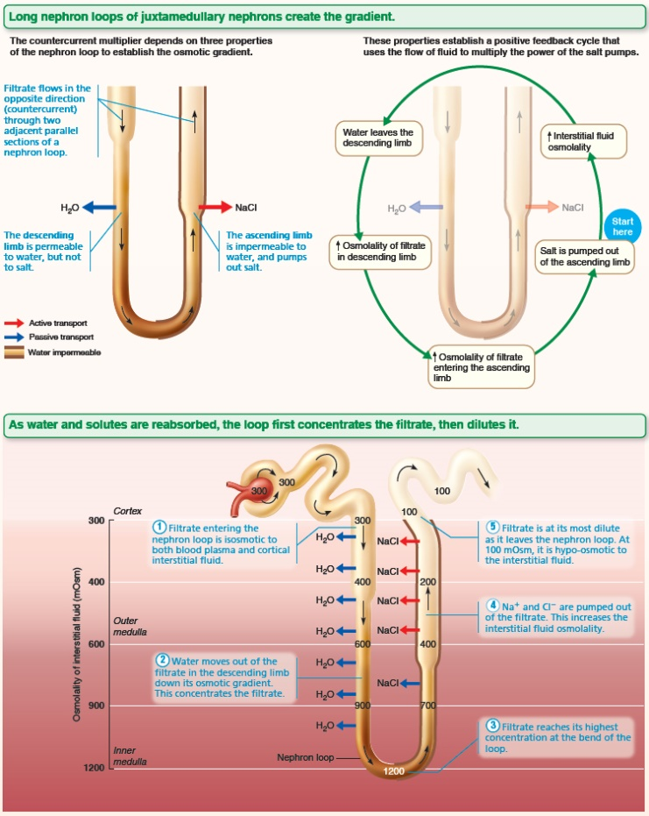
Juxtamedullary Nephrons Create an Osmotic Gradient within the Renal Medulla that Allows the Kidney to Produce Urine of Varying Concentration (2 of 7)
FOCUS FIGURE 25.1 Medullary Osmotic Gradient

Slide 48
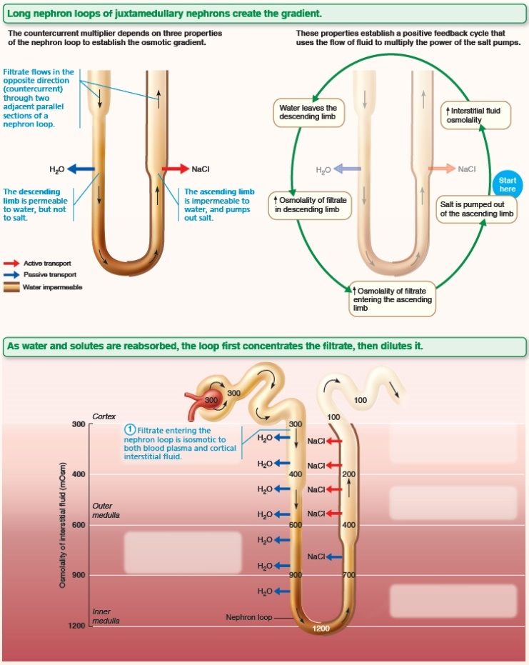
Juxtamedullary Nephrons Create an Osmotic Gradient within the Renal Medulla that Allows the Kidney to Produce Urine of Varying Concentration (3 of 7)
FOCUS FIGURE 25.1 Medullary Osmotic Gradient

Slide 49
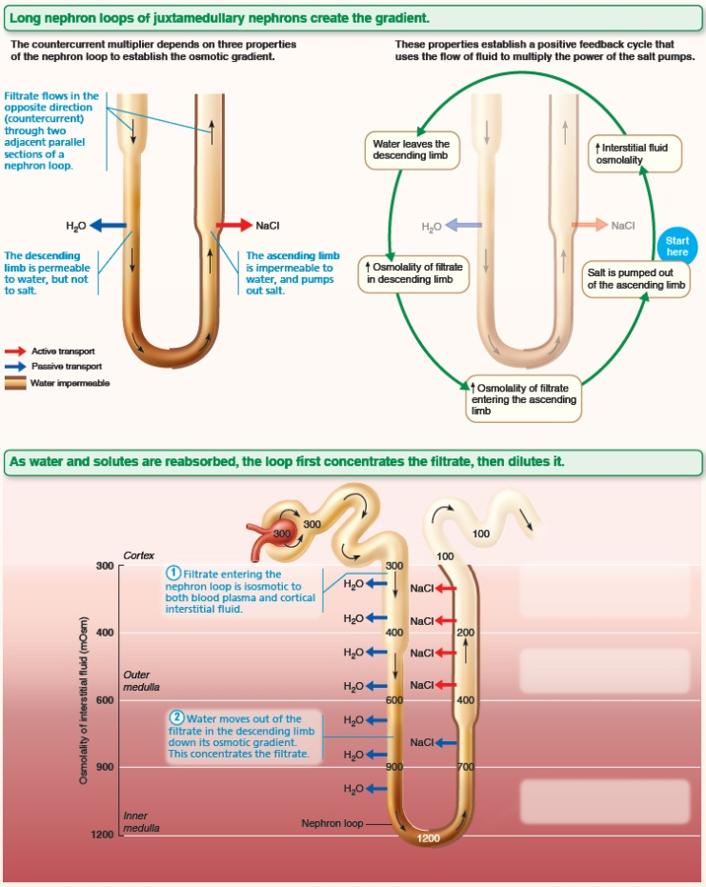
Juxtamedullary Nephrons Create an Osmotic Gradient within the Renal Medulla that Allows the Kidney to Produce Urine of Varying Concentration (4 of 7)
FOCUS FIGURE 25.1 Medullary Osmotic Gradient

Slide 50
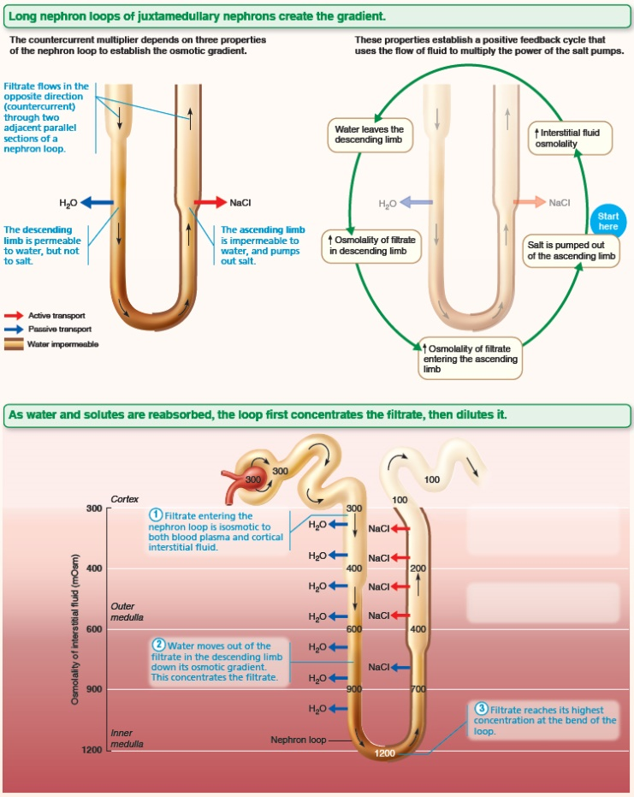
Juxtamedullary Nephrons Create an Osmotic Gradient within the Renal Medulla that Allows the Kidney to Produce Urine of Varying Concentration (5 of 7)
FOCUS FIGURE 25.1 Medullary Osmotic Gradient

Slide 51
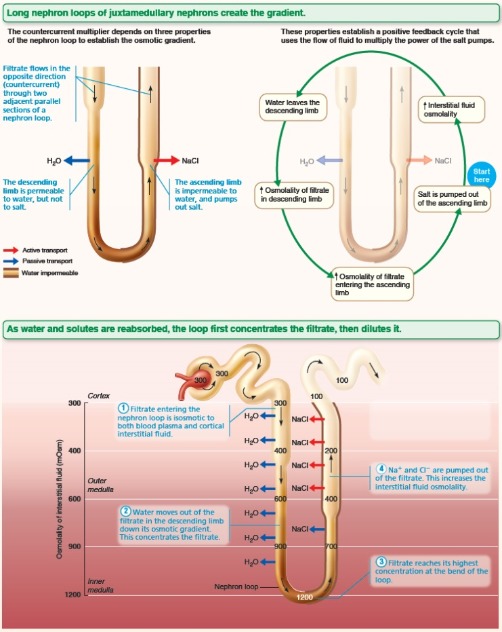
Juxtamedullary Nephrons Create an Osmotic Gradient within the Renal Medulla that Allows the Kidney to Produce Urine of Varying Concentration (6 of 7)
FOCUS FIGURE 25.1 Medullary Osmotic Gradient

Slide 52
Juxtamedullary Nephrons Create an Osmotic Gradient within the Renal Medulla that Allows the Kidney to Produce Urine of Varying Concentration (7 of 7)
FOCUS FIGURE 25.1 Medullary Osmotic Gradient

Slide 53
Countercurrent Exchanger (1 of 3)
Countercurrent exchanger utilizes vasa recta
Vasa recta is highly permeable to water and solutes
Flow of blood in vasa recta is also countercurrent (hairpin turn) so blood can exchange NaCl and water with surrounding interstitial fluid as it moves through adjacent parallel sections of gradient
  Blood inside vasa recta remains isosmotic with surrounding interstitial fluid
  Vasa recta is able to reabsorb water and solutes without undoing osmotic gradient created by countercurrent multiplier

Slide 54
Countercurrent Exchanger (2 of 3)
Countercurrent exchanger preserves medullary gradient by:
  Preventing rapid removal of salt from interstitial space
  Removing reabsorbed water
Water in ascending vasa recta comes from descending vasa recta or is reabsorbed from nephron loop and collecting duct
  As a result, volume of blood at end of vasa recta is greater than at beginning

Slide 55
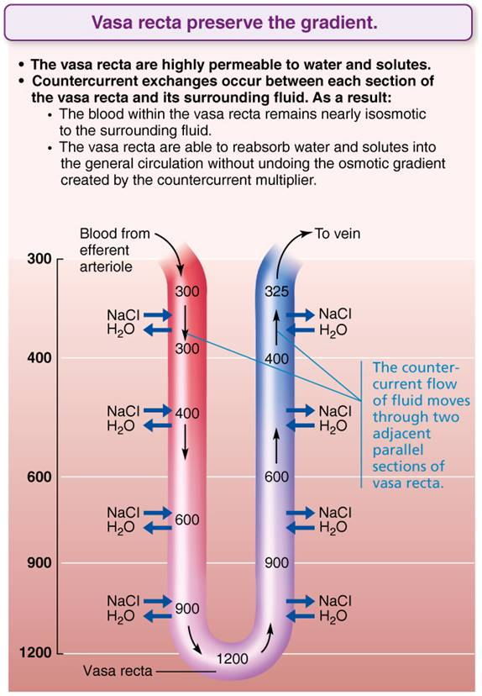
Countercurrent Exchange (3 of 3)
Figure 25.19 Countercurrent exchange.

Slide 56
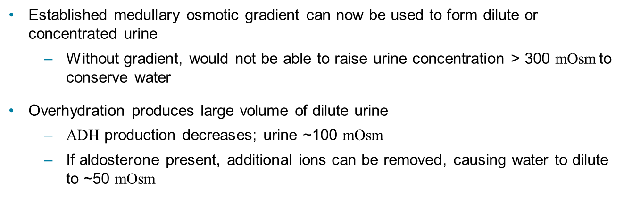
Formation of Dilute or Concentrated Urine (1 of 2)
Established medullary osmotic gradient can now be used to form dilute or concentrated urine
  Without gradient, would not be able to raise urine concentration > 300 mOsm to conserve water
Overhydration produces large volume of dilute urine
  ADH production decreases; urine ~100 mOsm
  If aldosterone present, additional ions can be removed, causing water to dilute to ~50 mOsm

Slide 57
Formation of Dilute or Concentrated Urine (2 of 2)
Dehydration produces small volume of concentrated urine
  Maximal ADH is released; urine ~1200 mOsm
  Severe dehydration: 99% water reabsorbed

Slide 58
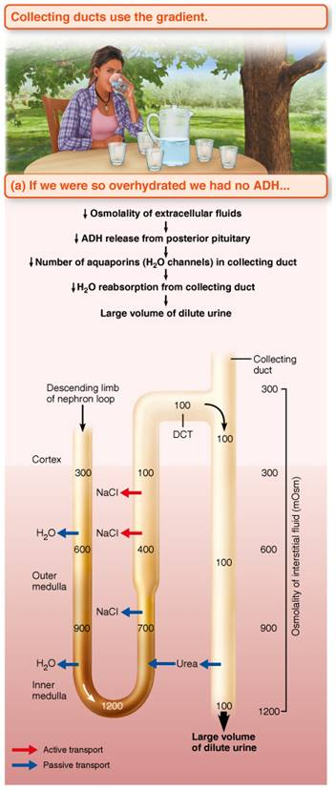
Mechanism for Forming Dilute or Concentrated Urine (1 of 2)
Figure 25.20a Mechanism for forming dilute or concentrated urine.

Slide 59
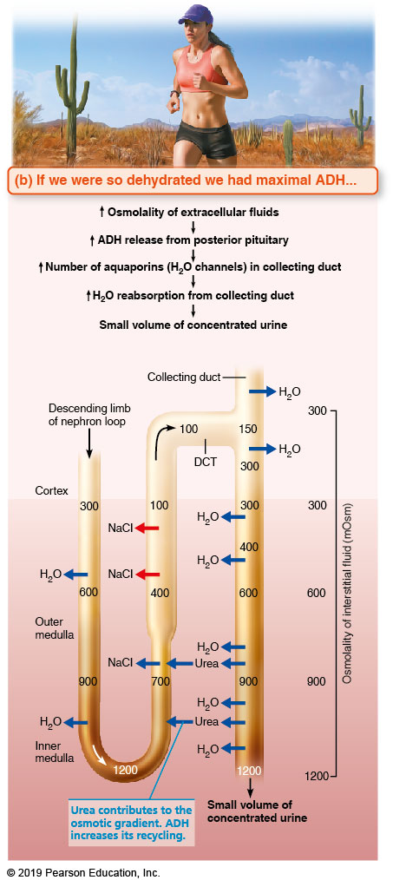
Mechanism for Forming Dilute or Concentrated Urine (2 of 2)
Figure 25.20b Mechanism for forming dilute or concentrated urine.

Slide 60
Urea Recycling and the Medullary Osmotic Gradient
Urea helps form medullary gradient
  Urea enters filtrate in ascending thin limb of nephron loop by facilitated diffusion
  Cortical collecting duct reabsorbs water, leaving urea behind
  In deep medullary region, now highly concentrated urea leaves collecting duct and enters interstitial fluid of medulla
    Urea then moves back into ascending thin limb
    Contributes to high osmolality in medulla

Slide 61
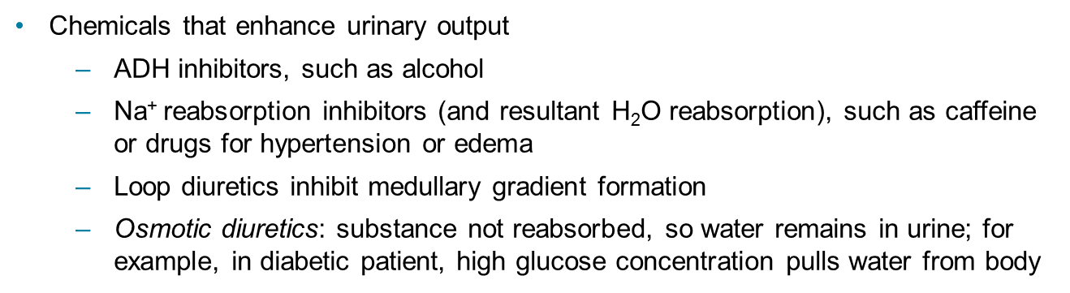
Diuretics
Chemicals that enhance urinary output
  ADH inhibitors, such as alcohol
  Na⁺ reabsorption inhibitors (and resultant H₂O reabsorption), such as caffeine or drugs for hypertension or edema
  Loop diuretics inhibit medullary gradient formation
  Osmotic diuretics: substance not reabsorbed, so water remains in urine; for example, in diabetic patient, high glucose concentration pulls water from body

Slide 62
25.8 Clinical Evaluation of Kidney
Urinalysis: urine is examined for signs of disease
  Can also be used to test for illegal substances
Assessing renal function requires both blood and urine examination
  Example: renal function can be assessed by measuring nitrogenous wastes in blood only
  To determine renal clearance, both blood and urine are required

Slide 63
Renal Clearance (1 of 3)
Renal clearance: volume of plasma kidneys can clear of a particular substance in a given time
Renal clearance tests are used to determine GFR
  To help detect glomerular damage
  To follow progress of renal disease

Slide 64
Renal Clearance (2 of 3)
Renal clearance rate is calculated as:
C = UV/P
  C = renal clearance rate (ml/min)
  U = concentration (mg/ml) of substance in urine
  V = flow rate of urine formation (ml/min)
  P = concentration of same substance in plasma

Slide 65
Renal Clearance (3 of 3)
Inulin, a plant polysaccharide, is standard used
  Freely filtered and neither reabsorbed nor secreted by kidneys
  Its renal clearance = GFR (~125 ml/min)
If C < 125 ml/min, means substance reabsorbed
If C = 0, substance was completely reabsorbed, or not filtered
If C = 125 ml/min, no net reabsorption or secretion
If C > 125 ml/min, substance was secreted (most drug metabolites)

Slide 66
Clinical – Homeostatic Imbalance 25.4 (1 of 2)
Chronic renal disease: defined as a GFR < 60 ml/min for 3 months
  Filtrate formation decreases, nitrogenous wastes accumulate in blood, pH becomes acidic
  Seen in diabetes mellitus and hypertension

Slide 67
Clinical – Homeostatic Imbalance 25.4 (2 of 2)
Renal failure: defined as GFR < 15 ml/min
  Causes uremia: ionic and hormonal imbalances, metabolic abnormalities, toxic molecule accumulation
  Symptoms: fatigue, anorexia, nausea, mental changes, cramps
  Treatment: hemodialysis or transplant

Slide 68
Urine (1 of 5)
Chemical composition
  95% water and 5% solutes
  Nitrogenous wastes
    Urea (from amino acid breakdown): largest solute component
    Uric acid (from nucleic acid metabolism)
    Creatinine (metabolite of creatine phosphate)

Slide 69
Urine (2 of 5)
  Other normal solutes found in urine
    Na⁺, K⁺, PO₄^{3–}, and SO₄^{2–}, Ca²⁺, Mg²⁺ and HCO₃–
  Abnormally high concentrations of any constituent, or abnormal components such as blood proteins, WBCs, and bile pigments, may indicate pathology

Slide 70
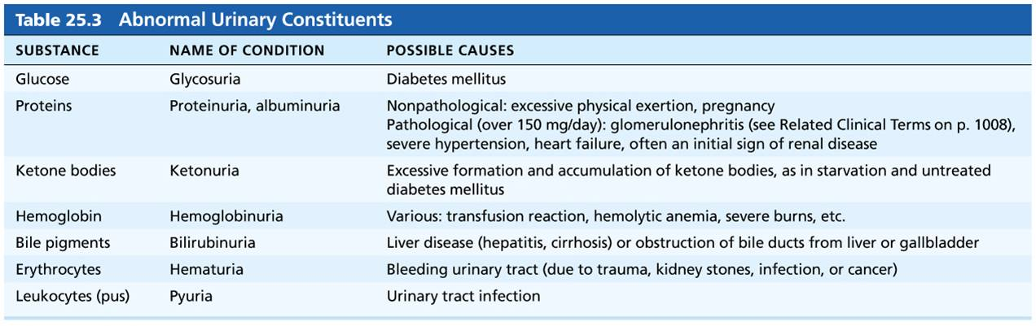
Table 25.3 Abnormal Urinary Constituents
Table 25.3 Abnormal Urinary Constituents

Slide 71
Urine (3 of 5)
Physical characteristics
  Color and transparency
    Clear
      Cloudy may indicate urinary tract infection
    Pale to deep yellow from urochrome
      Pigment from hemoglobin breakdown
      Yellow color deepens with increased concentration
    Abnormal color (pink, brown, smoky)
      Can be caused by certain foods, bile pigments, blood, drugs

Slide 72
Urine (4 of 5)
  Odor
    Slightly aromatic when fresh
    Develops ammonia odor upon standing as bacteria metabolize urea
    May be altered by some drugs or vegetables
    Disease may alter smell
      Patients with diabetes may have acetone smell to urine

Slide 73
Urine (5 of 5)
  pH
    Urine is slightly acidic (~pH 6, with range of 4.5 to 8.0)
    Acidic diet (protein, whole wheat) can cause drop in pH
    Alkaline diet (vegetarian), prolonged vomiting, or urinary tract infections can cause an increase in pH
  Specific gravity
    Ratio of mass of substance to mass of equal volume of water (specific gravity of water = 1)
    Ranges from 1.001 to 1.035 because urine is made up of water and solutes

Slide 74
25.9 Transport, Storage, and Elimination of Urine

Slide 75
Ureters (1 of 2)
Ureters: slender tubes that convey urine from kidneys to bladder
  Begin at L₂ as continuation of renal pelvis
Retroperitoneal
Enter base of bladder through posterior wall
  As bladder pressure increases, distal ends of ureters close, preventing backflow of urine

Slide 76
Ureters (2 of 2)
Three layers of ureter wall (from inside out)
  Mucosa: consists of transitional epithelium
  Muscularis: smooth muscle sheets contract in response to stretch
    Propels urine into bladder: gravity alone is not enough; must also be pushed by peristaltic wave action of smooth muscle
    Rate of peristalsis adjusted to rate of urine formation
    Sympathetic and parasympathetic innervate ureters but play insignificant role in peristalsis
  Adventitia: outer fibrous connective tissue

Slide 77
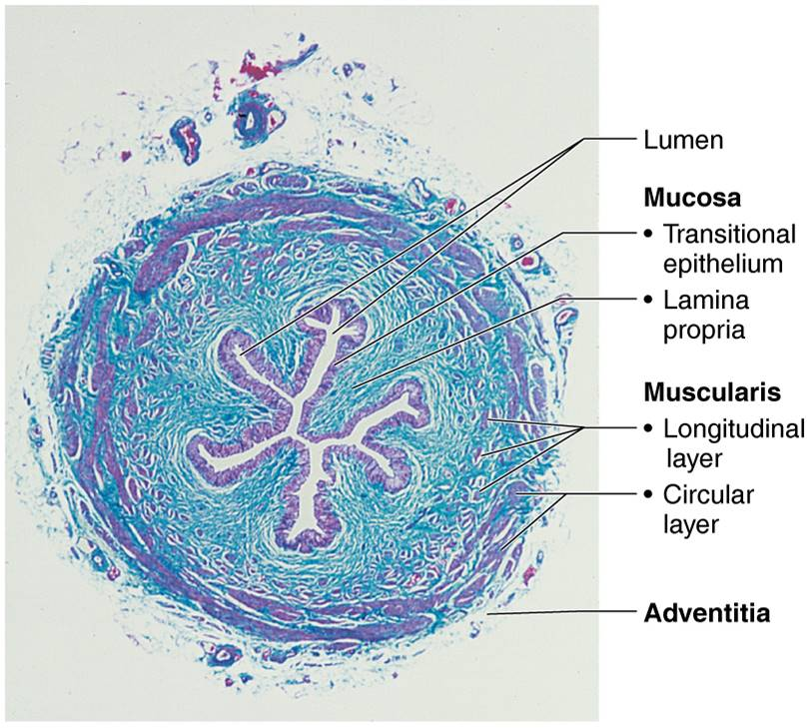
Cross Section of the Ureter Wall (10x)
Figure 25.21 Cross section of the ureter wall (10x).

Slide 78
Clinical – Homeostatic Imbalance 25.5 (1 of 2)
Renal calculi: kidney stones in renal pelvis
  Crystallized calcium, magnesium, or uric acid salts
Large stones can block ureter, obstructing urine flow, causing excrutiating pain from flank to abdomen
Nephrolithiasis – calculi in kidneys
Ureterolithiasis – calculi lodged in ureters

Slide 79
Clinical – Homeostatic Imbalance 25.5 (2 of 2)
Most small calculi pass without intervention
Larger calculi or those lodged in ureter can be removed endoscopically or surgically
Many kidney calculi can be treated with lithotripsy
  procedure that uses acoustic wave energy to break stones so they pass more easily
  Risk factors: obesity and elevated blood calcium levels
  Prevention: adequate hydration

Slide 80
Urinary Bladder (1 of 3)
Urinary bladder anatomy
  Muscular sac for temporary storage of urine
  Retroperitoneal, on pelvic floor posterior to pubic symphysis
    Males: prostate inferior to bladder neck
    Females: anterior to vagina and uterus
  Has openings for ureters and urethra
    Trigone
      Smooth triangular area outlined by openings for ureters and urethra
      Infections tend to persist in this region

Slide 81
Urinary Bladder (2 of 3)
  Layers of bladder wall
    Mucosa: transitional epithelial mucosa
    Muscular layer: thick detrusor muscle—contains three layers of smooth muscle
      Inner and outer longitudinal layers with circular middle layer
    Fibrous adventitia, except on superior surface where it is covered by peritoneum

Slide 82
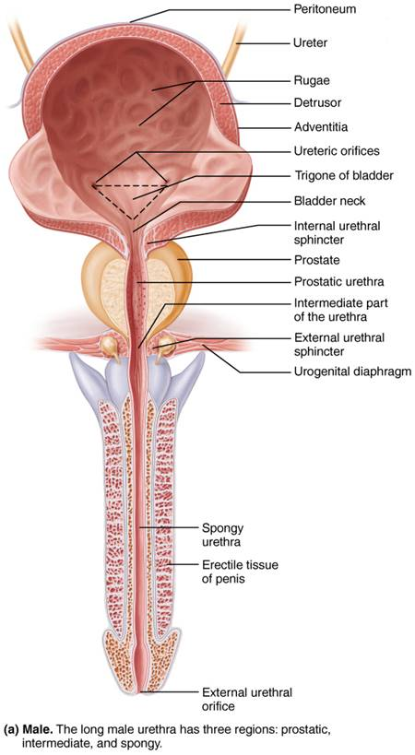
Structure of the Urinary Bladder and Urethra (1 of 4)
Figure 25.22a Structure of the urinary bladder and urethra.

Slide 83
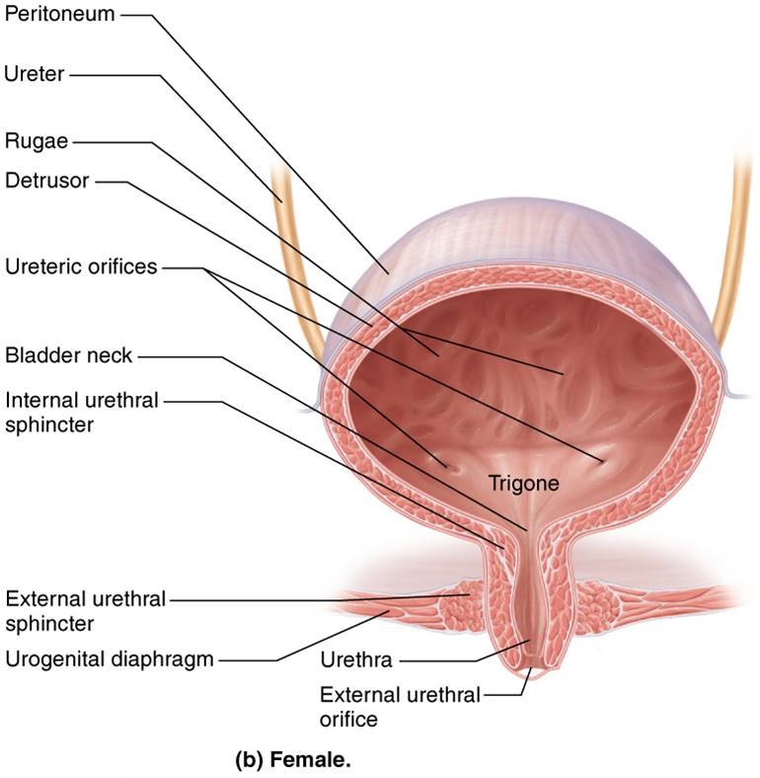
Structure of the Urinary Bladder and Urethra (2 of 4)
Figure 25.22b Structure of the urinary bladder and urethra.

Slide 84
Urinary Bladder (3 of 3)
Urine storage capacity
  Collapses when empty
  Rugae appear
  Expands and rises superiorly during filling without significant rise in internal pressure
  Moderately full bladder is ~12 cm long (5 in.) and can hold ~ 500 ml (1 pint)
    Can hold twice that amount if necessary but can burst if overdistended

Slide 85
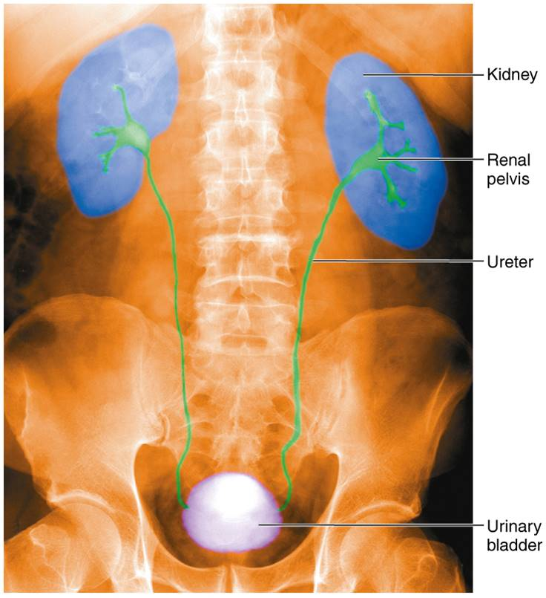
Pyelogram
Figure 25.23 Pyelogram.

Slide 86
Urethra (1 of 3)
Muscular tube that drains urinary bladder
  Lining epithelium
    Consists of mostly pseudostratified columnar epithelium, except:
      Transitional epithelium near bladder
      Stratified squamous epithelium near external urethral orifice

Slide 87
Urethra (2 of 3)
Sphincters
  Internal urethral sphincter
    Involuntary (smooth muscle) at bladder-urethra junction
    Contracts to open
  External urethral sphincter
    Voluntary (skeletal) muscle surrounding urethra as it passes through pelvic floor
Female urethra (3–4 cm): tightly bound to anterior vaginal wall
  External urethral orifice: anterior to vaginal opening; posterior to clitoris

Slide 88
Urethra (3 of 3)
Male urethra carries semen and urine
  Three named regions
    Prostatic urethra (2.5 cm): within prostate
    Intermediate part of the urethra (membranous urethra) (2 cm): passes through urogenital diaphragm from prostate to beginning of penis
    Spongy urethra (15 cm): passes through penis; opens via external urethral orifice

Slide 89
Structure of the Urinary Bladder and Urethra (3 of 4)
Figure 25.22a Structure of the urinary bladder and urethra.

Slide 90
Structure of the Urinary Bladder and Urethra (4 of 4)
Figure 25.22b Structure of the urinary bladder and urethra.

Slide 91
Clinical – Homeostatic Imbalance 25.6 (1 of 2)
Urinary tract infections can be caused by:
  Improper toilet habits, such as wiping back to front after defecation
    Short urethra of females can allow fecal bacteria to easily enter urethra
  Most UTIs occur in sexually active women
    40% of women get urinary tract infections
    Intercourse drives bacteria from vagina and external genital region toward bladder
      Use of spermicides magnifies problem

Slide 92
Clinical – Homeostatic Imbalance 25.6 (2 of 2)
Urethritis: inflammation of urethra
Cystitis: inflammation of bladder
Pyelitis or pyelonephritis: inflammation of kidneys
Symptoms: dysuria (painful urination), urinary urgency and frequency, fever, and sometimes cloudy or blood-tinged urine
  Back pain when kidneys are involved
Treatment: antibiotics can cure most urinary tract infections

Slide 93
Micturition (1 of 3)
Micturition, also called urination or voiding
Three simultaneous events must occur
  Contraction of detrusor by ANS
  Opening of internal urethral sphincter by ANS
  Opening of external urethral sphincter by somatic nervous system

Slide 94
Micturition (2 of 3)
Reflexive urination (urination in infants)
  Distension of bladder activates stretch receptors
  Causes excitation of parasympathetic neurons in reflex center in sacral region of spinal cord
  Leads to contraction of detrusor and opening (contraction) of internal sphincter
  Inhibition of somatic pathways to external sphincter allow its relaxation and opening

Slide 95
Micturition (3 of 3)
Pontine control centers mature between ages 2 and 3
  Pontine storage center inhibits micturition
    Inhibits parasympathetic pathways
    Excites sympathetic and somatic efferent pathways
  Pontine micturition center promotes micturition
    Excites parasympathetic pathways
    Inhibits sympathetic and somatic efferent pathways

Slide 96
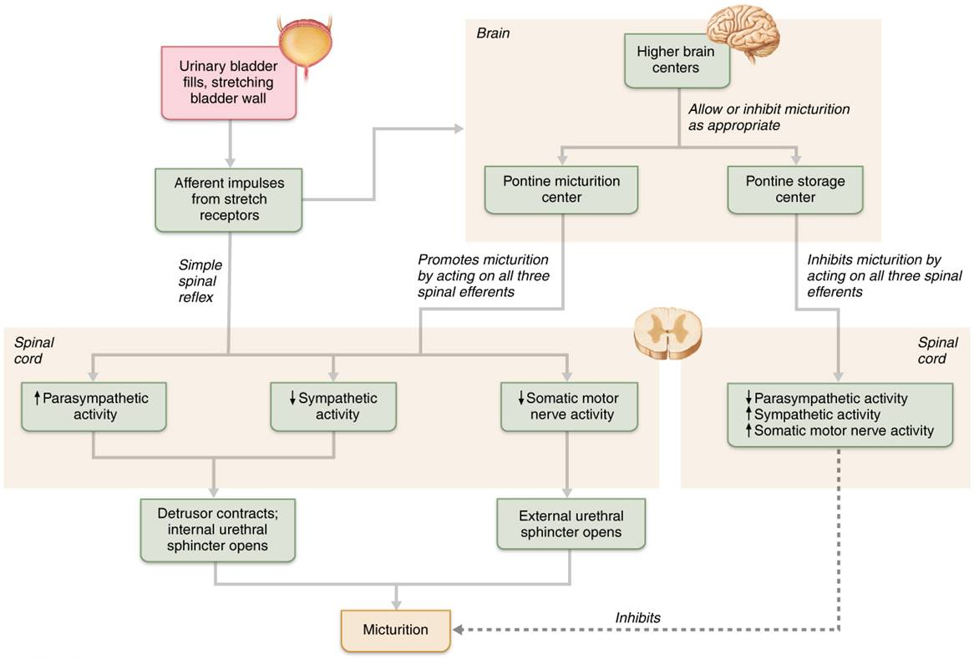
Control of Micturition
Figure 25.24 Control of micturition.

Slide 97
Clinical – Homeostatic Imbalance 25.7 (1 of 2)
Urinary incontinence: in adults, usually caused by weakened pelvic muscles
  Stress incontinence
    Increased intra-abdominal pressure forces urine through external sphincter
    Laughing, coughing, or sneezing can cause incontinence
  Overflow incontinence
    Urine dribbles when bladder overfills

Slide 98
Clinical – Homeostatic Imbalance 25.7 (2 of 2)
Urinary retention
  Bladder is unable to expel urine
  Causes:
    Common after general anesthesia
    Hypertrophy of prostate
  Treatment: catheterization

Slide 99
Developmental Aspects of the Urinary System (1 of 4)
Three sets of embryonic kidneys form in succession
  Pronephros degenerates, but pronephric duct persists
  Mesonephros claims this duct and becomes mesonephric duct
  Metanephros develops by week 5 and is what develops into adult kidneys and ascends

Slide 100
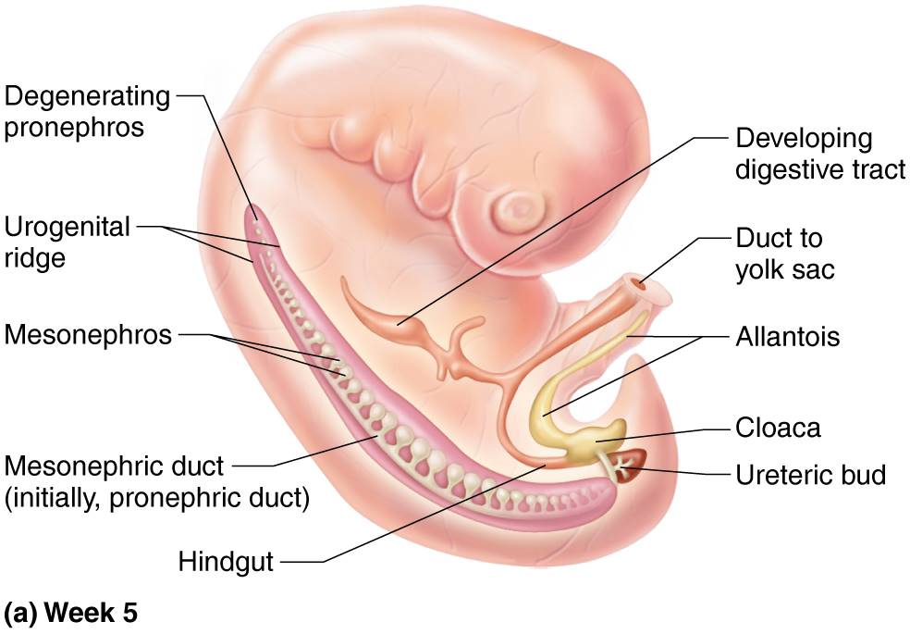
Development of the Urinary System in the Embryo (1 of 4)
Figure 25.25a Development of the urinary system in the embryo.

Slide 101
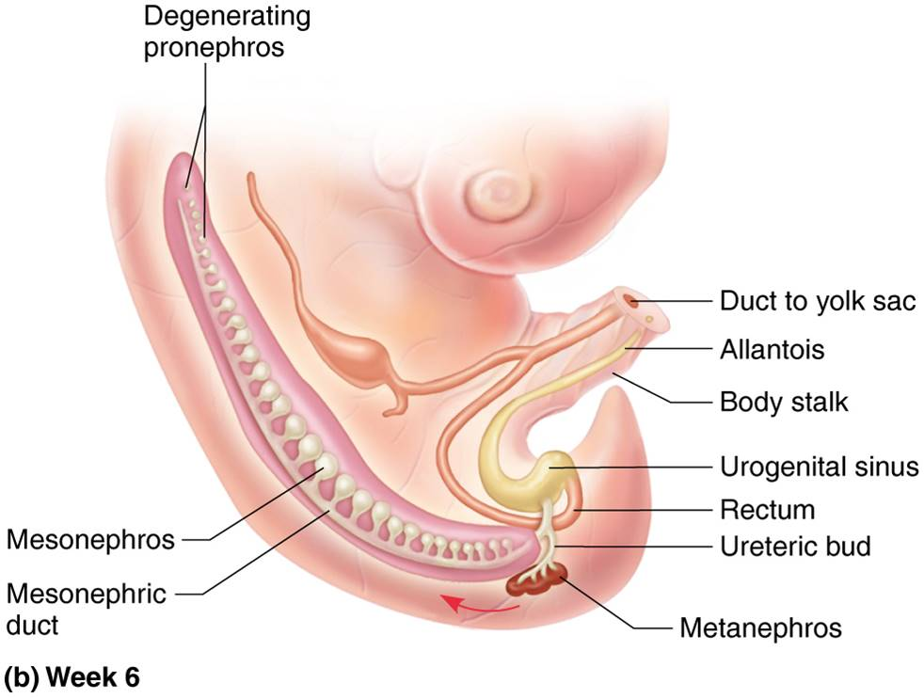
Development of the Urinary System in the Embryo (2 of 4)
Figure 25.25b Development of the urinary system in the embryo.

Slide 102
Developmental Aspects of the Urinary System (2 of 4)
Metanephros develops as ureteric buds that induce mesoderm of urogenital ridge to form nephrons
  Distal ends of ureteric buds form renal pelves, calyces, and collecting ducts
  Ureteric ducts: proximal ends that will become ureters
Kidneys excrete urine into amniotic fluid by month 3
Cloaca subdivides into rectum, anal canal, and urogenital sinus

Slide 103
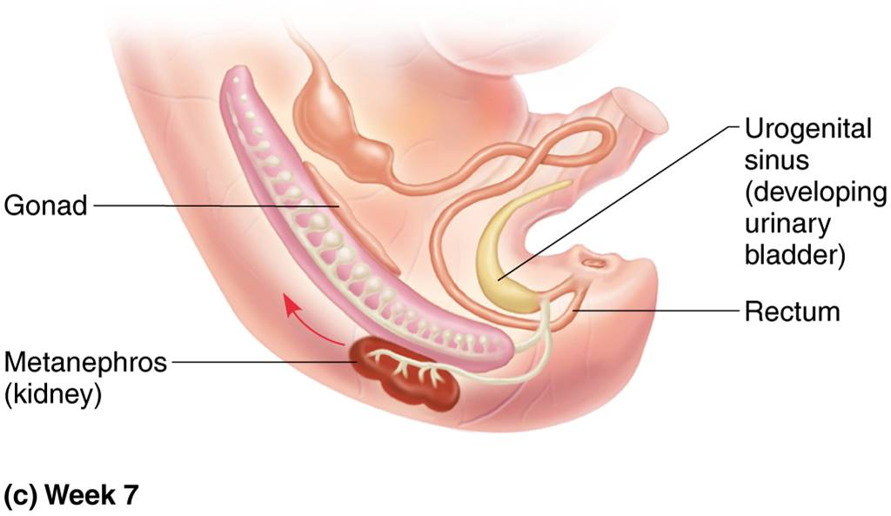
Development of the Urinary System in the Embryo (3 of 4)
Figure 25.25c Development of the urinary system in the embryo.

Slide 104
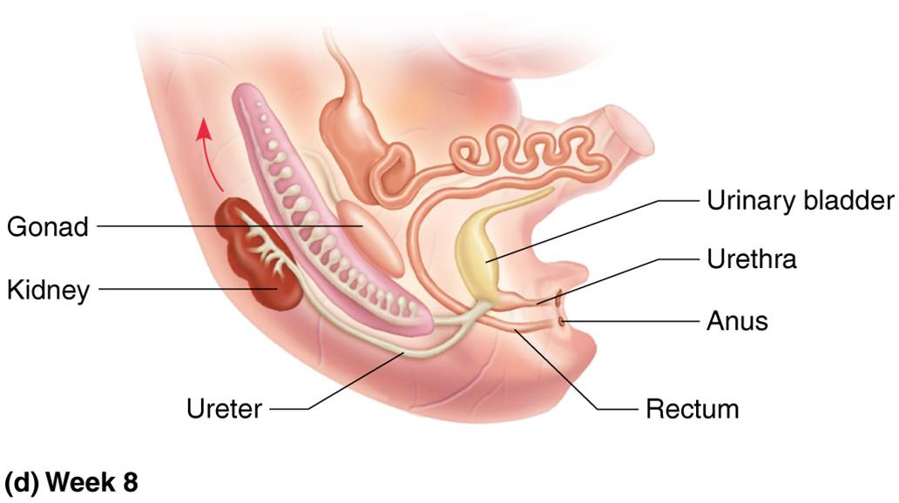
Development of the Urinary System in the Embryo (4 of 4)
Figure 25.25d Development of the urinary system in the embryo.

Slide 105
Clinical – Homeostatic Imbalance 25.8
Three common congenital abnormalities
  Horseshoe kidney: 2 kidneys fuse across midline, forming single U-shaped kidney; usually asymptomatic
  Hypospadias: urethral orifice located on ventral surface of penis; corrected surgically at ~1 year
  Polycystic kidney disease: many fluid-filled cysts interfere with function of kidneys
    Autosomal dominant: most common, less severe form
    Autosomal recessive: more severe form
    May be caused by defect in signaling proteins

Slide 106
Developmental Aspects of the Urinary System (3 of 4)
Frequent micturition in infants is due to small bladders and less-concentrated urine
Incontinence normal in infants: control of voluntary urethral sphincter develops with nervous system
E. coli bacteria account for 80% of all urinary tract infections
Untreated childhood streptococcal infections may cause long-term renal damage
Sexually transmitted diseases can also inflame urinary tract

Slide 107
Developmental Aspects of the Urinary System (4 of 4)
Most elderly people have abnormal kidneys histologically
  Kidneys shrink, and nephrons decrease in size and number; tubule cells become less efficient
  By age 80, GFR is half that of young adult
    Possibly from atherosclerosis of renal arteries
Loss of bladder tone can cause nocturia (frequent trips to urinate at night) and incontinence

Slide 108

Copyright

