Slide 1

Human Anatomy and Physiology
Eleventh Edition
Chapter 25 Part A
The Urinary System
PowerPoint® Lectures Slides prepared by Karen Dunbar Kareiva, Ivy Tech Community College
Copyright © 2019, 2016, 2013 Pearson Education, Inc. All Rights Reserved

Slide 2
Why This Matters
Understanding the process of how the body eliminates wastes and toxins via urine will help you better understand what is happening when kidneys fail so you can better advise your patients with renal disease.

Slide 3
Video: Why This Matters (Career Connection)
Click here to view ADA compliant video:
Why This Matters (Career Connection)
https://mediaplayer.pearsoncmg.com/assets/secs_wtm_ch_25_peter_v5

Slide 4
Function of Kidneys (1 of 2)
Kidneys, a major excretory organ, maintain the body’s internal environment by:
  Regulating total water volume and total solute concentration in water
  Regulating ion concentrations in extracellular fluid (ECF)
  Ensuring long-term acid-base balance
  Excreting metabolic wastes, toxins, drugs
  Producing erythropoietin (regulates blood pressure and renin (regulates RBC production)

Slide 5
Function of Kidneys (2 of 2)
  Activating vitamin D
  Carrying out gluconeogenesis, if needed
Kidneys are part of the urinary system, which also includes:
  Ureters: transport urine from kidneys to urinary bladder
  Urinary bladder: temporary storage reservoir for urine
  Urethra: transports urine out of body

Slide 6
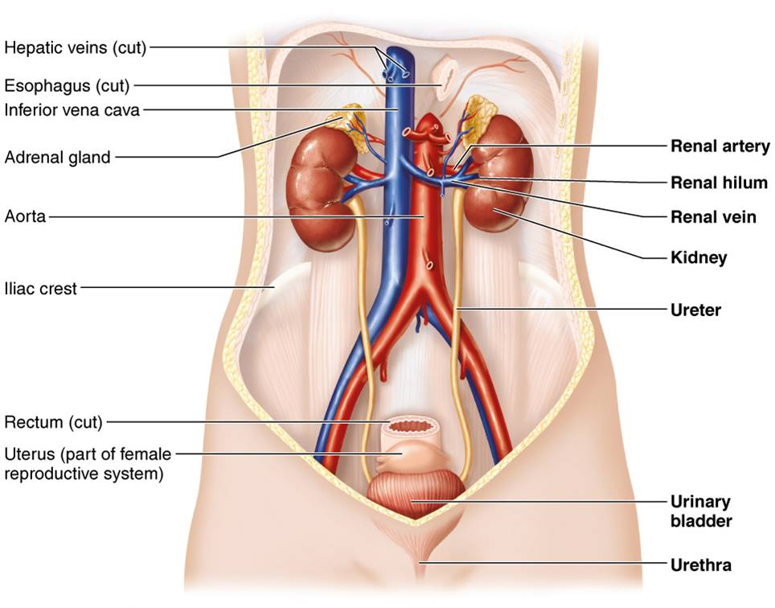
The Urinary System
Figure 25.1 The urinary system.

Slide 7
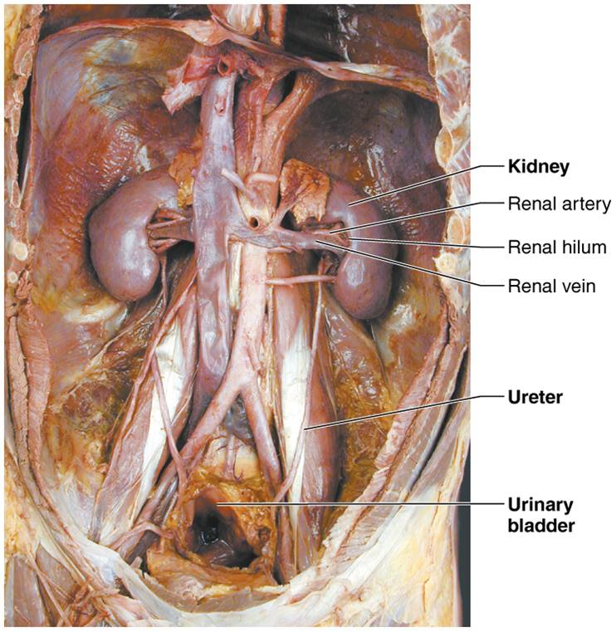
Dissection of Urinary System Organs (Male)
Figure 25.2 Dissection of urinary system organs (male).

Slide 8
25.1 Gross Anatomy of Kidneys

Slide 9
Location and External Anatomy (1 of 2)
Retroperitoneal, in the superior lumbar region
  Located between T₁₂ and L₅
Right kidney is crowded by liver, so is lower than left
Adrenal (suprarenal) gland sits atop each kidney
Convex lateral surface
Concave medial surface with vertical renal hilum leads to internal space, renal sinus
  Ureters, renal blood vessels, lymphatics, and nerves enter and exit at hilum

Slide 10
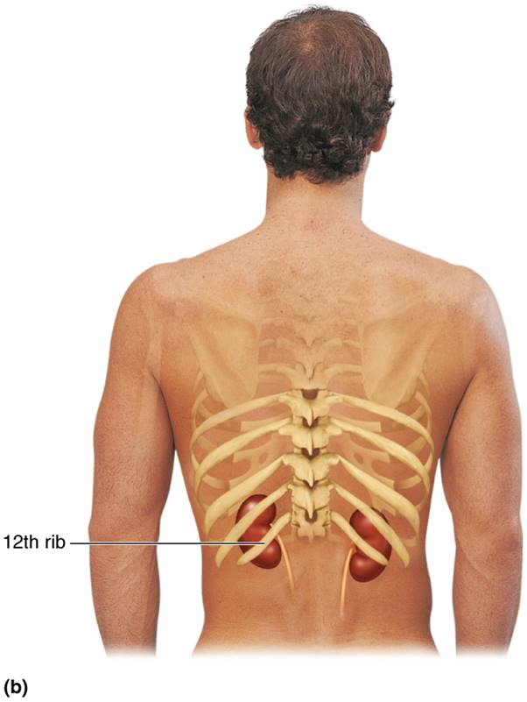
Position of the Kidneys Against the Posterior
Body Wall (1 of 2)
Figure 25.3b Position of the kidneys against the posterior body wall.

Slide 11
Location and External Anatomy (2 of 2)
Three layers of supportive tissue surround kidney
  Renal fascia
    Anchoring outer layer of dense fibrous connective tissue
  Perirenal fat capsule
    Fatty cushion
  Fibrous capsule
    Transparent capsule that prevents spread of infection to kidney

Slide 12
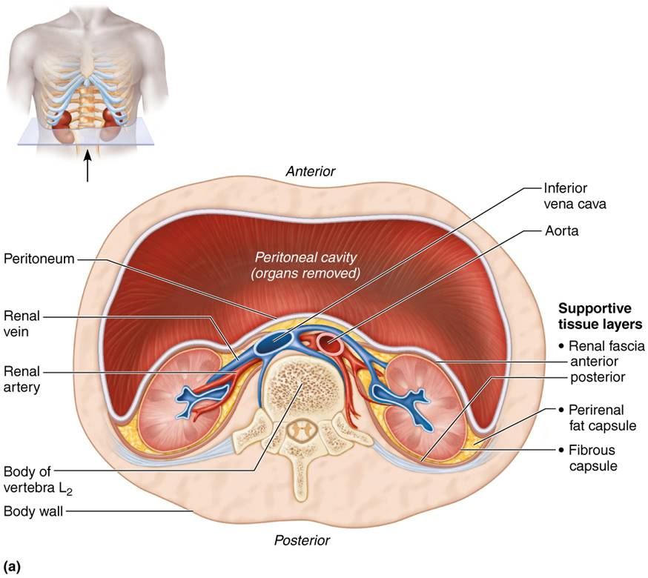
Position of the Kidneys Against the Posterior
Body Wall (2 of 2)
Figure 25.3a Position of the kidneys against the posterior body wall.

Slide 13
Clinical – Homeostatic Imbalance 25.1
Upper parts of both kidneys are protected by thoracic cage
  Perirenal fat provides cushioning
Lower parts of kidneys are susceptible to blunt trauma,
  Especially right kidney
  Ex: falls, motor vehicle accidents, or contact sports injuries
Renal artery is especially vulnerable to injury from rapid deceleration during car crashes, lead to lacerations (torn) or thrombosis (blood clot)
Hematuria (blood in urine) is an important sign of such trauma
Surgical treatment may be required

Slide 14
Internal Gross Anatomy (1 of 2)
Internal kidney has three distinct regions
  Renal cortex: granular-appearing superficial region
  Renal medulla: deep to cortex, composed of cone-shaped medullary (renal) pyramids
    Broad base of pyramid faces cortex
    Papilla, tip of pyramid, points internally
    Renal pyramids are separated by renal columns, inward extensions of cortical tissue
    Lobe: medullary pyramid and its surrounding cortical tissue; about eight lobes per kidney

Slide 15
Internal Gross Anatomy (2 of 2)
  Renal pelvis
    Funnel-shaped tube continuous with ureter
    Minor calyces
      Cup-shaped areas that collect urine draining from pyramidal papillae
    Major calyces
      Areas that collect urine from minor calyces
      Empty urine into renal pelvis
    Urine flow
      Renal pyramid → minor calyx → major calyx → renal pelvis → ureter

Slide 16
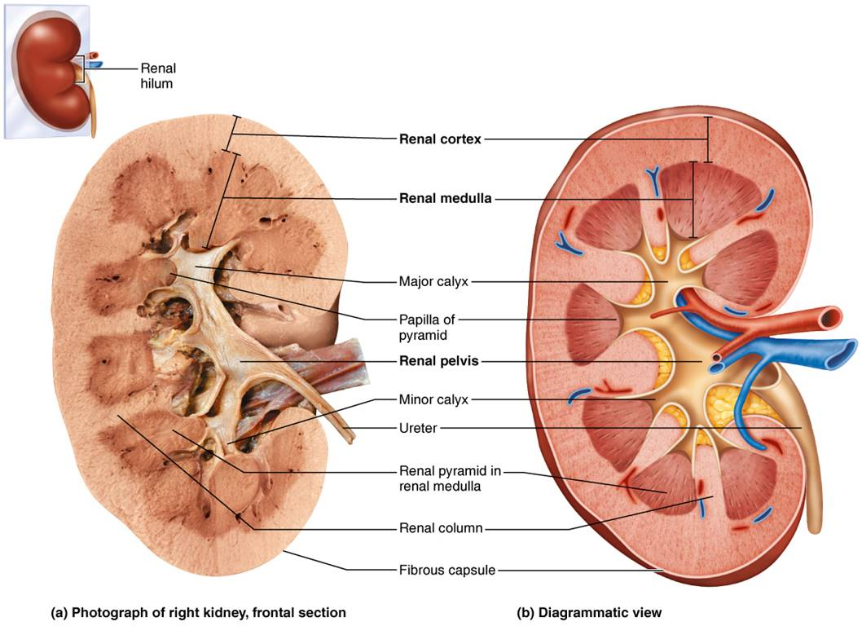
Internal Anatomy of the Kidney
Figure 25.4 Internal anatomy of the kidney.

Slide 17
Clinical – Homeostatic Imbalance 25.2
Pyelitis
  Infection of renal pelvis and calyces
Pyelonephritis
  Infection or inflammation of entire kidney
    Infections in females are usually caused by fecal bacteria entering urinary tract
  Severe cases can cause swelling of kidney and abscess formation, and pus may fill renal pelvis
  If left untreated, kidney damage may result
  Normally is successfully treated with antibiotics

Slide 18
Blood and Nerve Supply
Blood: kidneys cleanse blood and adjust its composition, so it has a rich blood supply
  Renal arteries deliver about one-fourth (1200 ml) of cardiac output to kidneys each minute
  Arterial flow: renal → segmental → interlobar → arcuate → cortical radiate (interlobular)
  Venous flow: cortical radiate → arcuate → interlobar → renal veins
    No segmental veins
Nerve supply: via sympathetic fibers from renal plexus

Slide 19
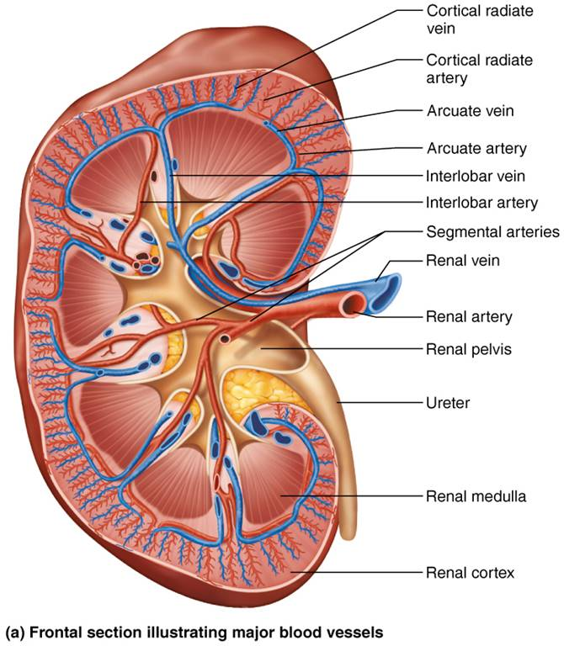
Blood Vessels of the Kidney (1 of 2)
Figure 25.5a Blood vessels of the kidney.

Slide 20
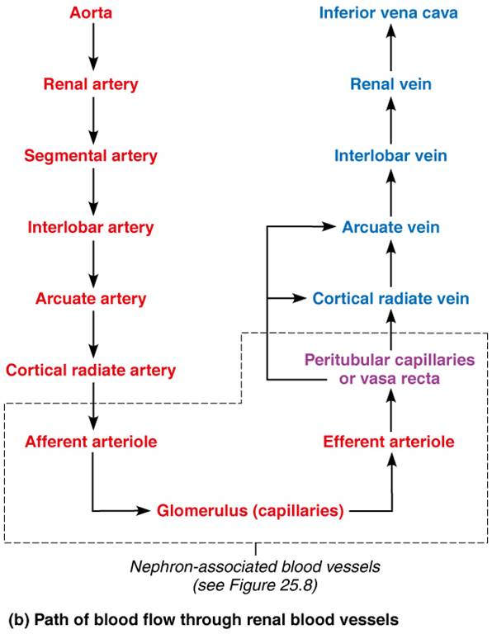
Blood Vessels of the Kidney (2 of 2)
Figure 25.5b Blood vessels of the kidney.

Slide 21
25.2 Nephrons
Nephrons are the structural and functional units that form urine
> 1 million per kidney
Two main parts
  Renal corpuscle
  Renal tubule

Slide 22
Renal Corpuscle (1 of 2)
Two parts of renal corpuscle
Glomerulus
  Tuft of capillaries composed of fenestrated endothelium
    Highly porous capillaries
    Allows for efficient filtrate formation
      Filtrate: plasma-derived fluid that renal tubules process to form urine

Slide 23
Renal Corpuscle (2 of 2)
Glomerular capsule
  Also called Bowman’s capsule: cup-shaped, hollow structure surrounding glomerulus
  Consists of two layers
    Parietal layer : simple squamous epithelium
    Visceral layer : clings to glomerular capillaries; branching epithelial podocytes
      Extensions terminate in foot processes that cling to basement membrane
      Filtration slits between foot processes allow filtrate to pass into capsular space

Slide 24
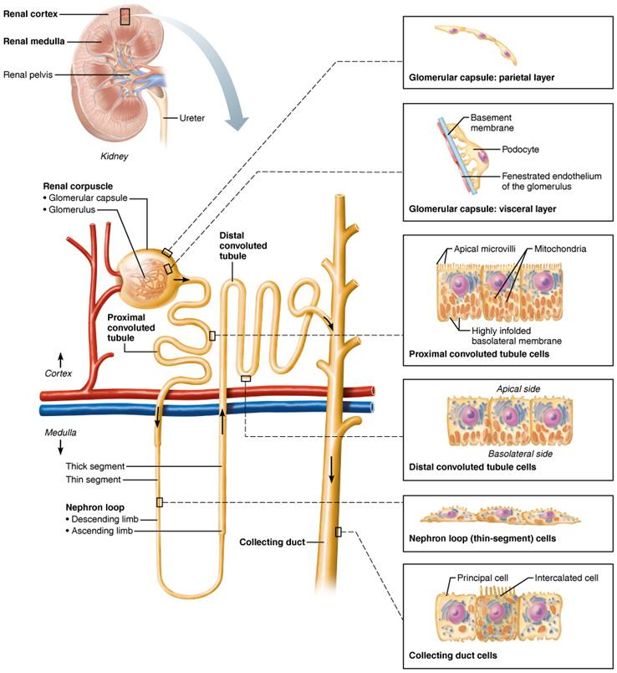
Location and Structure of Nephrons (1 of 8)
Figure 25.6 Location and structure of nephrons.

Slide 25
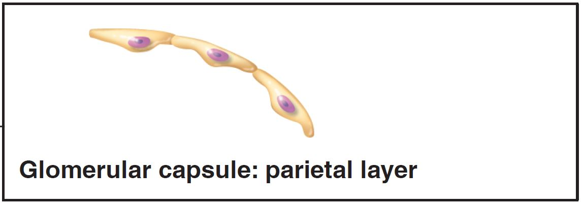
Location and Structure of Nephrons (2 of 8)
Figure 25.6 Location and structure of nephrons.

Slide 26
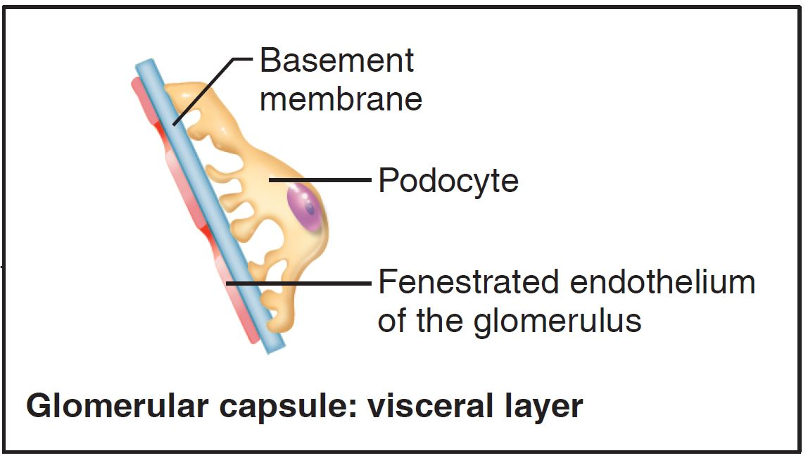
Location and Structure of Nephrons (3 of 8)
Figure 25.6 Location and structure of nephrons.

Slide 27
Renal Tubule and Collecting Duct (1 of 6)
Renal tubule is about 3 cm (1.2 in.) long
Consists of single layer of epithelial cells, but each region has its own unique histology and function
Three major parts
  Proximal convoluted tubule
    Proximal, closest to renal corpuscle
  Nephron loop
  Distal convoluted tubule
    Distal, farthest from renal corpuscle
Distal convoluted tubule drains into collecting duct

Slide 28
Renal Tubule and Collecting Duct (2 of 6)
Proximal convoluted tubule (PCT)
  Cuboidal cells with dense microvilli that form brush border
    Increase surface area
    Also have large mitochondria
  Functions in reabsorption and secretion
  Confined to cortex

Slide 29
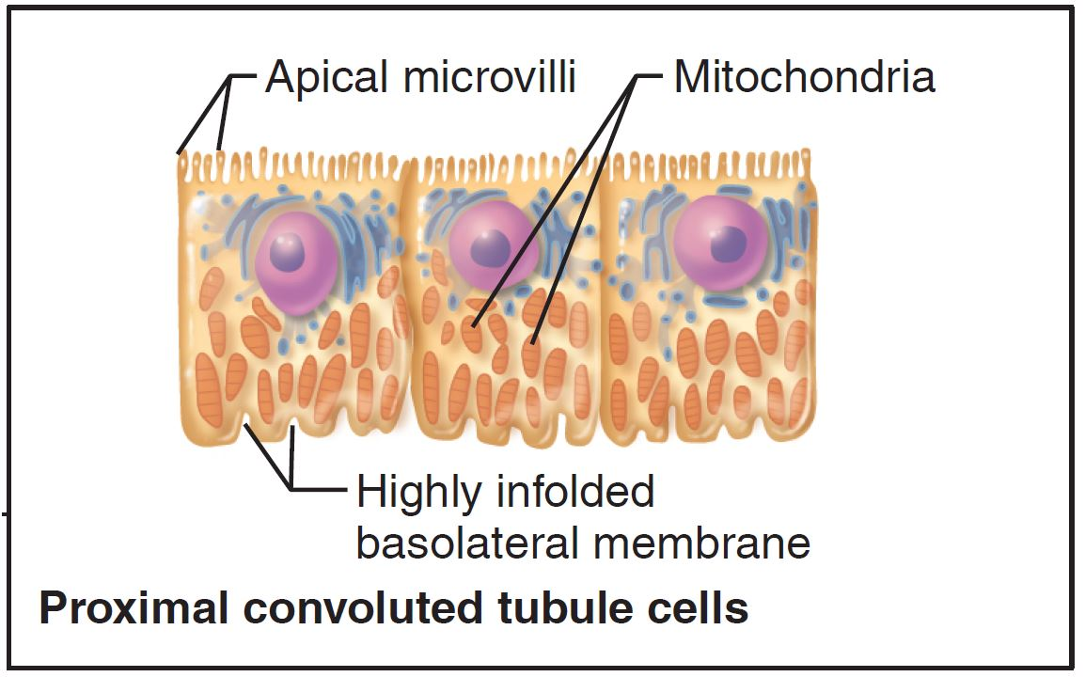
Location and Structure of Nephrons (4 of 8)
Figure 25.6 Location and structure of nephrons.

Slide 30
Renal Tubule and Collecting Duct (3 of 6)
Nephron loop
  Formerly called loop of Henle
  U-shaped structure consisting of two limbs
    Descending limb
      Proximal part of descending limb is continuous with proximal tubule
      Distal portion also called descending thin limb; simple squamous epithelium
    Ascending limb
      Thick ascending limb
        Thin in some nephrons
      Cuboidal or columnar cells

Slide 31
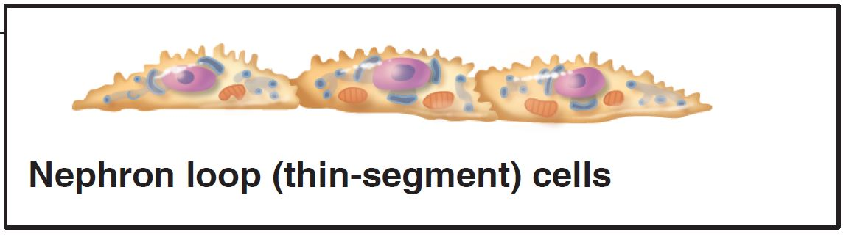
Location and Structure of Nephrons (5 of 8)
Figure 25.6 Location and structure of nephrons.

Slide 32
Renal Tubule and Collecting Duct (4 of 6)
Distal convoluted tubule (DCT)
  Cuboidal cells with very few microvilli
  Function more in secretion than reabsorption
  Confined to cortex

Slide 33
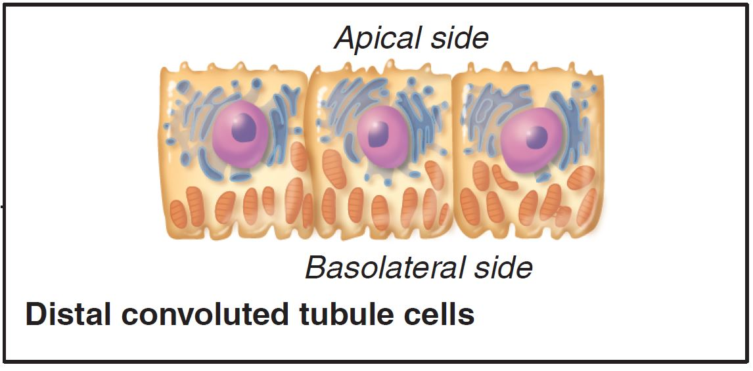
Location and Structure of Nephrons (6 of 8)
Figure 25.6 Location and structure of nephrons.

Slide 34
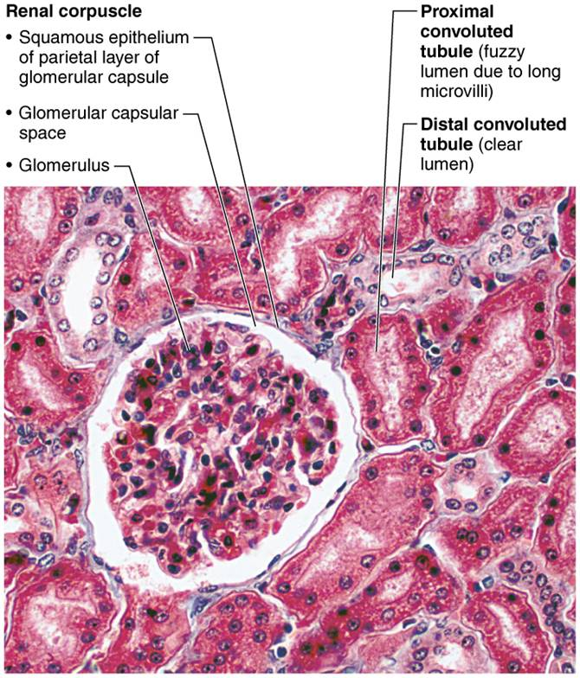
Renal Cortical Tissue
Figure 25.7 Renal cortical tissue.

Slide 35
Renal Tubule and Collecting Duct (5 of 6)
Collecting ducts
  Two cell types
    Principal cells
      Sparse with short microvilli
      Maintain water and Na⁺ balance
    Intercalated cells
      Cuboidal cells with abundant microvilli
      Two types of intercalated cells
        A and B: both help maintain acid-base balance of blood

Slide 36
Renal Tubule and Collecting Duct (6 of 6)
  Collecting ducts (cont.)
  Collecting ducts receive filtrate from many nephrons
  Run through medullary pyramids
    Give pyramids their striped appearance
  Ducts fuse together to deliver urine through papillae into minor calyces

Slide 37
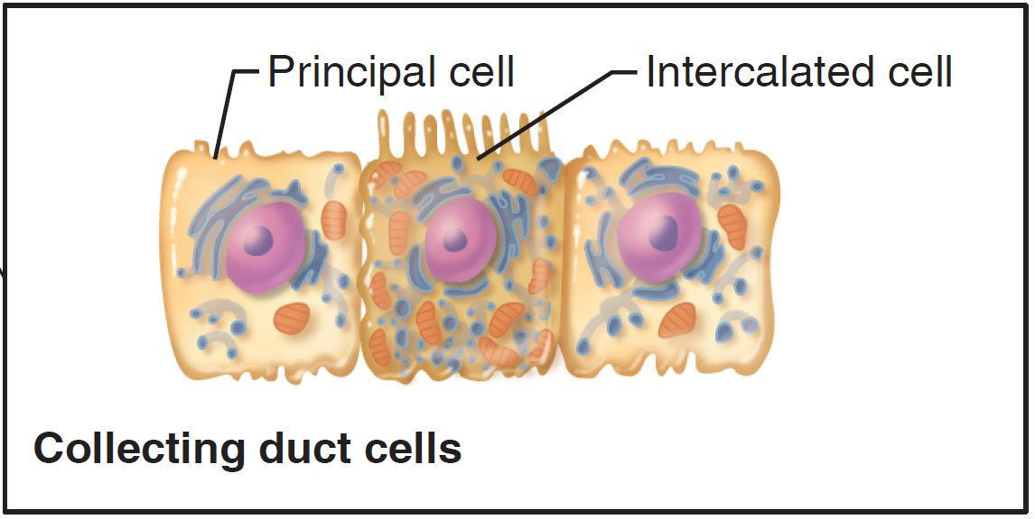
Location and Structure of Nephrons (7 of 8)
Figure 25.6 Location and structure of nephrons.

Slide 38

Location and Structure of Nephrons (8 of 8)
Figure 25.6 Location and structure of nephrons.

Slide 39
Classes of Nephrons
Two major groups of nephrons
  Cortical nephrons
    Make up 85% of nephrons
    Almost entirely in cortex
  Juxtamedullary nephrons
    Long nephron loops deeply invade medulla
    Ascending limbs have thick and thin segments
    Important in production of concentrated urine

Slide 40
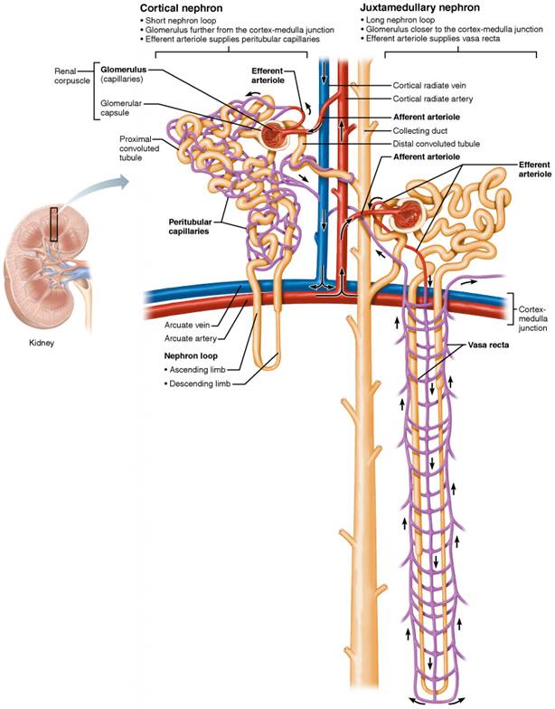
Cortical and Juxtamedullary Nephrons, and
Their Blood Vessels (1 of 2)
Figure 25.8 Cortical and juxtamedullary nephrons, and their blood vessels.

Slide 41
Nephron Capillary Beds (1 of 4)
Renal tubules are associated with two capillary beds
  Glomerulus
  Peritubular capillaries
Juxtamedullary nephrons are associated with
  Vasa recta

Slide 42
Nephron Capillary Beds (2 of 4)
Glomerulus
  Capillaries are specialized for filtration
  Different from other capillary beds because they are fed and drained by arteriole
    Afferent arteriole enters glomerulus and leaves via efferent arteriole
      Afferent arteriole arises from cortical radiate arteries
      Efferent feed into either peritubular capillaries or vasa recta
  Blood pressure in glomerulus high because:
    Afferent arterioles are larger in diameter than efferent arterioles
    Arterioles are high-resistance vessels

Slide 43
Nephron Capillary Beds (3 of 4)
Peritubular capillaries
  Low-pressure, porous capillaries adapted for absorption of water and solutes
  Arise from efferent arterioles
  Cling to adjacent renal tubules in cortex
  Empty into venules

Slide 44
Nephron Capillary Beds (4 of 4)
Vasa recta
  Long, thin-walled vessels parallel to long nephron loops of juxtamedullary nephrons
  Arise from efferent arterioles serving juxtamedullary nephrons
    Instead of peritubular capillaries
  Function in formation of concentrated urine

Slide 45
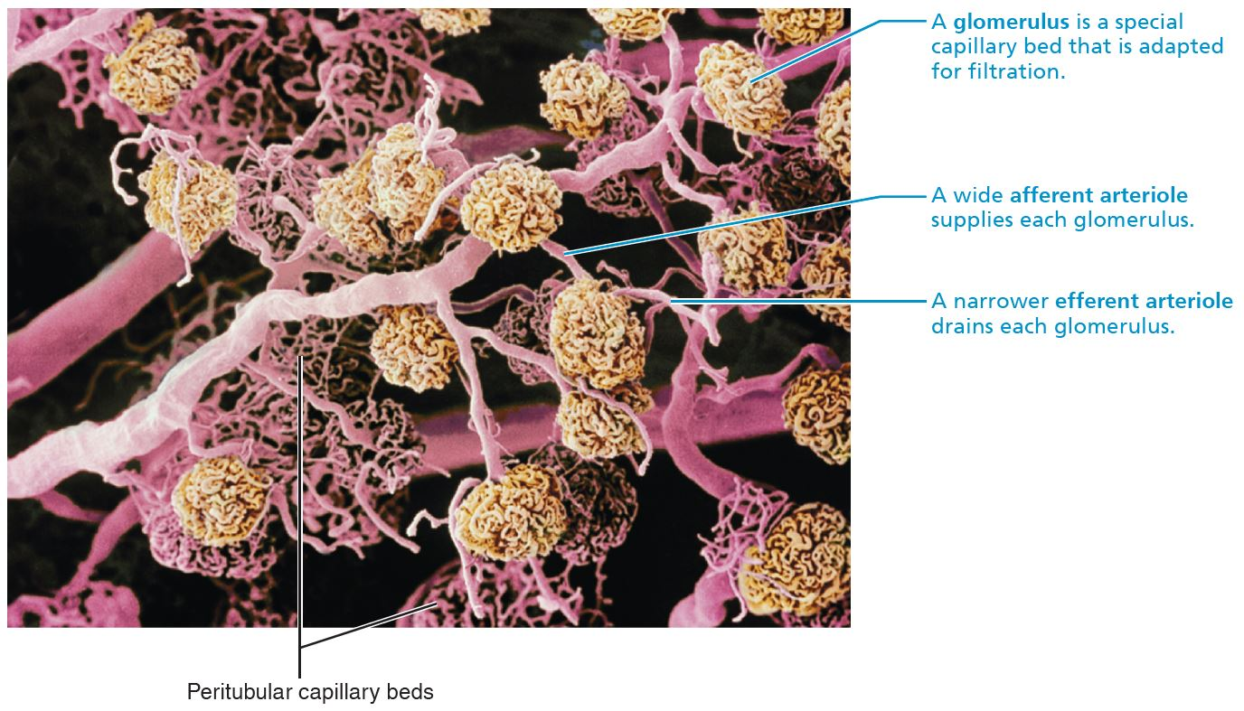
Blood Vessels of the Renal Cortex
Figure 25.9 Blood vessels of the renal cortex.

Slide 46
Cortical and Juxtamedullary Nephrons, and
Their Blood Vessels (2 of 2)
Figure 25.8 Cortical and juxtamedullary nephrons, and their blood vessels.

Slide 47
Juxtaglomerular Complex (JGC) (1 of 3)
Each nephron has one juxtaglomerular complex (JGC)
Involves modified portions of:
  Distal portion of ascending limb of nephron loop
  Afferent (sometimes efferent) arteriole
Important in regulating rate of filtrate formation and blood pressure

Slide 48
Juxtaglomerular Complex (JGC) (2 of 3)
Three cell populations are seen in JGC:
  Macula densa
    Tall, closely packed cells of ascending limb
    Contain chemoreceptors that sense NaCl content of filtrate
  Granular cells (juxtaglomerular, or JG cells)
    Enlarged, smooth muscle cells of arteriole
    Act as mechanoreceptors to sense blood pressure in afferent arteriole
    Contain secretory granules that contain enzyme renin

Slide 49
Juxtaglomerular Complex (JGC) (3 of 3)
Extraglomerular mesangial cells
  Located between arteriole and tubule cells
  Interconnected with gap junctions
  May pass signals between macula densa and granular cells

Slide 50
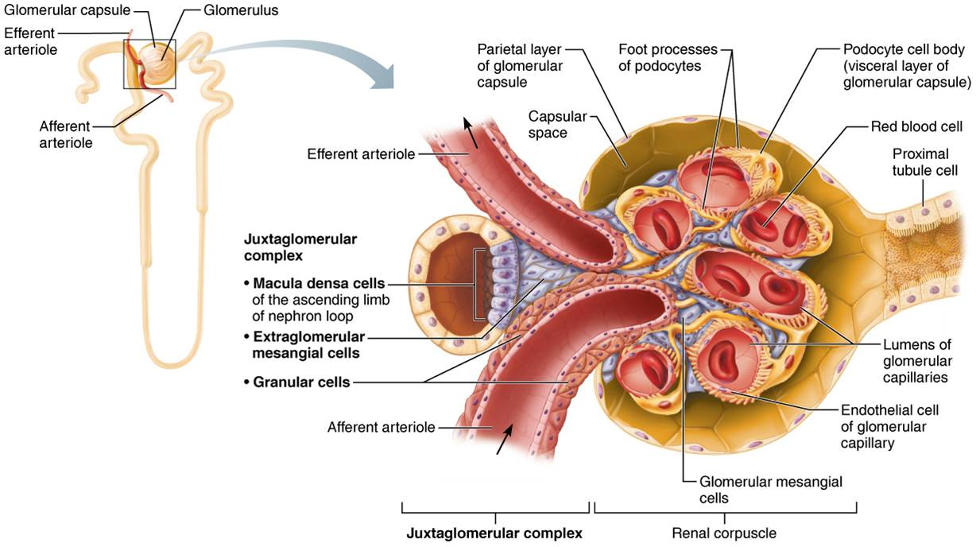
Juxtaglomerular Complex (JGC) of a Nephron
Figure 25.10 Juxtaglomerular complex (JGC) of a nephron.

Slide 51
IP Anatomy Review Animation: Urinary
Click here to view ADA compliant Animation:
IP Anatomy Review Animation: Urinary
https://mediaplayer.pearsoncmg.com/assets/_video.true/secs-ipweb-urinary-system-rev

Slide 52
25.3 Physiology of Kidney (1 of 2)
180 L of fluid processed daily, but only 1.5 L of urine is formed
Kidneys filter body’s entire plasma volume 60 times each day
Consume 20–25% of oxygen used by body at rest
Filtrate (produced by glomerular filtration) is basically blood plasma minus proteins
Urine is produced from filtrate
  Urine
    <1% of original filtrate
    Contains metabolic wastes and unneeded substances

Slide 53
25.3 Physiology of Kidney (2 of 2)
Three processes are involved in urine formation and adjustment of blood composition:
  Glomerular filtration: produces cell- and protein-free filtrate
  Tubular reabsorption: selectively returns 99% of substances from filtrate to blood in renal tubules and collecting ducts
  Tubular secretion: selectively moves substances from blood to filtrate in renal tubules and collecting ducts

Slide 54
IP2: How the Kidneys Make Urine
Click here to view ADA compliant video:
IP2: How the Kidneys Make Urine
https://mediaplayer.pearsoncmg.com/assets/_video.true/sci-ip2-how-kidneys-make-urine

Slide 55
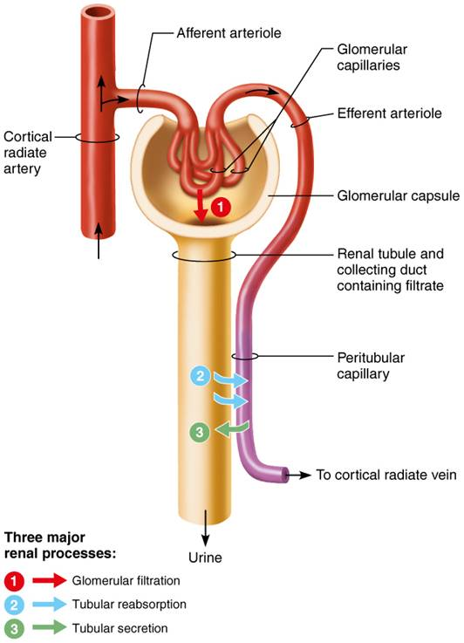
The Three Major Renal Processes
Figure 25.11 The three major renal processes.

Slide 56
25.4 Step 1: Glomerular Filtration
Glomerular filtration is a passive process
  No metabolic energy required
Hydrostatic pressure forces fluids and solutes through filtration membrane into glomerular capsule
No reabsorption into capillaries of glomerulus occurs

Slide 57
The Filtration Membrane (1 of 6)
Porous membrane between blood and interior of glomerular capsule
  Allows water and solutes smaller than plasma proteins to pass
    Normally no cells can pass
Contains three layers
  Fenestrated endothelium of glomerular capillaries
  Basement membrane: fused basal laminae of two other layers
  Foot processes of podocytes with filtration slits; slit diaphragms repel macromolecules

Slide 58
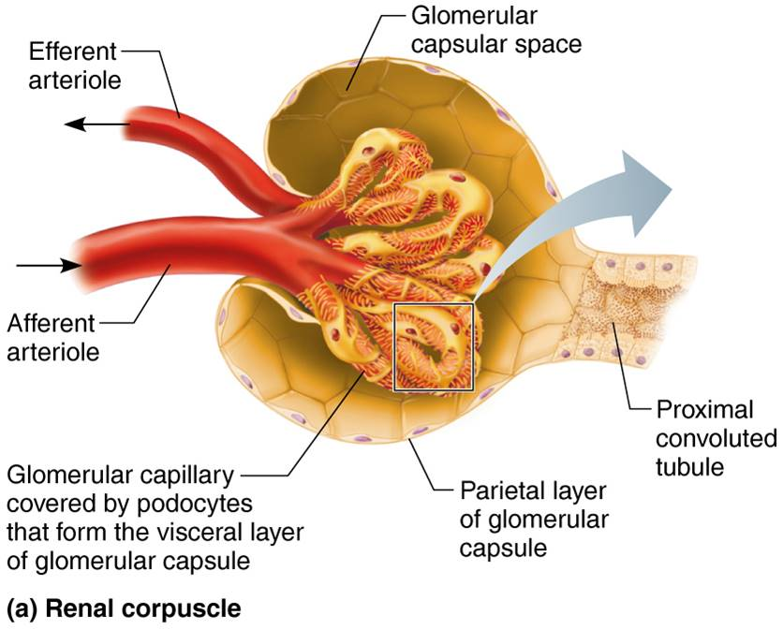
The Filtration Membrane (2 of 6)
Figure 25.12a The filtration membrane.

Slide 59
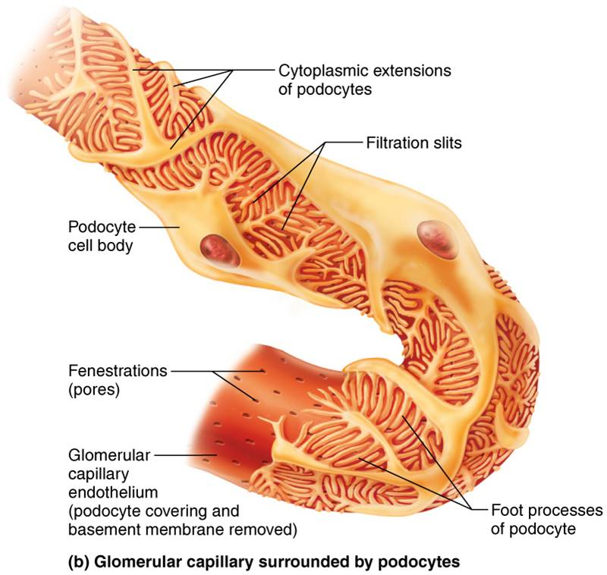
The Filtration Membrane (3 of 6)
Figure 25.12b The filtration membrane.

Slide 60
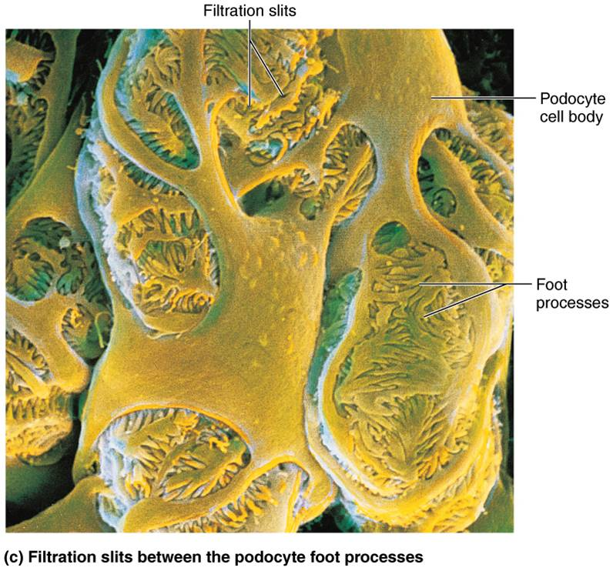
The Filtration Membrane (4 of 6)
Figure 25.12c The filtration membrane.

Slide 61
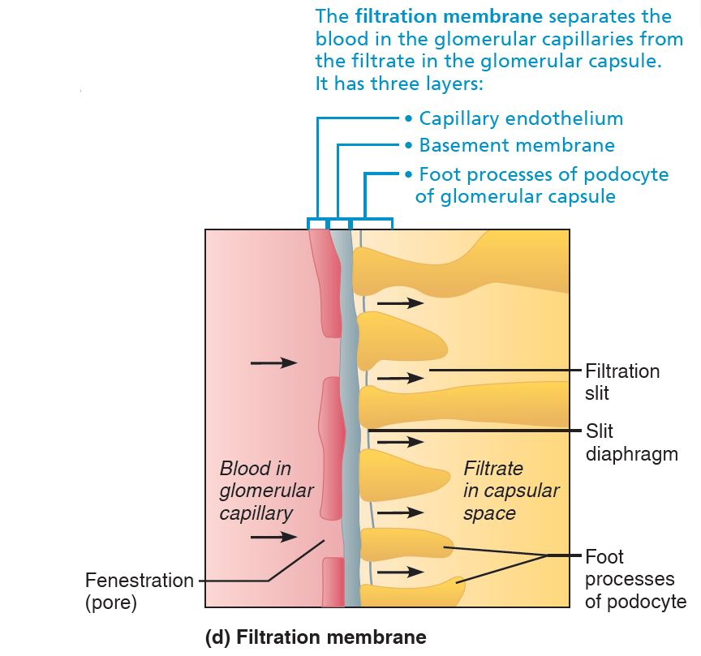
The Filtration Membrane (5 of 6)
Figure 25.12d The filtration membrane.

Slide 62
The Filtration Membrane (6 of 6)
Macromolecules “stuck” in filtration membrane are engulfed by glomerular mesangial cells
Allows molecules smaller than three nm to pass
  Water, glucose, amino acids, nitrogenous wastes
Plasma proteins remain in blood to maintain colloid osmotic pressure
  Prevents loss of all water to capsular space
  Proteins in filtrate indicate membrane problem

Slide 63
Pressures That Affect Filtration (1 of 2)
Outward pressures
  Forces that promote filtrate formation
    Hydrostatic pressure in glomerular capillaries (HP_{gc}) is essentially glomerular blood pressure
      Chief force pushing water, solutes out of blood
      Quite high: 55 mm Hg
        Compared to ~ 26 mm Hg seen in most capillary beds
      Reason is that efferent arteriole is a high-resistance vessel with a diameter smaller than afferent arteriole

Slide 64
Pressures That Affect Filtration (2 of 2)
Inward Pressures
  Forces inhibiting filtrate formation:
    Hydrostatic pressure in capsular space (HP_{cs}): filtrate pressure in capsule; 15 mm Hg
    Colloid osmotic pressure in capillaries (OP_{gc}): “pull” of proteins in blood; 30 mm Hg
  Net filtration pressure (NFP): sum of forces
    55 mm Hg forcing out minus 45 mm Hg opposing = net outward force of 10 mm Hg
    Pressure responsible for filtrate formation
    Main controllable factor determining glomerular filtration rate (GFR)

Slide 65
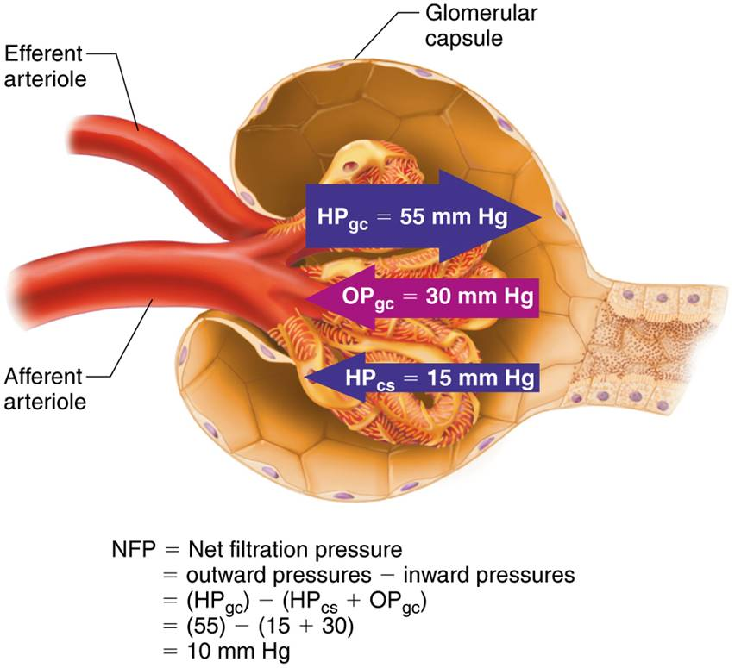
Forces Determining Net Filtration Pressure
(NFP)
Figure 25.13 Forces determining net filtration pressure (NFP).

Slide 66
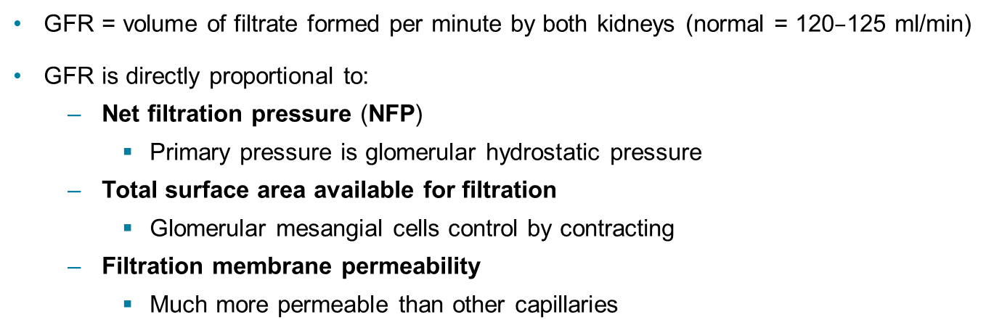
Glomerular Filtration Rate (GFR)
GFR = volume of filtrate formed per minute by both kidneys (normal = 120$–$125 ml/min)
GFR is directly proportional to:
  Net filtration pressure (NFP)
    Primary pressure is glomerular hydrostatic pressure
  Total surface area available for filtration
    Glomerular mesangial cells control by contracting
  Filtration membrane permeability
    Much more permeable than other capillaries

Slide 67
Regulation of Glomerular Filtration (1 of 8)
Constant GFR is important as it allows kidneys to make filtrate and maintain extracellular homeostasis
  Goal of local intrinsic controls (renal autoregulation): maintain GFR in kidney
GFR affects systemic blood pressure
  Increased GFR causes increased urine output, which lowers blood pressure, and vice versa
  Goal of extrinsic controls: maintain systemic blood pressure
    Nervous system and endocrine mechanisms are main extrinsic controls

Slide 68
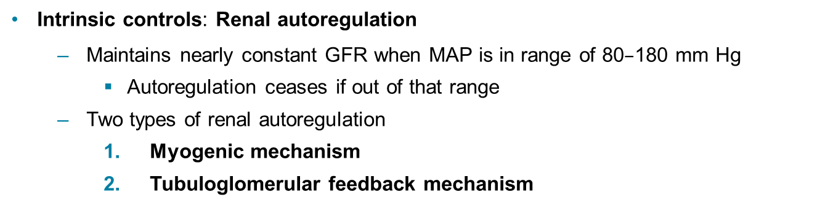
Regulation of Glomerular Filtration (2 of 8)
Intrinsic controls: Renal autoregulation
  Maintains nearly constant GFR when MAP is in range of 80$–$180 mm Hg
    Autoregulation ceases if out of that range
  Two types of renal autoregulation
    Myogenic mechanism
    Tubuloglomerular feedback mechanism

Slide 69
Regulation of Glomerular Filtration (3 of 8)
  Myogenic mechanism
    Local smooth muscle contracts when stretched
      Increased BP causes muscle to stretch, leading to constriction of afferent arterioles
        Restricts blood flow into glomerulus
        Protects glomeruli from damaging high BP
      Decreased BP causes dilation of afferent arterioles
    Both help maintain normal GFR despite normal fluctuations in blood pressure

Slide 70
Regulation of Glomerular Filtration (4 of 8)
Tubuloglomerular feedback mechanism
    Flow-dependent mechanism directed by macula densa cells
      Respond to filtrate’s NaCl concentration
    If GFR increases, filtrate flow rate increases
      Leads to decreased reabsorption time, causing high NaCl levels in filtrate
      Feedback mechanism causes constriction of afferent arteriole, which lowers NFP and GFR, allowing more time for NaCl reabsorption
    Opposite mechanism for decreased GFR

Slide 71
Regulation of Glomerular Filtration (5 of 8)
Extrinsic controls: Neural and hormonal mechanisms
  Purpose of extrinsic controls is to regulate GFR to maintain systemic blood pressure
  Extrinsic controls will override renal intrinsic controls if blood volume needs to be increased
  Sympathetic nervous system
    Under normal conditions at rest
      Renal blood vessels dilated
      Renal autoregulation mechanisms prevail

Slide 72
Regulation of Glomerular Filtration (6 of 8)
  Sympathetic nervous system (cont.)
    Under abnormal conditions, such as extremely low ECF volume (low blood pressure)
      Norepinephrine is released by sympathetic nervous system and epinephrine is released by adrenal medulla, causing:
        Systemic vasoconstriction, which increases blood pressure
        Constriction of afferent arterioles, which decreases GFR
        Blood volume and pressure increases
        Sympathetic nervous system

Slide 73
Regulation of Glomerular Filtration (7 of 8)
  Renin-angiotensin-aldosterone mechanism
    Main mechanism for increasing blood pressure
    Three pathways to renin release by granular cells
      Direct stimulation of granular cells by sympathetic nervous system
      Stimulation by activated macula densa cells when filtrate NaCl concentration is low
      Reduced stretch of granular cells

Slide 74
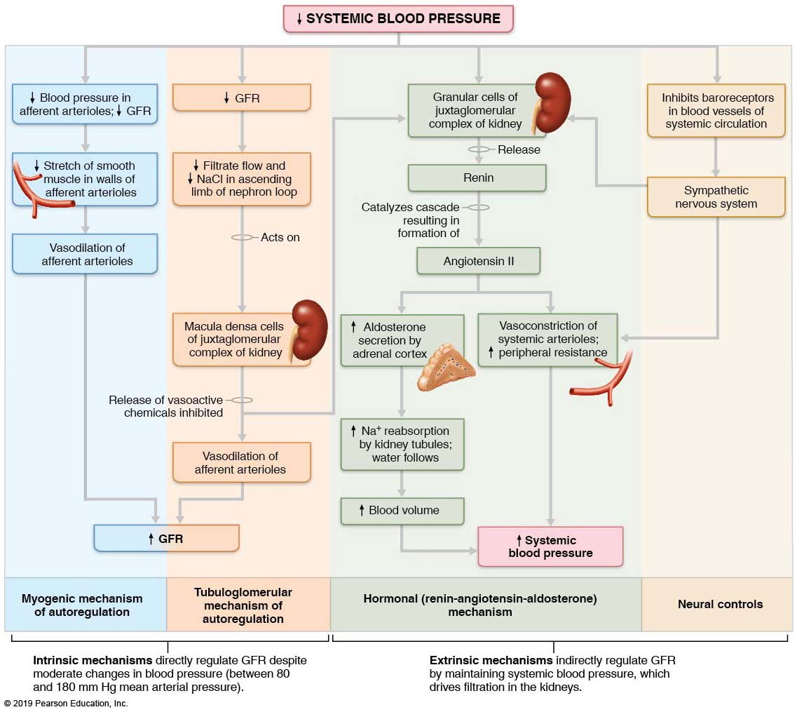
Regulation of Glomerular Filtration Rate (GFR) in the Kidneys
Figure 25.14 Regulation of glomerular filtration rate (GFR) in the kidneys.

Slide 75
Regulation of Glomerular Filtration (8 of 8)
Other factors affecting GFR
  Renal cells release a variety of chemicals
    Some chemicals act as paracrines that affect renal arterioles, such as:
      Adenosine
      Prostaglandin E₂
    Some cells make their own locally acting angiotensin II
      Reinforces effects of hormonal angiotensin II

Slide 76
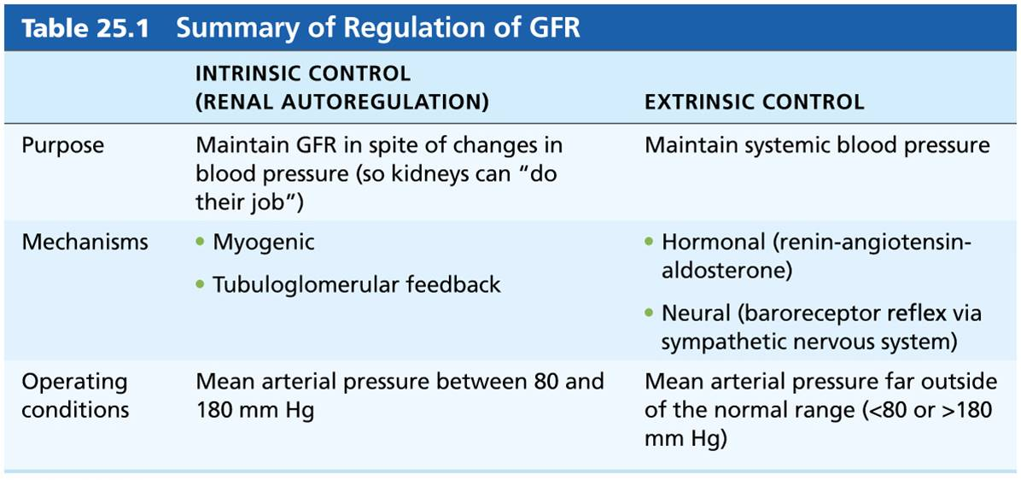
Table 25.1 Summary of Regulation of GFR
Table 25.1 Summary of Regulation of GFR

Slide 77
IP2: Glomerular Filtration: Summary
Click here to view ADA compliant video:
IP2: Glomerular Filtration: Summary
https://mediaplayer.pearsoncmg.com/assets/_video.true/sci-ip2-glomerular-filtration-summary

Slide 78
Clinical – Homeostatic Imbalance 25.3
Anuria: abnormally low urinary output (less than 50 ml/day)
May indicate that glomerular blood pressure is too low to cause filtration
Renal failure and anuria can also result from situations in which nephrons stop functioning
  Example: acute nephritis, transfusion reactions, and crush injuries

Slide 79

Copyright

