Slide 1

Human Anatomy and Physiology
Eleventh Edition
Chapter 21 Part C
The Immune System: Innate
and Adaptive Body Defenses
PowerPoint® Lectures Slides prepared by Karen Dunbar Kareiva, Ivy Tech Community College
Copyright © 2019, 2016, 2013 Pearson Education, Inc. All Rights Reserved

Slide 2
21.6 Cellular Immune Response (1 of 3)
T cells provide defense against intracellular antigens
  Example: cells infected with viruses or bacteria, cancerous or abnormal cells, foreign (transplanted) cells
Some T cells directly kill cells; others release chemicals that regulate immune response

Slide 3
21.6 Cellular Immune Response (2 of 3)
T cells are more complex than B cells both in classification and function
Two populations of T cells are based on which cell differentiation glycoprotein receptors are displayed on their surface
  CD4 cells usually become helper T cells (T_{H}) that can activate B cells, other T cells, and macrophages; direct adaptive immune response
    Some become regulatory T cells, which moderate immune response
  Can also become memory T cells

Slide 4
21.6 Cellular Immune Response (3 of 3)
  CD8 cells become cytotoxic T cells (T_{C}) that are capable of destroying cells harboring foreign antigens
    Also become memory T cells
Helper, cytotoxic, and regulatory T cells are activated T cells
Naive T cells are simply termed CD4 or CD8 cells

Slide 5
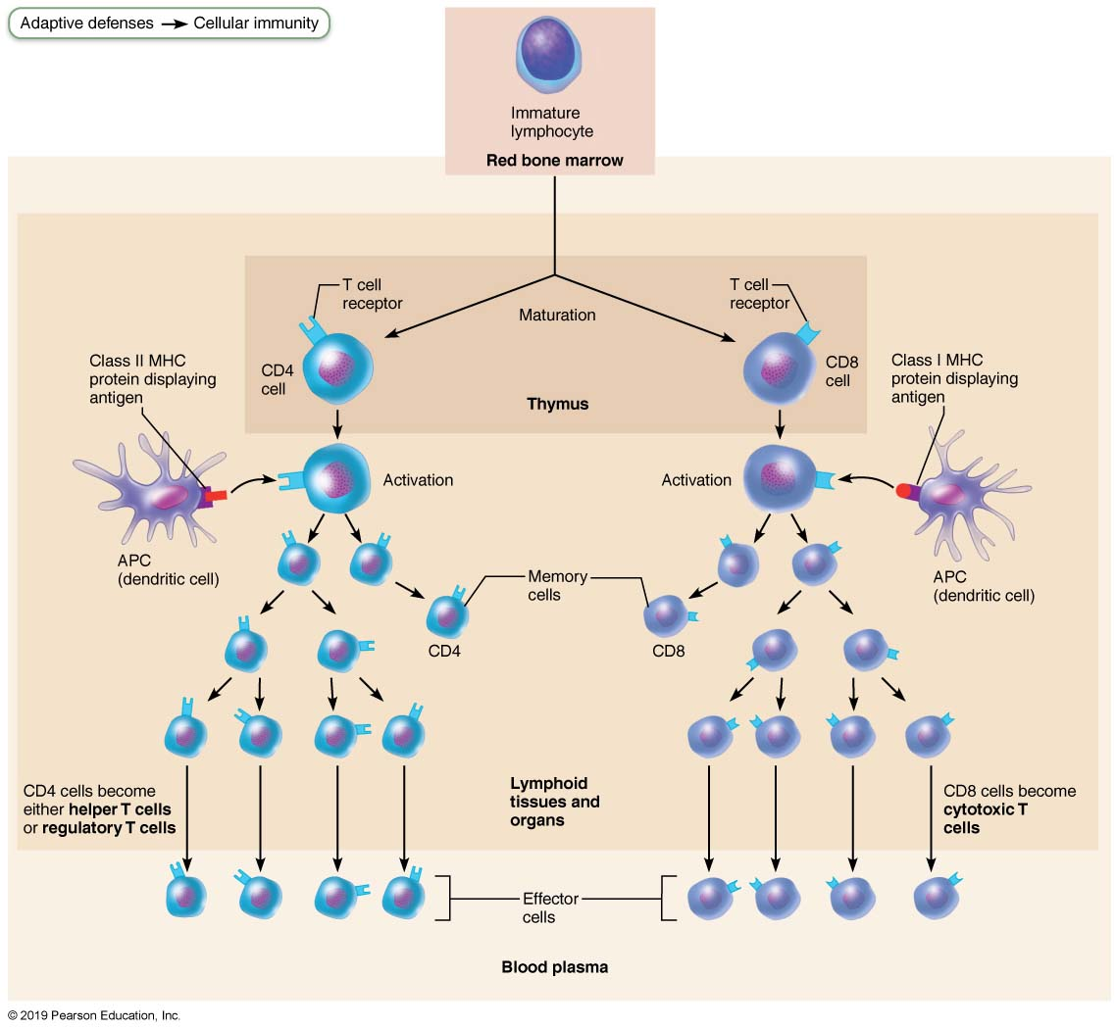
Major Types of T Cells
Figure 21.16 Major types of T cells.

Slide 6
MHC Proteins and Antigen Presentation
(1 of 6)
T cells respond only to processed fragments of antigens displayed on surfaces of cells by major histocompatibility complex (MHC) proteins
Antigen presentation is vital for activation of naive T cells and normal functioning of effector T cells

Slide 7
MHC Proteins and Antigen Presentation
(2 of 6)
Two classes of MHC proteins:
  Class I MHC proteins: displayed by all cells except RBCs
  Class II MHC proteins: displayed by APCs (dendritic cells, macrophages, and B cells)
Both types are synthesized in ER and bind to peptide fragments

Slide 8
MHC Proteins and Antigen Presentation
(3 of 6)
Class I MHC proteins
  Bind with short fragment (8–9 amino acids) of endogenous antigen, protein synthesized inside cell
    Endogenous antigen can be:
      Self-antigen: normal proteins of cell
      Nonself antigen: abnormal proteins found in infected or abnormal cell
  Class I MHC crucial for CD8 cell activation
    Act as antigen holders; form “self” part that T cells recognize
    Inform cytotoxic T cells of microorganisms hiding in cells (cytotoxic T cells ignore displayed self-antigens)

Slide 9
MHC Proteins and Antigen Presentation
(4 of 6)
Class II MHC proteins
  Bind with longer fragments (14–17 amino acids) of exogenous (extracellular) antigens that have been engulfed and broken down in a phagolysosome by antigen-presenting cell
  Class II MHC proteins recognized by helper T cells
    Signal CD4 cells that help is required

Slide 10
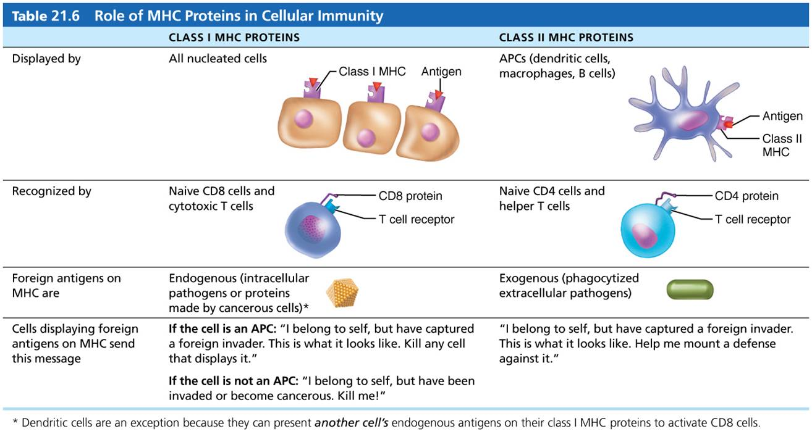
Table 21.6 Role of MHC Proteins in Cellular Immunity
Table 21.6 Role of MHC Proteins in Cellular Immunity

Slide 11
MHC Proteins and Antigen Presentation
(5 of 6)
MHC restriction
  CD4 and CD8 cells have different requirements for MHC protein that presents antigens to them
    CD4 cells that become T_{H} are restricted to binding to only class II MHC proteins typically on APC surfaces
    CD8 cells that become cytotoxic T cells are restricted to binding only class I MHC proteins found on every cell surface, including APC surfaces
      Once activated, cytotoxic T cells seek out same antigen on class I MHC proteins on any cell

Slide 12
MHC Proteins and Antigen Presentation
(6 of 6)
MHC restriction (cont.)
  Dilemma for APCs is how to enable CD8 cells to be activated by nonendogenous, phagocytosed proteins
  Dendritic cells get around this problem by engulfing dying virus-infected or tumor cells, then displaying engulfed cell’s endogenous proteins on both class I and class II MHCs
    Dendrites can also import antigens via temporary gap junctions with infected cells rather than engulf them

Slide 13
Activation and Differentiation of T Cells
(1 of 7)
T cells can be activated only when antigen is presented to them
Activation is a two-step process
  Antigen binding
  Co-stimulation
Both occur on surface of same APC
Both are required for clonal selection of T cell

Slide 14
Activation and Differentiation of T Cells
(2 of 7)
Step 1. Antigen binding:
  T cell antigen receptors (TCRs) bind to antigen-MHC complex on APC surface
  TCR must perform double recognition by recognizing both MHC and foreign antigen it displays
  Binding of TCR to complex triggers multiple intracellular signaling pathways that start T cell activation
  Other T cell surface proteins are involved in T cell activation (e.g., CD4 and CD8 help maintain coupling during antigen recognition)

Slide 15
Activation and Differentiation of T Cells
(3 of 7)
Step 2. Co-stimulation:
  Complete T cell activation requires T cell to also bind to one or more co-stimulatory signals on surface of APC
  Without co-stimulation, anergy occurs, in which T cells:
    Become tolerant to that antigen
    Are unable to divide
    Do not secrete cytokines
  Two-step process is a safeguard against unwanted T cell activation

Slide 16
Activation and Differentiation of T Cells
(4 of 7)
Proliferation and differentiation
  T cells that are activated enlarge and proliferate in response to cytokines
    Differentiate and perform functions according to their T cell class
  Primary T cell response peaks within a week

Slide 17
Activation and Differentiation of T Cells
(5 of 7)
Proliferation and differentiation (cont.)
  T cell apoptosis occurs between days 7 and 30
    Activated T cells are a hazard because they produce large amounts of inflammatory cytokines
    Could result in hyperplasia or cancer if not cleared from system
  Memory T cells remain and mediate secondary responses

Slide 18
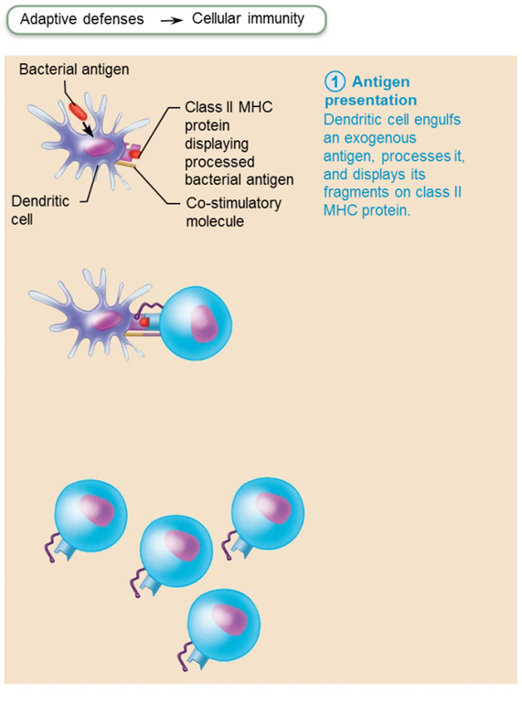
Clonal Selection of T Cells Involves Simultaneous Recognition of Self and Nonself (1 of 3)
Figure 21.17 Clonal selection of T cells involves simultaneous recognition of self and nonself.

Slide 19
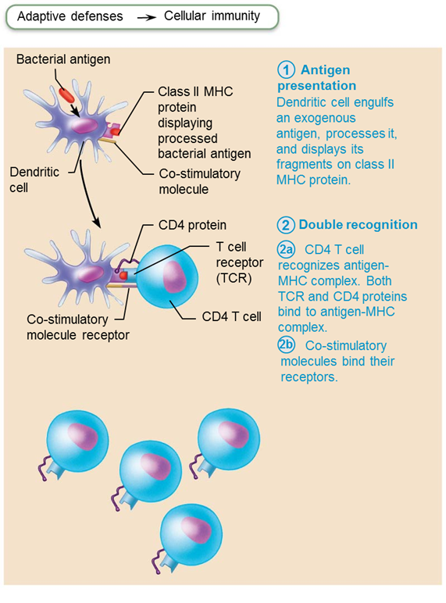
Clonal Selection of T Cells Involves Simultaneous Recognition of Self and Nonself (2 of 3)
Figure 21.17 Clonal selection of T cells involves simultaneous recognition of self and nonself.

Slide 20
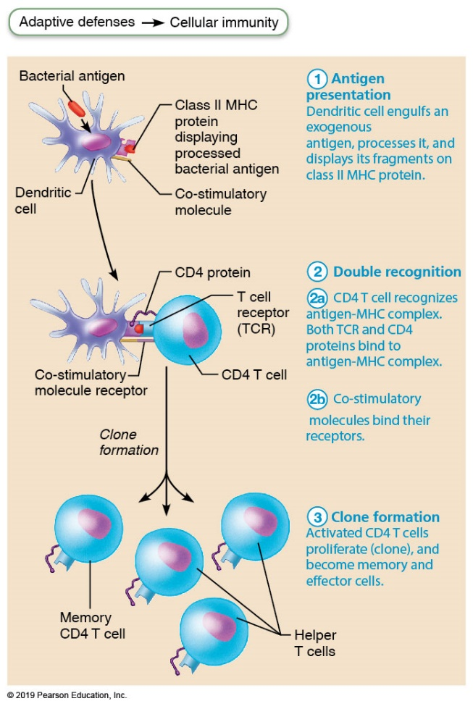
Clonal Selection of T Cells Involves Simultaneous Recognition of Self and Nonself (3 of 3)
Figure 21.17 Clonal selection of T cells involves simultaneous recognition of self and nonself.

Slide 21
Activation and Differentiation of T Cells
(6 of 7)
Cytokines
  Chemical messengers of immune system
  Mediate cell development, differentiation, and responses in immune system
  Include interferons and interleukins
    Interleukin 1 (IL-1) is released by macrophages and stimulates T cells to:
      Release interleukin 2 (IL-2)
      Synthesize more IL-2 receptors

Slide 22
Activation and Differentiation of T Cells
(7 of 7)
Cytokines (cont.)
  IL-2 is a key growth factor, acting on same cells that release it and other T cells
    Encourages activated T cells to divide rapidly
  Other cytokines amplify and regulate innate and adaptive responses
    Example: gamma interferon—enhances killing power of macrophages

Slide 23
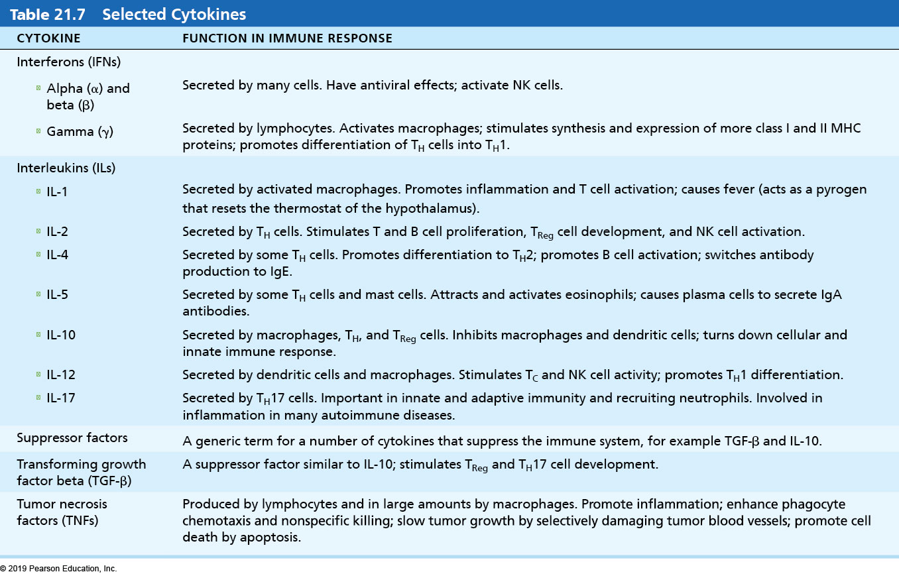
Table 21.7 Selected Cytokines
Table 21.7 Selected Cytokines

Slide 24
Roles of Specific Effector T Cells (1 of 9)
Helper T (T_{H}) cells
  Play central role in adaptive immune response
  Activate both humoral and cellular arms
  Once primed by APC presentation of antigen, helper T cells:
    Help activate B cells and other T cells
    Induce T and B cell proliferation
    Secrete cytokines that recruit other immune cells
Without T_{H}, there is no immune response

Slide 25
Roles of Specific Effector T Cells (2 of 9)
  Activation of B cells
    Helper T cells interact directly with B cells displaying antigen fragments bound to MHC II receptors
    Stimulate B cells to divide more rapidly and begin antibody formation
    B cells may be activated without T_{H} cells by binding to T cell–independent antigens
      Response is weak and short-lived
    Most antigens are T cell–dependent antigens that require T_{H} co-stimulation to activate B cells

Slide 26
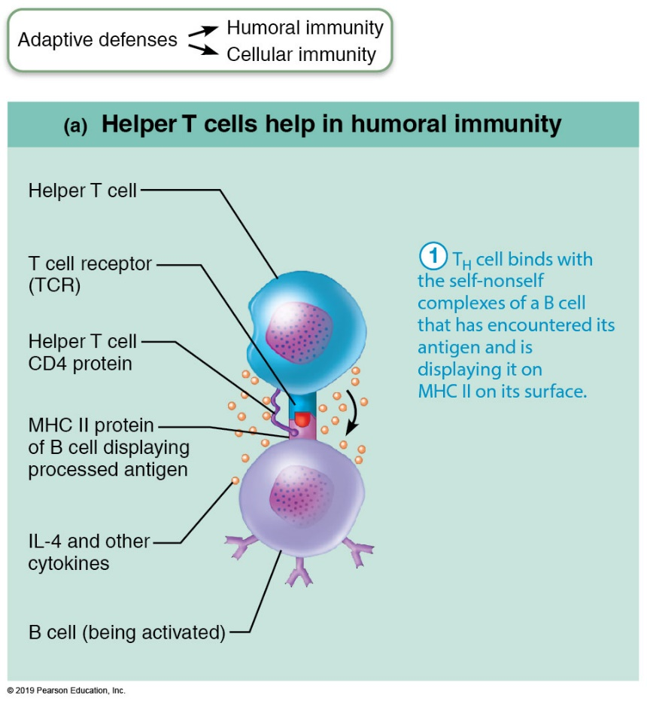
The Central Role of Helper T Cells in Mobilizing Both Humoral and Cellular Immunity (1 of 5)
Figure 21.18a The central role of helper T cells in mobilizing both humoral and cellular immunity.

Slide 27
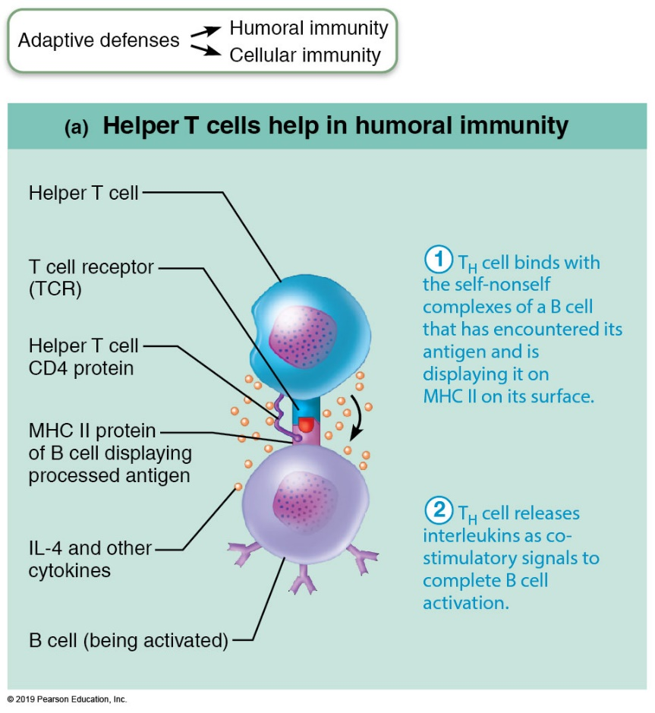
The Central Role of Helper T Cells in Mobilizing Both Humoral and Cellular Immunity (2 of 5)
Figure 21.18a The central role of helper T cells in mobilizing both humoral and cellular immunity.

Slide 28
Roles of Specific Effector T Cells (3 of 9)
  Activation of CD8 cells
    CD8 cells require T_{H} cell to become activated into destructive cytotoxic T cells
    Cause dendritic cells to express co-stimulatory molecules required for CD8 cell activation

Slide 29
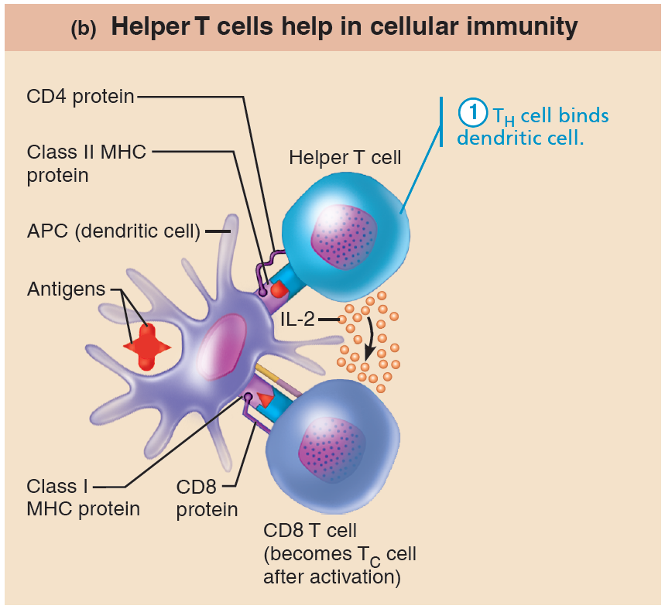
The Central Role of Helper T Cells in Mobilizing Both Humoral and Cellular Immunity (3 of 5)
Figure 21.18b The central role of helper T cells in mobilizing both humoral and cellular immunity.

Slide 30
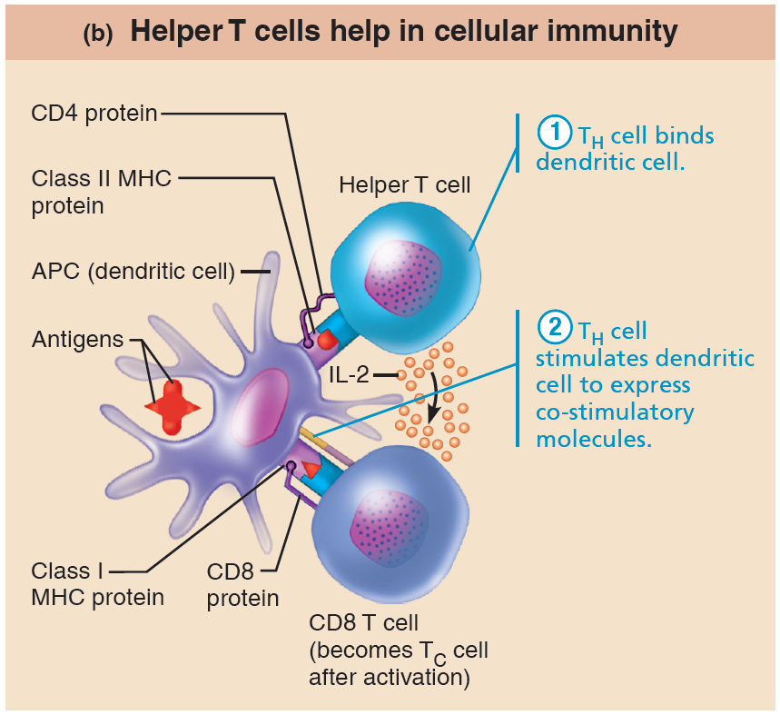
The Central Role of Helper T Cells in Mobilizing Both Humoral and Cellular Immunity (4 of 5)
Figure 21.18b The central role of helper T cells in mobilizing both humoral and cellular immunity.

Slide 31
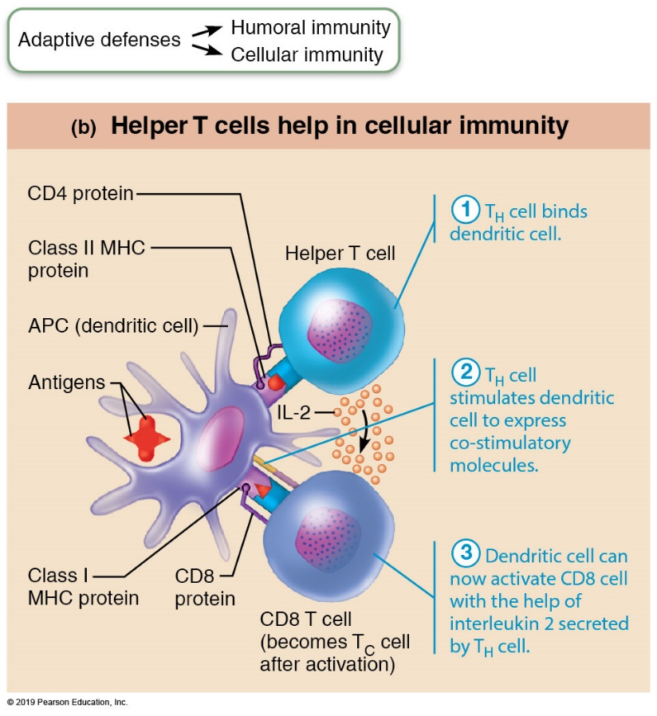
The Central Role of Helper T Cells in Mobilizing Both Humoral and Cellular Immunity (5 of 5)
Figure 21.18b The central role of helper T cells in mobilizing both humoral and cellular immunity.

Slide 32
Roles of Specific Effector T Cells (4 of 9)
  Amplification of innate defenses
    Amplify responses of innate immune system
    Activate macrophages, leading to more potent killers
    Mobilize lymphocytes and macrophages and attract other types of WBCs

Slide 33
Roles of Specific Effector T Cells (5 of 9)
  Subsets of T_{H} cells
    T_{H}1—mediates most aspects of cellular immunity
    T_{H}2—defends against parasitic worms, mobilizes eosinophils; activates responses dependent on humoral immunity; promotes allergies
    T_{H}17—links adaptive and innate immunity by releasing IL-17
      May play role in autoimmune disease

Slide 34
Roles of Specific Effector T Cells (6 of 9)
Cytotoxic T (T_{C}) cells
  Directly attack and kill other cells
  Activated T_{C} cells circulate in blood and lymph and lymphoid organs in search of body cells displaying antigen they recognize
  Activated T_{C} cells target:
    Virus-infected cells
    Cells with intracellular bacteria or parasites
    Cancer cells
    Foreign cells (transfusions or transplants)

Slide 35
Roles of Specific Effector T Cells (7 of 9)
Cytotoxic T (T_{C}) cells (cont.)
  Cytotoxic T cells deliver lethal hit using two mechanisms
    T_{C} cell releases perforins and granzymes by exocytosis
      Perforins create pores through which granzymes enter target cell
      Granzymes stimulate apoptosis
    T_{C} cell binds specific membrane receptor on target cell and stimulates apoptosis

Slide 36
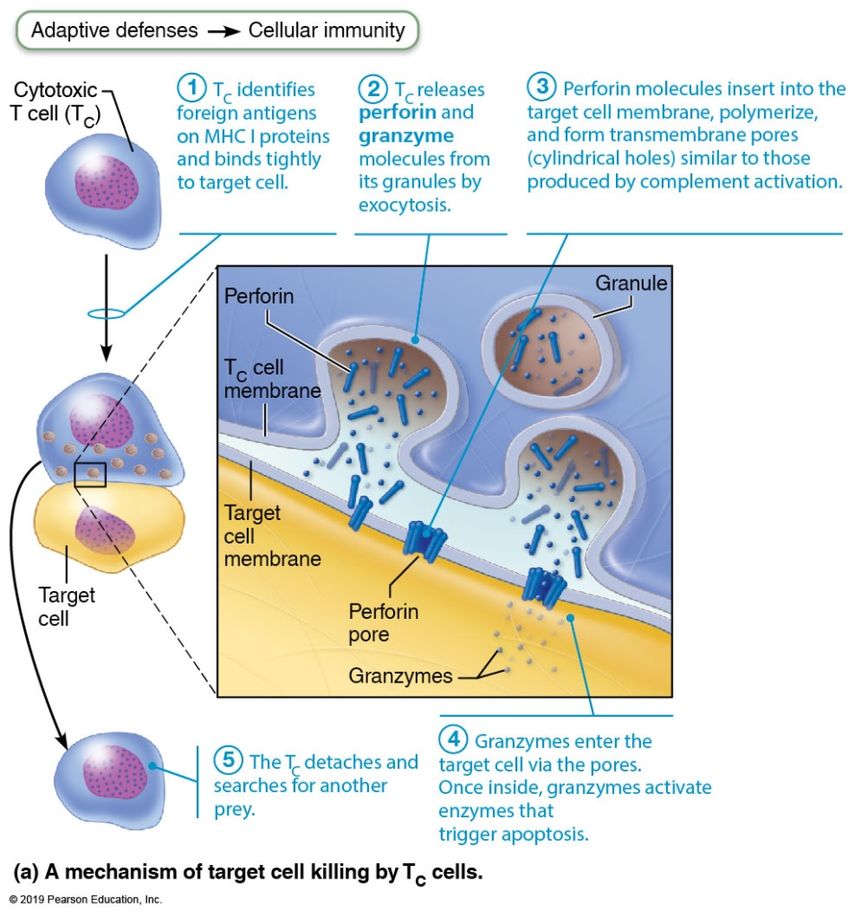
Cytotoxic T Cells Attack Infected and Cancerous Cells (1 of 2)
Figure 21.19a Cytotoxic T cells attack infected and cancerous cells.

Slide 37
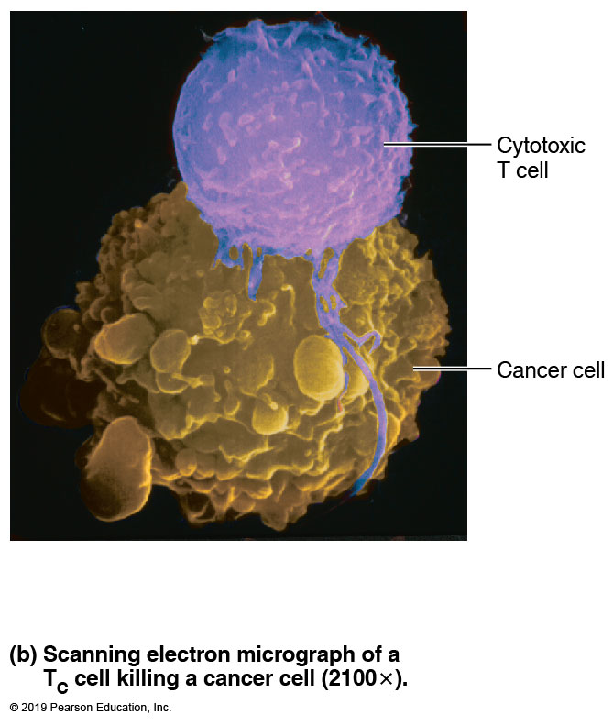
Cytotoxic T Cells Attack Infected and Cancerous Cells (2 of 2)
Figure 21.19b Cytotoxic T cells attack infected and cancerous cells.

Slide 38
Roles of Specific Effector T Cells (8 of 9)
Cytotoxic T (T_{C}) cells (cont.)
  Natural killer cells recognize other signs of abnormality that cytotoxic T cells do not look for, such as:
    Cells that lack class I MHC proteins
    Antibodies coating target cell
    Different surface markers seen on stressed cells
  NK cells use same key mechanisms as T_{C} cells for killing their target cells
  Immune surveillance: NK and T_{C} cells prowl body looking for markers they each recognize

Slide 39
Roles of Specific Effector T Cells (9 of 9)
Regulatory T (TReg) cells
  Dampen immune response by direct contact or by secreting inhibitory cytokines such as IL-10 and transforming growth factor beta (TGF-β)
  Important in preventing autoimmune reactions
    Suppress self-reactive lymphocytes in periphery (outside lymphoid organs)
    Research into using them to induce tolerance to transplanted tissue

Slide 40
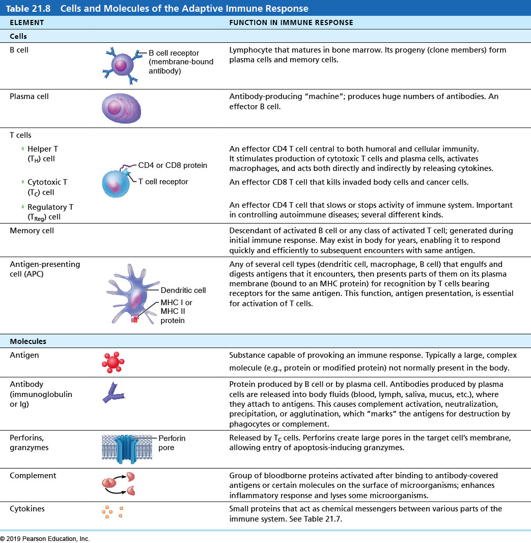
Table 21.8 Cells and Molecules of the Adaptive Immune Response
Table 21.8 Cells and Molecules of the Adaptive Immune Response

Slide 41
MicroFlix: Immunology
Click here to view ADA compliant Animation:
MicroFlix: Immunology
https://mediaplayer.pearsoncmg.com/assets/secs-microflix-immunology

Slide 42
Organ Transplants and Prevention of Rejection (1 of 2)
Most common type of organ transplant is an allograft: transplant from same species
Success depends on similarity of tissues
  ABO, other blood antigens, and MHC antigens are matched as closely as possible
After surgery
  Patient treated with immunosuppressive therapy
  Many of these therapies have severe side effects

Slide 43
Organ Transplants and Prevention of Rejection (2 of 2)
When patient’s immune system is suppressed, it:
  Cannot protect body from foreign agents such as bacterial and viral infections
    Leading cause of death among transplant recipients
  Best circumstances: rejection after 10 years in 50% of patients

Slide 44
12.7 Immune Problems

Slide 45
Immunodeficiencies (1 of 7)
Immunodeficiency: congenital or acquired conditions that impair function or production of immune cells or molecules
Severe combined immunodeficiency (SCID) syndrome: genetic defect with marked deficit in B and T cells
  Defective adenosine deaminase (ADA) enzyme allows accumulation of metabolites lethal to T cells; fatal if untreated
  Treatment: bone marrow transplants

Slide 46
Immunodeficiencies (2 of 7)
Hodgkin’s disease is an acquired immunodeficiency that causes cancer of B cells, which depresses lymph node cells and thus leads to immunodeficiency

Slide 47
Immunodeficiencies (3 of 7)
Acquired immune deficiency syndrome (AIDS)
  Human immunodeficiency virus (HIV) cripples immune system by interfering with activity of helper T cells
  Characterized by severe weight loss, night sweats, and swollen lymph nodes
  Opportunistic infections occur, including Pneumocystis pneumonia and Kaposi’s sarcoma

Slide 48
Immunodeficiencies (4 of 7)
HIV is transmitted via body fluids: blood, semen, and vaginal secretions
HIV can enter the body via:
  Blood transfusions; blood-contaminated needles; sexual intercourse and oral sex; mother to fetus
HIV destroys T_{H} cells, thereby depressing cellular immunity

Slide 49
Immunodeficiencies (5 of 7)
HIV multiplies in lymph nodes throughout asymptomatic period, ∼10 years if untreated
Symptoms begin when immune system collapses
Virus also can invade brain, leading to dementia

Slide 50
Immunodeficiencies (6 of 7)
HIV-coated glycoprotein complex attaches to CD4 receptors
HIV enters cell and uses reverse transcriptase to produce DNA from its viral RNA
  HIV reverse transcriptase is prone to frequent errors, leading to high mutation rate and resistance to drugs
The DNA copy (a provirus) directs host cell to make viral RNA and proteins, enabling virus to reproduce

Slide 51
Immunodeficiencies (7 of 7)
No cure for AIDS found; four major classes of antivirals in combination help but can fail as virus becomes resistant

Slide 52
Autoimmune Diseases (1 of 4)
Autoimmune disease results when immune system loses ability to distinguish self from foreign
Autoimmunity: production of autoantibodies and sensitized T_{C} cells that destroys body tissues

Slide 53
Autoimmune Diseases (2 of 4)
Examples
  Rheumatoid arthritis: destroys joints
  Myasthenia gravis: impairs nerve-muscle connections
  Multiple sclerosis: destroys white matter myelin
  Graves’ disease: causes hyperthyroidism
  Type 1 diabetes mellitus: destroys pancreatic cells
  Systemic lupus erythematosus (SLE): affects multiple organs
  Glomerulonephritis: damages kidney

Slide 54
Autoimmune Diseases (3 of 4)
Treatment of autoimmune diseases
  Suppress entire immune system
    Anti-inflammatory drugs, such as corticosteroids
    Blocking cytokine action
    Blocking co-stimulatory molecules
  Research
    Activating regulatory T cells; inducing self-tolerance using vaccines; directing antibodies against self-reactive immune cells

Slide 55
Autoimmune Diseases (4 of 4)
Failure of self-tolerance
  Autoimmunity may be caused by weakly self-reactive lymphocytes that are activated by:
    Foreign antigens that resemble self-antigens
      Antibodies against foreign antigen may cross-react with self-antigen
    Appearance of new self-antigens, generated by:
      Gene mutations
      Changes in self-antigens by hapten attachment or infectious damage
      Release of novel self-antigens by trauma to barrier

Slide 56
Hypersensitivities (1 of 4)
Hypersensitivities: immune responses to perceived (otherwise harmless) threat that cause tissue damage
Different types are distinguished by:
  Their time course
  Whether antibodies or T cells are involved
Antibodies cause immediate and subacute hypersensitivities
T cells cause delayed hypersensitivity

Slide 57
Hypersensitivities (2 of 4)
Immediate hypersensitivity
  Also called acute (type I) hypersensitivities (allergies); begin in seconds after contact with allergen, antigen that causes allergic reaction
  Initial contact with allergen is asymptomatic but sensitizes person
  Activated IgE against antigen binds to mast cells and basophils
  Later encounter with same allergen causes flood of histamine release from IgEs, resulting in induced inflammatory response

Slide 58
Hypersensitivities (3 of 4)
Immediate hypersensitivity (cont.)
  Histamines causes vasodilation and leakiness of the vessels, leading to symptoms of runny nose, itchy hives, or watery eyes
    Asthma can occur if allergen is inhaled
    Antihistamines are needed to control
  Allergic reactions can be local or systemic
    Local reaction involves mast cells of skin or respiratory or gastrointestinal mucosa

Slide 59
Hypersensitivities (4 of 4)
Immediate hypersensitivity (cont.)
  Systemic response is anaphylactic shock
    Usually seen with injected allergens (example: bee sting)
    Bronchioles constrict, making breathing difficult
    Vasodilation results in low blood volume, which could cause circulatory collapse
    Treatment: epinephrine

Slide 60
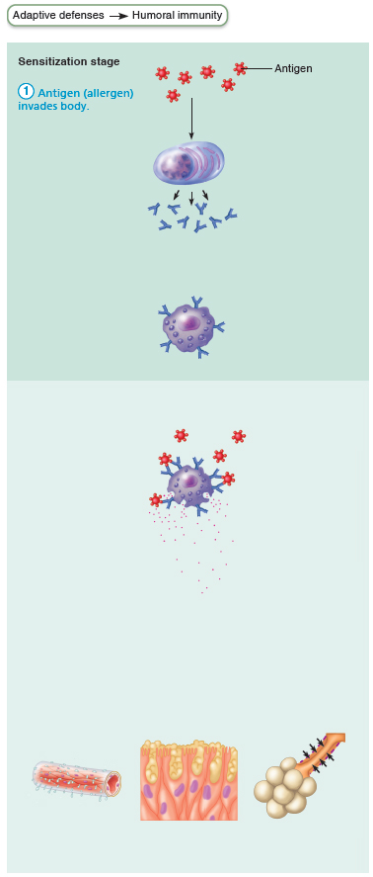
Mechanism of an Acute Allergic (Immediate
Hypersensitivity) Response (1 of 6)
Figure 21.20 Mechanism of an acute allergic (immediate hypersensitivity) response.

Slide 61
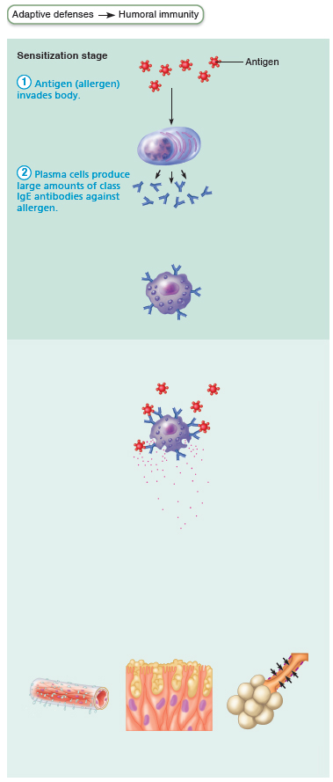
Mechanism of an Acute Allergic (Immediate
Hypersensitivity) Response (2 of 6)
Figure 21.20 Mechanism of an acute allergic (immediate hypersensitivity) response.

Slide 62
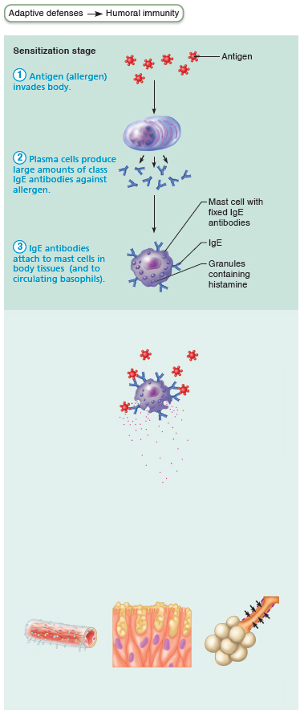
Mechanism of an Acute Allergic (Immediate
Hypersensitivity) Response (3 of 6)
Figure 21.20 Mechanism of an acute allergic (immediate hypersensitivity) response.

Slide 63
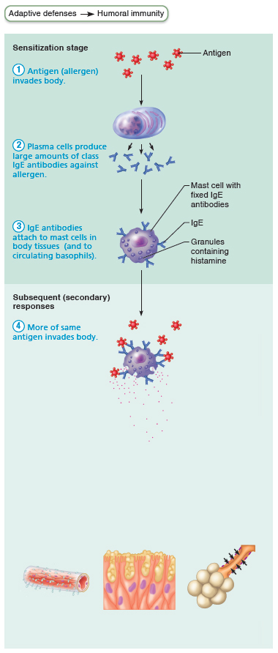
Mechanism of an Acute Allergic (Immediate
Hypersensitivity) Response (4 of 6)
Figure 21.20 Mechanism of an acute allergic (immediate hypersensitivity) response.

Slide 64
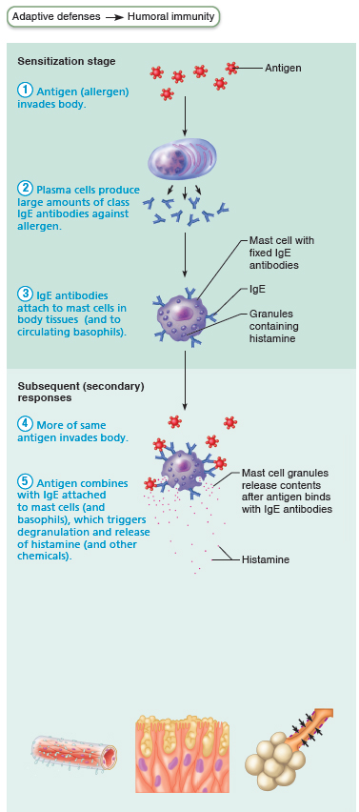
Mechanism of an Acute Allergic (Immediate
Hypersensitivity) Response (5 of 6)
Figure 21.20 Mechanism of an acute allergic (immediate hypersensitivity) response.

Slide 65
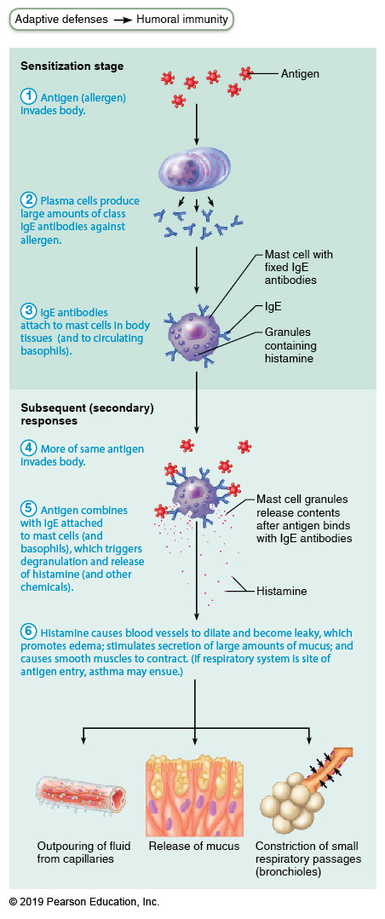
Mechanism of an Acute Allergic (Immediate
Hypersensitivity) Response (6 of 6)
Figure 21.20 Mechanism of an acute allergic (immediate hypersensitivity) response.

Slide 66
Hypersensitivities (1 of 3)
Subacute hypersensitivities
  Caused by IgM and IgG transferred via blood plasma or serum
  Slow onset (1–3 hours) and long duration
  (10–15 hours)
  Cytotoxic (type II) reactions
    Antibodies bind to antigens on specific body cells, stimulate phagocytosis and complement-mediated lysis of cellular antigens
    Example: mismatched blood transfusion reaction

Slide 67
Hypersensitivities (2 of 3)
Subacute hypersensitivities (cont.)
  Immune complex (type III) hypersensitivity
    Antigens widely distributed in body or blood
    Insoluble antigen-antibody complexes form
    Complexes cannot be cleared from particular area of body
    Intense inflammation, local cell lysis, and cell killing by neutrophils
    Example: systemic lupus erythematosus (SLE)

Slide 68
Hypersensitivities (3 of 3)
Delayed hypersensitivities (type IV)
  Slow onset (1–3 days)
  Mechanism depends on helper T cells
  Cytokine-activated macrophages and cytotoxic T cells cause damage
  Example: allergic contact dermatitis (e.g., poison ivy)
  Agents act as haptens
  TB skin test depends on this reaction

Slide 69
Developmental Aspects of Immune System
(1 of 3)
Immune system stem cells develop in liver and spleen in weeks 1–9
Bone marrow becomes primary source of stem cells later and through adult life
Lymphocyte development continues in bone marrow and thymus
T_{H}2 lymphocytes predominate in newborn; T_{H}1 system educated as person encounters antigens

Slide 70
Developmental Aspects of Immune System
(2 of 3)
Influences on immune system function
  Nervous system: depression, emotional stress, and grief impair immune response
  Diet: vitamin D is required for activation of CD8 cells → TC cells

Slide 71
Developmental Aspects of Immune System
(3 of 3)
With age, immune system begins to wane
  Greater susceptibility to immunodeficiency and autoimmune diseases
  Greater incidence of cancer
  Why immune system fails is unknown, but may be due to atrophy of thymus and decreased production of naive T and B cells

Slide 72
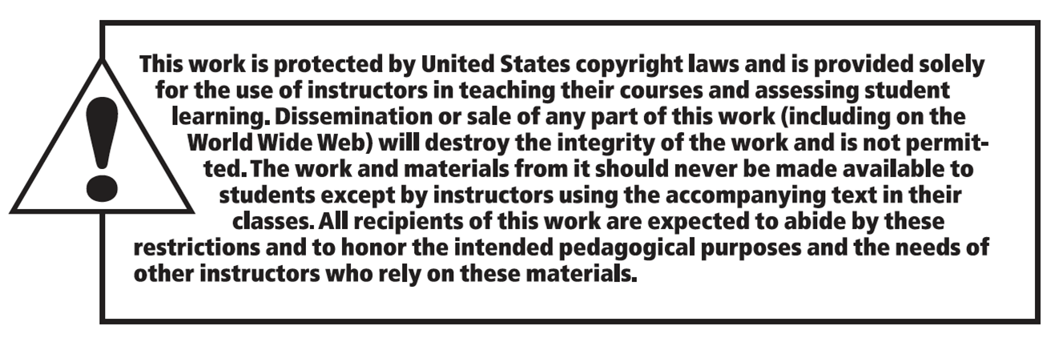
Copyright

