Slide 1

Human Anatomy and Physiology
Eleventh Edition
Chapter 21 Part B
The Immune System: Innate
and Adaptive Body Defenses
PowerPoint® Lectures Slides prepared by Karen Dunbar Kareiva, Ivy Tech Community College
Copyright © 2019, 2016, 2013 Pearson Education, Inc. All Rights Reserved

Slide 2
Part 2 – Adaptive Defenses (1 of 4)
Adaptive immune system is a specific defensive system that eliminates almost any pathogen or abnormal cell in body
Activities
Amplifies inflammatory response
Activates complement
Shortcoming: must be primed by initial exposure to specific foreign substance
Priming takes time

Slide 3
Part 2 – Adaptive Defenses (2 of 4)
Characteristics of adaptive immunity
It is specific: recognizes and targets specific antigens
It is systemic: not restricted to initial site
It has memory: mounts an even stronger attack to “known” antigens (second and subsequent exposures)
Two main branches of adaptive system
Humoral (antibody-mediated) immunity
Cellular (cell-mediated) immunity

Slide 4
Part 2 – Adaptive Defenses (3 of 4)
Humoral immunity
Antibodies, produced by lymphocytes, circulate freely in body fluids
Bind temporarily to target cell
Temporarily inactivate
Mark for destruction by phagocytes or complement
Humoral immunity has extracellular targets

Slide 5
Part 2 – Adaptive Defenses (4 of 4)
Cellular Immunity
Lymphocytes act against target cell
Directly—by killing infected cells
Indirectly—by releasing chemicals that enhance inflammatory response; or activating other lymphocytes or macrophages
Cellular immunity has cellular targets

Slide 6
21.3 Antigens
Antigens: substances that can mobilize adaptive defenses and provoke an immune response
Targets of all adaptive immune responses
Most are large, complex molecules not normally found in body (nonself)
Characteristics of antigens
Can be a complete antigen or hapten (incomplete)
Contain antigentic determinants
Can be a self-antigen

Slide 7
Complete Antigens and Haptens (1 of 3)
Antigens can be complete or incomplete
Complete antigens have two important functional properties:
Immunogenicity: ability to stimulate proliferation of specific lymphocytes
Reactivity: ability to react with activated lymphocytes and antibodies released by immunogenic reactions
Examples: foreign proteins, polysaccharides, lipids, and nucleic acids; seen on many foreign invaders such as pollen and microorganisms

Slide 8
Complete Antigens and Haptens (2 of 3)
Incomplete antigens, also called haptens, involve molecules too small to be seen so are not immunogenic by themselves
Examples: small peptides, nucleotides, some hormones
May become immunogenic if hapten attaches to body’s own proteins
Combination of protein and hapten is then seen as foreign

Slide 9
Complete Antigens and Haptens (3 of 3)
Causes immune system to mount attack that is harmful to person because it attacks self-proteins as well as hapten
Examples: poison ivy, animal dander, detergents, and cosmetics

Slide 10
Antigenic Determinants
Antigenic determinants: parts of antigen that antibodies or lymphocyte receptors bind to
Most naturally occurring antigens have numerous antigenic determinants that:
Mobilize several different lymphocyte populations
Form different kinds of antibodies against them
Large, chemically simple molecules (such as plastics) have little or no immunogenicity

Slide 11
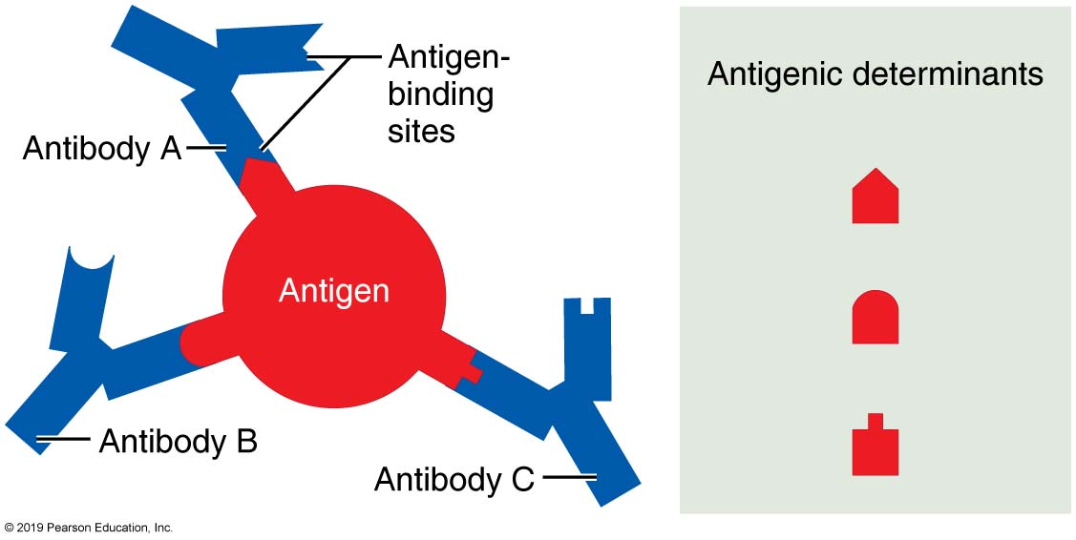
Most Antigens Have Several Different Antigenic Determinants
Figure 21.7 Most antigens have several different antigenic determinants.

Slide 12
Self-Antigens: MHC Proteins
Self-antigens: all cells are covered with variety of proteins located on surface that are not antigenic to self, but may be antigenic to others in transfusions or grafts
One set of important self-proteins are group of glycoproteins called MHC proteins
Coded by genes of major histocompatibility complex (MHC) and unique to each individual
Contain groove that can hold piece of self-antigen or foreign antigen
T lymphocytes can recognize only antigens that are presented on MHC proteins

Slide 13
21.4 Lymphocytes and Antigen-Presenting Cells
Adaptive immune system involves three crucial types of cells
Two types of lymphocytes
B lymphocytes (B cells)—humoral immunity
T lymphocytes (T cells)—cellular immunity
Antigen-presenting cells (APCs)
Do not respond to specific antigens
Play essential auxiliary roles in immunity

Slide 14
Lymphocytes (1 of 7)
Lymphocyte development, maturation, and activation
T and B lymphocytes share common development and steps in their life cycles
Five general steps:
Origin: both lymphocytes originate in red bone marrow

Slide 15
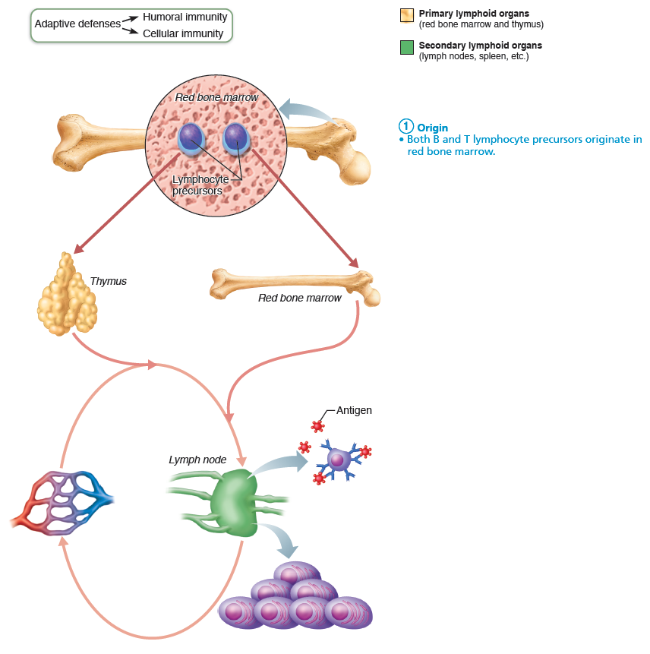
Lymphocyte Development, Maturation, and Activation (1 of 5)
Figure 21.8 Lymphocyte development, maturation, and activation.

Slide 16
Lymphocytes (2 of 7)
Maturation
Lymphocytes are “educated” in a 2-3 day process and mature in primary lymphoid organs (B cells in bone marrow and thymus)
Lymphocytes are educated for 2 reasons:
1. Immunocompetence: lymphocytes must be able to recognize only 1 specific antigen
B or T cells display only one unique type of antigen receptor on surface when mature so bind only one specific antigen
2. Self-tolerance: lymphocytes must be unresponsive to own antigens

Slide 17
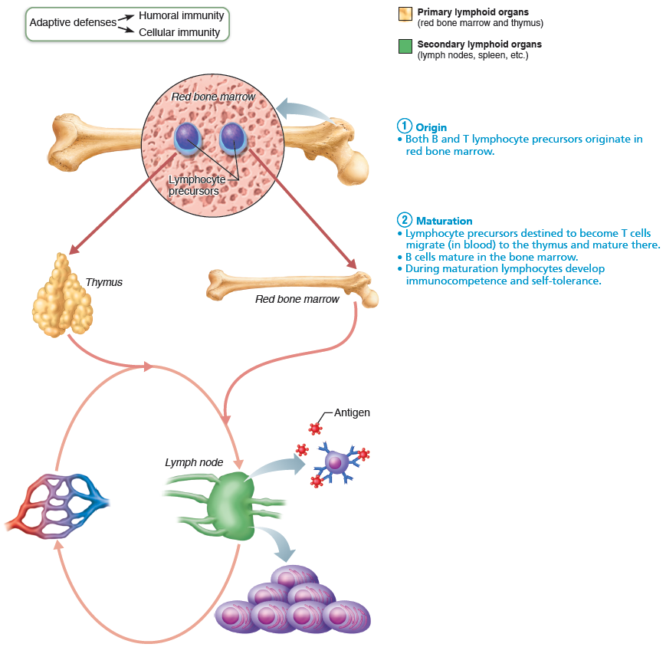
Lymphocyte Development, Maturation, and Activation (2 of 5)
Figure 21.8 Lymphocyte development, maturation, and activation.

Slide 18
Lymphocytes (3 of 7)
Seeding secondary lymphoid organs and circulation
Immunocompetent B and T cells not yet exposed to antigen are called naive
Exported from primary lymphoid organs (bone marrow and thymus) to “seed” (colonize) secondary lymphoid organs (lymph nodes, spleen, etc.)
Increases chance of encounter with antigen

Slide 19
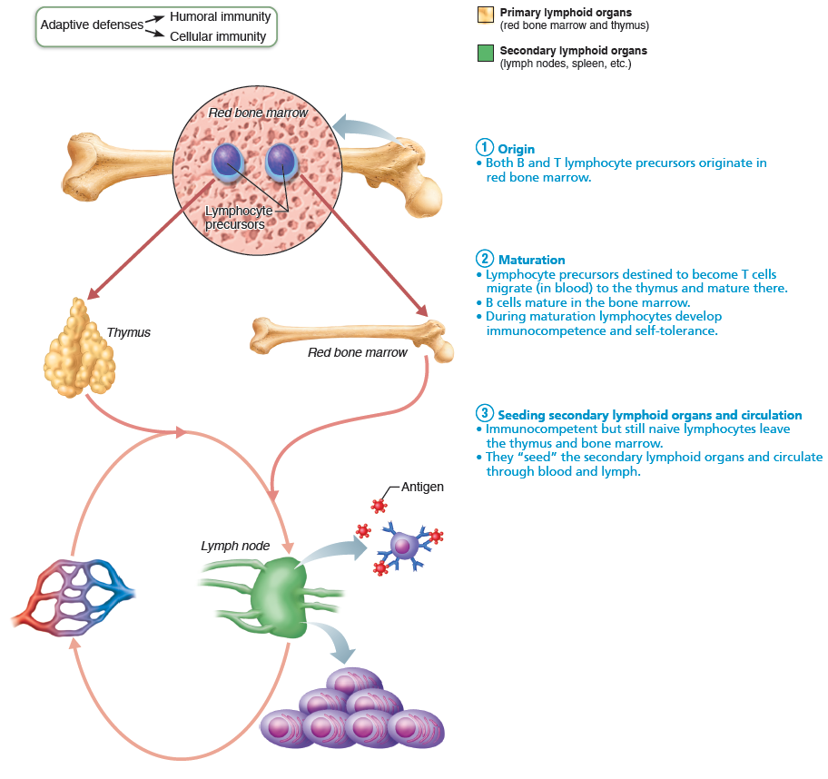
Lymphocyte Development, Maturation, and Activation (3 of 5)
Figure 21.8 Lymphocyte development, maturation, and activation.

Slide 20
Lymphocytes (4 of 7)
Antigen encounter and activation
Naive lymphocyte’s first encounter with antigen triggers lymphocyte to develop further
Lymphocyte is selected to differentiate into active cell by binding to its specific antigen
Referred to as clonal selection
If correct signals are present, lymphocyte will complete its differentiation into active cell

Slide 21
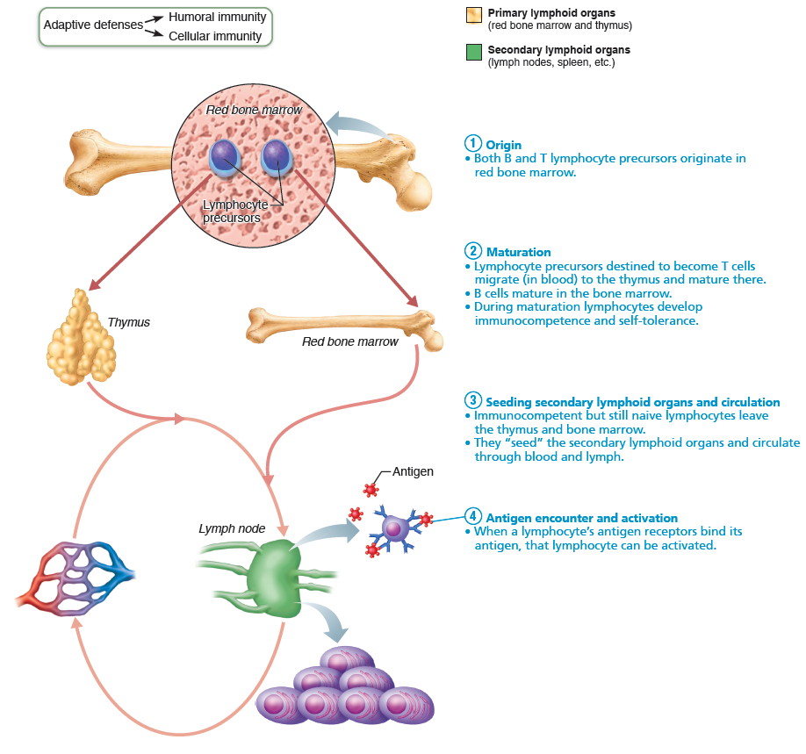
Lymphocyte Development, Maturation, and Activation (4 of 5)
Figure 21.8 Lymphocyte development, maturation, and activation.

Slide 22
Lymphocytes (5 of 7)
Proliferation and differentiation
Once selected and activated, lymphocyte proliferates
Forms army of exact copies of itself
Referred to as clones
Most clones become effector cells that fight infections
A few remain as memory cells
Able to respond to same antigen more quickly second time it is encountered
B and T memory cells and effector T cells circulate continuously

Slide 23
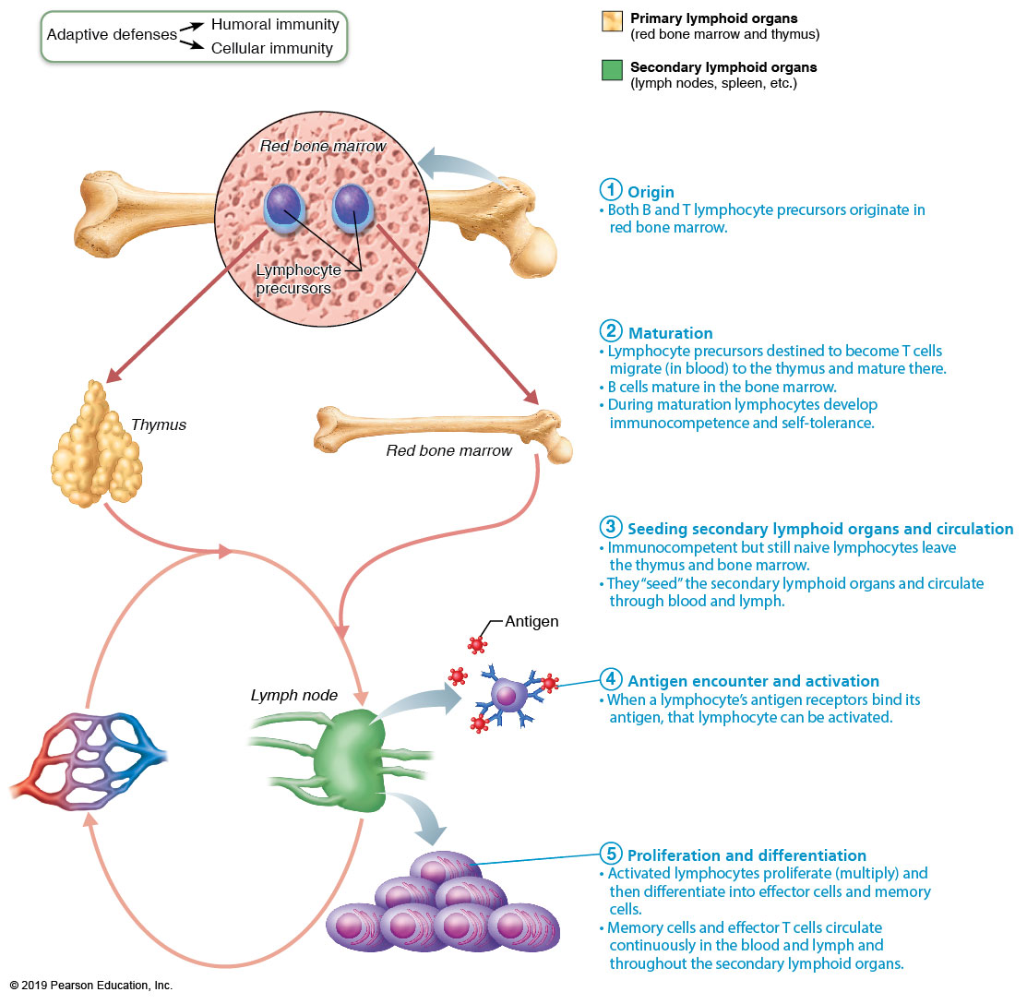
Lymphocyte Development, Maturation, and Activation (5 of 5)
Figure 21.8 Lymphocyte development, maturation, and activation.

Slide 24
Lymphocytes (6 of 7)
Antigen receptor diversity
Genes, not antigens, determine which foreign substances the immune system will recognize
Variety of immune cell receptors are result of acquired genetic knowledge of microbes
∼25,000 different genes codes for up to a billion different types of lymphocyte antigen receptors
Huge variety of receptors: gene segments are shuffled around, resulting in many combinations

Slide 25
Lymphocytes (7 of 7)
Lymphocyte Education during Maturation
T cells mature in thymus under negative and positive selection pressures (“tests”)
Positive selection process
Selects T cells capable of recognizing self-MHC proteins (MHC restriction); those that can’t are destroyed by apoptosis
Negative selection
Prompts apoptosis of T cells that bind to self-antigens displayed by self-MHC
Process, called clonal deletion, ensures self-tolerance

Slide 26
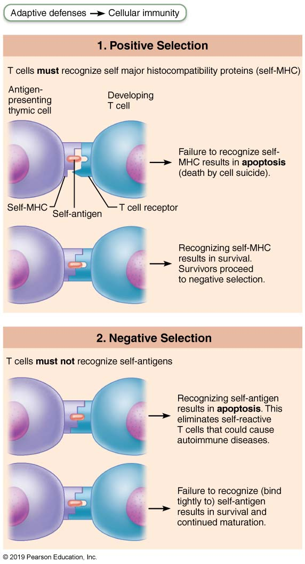
T Cell Education in the Thymus
Figure 21.9 T cell education in the thymus.

Slide 27
Antigen-Presenting Cells (APCs) (1 of 4)
Engulf antigens and present fragments of antigens to T cells for recognition
Major types
Dendritic cells
Macrophages
B cells

Slide 28
Antigen-Presenting Cells (APCs) (2 of 4)
Dendritic cells
Found in connective tissues and epidermis
Act as mobile sentinels of boundary tissues
Phagocytize pathogens that enter tissues, then enter lymphatics to present antigens to T cells in lymph node
Most effective antigen presenter known
Key link between innate and adaptive immunity

Slide 29
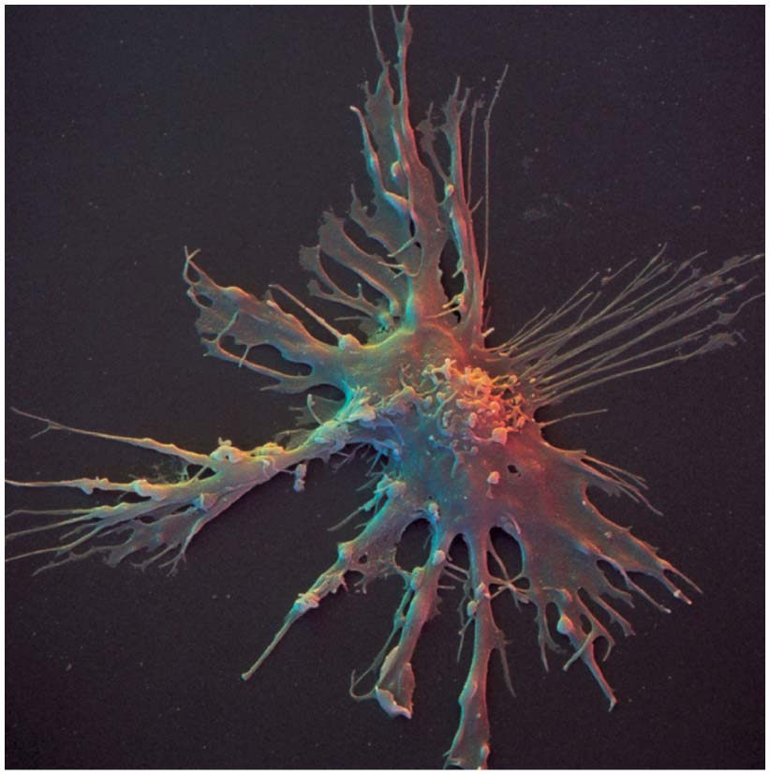
Dendritic Cell
Figure 21.10 Dendritic cell.

Slide 30
Antigen-Presenting Cells (APCs) (3 of 4)
Macrophages
Widely distributed in connective tissues and lymphoid organs
Present antigens to T cells, which not only activates T cell, but also further activates macrophage
Activated macrophage becomes voracious phagocytic killer
Also trigger powerful inflammatory responses and recruit additional defenses

Slide 31
Antigen-Presenting Cells (APCs) (4 of 4)
B lymphocytes
Do not activate naive T cells
Present antigens to helper T cell to assist their own activation

Slide 32
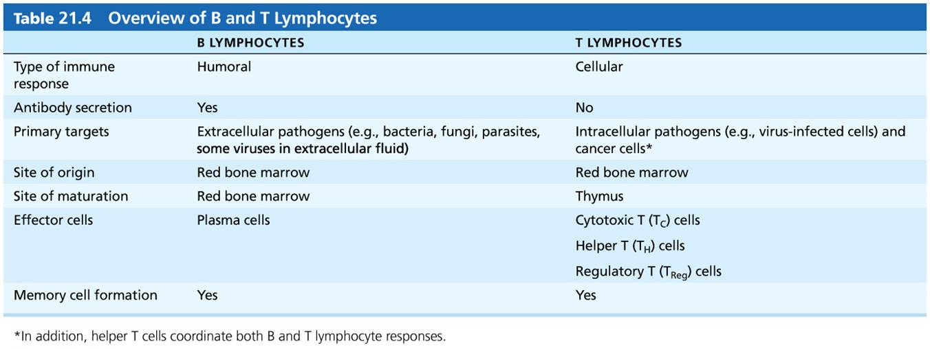
Table 21.4 Overview of B and T Lymphocytes
Table 21.4 Overview of B and T Lymphocytes.

Slide 33
21.5 Humoral Immune Response
When B cell encounters target antigen, it provokes humoral immune response
Antibodies specific for that particular antigen are then produced

Slide 34
Activation and Differentiation of B Cells (1 of 3)
B cells are activated when antigens bind to surface receptors, cross-linking them
Triggers receptor-mediated endocytosis of cross-linked antigen-receptor complexes (clonal selection), leading to proliferation and differentiation of B cell into effector cells

Slide 35
Activation and Differentiation of B Cells (2 of 3)
Most clone cells become plasma cells, antibody-secreting effector cells
Secrete specific antibodies at rate of 2000 molecules per second for 4 to 5 days, then die
Antibodies circulate in blood or lymph, binding to free antigens, marking them for destruction by innate or other adaptive mechanisms

Slide 36
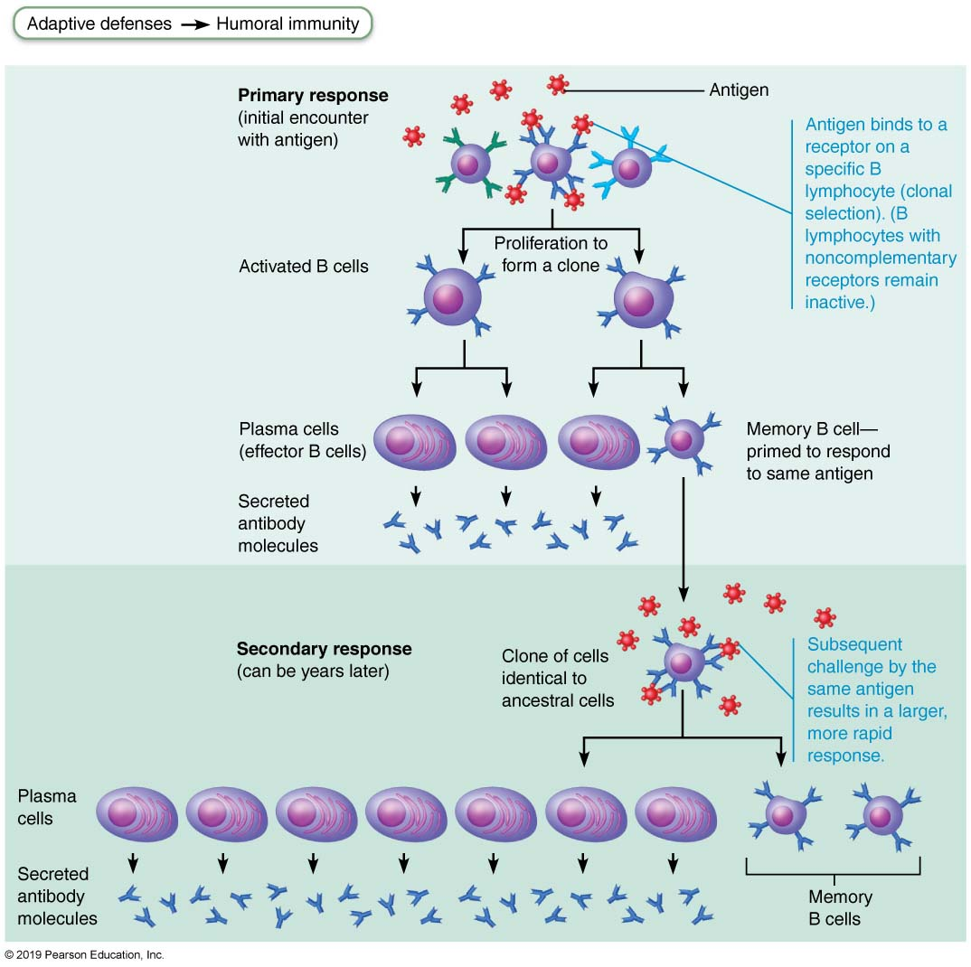
Clonal Selection of a B cell (1 of 2)
Figure 21.11 Clonal selection of a B cell.

Slide 37
Activation and Differentiation of B Cells (3 of 3)
Clone cells that do not become plasma cells become memory cells
Provide immunological memory
Mount an immediate response to future exposures to same antigen

Slide 38
Clonal Selection of a B cell (2 of 2)
Figure 21.11 Clonal selection of a B cell.

Slide 39
Immunological Memory (1 of 2)
Primary immune response: cell proliferation and differentiation upon exposure to antigen for the first time
Lag period: 3 to 6 days
Peak levels of plasma antibody are reached in 10 days
Antibody levels then decline

Slide 40
Immunological Memory (2 of 2)
Secondary immune response
Re-exposure to same antigen gives faster, more prolonged, more effective response
Sensitized memory cells provide immunological memory
Respond within hours, not days
Antibody levels peak in 2 to 3 days at much higher levels
Antibodies bind with greater affinity
Antibody level can remain high for weeks to months

Slide 41
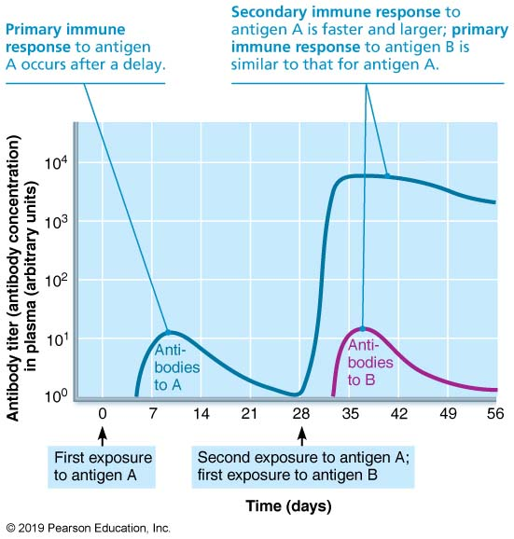
Primary and Secondary Humoral Responses
Figure 21.12 Primary and secondary humoral responses.

Slide 42
Active and Passive Humoral Immunity (1 of 2)
Active humoral immunity occurs when B cells encounter antigens and produce specific antibodies against them
Two types of active humoral immunity
Naturally acquired: formed in response to actual bacterial or viral infection
Artificially acquired: formed in response to vaccine of dead or attenuated pathogens
Provide antigenic determinants that are immunogenic and reactive
Spare us symptoms of primary response

Slide 43
Active and Passive Humoral Immunity (2 of 2)
Passive humoral immunity occurs when ready-made antibodies are introduced into body
B cells are not challenged by antigens; Immunological memory does not occur
Protection ends when antibodies degrade
Two types of passive humoral immunity
Naturally acquired: antibodies delivered to fetus via placenta or to infant through milk
Artificially acquired: injection of serum, such as gamma globulin
Protection immediate but ends when antibodies naturally degrade in body

Slide 44
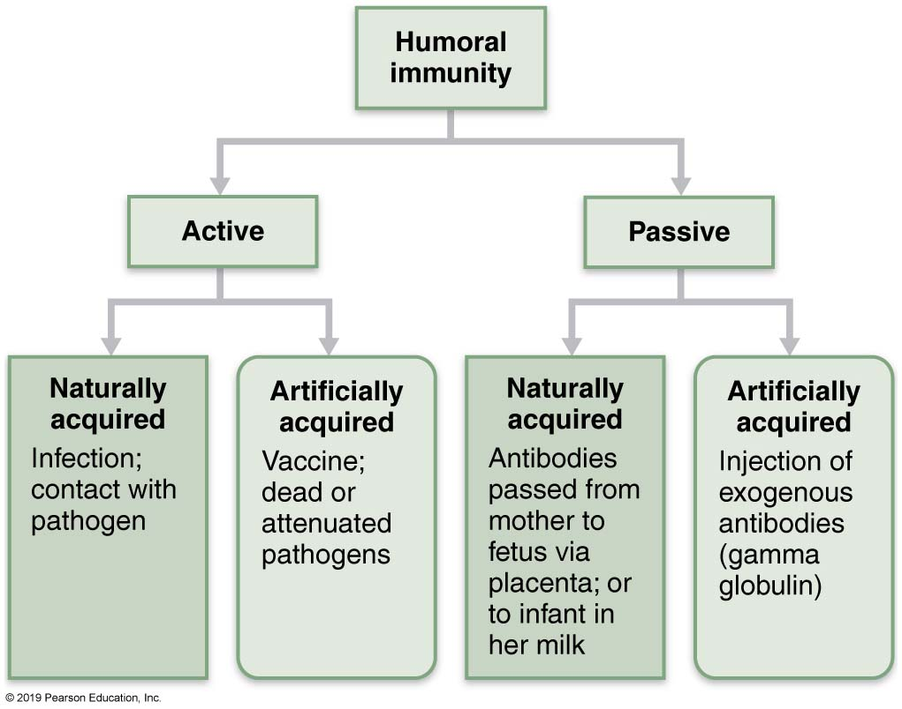
Active and Passive Humoral Immunity
Figure 21.13 Active and passive humoral immunity.

Slide 45
Antibodies (1 of 13)
Antibodies—also called Immunoglobulins (Igs)—are proteins secreted by plasma cells
Make up gamma globulin portion of blood
Capable of binding specifically with antigen detected by B cells
Grouped into one of five Ig classes

Slide 46
Antibodies (2 of 13)
Basic antibody structure
Overall T- or Y-shaped antibody monomer consists of four looping polypeptide chains linked by disulfide bonds
Four chains consist of:
Two identical heavy (H) chains with hinge region at “middles”
Two identical light (L) chains
Variable (V) regions at one end of each arm combine to form two identical antigen-binding sites

Slide 47
Antibodies (3 of 13)
Basic antibody structure (cont.)
Stems make up constant (C) regions
Area that determines antibody class
Considered effector region of antibody
Serves common functions in all antibodies dictating:
Type of cells and/or chemicals that antibody can bind
How antibody class functions to eliminate antigens
Example: some antibodies fix complement, some circulate in blood, some are found in body secretions

Slide 48
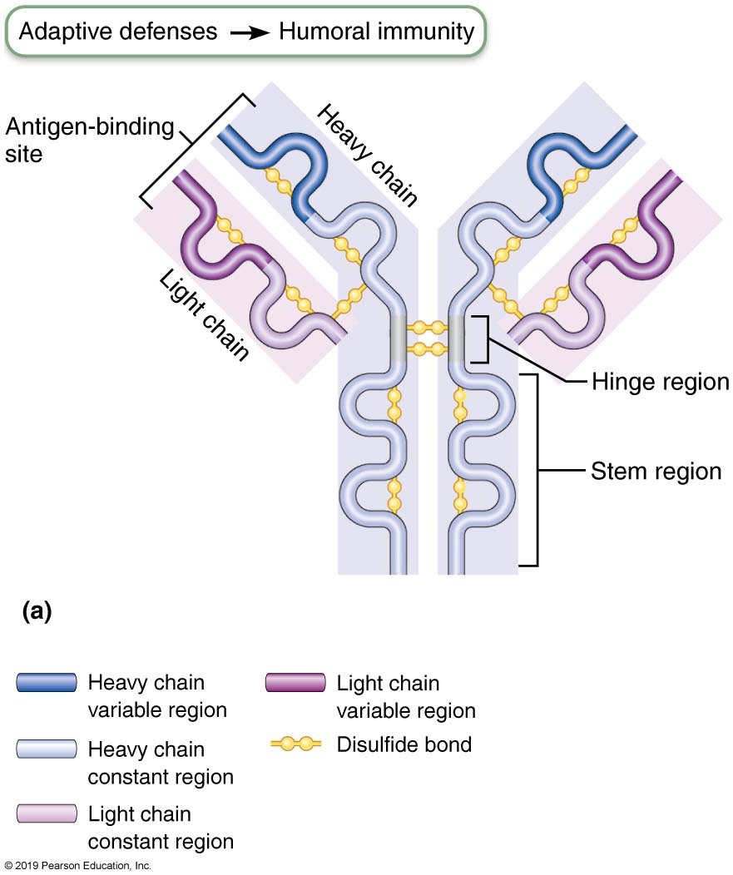
Antibody Structure (1 of 2)
Figure 21.14a Antibody structure.

Slide 49
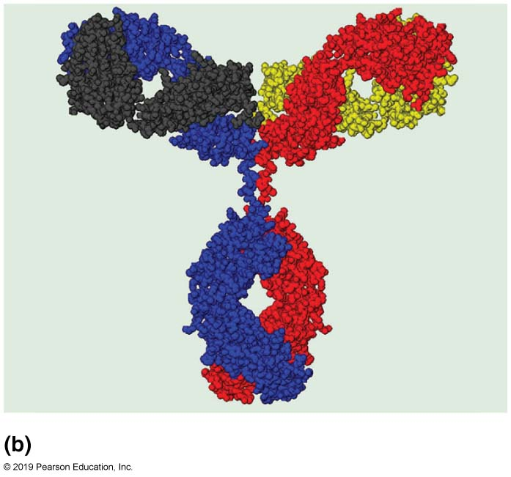
Antibody Structure (2 of 2)
Figure 21.14b Antibody structure.

Slide 50
Antibodies (4 of 13)
Antibody classes
Five major classes: IgM, IgA, IgD, IgG, and IgE
IgM
Pentamer (larger than others); first antibody released
Potent agglutinating agent
Readily fixes and activates complement
IgA (secretory IgA)
Monomer or dimer; found in mucus and other secretions
Helps prevent entry of pathogens

Slide 51
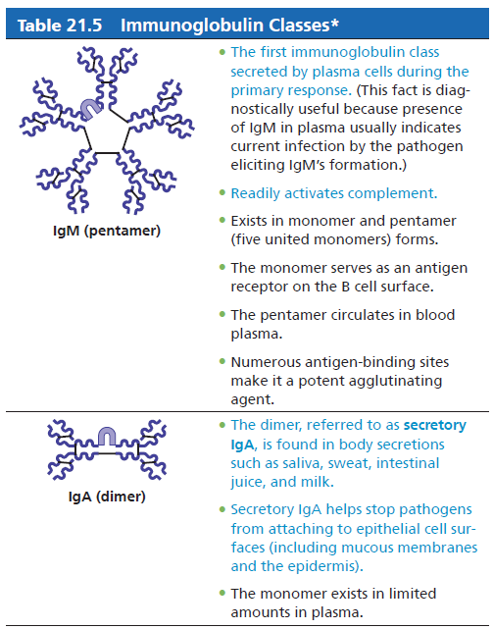
Table 21.5-1 Immunoglobulin Classes
Table 21.5-1 Immunoglobulin Classes

Slide 52
Antibodies (5 of 13)
Antibody classes (cont.)
IgD
Monomer attached to surface of B cells
Functions as B cell receptor
IgG
Monomer; 75–85% of antibodies in plasma
From secondary and late primary responses
Crosses placental barrier
IgE
Monomer active in some allergies and parasitic infections
Causes mast cells and basophils to release histamine

Slide 53
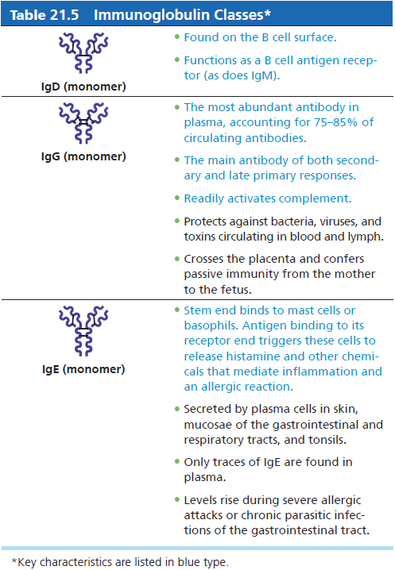
Table 21.5-2 Immunoglobulin Classes
Table 21.5-2 Immunoglobulin Classes

Slide 54
Antibodies (6 of 13)
Plasma B cells can switch from making one class of antibodies to another
Retain specificity for same antigen
IgM is released during primary response, but plasma cell can switch to IgG for secondary response
Almost all secondary responses are IgG
Switching from IgM to IgA or IgE can also occur

Slide 55
Antibodies (7 of 13)
Antibody targets and functions
Antibodies do not destroy antigens; they inactivate and tag them
Form antigen-antibody (immune) complexes
Defensive mechanisms used by antibodies
Neutralization
Agglutination
Precipitation
Complement fixation

Slide 56
Antibodies (8 of 13)
Neutralization
Simplest, but one of most important defensive mechanism
Antibodies block specific sites on viruses or bacterial exotoxins
Prevent antigens from binding to receptors on tissue cells
Antigen-antibody complexes undergo phagocytosis

Slide 57
Antibodies (9 of 13)
Agglutination
Antibodies can bind same determinant on two different antigens at the same time
Each antibody has two arms, each containing a variable region capable of binding to one antigen
Allows for antigen-antibody complexes to become cross-linked into large lattice-like clumps
Process referred to as agglutination
Example: clumping of mismatched blood cells

Slide 58
Antibodies (10 of 13)
Precipitation
Soluble molecules (instead of cells) are cross-linked into complexes
Complexes precipitate out of solution
Precipated complexes are easier for phagocytes to engulf

Slide 59
Antibodies (11 of 13)
Complement fixation and activation
Main antibody defense against cellular antigens (bacteria, mismatched RBCs)
When several antibodies are bound close together on same antigen, complement-binding sites on their stem regions are aligned
Alignment triggers complement fixation, which leads to cell lysis, as well as other complement functions
Example: amplification of inflammatory response, opsonization

Slide 60
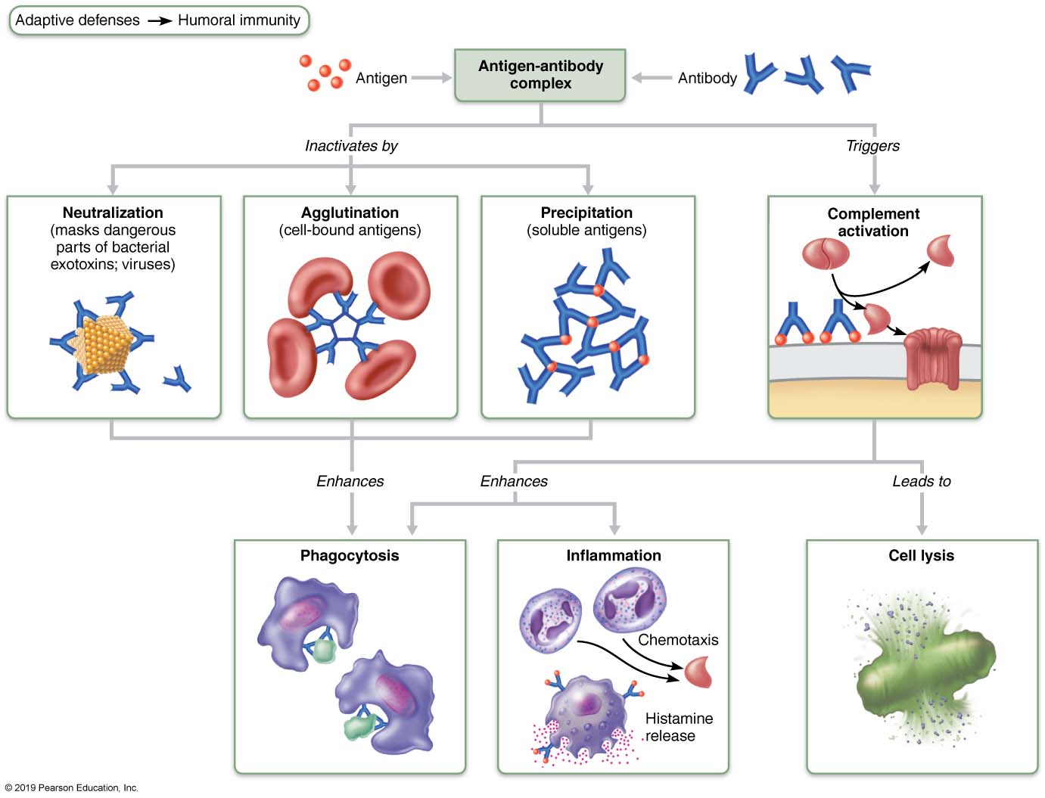
Mechanisms of Antibody Action
Figure 21.15 Mechanisms of antibody action.

Slide 61
Clinical – Homeostatic Imbalance 21.2
Parasitic infections by worms such as Ascaris and Schistosoma require different immune attack strategies
Worms are too big for regular PLAN attack (Precipitation, Lysis (by complement), Agglutination, or Neutralization)
IgE antibodies still play a critical role in worm’s destruction by binding to surface of worm, marking it for destruction by eosinophils
Eosinophils bind to exposed stems of IgE, which triggers eosinophils to release their toxic contents onto prey, lysing it from the outside

Slide 62
Antibodies (12 of 13)
Monoclonal antibodies as clinical and research tools
Monoclonal antibodies: commercially prepared pure antibodies that are specific for a single antigenic determinant
Produced by hybridomas, cell hybrids formed from fusion of tumor cell and B cell
Tumor cell portion allows cells to proliferate indefinitely, while B cell portion allows production of single type of antibody
Used in research, clinical testing, and cancer treatment

Slide 63
Antibodies (13 of 13)
Summary of antibody actions
Antigen-antibody complexes do not destroy antigens; they prepare them for destruction by innate defenses
Antibodies go after extracellular pathogens; they do not invade solid tissue unless lesion is present
Recent exception found: antibodies can act intracellularly if attached to virus before it enters cell
Activate mechanisms that destroy virus

Slide 64

Copyright

