Slide 1
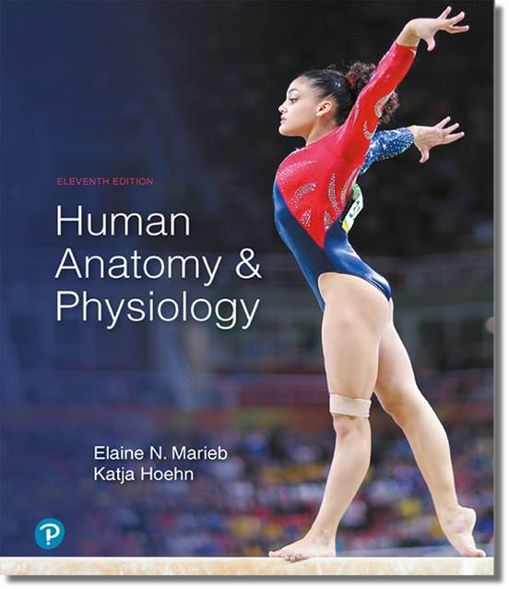
Human Anatomy and Physiology
Eleventh Edition
Chapter 21 Part A
The Immune System: Innate
and Adaptive Body Defenses
PowerPoint® Lectures Slides prepared by Karen Dunbar Kareiva, Ivy Tech Community College
Copyright © 2019, 2016, 2013 Pearson Education, Inc. All Rights Reserved

Slide 2
Why This Matters
Understanding the signs of a healthy immune response will help you assess your patients

Slide 3
Video: Why This Matters (Career Connection)
Click here to view ADA compliant video:
Why This Matters (Career Connection)
https://mediaplayer.pearsoncmg.com/assets/secs_wtm_ch_21_dea_v2

Slide 4
The Immune System (1 of 2)
Immune system provides resistance to disease
Made up of two intrinsic systems
Innate (nonspecific) defense system
Constitutes first and second lines of defense
First line of defense: external body membranes (skin and mucosae)
Second line of defense: antimicrobial proteins, phagocytes, and other cells (inhibit spread of invaders; inflammation most important mechanism)
Adaptive (specific) defense system
Third line of defense attacks particular foreign substances (takes longer to react than innate)

Slide 5
The Immune System (2 of 2)
Immune system is a functional system rather than organ system
Innate and adaptive defenses are intertwined
Both release and recognize many of the same defensive molecules
Innate defenses do have specific pathways for certain substances
Innate responses release proteins that alert cells of adaptive system to foreign molecules

Slide 6
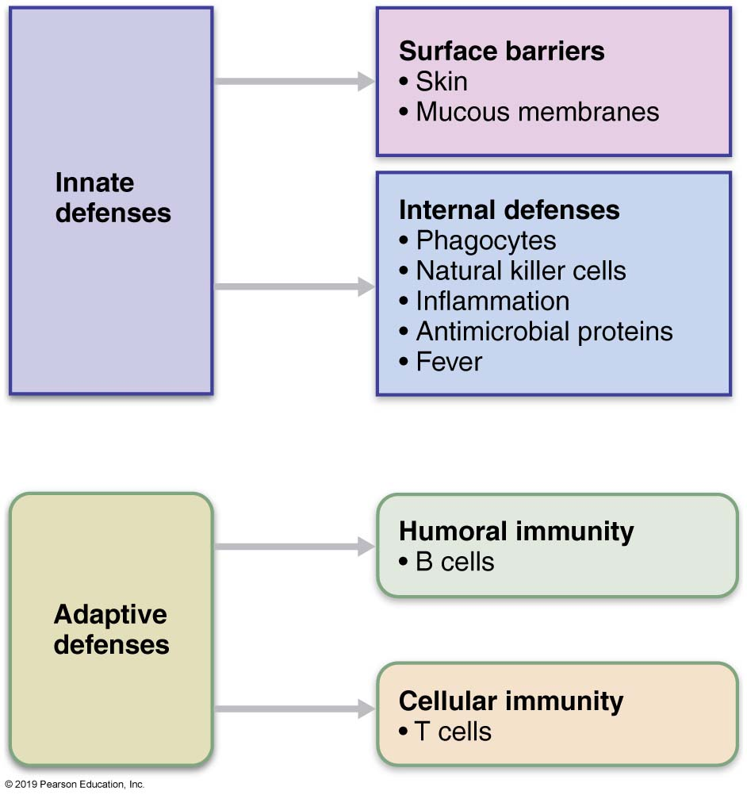
Simplified Overview of Innate and Adaptive Defenses
Figure 21.1 Simplified overview of innate and adaptive defenses.

Slide 7
Part 1 – Innate Defenses
Innate system uses the first and/or second lines of defense to stop attacks by pathogens (disease-causing microorganisms)

Slide 8
21.1 First Line of Defense: Surface Barriers (1 of 4)
Surface barriers are skin and mucous membranes, along with their secretions
Physical barrier to most microorganisms
Keratin is resistant to weak acids and bases, bacterial enzymes, and toxins
Mucosae provide similar mechanical barriers

Slide 9
21.1 First Line of Defense: Surface Barriers (2 of 4)
Skin and mucous membranes produce protective chemicals that inhibit or destroy microorganisms
Acid: acidity of skin and some mucous secretions inhibits growth; called acid mantle
Enzymes: lysozyme of saliva, respiratory mucus, and lacrimal fluid kills many microorganisms; enzymes in stomach kill many microorganisms

Slide 10
21.1 First Line of Defense: Surface Barriers (3 of 4)
Mucin: sticky mucus that lines digestive and respiratory tract traps microorganisms
Defensins: antimicrobial peptides that inhibit microbial growth
Other chemicals: lipids in sebum and dermicidin in sweat are toxic to some bacteria

Slide 11
21.1 First Line of Defense: Surface Barriers (4 of 4)
Respiratory system also has modifications to stop pathogens
Mucus-coated hairs in nose trap inhaled particles
Cilia of upper respiratory tract sweep dust- and bacteria-laden mucus toward mouth
Surface barriers breached by nicks or cuts trigger the internal second line of defense that protects deeper tissues

Slide 12
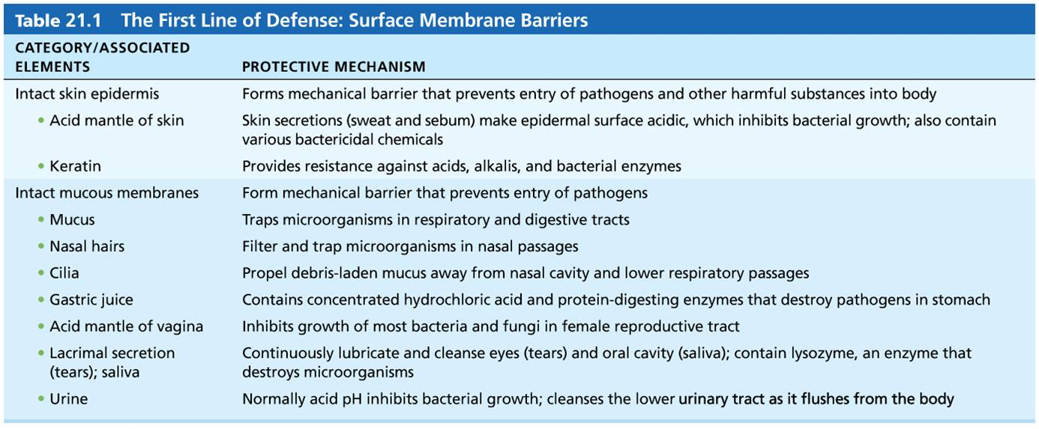
Table 21.1 The First Line of Defense: Surface Membrane Barriers
Table 21.1 The First Line of Defense: Surface Membrane Barriers

Slide 13
21.2 Second Line of Defense: Cells and Chemicals (1 of 2)
Innate system necessary if microorganisms invade deeper tissues; includes:
Phagocytes
Natural killer (NK) cells
Inflammatory response (macrophages, mast cells, WBCs, and inflammatory chemicals)
Antimicrobial proteins (interferons and complement proteins)
Fever

Slide 14
21.2 Second Line of Defense: Cells and Chemicals (2 of 2)
Many second-line cells have pattern recognition receptors that recognize and bind tightly to structures on microbes, disarming them before they do harm
One class, Toll-like receptors (TLRs), play central role in triggering immune responses.
Humans have 11 different TLRs, each recognizes a particular class of attaching microbe

Slide 15
Phagocytes (1 of 5)
Phagocytes: white blood cells that ingest and digest (eat) foreign invaders
Neutrophils: most abundant phagocytes, but die fighting; become phagocytic on exposure to infectious material

Slide 16
Phagocytes (2 of 5)
Macrophages: develop from monocytes and are chief phagocytic cells; most robust phagocytic cell
Free macrophages: wander through tissue spaces; example: alveolar macrophages
Fixed macrophages: permanent residents of some organs; examples: stellate macrophages (liver) and microglia (brain)

Slide 17
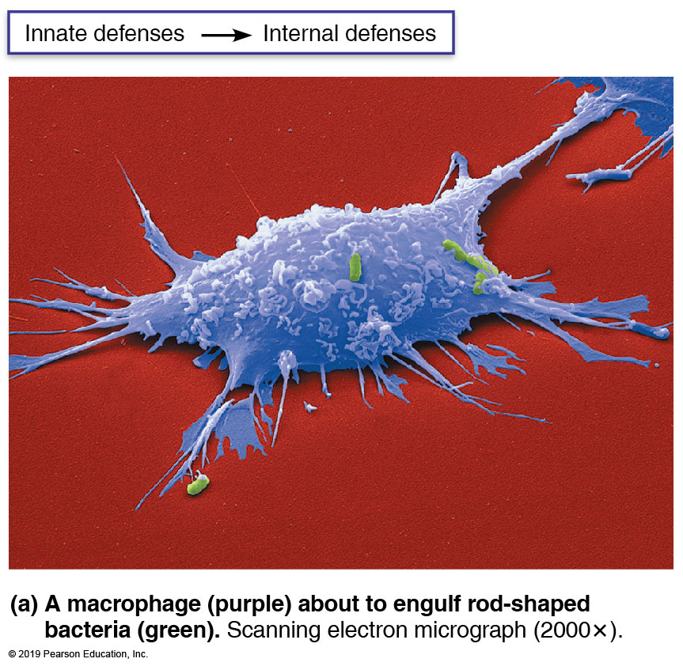
Phagocytosis (1 of 6)
Figure 21.2a Phagocytosis.

Slide 18
Phagocytes (3 of 5)
Phagocytosis
Process starts when phagocyte recognizes and adheres to pathogen’s carbohydrate “signature”
Some microorganisms have external capsules that hide their surface carbohydrates, helping them evade phagocytosis
Opsonization: immune system uses antibodies or complement proteins as opsonins that coat pathogens
Act as “handles” for phagocytes to grab on to, enhancing phagocytosis

Slide 19
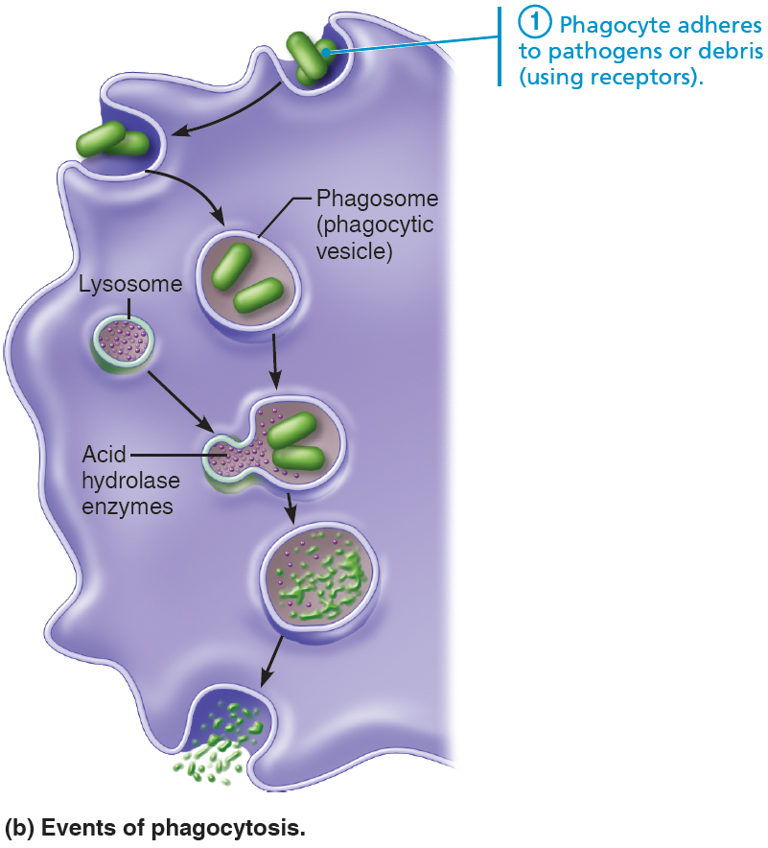
Phagocytosis (1 of 5)
Figure 21.2b Phagocytosis.

Slide 20
Phagocytes (4 of 5)
Phagocytosis (cont.)
Cytoplasmic extensions (pseudopods) bind to and engulf particle in vesicle called phagosome
Phagosome fuses with lysosome, forming phagolysosome
Phagolysosome is acidified, and lysosomal enzymes digest particles
Indigestible and residual waste is exocytosed from phagocyte

Slide 21
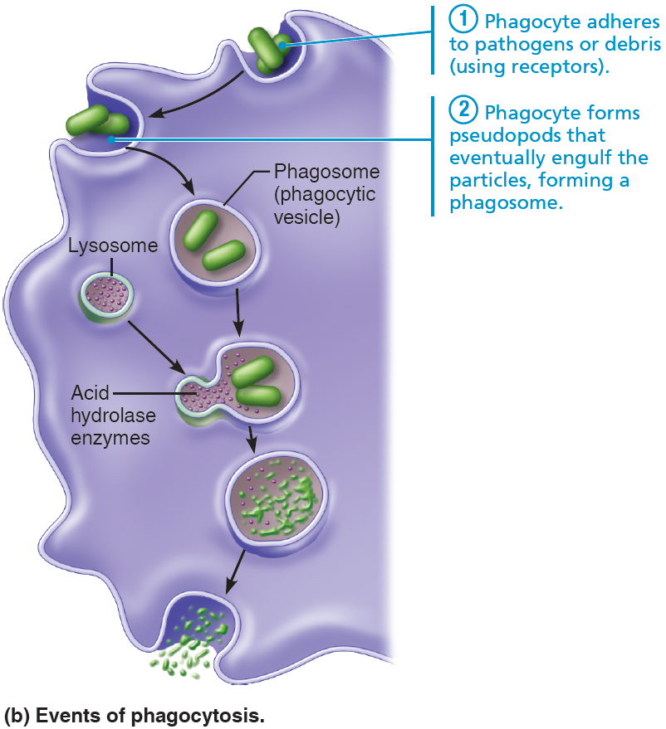
Phagocytosis (2 of 5)
Figure 21.2b Phagocytosis.

Slide 22
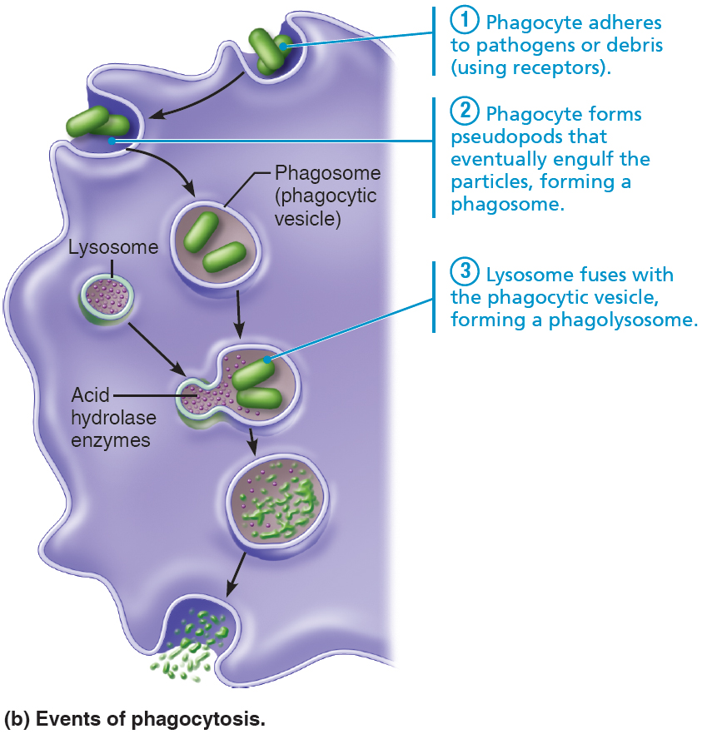
Phagocytosis (3 of 5)
Figure 21.2b Phagocytosis.

Slide 23
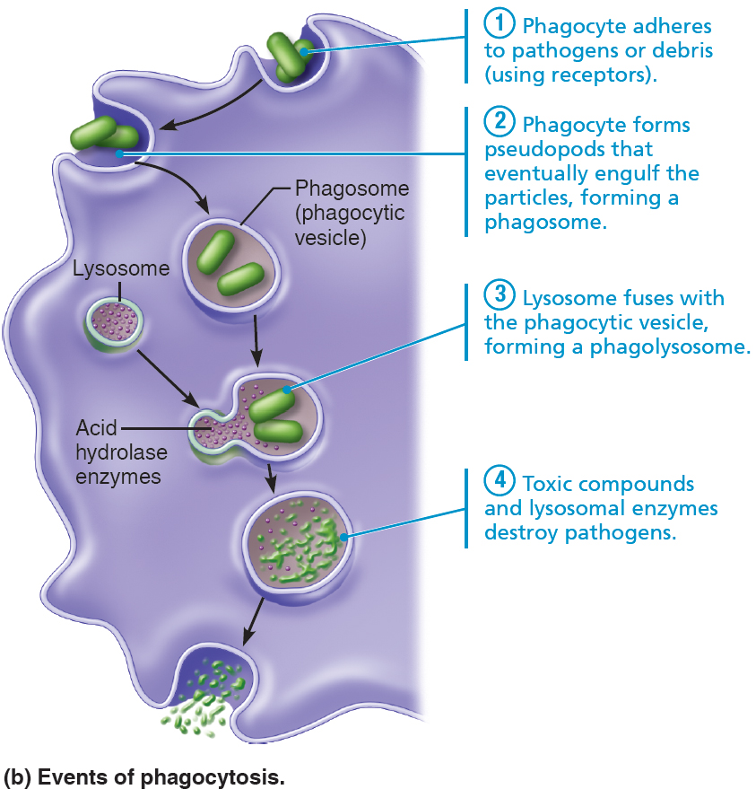
Phagocytosis (4 of 5)
Figure 21.2b Phagocytosis.

Slide 24
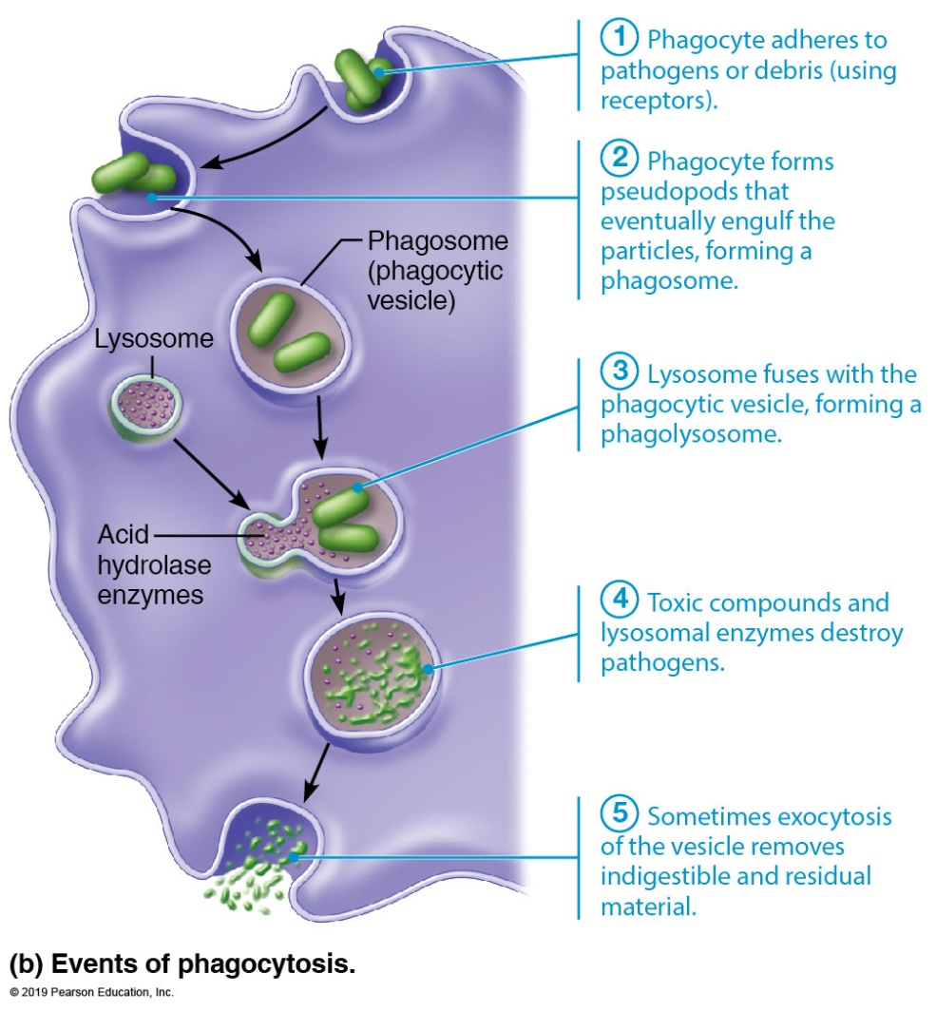
Phagocytosis (5 of 5)
Figure 21.2b Phagocytosis.

Slide 25
Phagocytes (5 of 5)
Phagocytosis (cont.)
Some pathogens are not killed with acidified lysosomal enzymes (e.g., tuberculosis bacteria)
Helper T cells trigger macrophage to produce respiratory burst, which kills pathogens resistant to lysosomal enzymes by:
Releasing cell-killing free radicals
Producing oxidizing chemicals (e.g., H₂O₂)
Increasing pH and osmolarity of phagolysosome
Defensins (in neutrophils) also help by piercing membrane of pathogen

Slide 26
Natural Killer (NK) Cells
Nonphagocytic, large granular lymphocytes that police blood and lymph
Can kill cancer and virus-infected cells before adaptive immune system is activated
Attack cells that lack “self” cell-surface receptors
Kill by inducing apoptosis in cancer cells and virus-infected cells
Secrete potent chemicals that enhance inflammatory response

Slide 27
Inflammation: Tissue Response to Injury (1 of 9)
Inflammation is triggered whenever body tissues are injured
Injuries can be due to trauma, heat, irritating chemicals, or infections by microorganisms
Benefits of inflammation:
Prevents spread of damaging agents
Disposes of cell debris and pathogens
Alerts adaptive immune system
Sets the stage for repair

Slide 28
Inflammation: Tissue Response to Injury (2 of 9)
Four cardinal signs of acute inflammation:
Redness
Heat
Swelling
Pain
Sometimes a fifth sign, impairment of function, is seen if movement or use of area is hampered

Slide 29
Inflammation: Tissue Response to Injury (3 of 9)
Stages of inflammation
Inflammatory chemical release
Vasodilation and increased vascular permeability
Phagocyte mobilization

Slide 30
Inflammation: Tissue Response to Injury (4 of 9)
Inflammatory chemical release
Chemicals are released into ECF by injured tissues or immune cells
Example: histamine released by mast cells is key inflammatory chemical
Other inflammatory mediators besides histamine
Kinins, prostaglandins (PGs), cytokines and if pathogens are involved, complement
All cause vasodilation of local arterioles
All make capillaries leaky
Many attract phagocytes to area

Slide 31
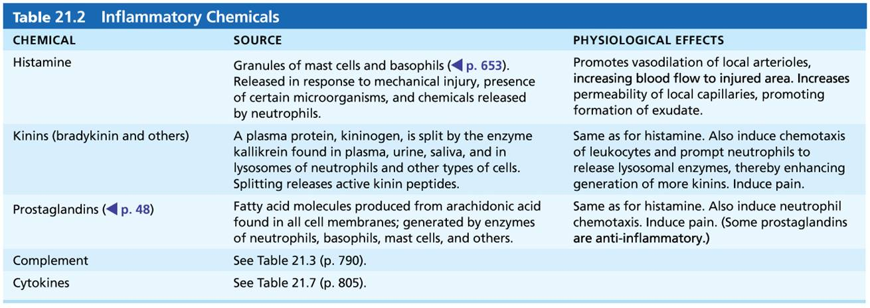
Table 21.2 Inflammatory Chemicals
Table 21.2 Inflammatory Chemicals

Slide 32
Inflammation: Tissue Response to Injury (5 of 9)
Vasodilation and increased vascular permeability
Vasodilation causes hyperemia—congestion with blood—which leads to redness and heat
Increased capillary permeability causes exudate—fluid containing clotting factors and antibodies—to leak into tissue
Results in local swelling (edema)
Swelling also pushes on nerve endings, resulting in pain

Slide 33
Inflammation: Tissue Response to Injury (6 of 9)
Vasodilation and increased vascular permeability (cont.)
Pain can also result from release of toxins from bacteria or released prostaglandins and kinins
Benefits of edema
Surge of fluid in tissue sweeps foreign material into lymphatic vessels for processing in lymph nodes
Delivers clotting proteins and complement to area
Clotting factors form fibrin mesh that acts as scaffold for repair
Mesh also isolates injured area so invaders cannot spread

Slide 34
Inflammation: Tissue Response to Injury (7 of 9)
Phagocyte mobilization
Neutrophils flood area first; macrophages follow
If inflammation is due to pathogens, complement is activated; adaptive immunity elements arrive
Steps for phagocyte mobilization
Leukocytosis: release of neutrophils from bone marrow in response to leukocytosis-inducing factors from injured cells

Slide 35
Inflammation: Tissue Response to Injury (8 of 9)
Steps for phagocyte mobilization (cont.)
2. Margination: endothelial cells of capillaries in inflamed area project cell adhesion molecules (CAMs) into vessel lumen that grab onto passing neutrophils, causing them to slow and roll along, clinging to vessel wall
3. Diapedesis: neutrophils flatten and squeeze between endothelial cells, moving into interstitial spaces

Slide 36
Inflammation: Tissue Response to Injury (9 of 9)
Steps for phagocyte mobilization (cont.)
4. Chemotaxis: inflammatory chemicals act as chemotactic agents that promote positive chemotaxis of neutrophils toward injured area
As attack continues, monocytes arrive later
12 hours after leaving bloodstream, they are transformed into macrophages
These “late-arrivers” replace dying neutrophils and remain for cleanup prior to repair

Slide 37
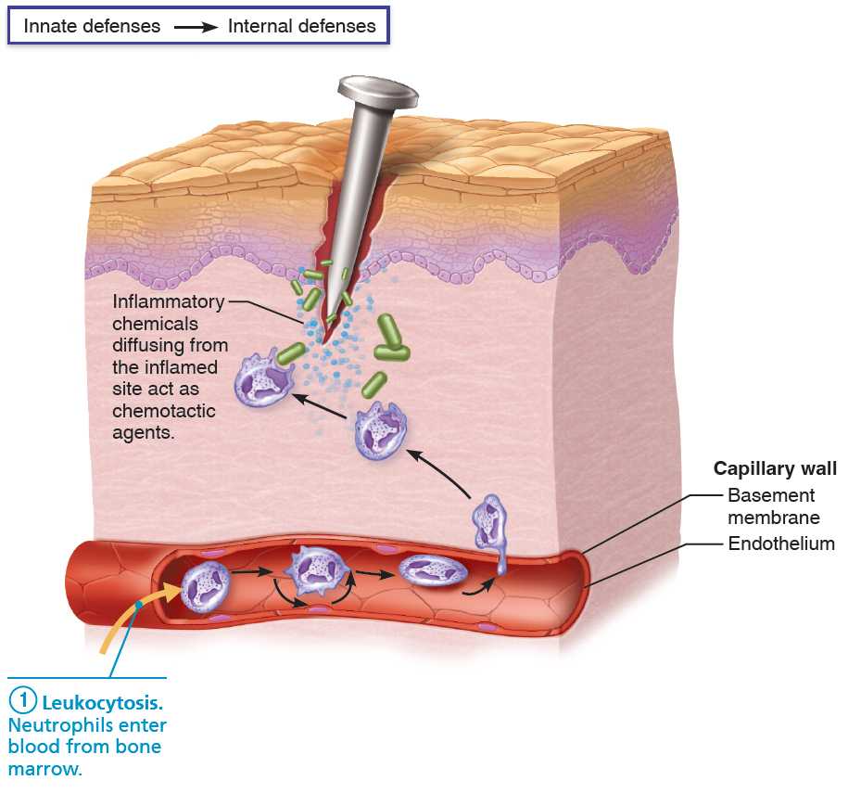
Phagocyte Mobilization (1 of 4)
Figure 21.3 Phagocyte mobilization.

Slide 38
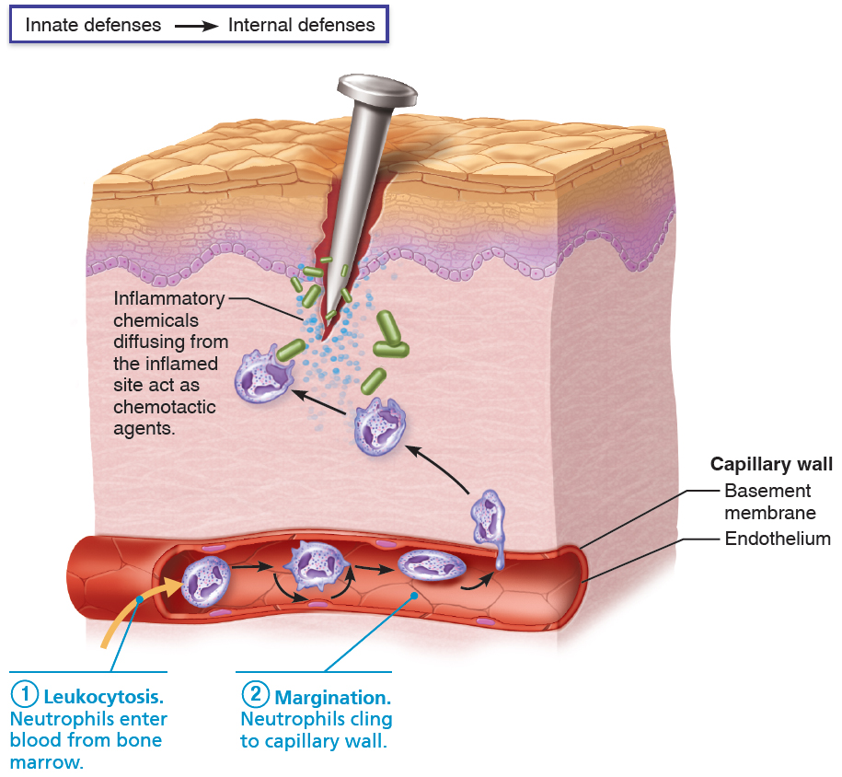
Phagocyte Mobilization (2 of 4)
Figure 21.3 Phagocyte mobilization.

Slide 39
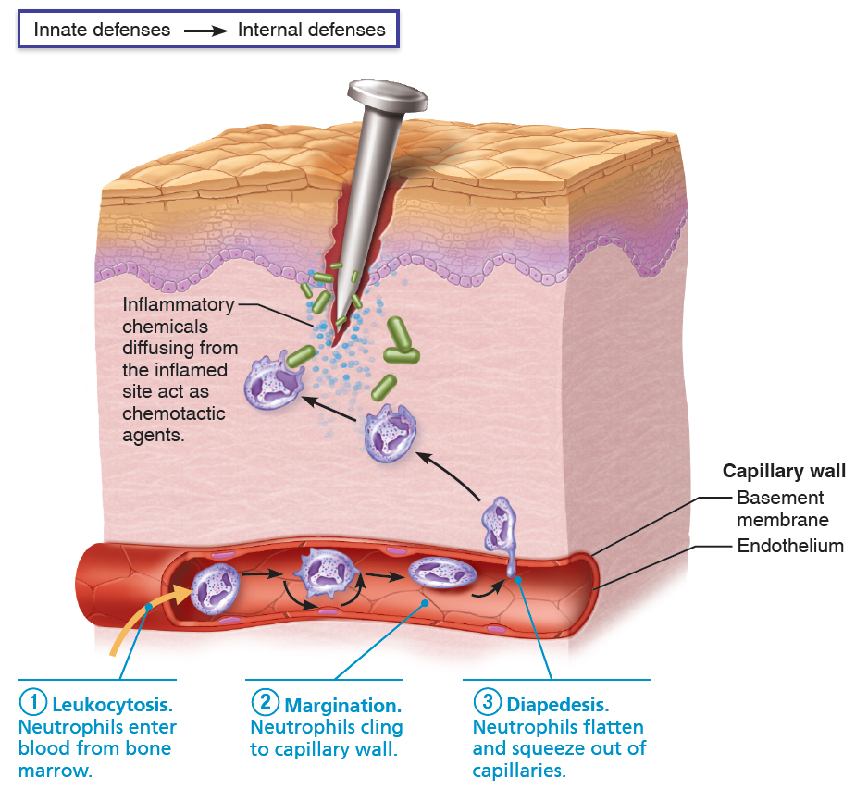
Phagocyte Mobilization (3 of 4)
Figure 21.3 Phagocyte mobilization.

Slide 40
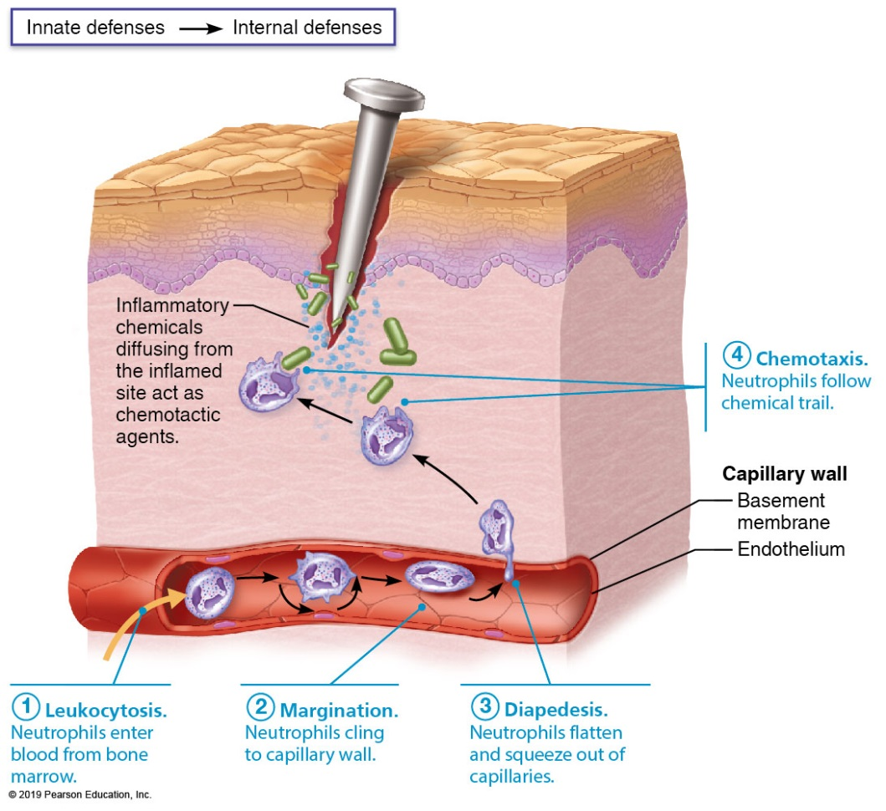
Phagocyte Mobilization (4 of 4)
Figure 21.3 Phagocyte mobilization.

Slide 41
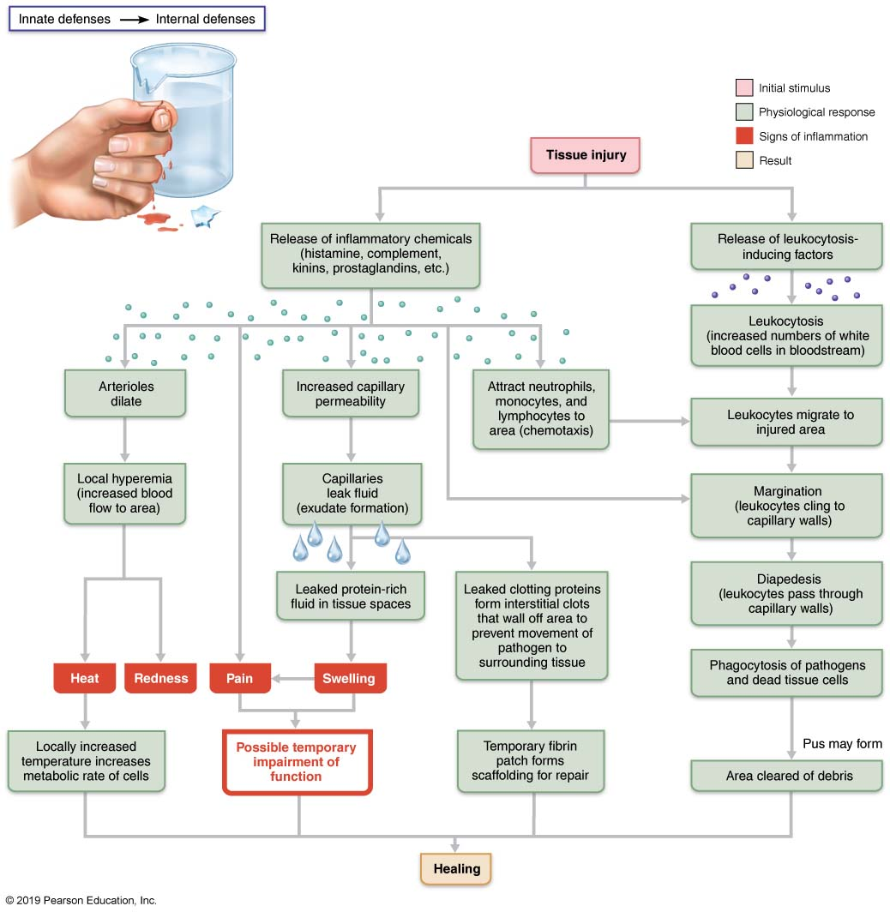
Events of Acute Inflammation
Figure 21.4 Events of acute inflammation.

Slide 42
Clinical – Homeostatic Imbalance 21.1
Pus: creamy yellow mixture of dead neutrophils, tissue/cells, and living/dead pathogens
Abscess: collagen fibers are laid down, walling off sac of pus; may need to be surgically drained
Some bacteria, such as tuberculosis bacilli, resist digestion by macrophages and remain alive inside
Can form tumorlike growths called granulomas—area of infected macrophages surrounded by uninfected macrophages and outer capsule
Bacteria may remain inactive forever, or if person’s immunity decreases, may break free, become activated, and cause disease

Slide 43
Antimicrobial Proteins (1 of 10)
Antimicrobial proteins enhance innate defense by:
Attacking microorganisms directly, or
Hindering microorganisms’ ability to reproduce
Most important antimicrobial proteins
Interferons
Complement proteins

Slide 44
Antimicrobial Proteins (2 of 10)
Interferons
Interferons (IFN): family of immune modulating proteins
Cells infected with viruses can secrete IFNs that “warn” healthy neighboring cells
IFNs enter neighboring cells, stimulating production of proteins that block viral reproduction and degrade viral RNA
IFN type α (alpha) and β (beta) work this way
IFN-α and IFN-β also activate NK cells

Slide 45
Antimicrobial Proteins (3 of 10)
Interferons (cont.)
IFN-γ (gamma, also called immune interferon):
Is secreted by lymphocytes
Has widespread immune mobilizing effects
Activates macrophages
IFNs activate NK cells and macrophages, so they indirectly fight cancer
Artificial IFNs are used to treat disorders such as hepatitis C, genital warts, and multiple sclerosis

Slide 46
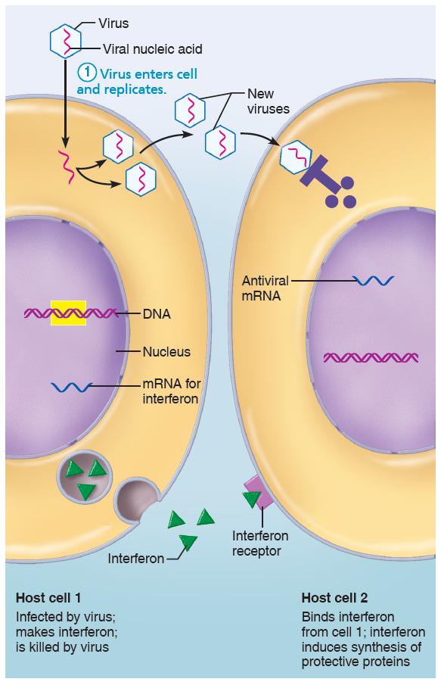
The Interferon Mechanism Against Viruses (1 of 5)
Figure 21.5 The interferon mechanism against viruses.

Slide 47
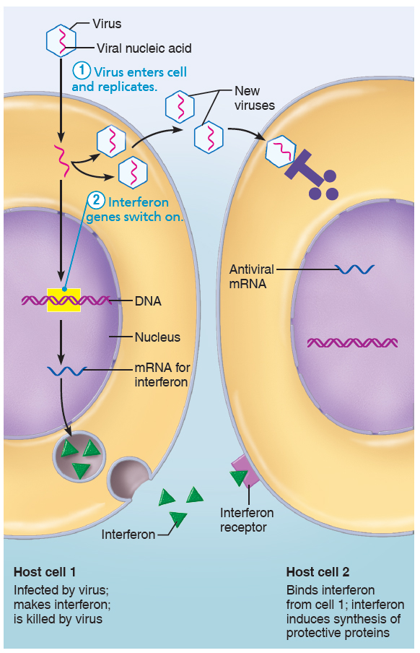
The Interferon Mechanism Against Viruses (2 of 5)
Figure 21.5 The interferon mechanism against viruses.

Slide 48
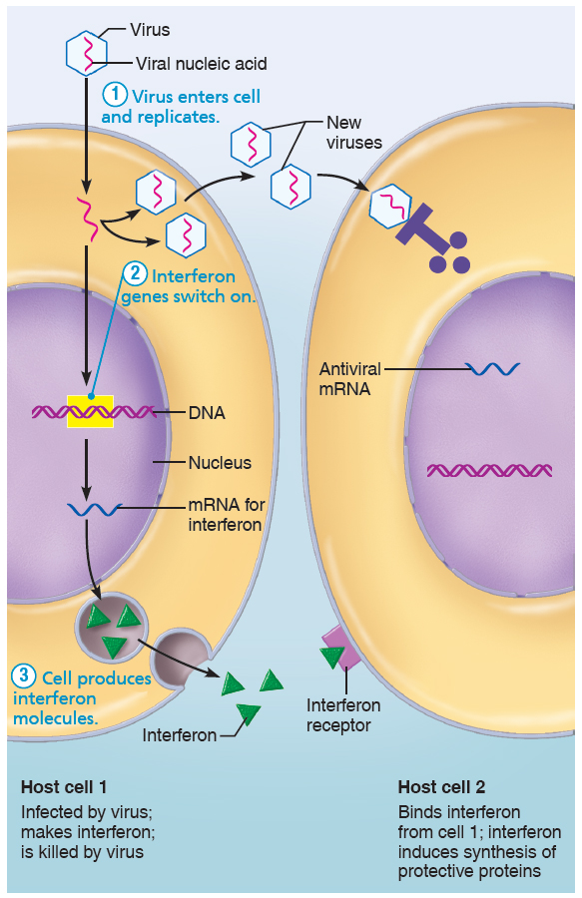
The Interferon Mechanism Against Viruses (3 of 5)
Figure 21.5 The interferon mechanism against viruses.

Slide 49
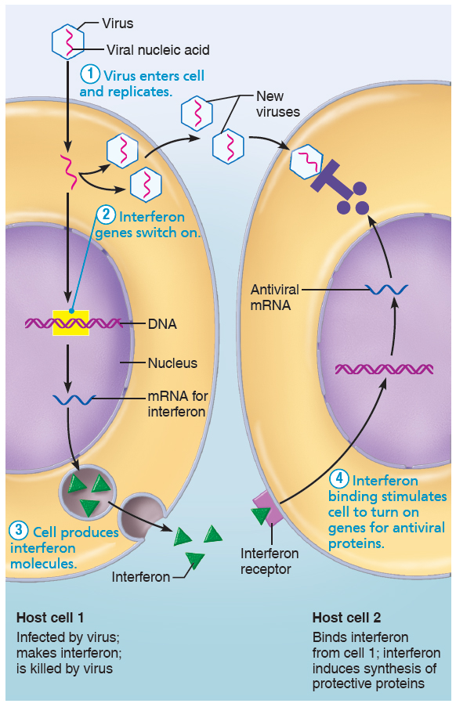
The Interferon Mechanism Against Viruses (4 of 5)
Figure 21.5 The interferon mechanism against viruses.

Slide 50
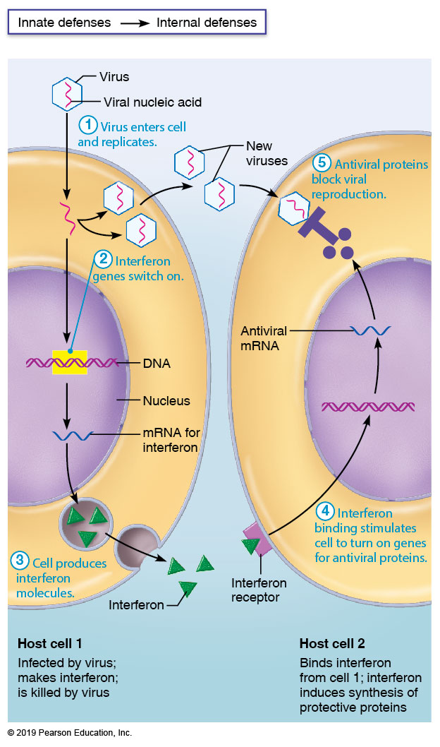
The Interferon Mechanism Against Viruses (5 of 5)
Figure 21.5 The interferon mechanism against viruses.

Slide 51
Antimicrobial Proteins (4 of 10)
Complement
Complement system consists of ~20 blood proteins that circulate in blood in inactive form
Includes proteins C1–C9, factors B, D, and P, and regulatory proteins
Provides major mechanism for destroying foreign substances
Activation enhances inflammation and also directly destroys bacteria
Enhances both innate and adaptive defenses

Slide 52
Antimicrobial Proteins (5 of 10)
Complement (cont.)
Complement system can be activated by three different pathways:
Classical pathway
Antibodies first bind to invading organisms and then bind to complement components, activating them
Double binding called complement fixation
Once initial complement proteins are activated, an activation cascade is triggered

Slide 53
Antimicrobial Proteins (6 of 10)
Complement (cont.)
Lectin pathway
Lectins are produced by innate system to recognize foreign invaders
When lectin is bound to specific sugars on foreign invaders, it can also bind and activate complement
Alternative pathway
Complement cascade is activated spontaneously when certain complement factors bind directly to foreign invader
Lack of inhibitors on microorganism’s surface allows process to proceed

Slide 54
Antimicrobial Proteins (7 of 10)
Complement (cont.)
Each pathway involves activation of proteins in an orderly sequence
Each step catalyzes the next, in cascade fashion
Each pathway converges on C3, which cleaves into C3a and C3b
Splitting C3 initiates common terminal pathway that enhances inflammation, promotes phagocytosis, and causes cell lysis

Slide 55
Antimicrobial Proteins (8 of 10)
Complement (cont.)
Cell lysis begins when:
C3b binds to target cell, triggering insertion of complement proteins called membrane attack complex (MAC) into cell’s membrane
MAC forms and stabilizes hole in membrane of microbe, causing influx of water and lysis of microbe

Slide 56
Antimicrobial Proteins (9 of 10)
Complement (cont.)
C3b also causes opsonization
C3a and other complement protein cleavage products amplify inflammation by:
Stimulating mast cells and basophils to release histamine
Attracting neutrophils and other inflammatory cells

Slide 57
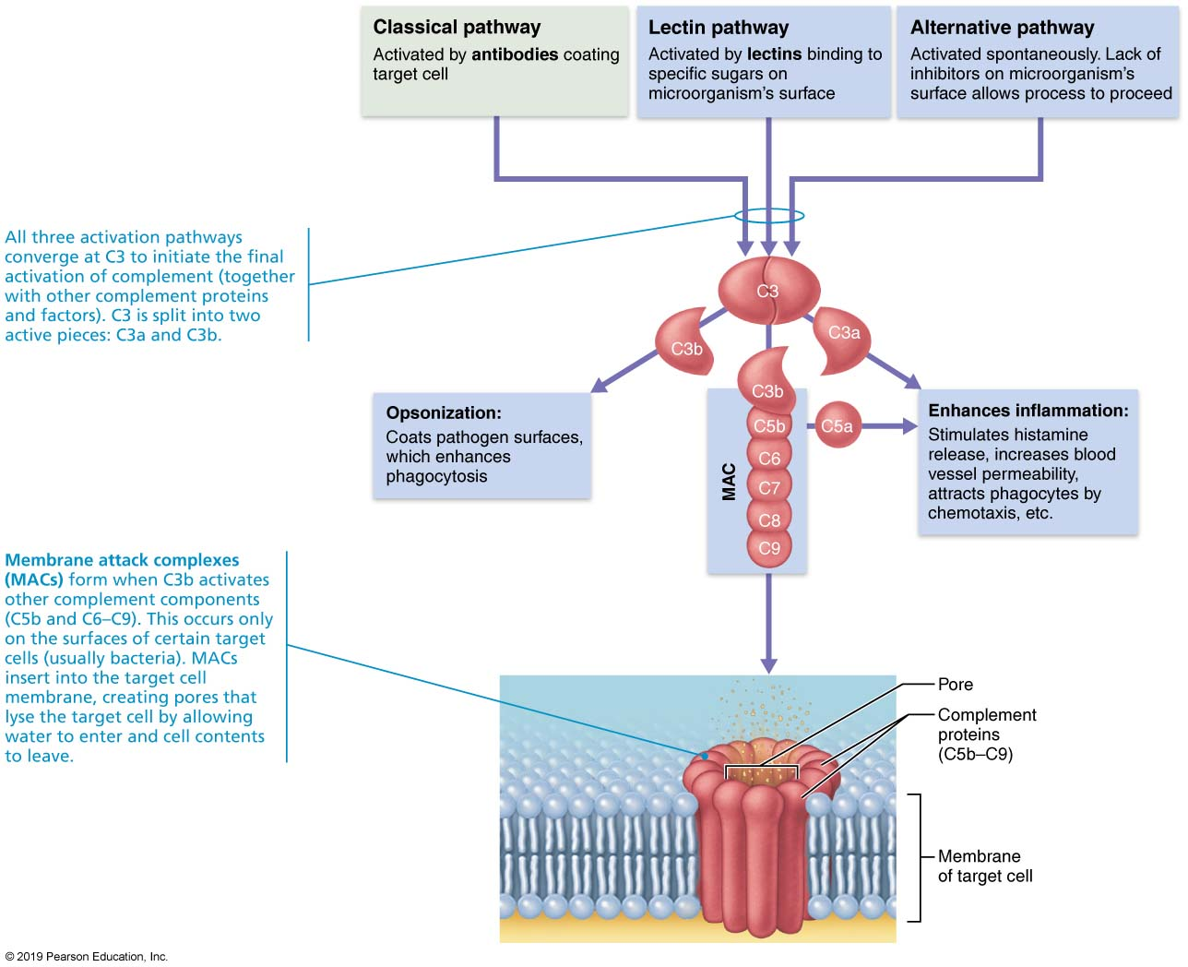
Complement Activation
Figure 21.6 Complement activation.

Slide 58
Antimicrobial Proteins (10 of 10)
Fever
Abnormally high body temperature that is systemic response to invading microorganisms
Leukocytes and macrophages exposed to foreign substances secrete pyrogens
Pyrogens act on body’s thermostat in hypothalamus, raising body temperature
Benefits of moderate fever
Causes liver and spleen to sequester iron and zinc (needed by microorganisms)
Increases metabolic rate, which increases rate of repair

Slide 59
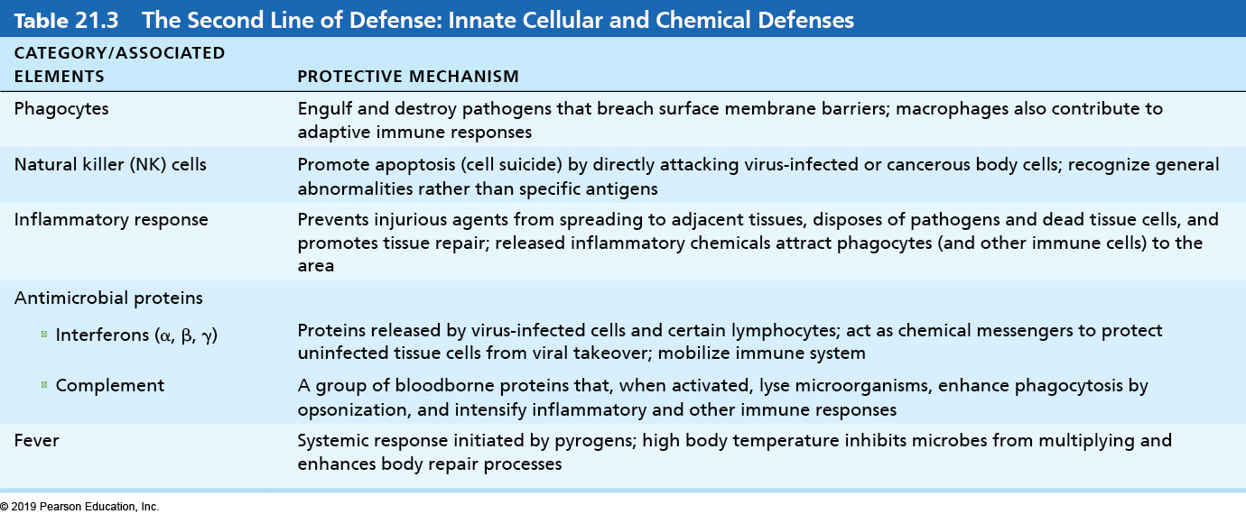
Table 21.3 The Second Line of Defense: Innate Cellular and Chemical Defenses
Table 21.3 The Second Line of Defense: Innate Cellular and Chemical Defenses

Slide 60
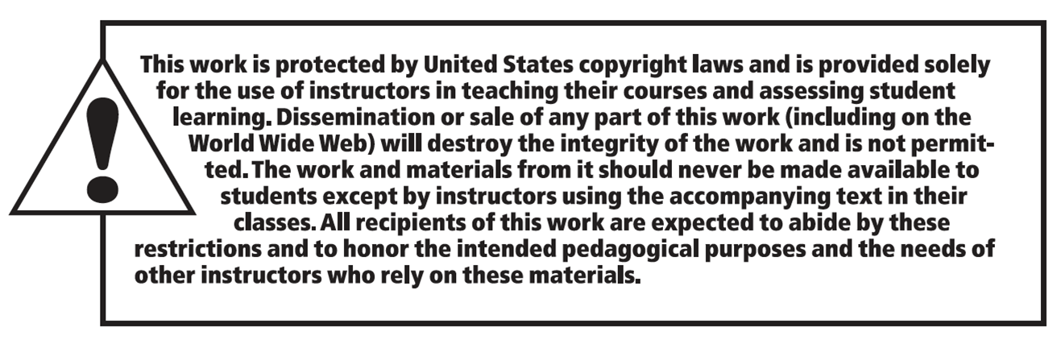
Copyright

