Slide 1

Human Anatomy and Physiology
Eleventh Edition
Chapter 20
The Lymphatic System and Lymphoid Organs and Tissues
PowerPoint® Lectures Slides prepared by Karen Dunbar Kareiva, Ivy Tech Community College
Copyright © 2019, 2016, 2013 Pearson Education, Inc. All Rights Reserved

Slide 2
Why This Matters
Understanding the structure and function of the lymph nodes allows you to evaluate a patient for signs of infection

Slide 3
Video: Why This Matters (Career Connection)
Click here to view ADA compliant video:
Why This Matters (Career Connection)
https://mediaplayer.pearsoncmg.com/assets/secs_wtm_ch_20_christian_v2

Slide 4
Lymphatic System and Lymphoid Organs and Tissues
Lymphatic system returns fluids leaked from blood vessels back to blood; consists of three parts
Network of lymphatic vessels (lymphatics)
Lymph: fluid in vessels
Lymph nodes: cleanse lymph
Lymphoid organs and tissues provide structural basis of immune system by housing phagocytic cells and lymphocytes
Structures include spleen, thymus, tonsils, lymph nodes, other lymphoid tissues

Slide 5
20.1 Lymphatic System
Lymphatic system returns interstitial fluid and leaked plasma proteins back to blood via:
Lymphatic vessels (lymphatics): elaborate network of drainage vessels
Circulates ~ 3L interstitial fluid per day
Once interstitial fluid enters lymphatics, it is called lymph

Slide 6
Distribution and Structure of Lymphatic Vessels (1 of 6)
Lymphatic vessels offer a one-way system, ensuring lymph flows only toward heart
Lymph vessels (lymphatics) include lymphatic capillaries and larger lymphatic vessels
Lymphatic capillaries
Blind-ended vessels that weave between tissue cells and blood capillaries
Absent from bones, teeth, and bone marrow
Once thought to be absent from CNS, but now found to be present but limited to locations in meninges where they help to drain interstitial fluid and CSF.

Slide 7
Distribution and Structure of Lymphatic Vessels (2 of 6)
Lymphatic capillaries (cont.)
Similar to blood capillaries, but more permeable
Can take up larger molecules and particles that blood capillaries cannot
Example: proteins, cell debris, pathogens, and cancer cells
Can act as route for pathogens or cancer cells to travel throughout body

Slide 8
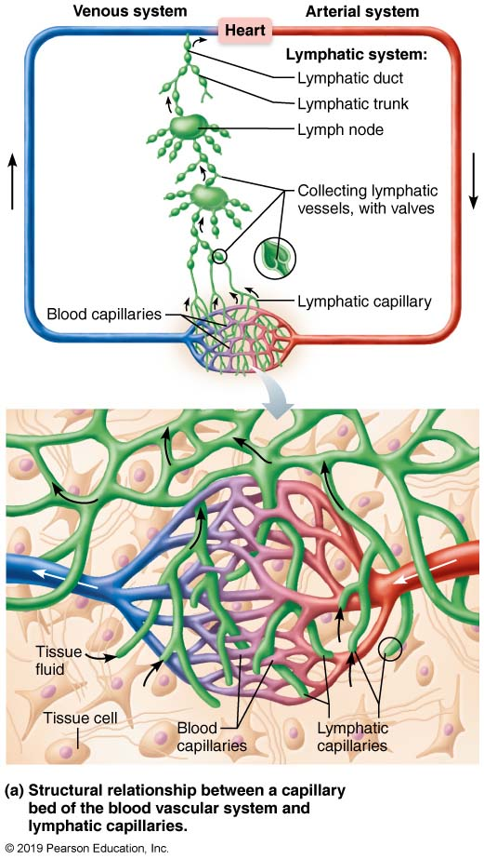
Distribution and Special Features of Lymphatic Capillaries (1 of 2)
Figure 20.1a Distribution and special features of lymphatic capillaries.

Slide 9
Distribution and Structure of Lymphatic Vessels (3 of 6)
Lymphatic capillaries (cont.)
Increased permeability due to two specialized structures
Endothelial cells overlap loosely to form one-way minivalves
Minivalves are anchored by collagen filaments to matrix, so increases in ECF volume opens minivalves even more
Decreases in ECF cause minivalves to close
Lacteals: specialized lymph capillaries present in intestinal mucosa
Absorb digested fat and deliver fatty lymph (chyle) to the blood

Slide 10
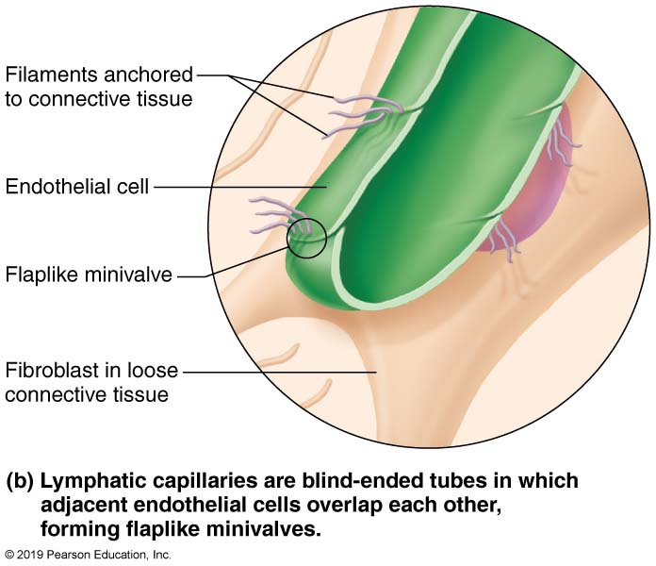
Distribution and Special Features of Lymphatic Capillaries (2 of 2)
Figure 20.1b Distribution and special features of lymphatic capillaries.

Slide 11
Distribution and Structure of Lymphatic Vessels (4 of 6)
Larger lymphatic vessels
Lymph capillaries drain into increasingly larger vessels called collecting lymphatic vessels
Consist of collecting vessels, trunks, and ducts
Have structures and tunics similar to veins, except:
Have thinner walls, with more internal valves
Anastomose more frequently
Collecting vessels in skin travel with superficial veins, but deep vessels travel with arteries

Slide 12
Distribution and Structure of Lymphatic Vessels (5 of 6)
Larger lymphatic vessels (cont.)
Lymphatic trunks, which are formed by union of largest collecting vessels, drain large areas of body
Named for regions of body they drain:
Paired lumbar
Paired bronchomediastinal
Paired subclavian
Paired jugular trunks
Single intestinal trunk

Slide 13
Distribution and Structure of Lymphatic Vessels (6 of 6)
Lymph is delivered from trunks into one of two large lymphatic ducts
Right lymphatic duct drains right upper arm and right side of head and thorax
Thoracic duct drains rest of body
In about half of individuals, starts out as an enlarged sac, cisterna chyli
Each empties lymph into venous circulation at junction of internal jugular and subclavian veins on its own side of body

Slide 14
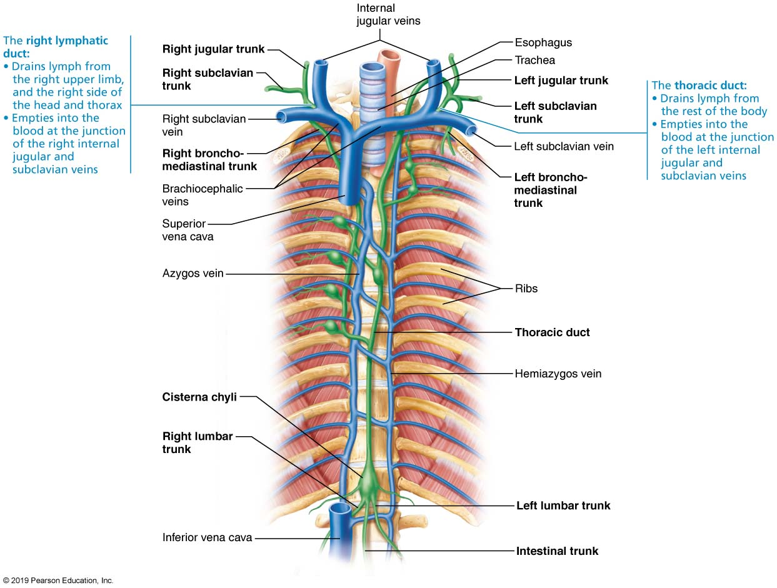
Major Lymphatic Trunks and Ducts
Figure 20.2 Major lymphatic trunks and ducts.

Slide 15
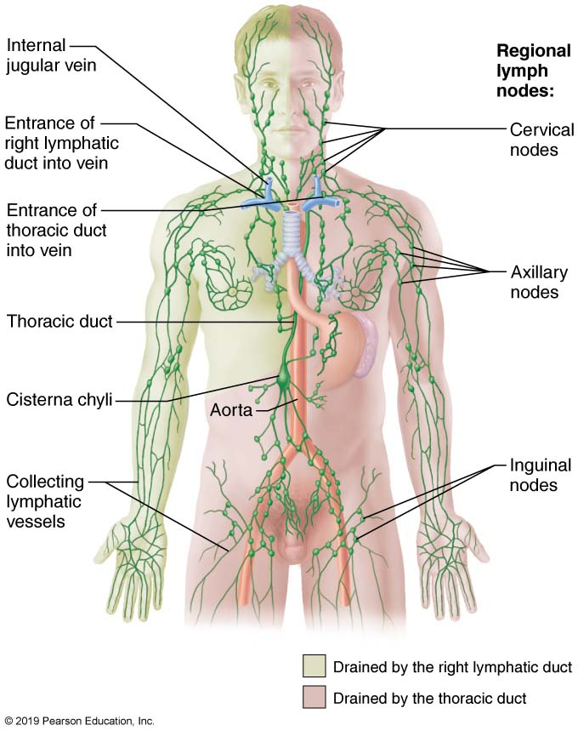
The Lymphatic System (1 of 2)
Figure 20.3 The lymphatic system.

Slide 16
Clinical – Homeostatic Imbalance 20.1
Lymphangitis: condition in which lymphatic vessels appear as painful red lines under the skin
Caused by inflammation of larger lymphatic vessels that contain vaso vasora
Vaso vasora become congested with blood
Larger lymphatics, like blood vessels, receive their nutrients from branching vasa vasorum

Slide 17
Lymph Transport
Lymph system is a low-pressure system like venous system
Lymph is propelled by same mechanisms:
Milking action of skeletal muscle
Pressure changes in thorax during breathing
Valves to prevent backflow
Pulsations of nearby arteries
Contractions of smooth muscle in walls of lymphatics
Physical activity increases flow of lymph; immobilization of area keeps needed inflammatory material in area for faster healing

Slide 18
Clinical – Homeostatic Imbalance 20.2
Lymphedema: severe localized edema
Caused by anything that prevents normal return of lymph to blood
Examples: tumors blocking lymphatics or removal of lymphatics during cancer surgery
Lymphedema may improve if some lymphatic pathways remain and enlarge

Slide 19
20.2 Lymphoid Cells, Tissues, and Organs

Slide 20
Lymphoid Cells (1 of 3)
Lymphoid cells consist of (1) immune system cells found in lymphoid tissue and (2) supporting cells that form lymphoid tissue structures
Immune system cells
Lymphocytes: cells of the adaptive immune system; mature into one of two main types
T cells (T lymphocytes)
B cells (B lymphocytes)

Slide 21
Lymphoid Cells (2 of 3)
Immune system cells (cont.)
T cells and B cells protect against antigens (anything the body perceives as foreign)
Examples: bacteria, toxins, viruses, mismatched RBCs, cancer cells
T cells: manage immune response, and some also attack and destroy infected cells
B cells: produce plasma cells, which secrete antibodies
Antibodies mark antigens for destruction by phagocytosis or other means

Slide 22
Lymphoid Cells (3 of 3)
Immune system cells (cont.)
Other lymphoid immune cells
Macrophages phagocytize foreign substances and help activate T cells
Dendritic cells capture antigens and deliver them to lymph nodes; also help activate T cells
Supporting lymphoid cell
Reticular cells produce reticular fibers called stroma in lymphoid organs
Stroma: network-like support that acts as scaffolding for immune cells

Slide 23
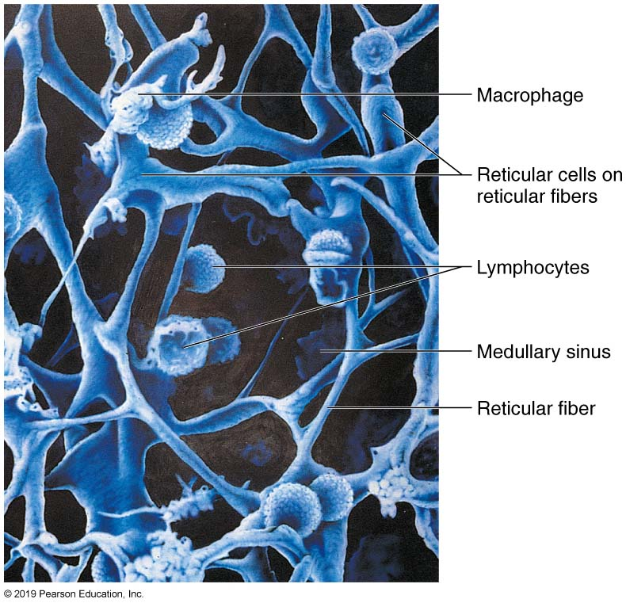
Reticular Connective Tissue in a Human Lymph Node
Figure 20.4 Reticular connective tissue in a human lymph node.

Slide 24
Lymphoid Tissue
Main functions of lymphoid tissue
Houses and provides proliferation sites for lymphocytes
Offers surveillance vantage points for lymphocytes and macrophages as they filter through lymph
Largely composed of reticular connective tissue, a type of loose connective tissue
Macrophages live on reticular fibers
Spaces between fibers offer a place for lymphocytes to occupy when they return from patrolling body

Slide 25
Lymphoid Organs (1 of 6)
Two main types of lymphoid tissues
Diffuse lymphoid tissue: loose arrangement of lymphoid cells and some reticular fibers
Found in virtually every body organ
Larger collections in lamina propria of mucous membranes

Slide 26
Lymphoid Organs (2 of 6)
Two main types of lymphoid tissues (cont.)
Lymphoid follicles (nodules): solid, spherical bodies consisting of tightly packed lymphoid cells and reticular fibers
Contain germinal centers of proliferating B cells
May form part of larger lymphoid organs (nodes)
Isolated aggregations of Peyer’s patches and in appendix

Slide 27
Lymphoid Organs (3 of 6)
Lymphoid organs are grouped into two functional categories
Primary lymphoid organs: areas where T and B cells mature—red bone marrow and thymus
T and B cells originate in bone marrow, but only B cells matures there; T cells mature in thymus
Secondary lymphoid organs: areas where mature lymphocytes first encounter their antigen and become activated
Nodes, spleen, MALT (mucosa-associated lymphoid tissue) and diffuse lymphoid tissues

Slide 28
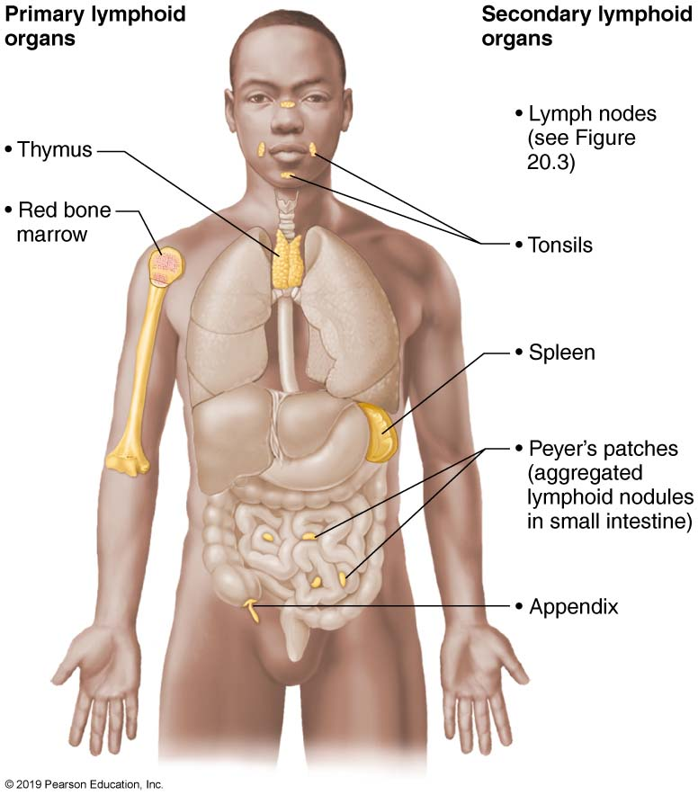
Lymphoid Organs (4 of 6)
Figure 20.5 Lymphoid organs.

Slide 29
20.3 Lymph Nodes (1 of 2)
Lymph nodes: principal secondary lymphoid organs of body
Hundreds of nodes are found throughout body
Most are embedded deep in connective tissue in clusters along lymphatic vessels
Some are nearer to body surface in inguinal, axillary, and cervical regions of body where collecting vessels converge into trunks

Slide 30
The Lymphatic System (2 of 2)
Figure 20.3 The lymphatic system.

Slide 31
20.3 Lymph Nodes (2 of 2)
Two main functions of lymph nodes
Cleansing the lymph: act as lymph “filters”
Macrophages remove and destroy microorganisms and debris that enter lymph
Prevent unwanted substances from being delivered to blood
Immune system activation: offer a place for lymphocytes to become activated and mount an attack against antigens

Slide 32
Structure of a Lymph Node (1 of 3)
Vary in shape and size, but most are bean shaped
Small, less than 2.5 cm (~1 inch)
Surrounded by external fibrous capsule
Capsule fibers extend inward as trabeculae that divide node into compartments
Two histologically distinct regions of node:
Cortex
Medulla

Slide 33
Structure of a Lymph Node (2 of 3)
Cortex
Superficial area of cortex contains follicles with germinal centers that are heavy with dividing B cells
Deep cortex houses T cells in transit
T cells circulate continuously among blood, lymph nodes, and lymph
Abundant numbers of dendritic cells are closely associated with both T and B cells
Play a role in activating both lymphocytes

Slide 34
Structure of a Lymph Node (3 of 3)
Medulla
Medullary cords extend inward from cortex and contain B cells, T cells, and plasma cells
Lymph sinuses are found throughout node
Consist of large lymphatic capillaries spanned by crisscrossing reticular fibers
Macrophages reside on fibers, checking for and phagocytizing any foreign matter

Slide 35
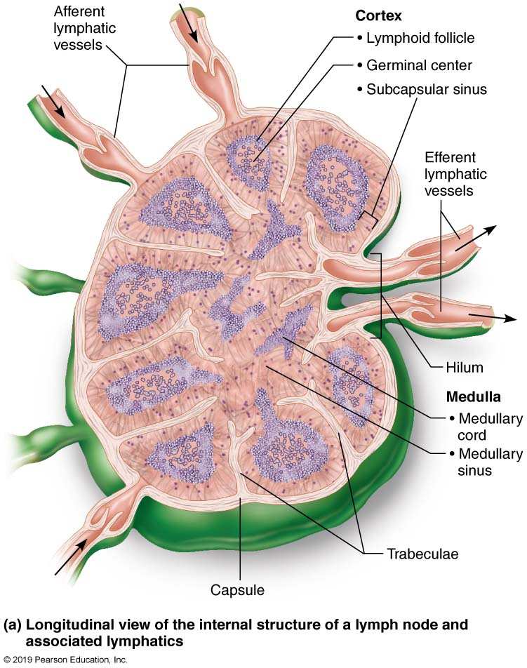
Lymph Node (1 of 3)
Figure 20.6a Lymph node.

Slide 36
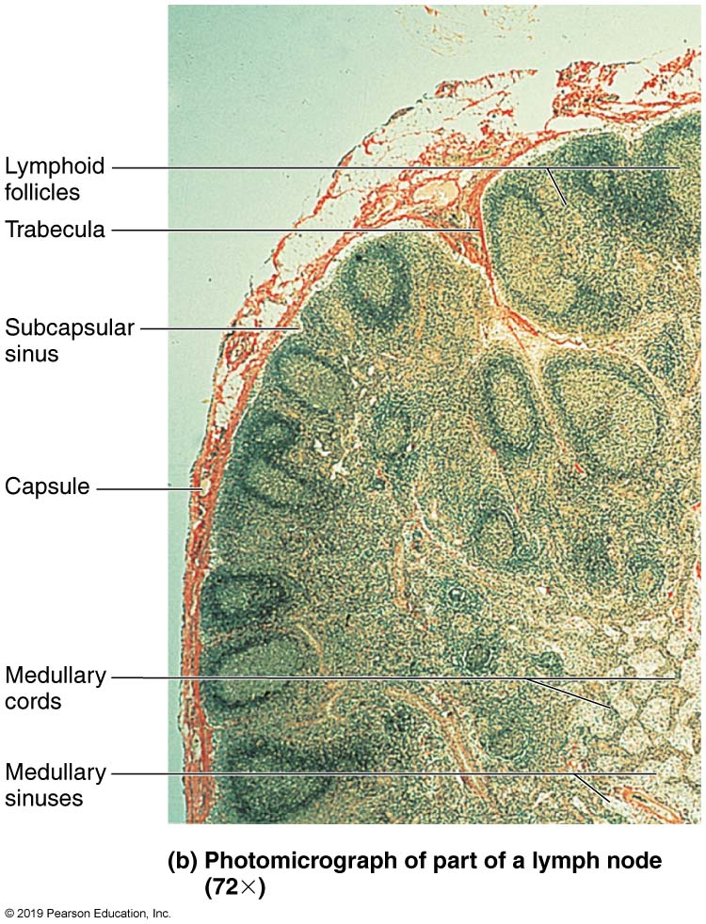
Lymph Node (2 of 3)
Figure 20.6b Lymph node.

Slide 37
Circulation in the Lymph Nodes
Lymph enters convex side of node via afferent lymphatic vessels
Travels through large subcapsular sinus and then into smaller sinuses found throughout cortex and medulla
Lymph then enters medullary sinuses
Finally exits concave side at hilum via efferent lymphatic vessels
Presence of fewer efferent vessels causes flow to somewhat stagnate; allows lymphocytes and macrophages time to function
Lymph travels through several nodes

Slide 38
Lymph Node (3 of 3)
Figure 20.6a Lymph node.

Slide 39
Clinical – Homeostatic Imbalance 20.3 (1 of 2)
Buboes: inflamed, swollen, tender lymph nodes that result when nodes are overwhelmed by what they are trying to destroy
Condition often referred to as swollen “glands”
Buboes are sometimes pus-filled
Bubonic plague was named after chief clinical feature of this disease

Slide 40
Clinical – Homeostatic Imbalance 20.3 (2 of 2)
Lymph nodes can become secondary cancer sites if metastasizing cancer cells become trapped in node
Cancer-infiltrated lymph nodes are swollen but usually not painful, a fact that helps distinguish cancerous nodes from those infected by microorganisms

Slide 41
20.4 Spleen (1 of 3)
Spleen is blood-rich organ about size of fist, located in left side of abdominal cavity, just below stomach
Largest lymphoid organ
Served by splenic artery and vein, which enter and exit at the hilum
Functions
Site of lymphocyte proliferation and immune surveillance and response
Cleanses blood of aged blood cells and platelets; macrophages remove debris

Slide 42
Lymphoid Organs (5 of 6)
Figure 20.5 Lymphoid organs.

Slide 43
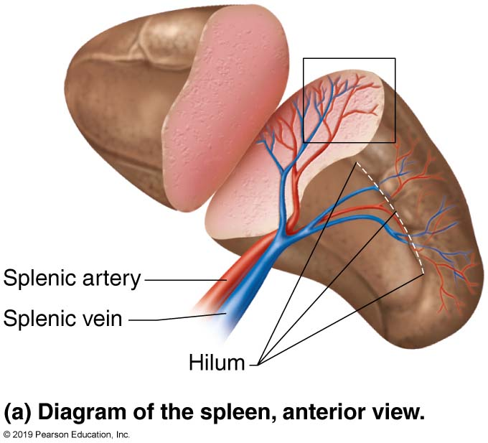
The Spleen (1 of 4)
Figure 20.7a The spleen.

Slide 44
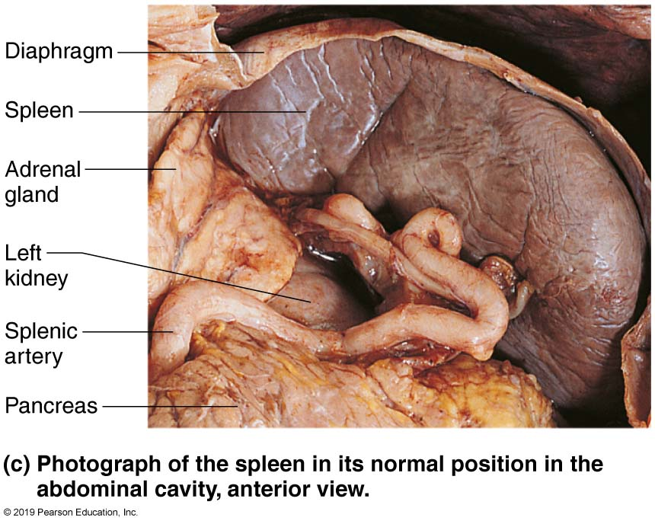
The Spleen (2 of 4)
Figure 20.7c The spleen.

Slide 45
20.4 Spleen (2 of 3)
Three additional functions of spleen:
Stores breakdown products of RBCs (e.g., iron) for later reuse
Stores blood platelets and monocytes for release into blood when needed
May be site of fetal erythrocyte production
Spleen is encased by fibrous capsule and also has trabeculae
Histologically, consists of two components
White pulp
Red pulp

Slide 46
20.4 Spleen (3 of 3)
White pulp: site where immune function occurs
Contains mostly lymphocytes on reticular fibers
White pulp clusters are found around central arteries; appear as islands of white in a sea of red pulp
Red pulp: site where old blood cells and bloodborne pathogens are destroyed
Rich in RBCs and macrophages that engulf them
Composed of splenic cords (reticular tissue) that separate blood-filled splenic sinusoids (venous sinuses)

Slide 47
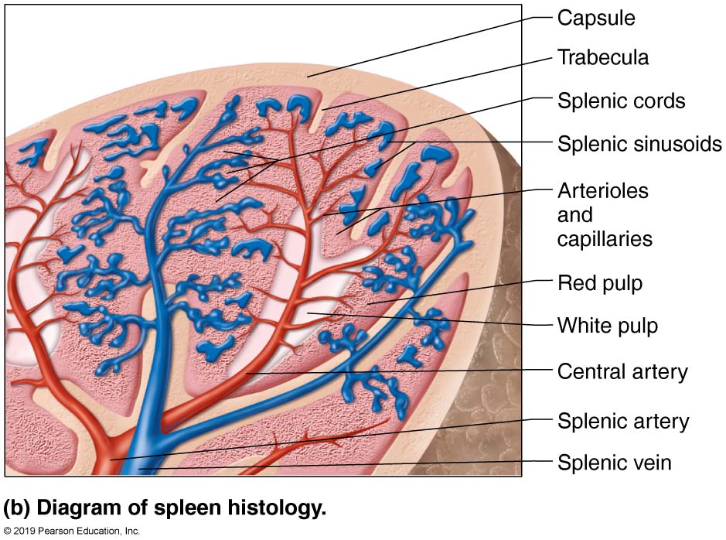
The Spleen (3 of 4)
Figure 20.7b The spleen.

Slide 48
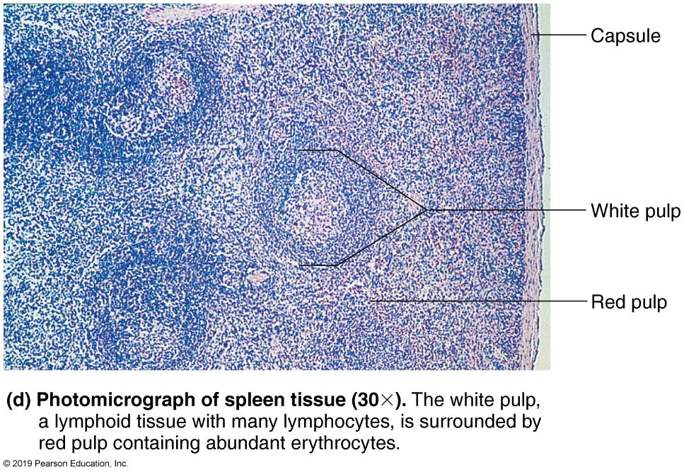
The Spleen (4 of 4)
Figure 20.7d The spleen.

Slide 49
Clinical – Homeostatic Imbalance 20.4 (1 of 2)
The spleen has a thin capsule, so direct blow or severe infection may cause it to rupture, spilling blood into peritoneal cavity
Splenectomy: surgical removal of ruptured spleen
Once standard treatment to prevent hemorrhage and shock, but has been discovered spleen can often repair itself
Frequency of emergency splenectomies has decreased dramatically

Slide 50
Clinical – Homeostatic Imbalance 20.4 (2 of 2)
Splenectomy (cont.):
If spleen must be removed, liver and bone marrow take over most of its functions
In children younger than 12, spleen will regenerate if a small part is left

Slide 51
20.5 MALT
Mucosa-associated lymphoid tissue (MALT)
Lymphoid tissues in mucous membranes throughout body
Protects from pathogens trying to enter body
Found in mucosa of respiratory tract, genitourinary organs, and digestive tract; largest collections of MALT found in
Tonsils
Peyer’s patches
Appendix

Slide 52
Tonsils (1 of 2)
Simplest lymphoid organs
Form ring of lymphatic tissue around pharynx; appear as swellings of mucosa
Named according to location
Palatine tonsils: at posterior end of oral cavity
Largest of tonsils and most often infected
Lingual tonsil: lumpy collection of follicles at base of tongue
Pharyngeal tonsil: also called adenoids; located in posterior wall of nasopharynx
Tubal tonsils: surround openings of auditory tubes into pharynx

Slide 53
Tonsils (2 of 2)
Tonsils function is to gather and remove pathogens in food or air
Contain follicles with germinal centers and scattered lymphocytes
Are not fully encapsulated
Overlying epithelium invaginates, forming tonsillar crypts
Bacteria or particulate matter enters crypts, where they are trapped and destroyed
Risky to lure bacteria into tissues, but allows immune cells to become activated and build memory cells against these potential pathogens

Slide 54
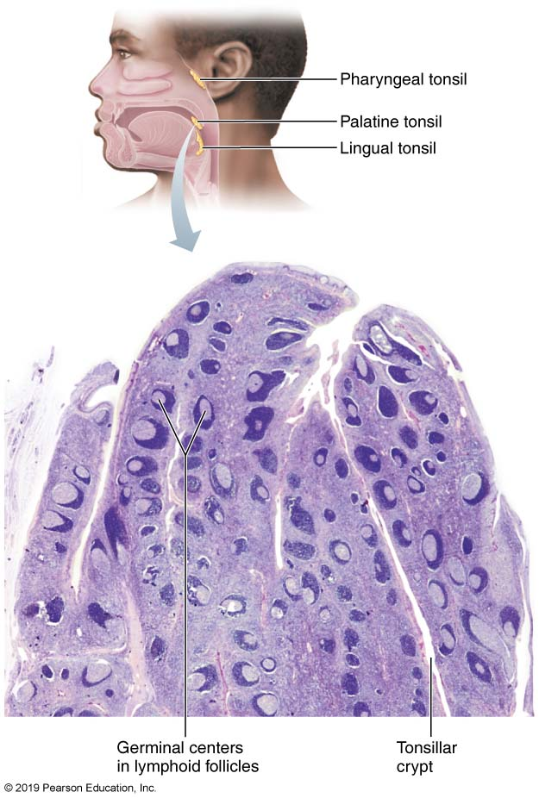
Histology of the Palatine Tonsil
Figure 20.8 Histology of the palatine tonsil.

Slide 55
Peyer’s Patches
Peyer’s patches: clusters of lymphoid follicles in wall of distal portion of small intestine
Also called aggregated lymphoid nodules
Structurally similar to tonsils
Location aids in functions
Destroy bacteria, preventing them from breaching intestinal wall
Generate “memory” lymphocytes

Slide 56
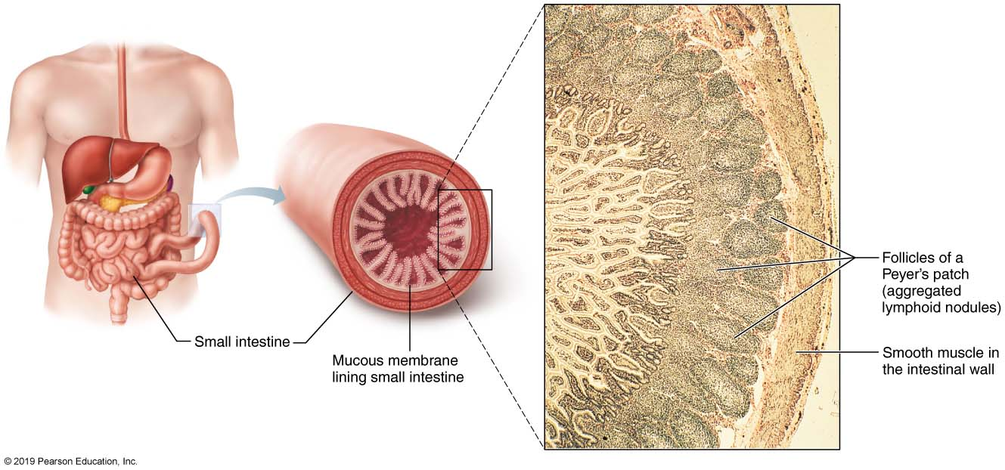
Peyer’s Patch (Aggregated Lymphoid Nodules)
Figure 20.9 Peyer’s patch (aggregated lymphoid nodules).

Slide 57
Appendix
Appendix: offshoot of first part of large intestine
Contains a large number of lymphoid follicles
Location aids in functions (like Peyer’s patches)
Destroy bacteria, preventing them from breaching intestinal wall
Generate “memory” lymphocytes

Slide 58
Lymphoid Organs (6 of 6)
Figure 20.5 Lymphoid organs.

Slide 59
20.6 Thymus (1 of 3)
Thymus: bilobed lymphoid organ found in inferior neck
Extends into mediastinum and partially overlies heart
Functions as lymphoid organ where T cells mature
Most active and largest in size during childhood
Stops growing during adolescence, then gradually atrophies
Still produces immunocompetent cells, though more slowly

Slide 60
20.6 Thymus (2 of 3)
Thymus is broken into lobules that contain outer cortex and inner medulla
Cortex contains rapidly dividing lymphocytes (the bulk of thymic cells) and scattered macrophages
Medulla contains fewer lymphocytes and thymic corpuscles
Thymic corpuscles are where regulatory T cells develop
Regulatory T cells: type of T cell that helps to prevent autoimmunity

Slide 61
20.6 Thymus (3 of 3)
Thymus differs from other lymphoid organs in important ways
Has no follicles because it lacks B cells
Does not directly fight antigens
Functions strictly in T lymphocyte maturation
Contains blood thymus barrier: keeps immature T lymphocytes isolated from any antigens to prevent premature activation
Stroma is made up of epithelial cells, not reticular fibers
Provide environment in which T lymphocytes become immunocompetent

Slide 62
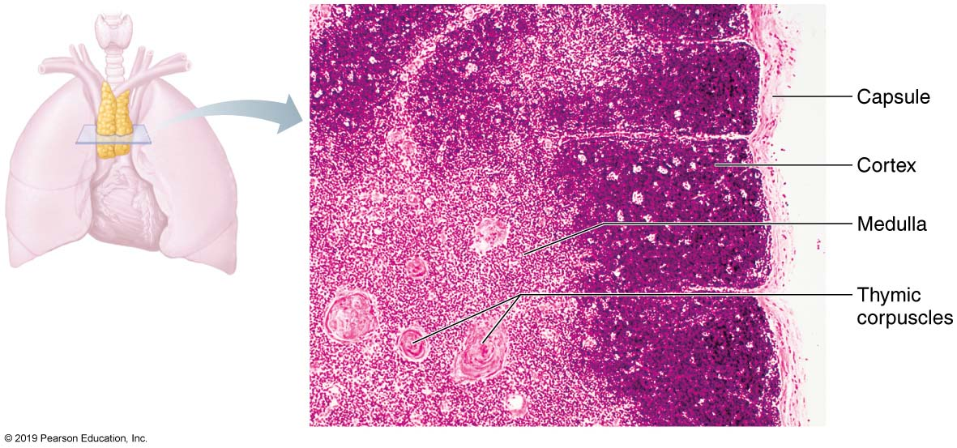
The Thymus
Figure 20.10 The thymus.

Slide 63
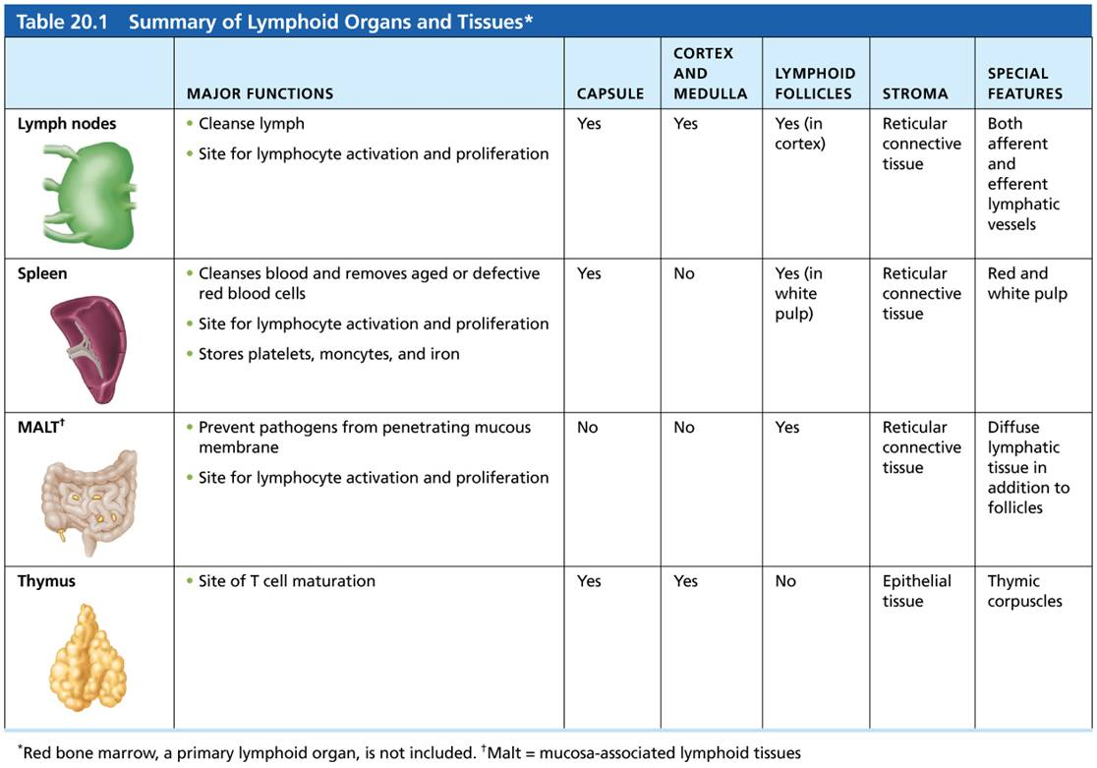
Table 20.1 Summary of Lymphoid Organs and Tissues
Table 20.1 Summary of Lymphoid Organs and Tissues.

Slide 64
IP Anatomy Review Animation: Immune
Click here to view ADA compliant Animation:
IP Anatomy Review Animation: Immune
https://mediaplayer.pearsoncmg.com/assets/secs-ipweb-immune-system-rev

Slide 65
Developmental Aspects of the Lymphatic System (1 of 2)
Beginnings of lymphatic vessels and main clusters of lymph nodes seen by week 5 of embryonic development
Arise as lymph sacs from developing veins
Jugular lymph sacs arise to form right lymphatic duct and thoracic duct
Lymphatic organs (except thymus) arise from mesoderm

Slide 66
Developmental Aspects of the Lymphatic System (2 of 2)
Lymphoid organs (except thymus) develop from mesodermal mesenchymal cells
Thymus (endodermal origin) forms as an outgrowth of pharynx
Except for spleen and tonsils, lymphoid organs are poorly developed at birth
After birth, high numbers of lymphocytes appear; their development parallels maturation of immune system

Slide 67
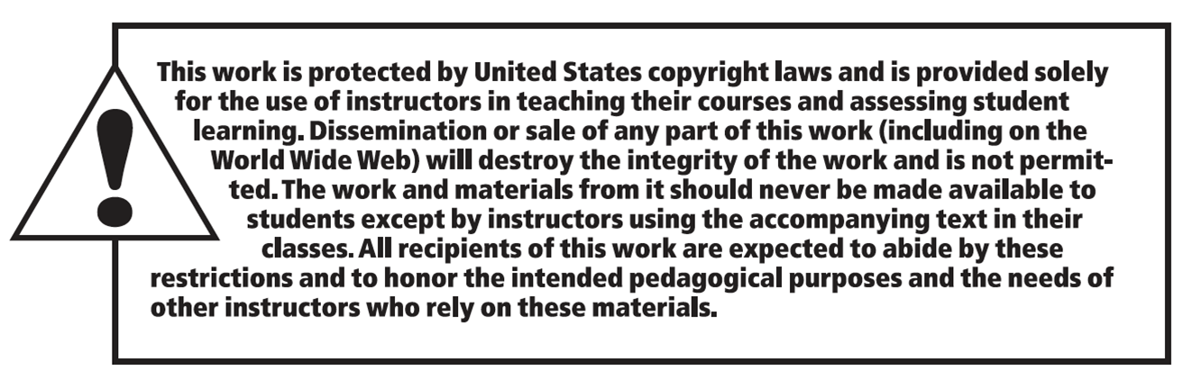
Copyright

