Slide 1
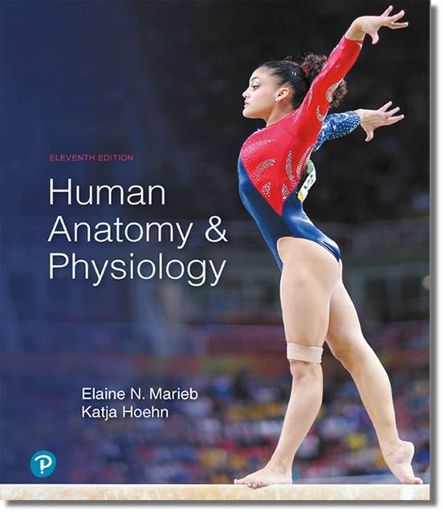
Human Anatomy and Physiology
Eleventh Edition
Chapter 19 Part C
The Cardiovascular System:
Blood Vessels
PowerPoint® Lectures Slides prepared by Karen Dunbar Kareiva, Ivy Tech Community College
Copyright © 2019, 2016, 2013 Pearson Education, Inc. All Rights Reserved

Slide 2
19.9 Control of Blood Flow (1 of 4)
Tissue perfusion: blood flow through body tissues; involved in:
  Delivery of O₂ and nutrients to, and removal of wastes from, tissue cells
  Gas exchange (lungs)
  Absorption of nutrients (digestive tract)
  Urine formation (kidneys)
Rate of flow is precisely right amount to provide proper function to that tissue or organ

Slide 3
19.9 Control of Blood Flow (2 of 4)
Rate of blood flow is controlled by extrinsic and intrinsic factors
  Extrinsic control: sympathetic nervous system and hormones control blood flow through whole body
    Act on arteriolar smooth muscle to reduce flow to regions that need it the least

Slide 4
19.9 Control of Blood Flow (3 of 4)
  Intrinsic control: Autoregulation (local) control of blood flow: blood flow is adjusted locally to meet specific tissue’s requirements
    Local arterioles that feed capillaries can undergo modification of their diameters
    Organs regulate own blood flow by varying resistance of own arterioles

Slide 5
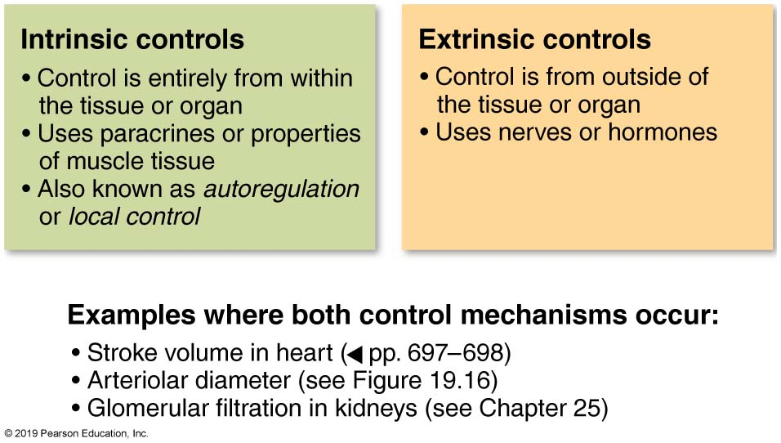
A Quick Summary of Intrinsic Versus Extrinsic Control Mechanisms
Figure 19.14 A quick summary of intrinsic versus extrinsic control mechanisms.

Slide 6
19.9 Control of Blood Flow (4 of 4)
  Example: redistribution of blood during exercise
    At rest, skeletal muscles receive about 20% of total blood in body, but during exercise, skeletal muscle can receive over 70% of blood
    Intrinsic controls: skeletal muscle arterioles dilate, increasing blood flow to muscle
    Extrinsic controls decrease blood flow to other organs such as kidneys and digestive organs
      MAP is maintained despite dilation of skeletal muscle arterioles

Slide 7
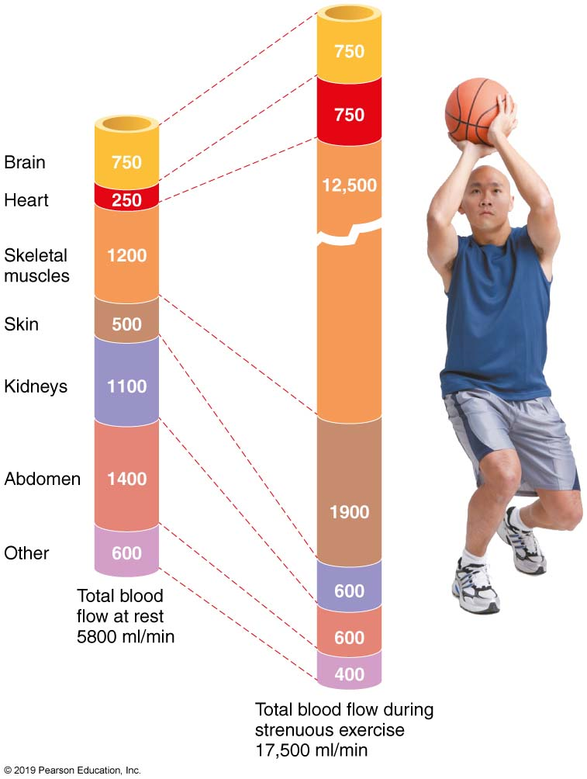
Distribution of Blood Flow at Rest and During Strenuous Exercise
Figure 19.15 Distribution of blood flow at rest and during strenuous exercise.

Slide 8
Autoregulation: Intrinsic (Local) Regulation of Blood Flow (1 of 5)
Autoregulation: local (intrinsic) conditions that regulate blood flow to that area
  Reactive hyperemia: increased blood flow to an area due to intrinsic factors
Two types of intrinsic mechanisms both determine final autoregulatory response
  Metabolic controls
  Myogenic controls

Slide 9
Autoregulation: Intrinsic (Local) Regulation of Blood Flow (2 of 5)
Metabolic controls
  Increase in tissue metabolic activities results in:
    Declining levels of O₂
    Increasing levels of metabolic products (H⁺, K⁺, adenosine, and prostaglandins)
  Effects of change in levels of local chemicals
    Cause direct relaxation of arterioles and relaxation of precapillary sphincters
    Cause release of nitric oxide (NO), a powerful vasodilator, by endothelial cells

Slide 10
Autoregulation: Intrinsic (Local) Regulation of Blood Flow (3 of 5)
Metabolic controls (cont.)
    Endothelins, also released from endothelium, are potent vasoconstrictors
    NO and endothelins are usually balanced unless blood flow is inadequate, in which case NO wins control, causing vasodilation
  Inflammatory chemicals can also cause vasodilation

Slide 11
Autoregulation: Intrinsic (Local) Regulation of Blood Flow (4 of 5)
Myogenic controls
  Myogenic responses: local vascular smooth muscle responds to changes in MAP to keep perfusion constant to avoid damage to tissue
    Passive stretch: increased MAP stretches vessel wall more than normal
      Smooth muscle responds by constricting, causing decreased blood flow to tissue
    Reduced stretch: decreased MAP causes less stretch than normal
      Smooth muscle responds by dilating, causing increased blood flow to tissue

Slide 12
Autoregulation: Intrinsic (Local) Regulation of Blood Flow (5 of 5)
Long-term autoregulation
  Occurs when short-term autoregulation cannot meet tissue nutrient requirements
    Long-term autoregulation may take weeks or months to increase blood supply
  Number of vessels to region increases (angiogenesis), and existing vessels enlarge
  Common in heart when coronary vessel occluded, or throughout body in people in
  high-altitude areas

Slide 13
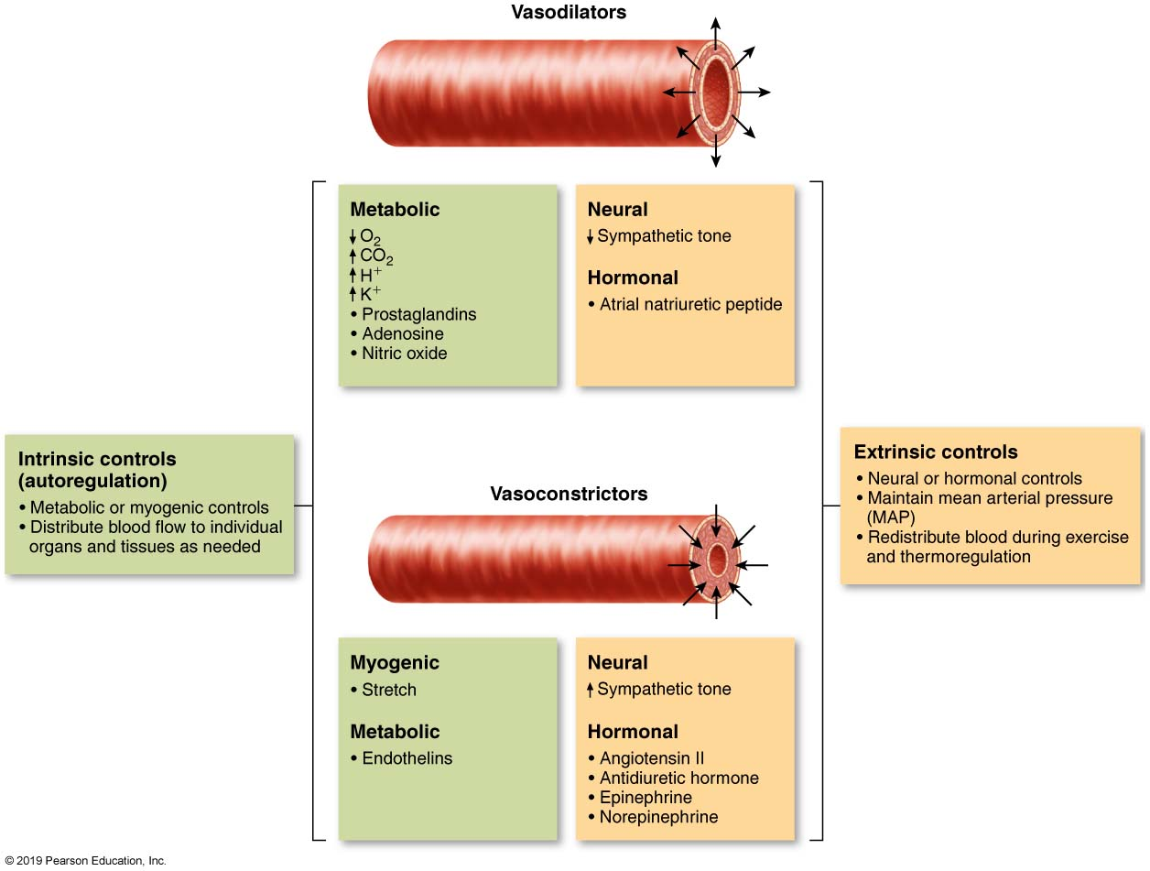
Intrinsic and Extrinsic Control of Arteriolar Smooth Muscle in the Systemic Circulation
Figure 19.16 Intrinsic and extrinsic control of arteriolar smooth muscle in the systemic circulation.

Slide 14
Blood Flow in Special Areas (1 of 9)
Skeletal muscles
  Blood flow varies with fiber type and activity
  At rest, myogenic and neural mechanisms predominate; maintain flow at ~1L /min
  Active or exercise hyperemia: during muscle activity, blood flow increases in direct proportion to metabolic activity
    Local controls override sympathetic vasoconstriction; flow can increase 10×

Slide 15
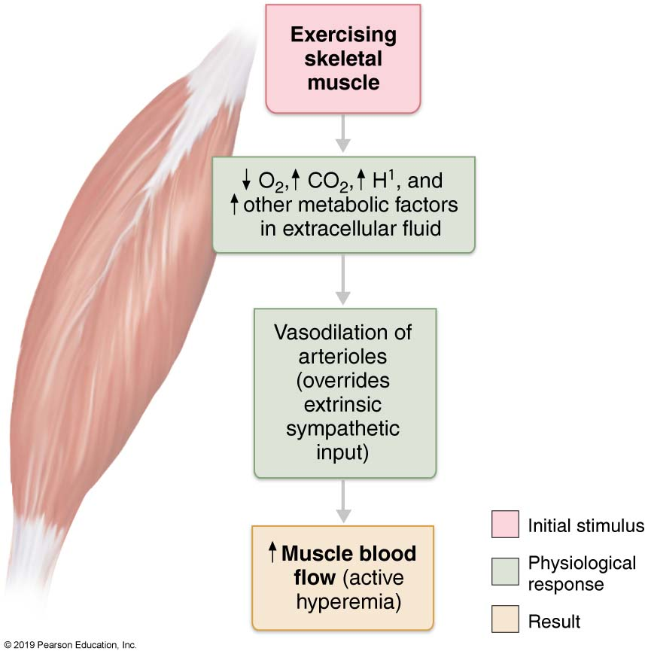
Active Hyperemia
Figure 19.17 Active hyperemia.

Slide 16
Blood Flow in Special Areas (2 of 9)
Brain
  Blood flow to brain must be constant because neurons are intolerant of ischemia
    Flow averages ~750 ml/min
  Control mechanisms
    Metabolic controls
      Decreased pH or increased carbon dioxide cause marked vasodilation
        Very high CO₂ levels depress autoregulatory mechanisms

Slide 17
Blood Flow in Special Areas (3 of 9)
Brain (cont.)
  Control mechanisms (cont.)
    Myogenic controls
      Decreased MAP causes cerebral vessels to dilate
      Increased MAP causes cerebral vessels to constrict
Brain vulnerable under extreme systemic pressure changes
  MAP below 60 mm Hg can cause syncope (fainting)
  MAP above 160 mm Hg can result in cerebral edema

Slide 18
Blood Flow in Special Areas (4 of 9)
Skin
  Functions of blood flow through skin
    Supplies nutrients to cells
      Autoregulated in response to O₂ needs
    Helps regulate body temperature
      Neurally controlled
      Important function of skin
    Provides a blood reservoir
      Also neurally controlled

Slide 19
Blood Flow in Special Areas (5 of 9)
Skin (cont.)
  Blood flow through venous plexuses below skin surface regulates body temperature
    Flow varies from 50 ml/min to 2500 ml/min, depending on body temperature
    Flow is controlled by sympathetic nervous system reflexes
      Reflexes initiated by temperature receptors and central nervous system

Slide 20
Blood Flow in Special Areas (6 of 9)
Skin (cont.)
  As temperature rises (e.g., from heat exposure, fever, vigorous exercise)
    Hypothalamic signals reduce vasomotor stimulation of skin vessels, causing dilation
    Warm blood flushes into capillary beds
    Heat radiates from skin
  As temperature decreases, blood is shunted to deeper, more vital organs
    Superficial skin vessels constrict strongly
    Blood in vessels may become trapped
      Causes rosy cheeks in cold

Slide 21
Blood Flow in Special Areas (7 of 9)
Lungs
  Pulmonary circuit is unusual; pathway is short
    Arteries/arterioles are more like veins/venules (thin walled, large lumens)
    Arterial resistance and pressure are much lower than in systemic circuit
      Averages ~24/10 mm Hg versus 120/80 mm Hg
  Autoregulatory mechanisms are opposite
    Low O₂ levels cause vasoconstriction, and high levels promote vasodilation
      Allows blood flow to O₂-rich areas of lung

Slide 22
Blood Flow in Special Areas (8 of 9)
Heart
  Blood flow through heart is influenced by aortic pressures and ventricular pumping
  During ventricular systole, coronary vessels are compressed
    Myocardial blood flow ceases
    Stored myoglobin supplies sufficient oxygen
  During diastole, high aortic pressure forces blood through coronary circulation

Slide 23
Blood Flow in Special Areas (9 of 9)
Heart (cont.)
  At rest, coronary blood flow is ~250 ml/min
    Control is probably via myogenic mechanisms
  During strenuous exercise, coronary vessels dilate in response to local accumulation of vasodilators
    Blood flow may increase three to four times
    Important because cardiac cells use 65% of O₂ delivered
      Other cells use only 25% of delivered O₂
      Increasing coronary blood flow is only way to provide more O₂

Slide 24
19.10 Capillary Exchange

Slide 25
Velocity of Blood Flow
Velocity of flow changes as blood travels through systemic circulation
Fastest in aorta, slowest in capillaries, then increases again in veins
Speed is inversely related to total cross-sectional area
  Capillaries have largest area so slowest flow
  Slow capillary flow allows adequate time for exchange between blood and tissues

Slide 26
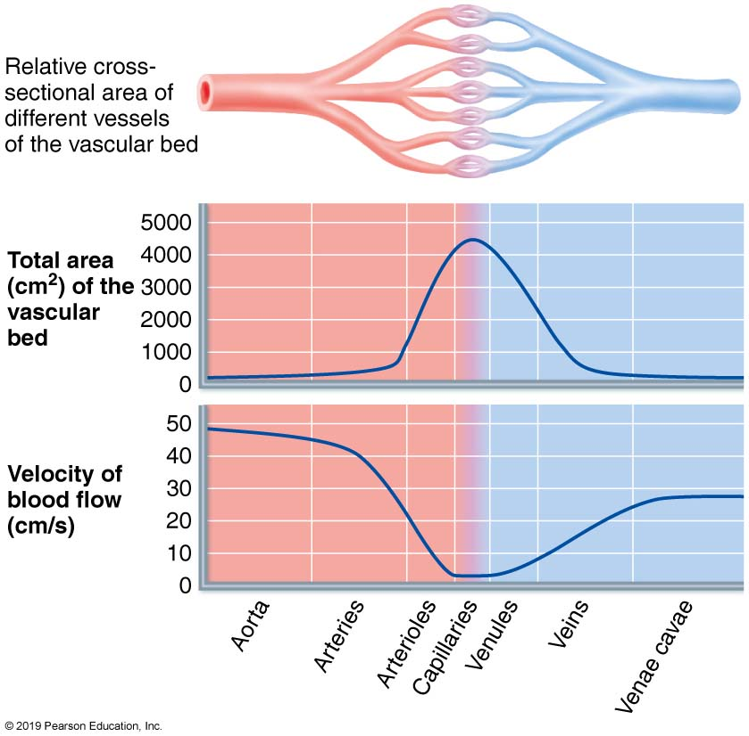
Blood Flow Velocity and Total Cross-Sectional Area of Vessels
Figure 19.18 Blood flow velocity and total cross-sectional area of vessels.

Slide 27
Vasomotion
Vasomotion: intermittent flow of blood through capillaries
  Due to on/off opening and closing of precapillary sphincters

Slide 28
Capillary Exchange of Respiratory Gases and Nutrients (1 of 2)
Many molecules pass by diffusion between blood and interstitial fluid
  Move down their concentration gradients
Molecules use four different routes to cross capillary:
  Diffuse directly through endothelial membranes
    Example: lipid-soluble molecules such as respiratory gases
  Pass through clefts
    Example: water-soluble solutes

Slide 29
Capillary Exchange of Respiratory Gases and Nutrients (2 of 2)
  Pass through fenestrations
    Example: water-soluble solutes
  Active transport via pinocytotic vesicles or caveolae
    Example: larger molecules, such as proteins

Slide 30
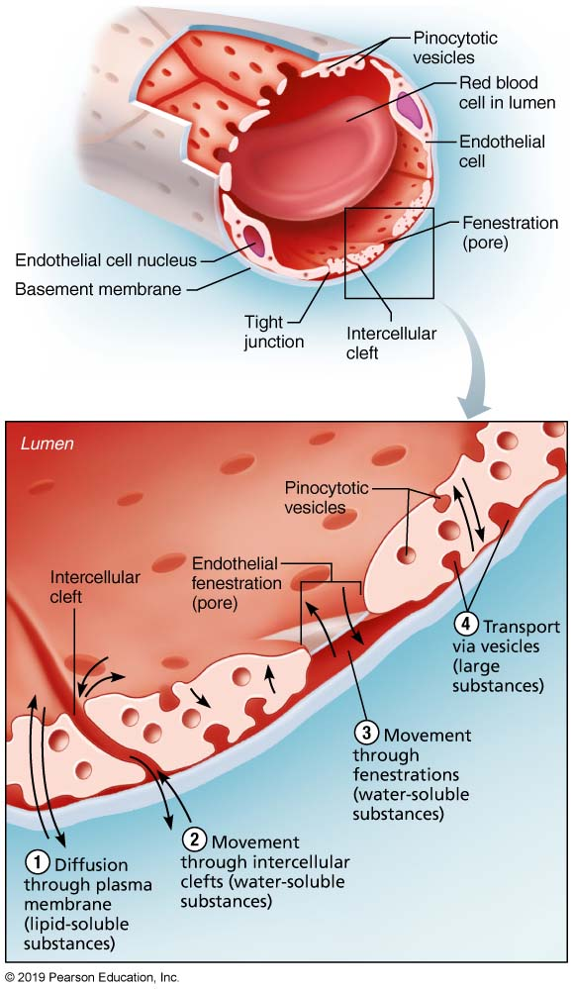
Capillary Transport Mechanisms (1 of 2)
Figure 19.19 Capillary transport mechanisms.

Slide 31
Capillary Transport Mechanisms (2 of 2)
Figure 19.19 Capillary transport mechanisms.

Slide 32
Fluid Movements: Bulk Flow (1 of 4)
Fluid is forced out clefts of capillaries at arterial end, and most returns to blood at venous end
  Extremely important in determining relative fluid volumes in blood and interstitial space
Bulk fluid flow across capillary walls causes continuous mixing of fluid between plasma and interstitial fluid; maintains interstitial environment.
Direction and amount of fluid flow depend on two opposing forces
  Hydrostatic pressures
  Colloid osmotic pressures

Slide 33
Fluid Movements: Bulk Flow (2 of 4)
Hydrostatic pressures
  Hydrostatic pressure (HP): force exerted by fluid pressing against wall; two types
    Capillary hydrostatic pressure (HP_{c}): capillary blood pressure that tends to force fluids through capillary walls
      Greater at arterial end (35 mm Hg) of bed than at venule end (17 mm Hg)
    Interstitial fluid hydrostatic pressure (HP_{if}): pressure pushing fluid back into vessel; usually assumed to be zero because lymphatic vessels drain interstitial fluid

Slide 34
Fluid Movements: Bulk Flow (3 of 4)
Colloid osmotic pressures
  Capillary colloid osmotic pressure (oncotic pressure, OP_{c})
    “Sucking” pressure created by nondiffusible plasma proteins pulling water back in to capillary
    Op_{c} ∼26 mm Hg
  Interstitial fluid colloid osmotic pressure (OP_{if})
    Pressure is inconsequential because interstitial fluid has very low protein content
    OP_{if} around only 1 mm Hg

Slide 35
Fluid Movements: Bulk Flow (4 of 4)
Hydrostatic-osmotic pressure interactions
  Net filtration pressure (NFP): comprises all forces acting on capillary bed
    NFP = (HP_{c} + OP_{if}) − (HP_{if} + OP_{c})
  Net fluid flow out at arterial end (filtration)
  Net fluid flow in at venous end (reabsorption)
  More fluid leaves at arterial end than is returned at venous end
    Excess interstitial fluid is returned to blood via lymphatic system

Slide 36
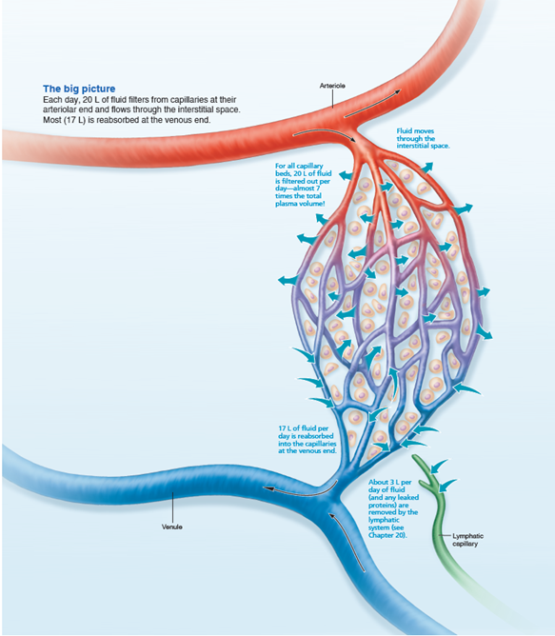
Bulk Fluid Flow Across Capillary Walls Causes Continuous Mixing of Fluid Between the Plasma and the Interstitial Fluid Compartments, and Maintains the Interstitial Environment (1 of 4)
FOCUS FIGURE 19.1 Bulk Flow across Capillary Walls.

Slide 37
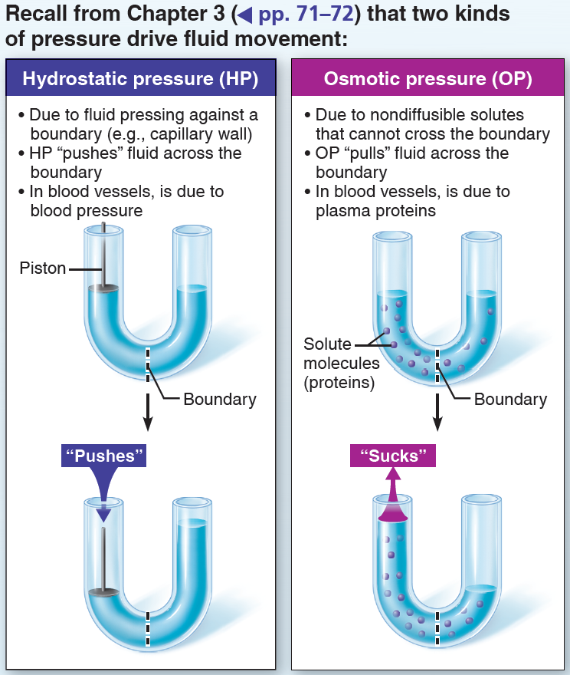
Bulk Fluid Flow Across Capillary Walls Causes Continuous Mixing of Fluid Between the Plasma and the Interstitial Fluid Compartments, and Maintains the Interstitial Environment (2 of 4)
FOCUS FIGURE 19.1 Bulk Flow across Capillary Walls.

Slide 38
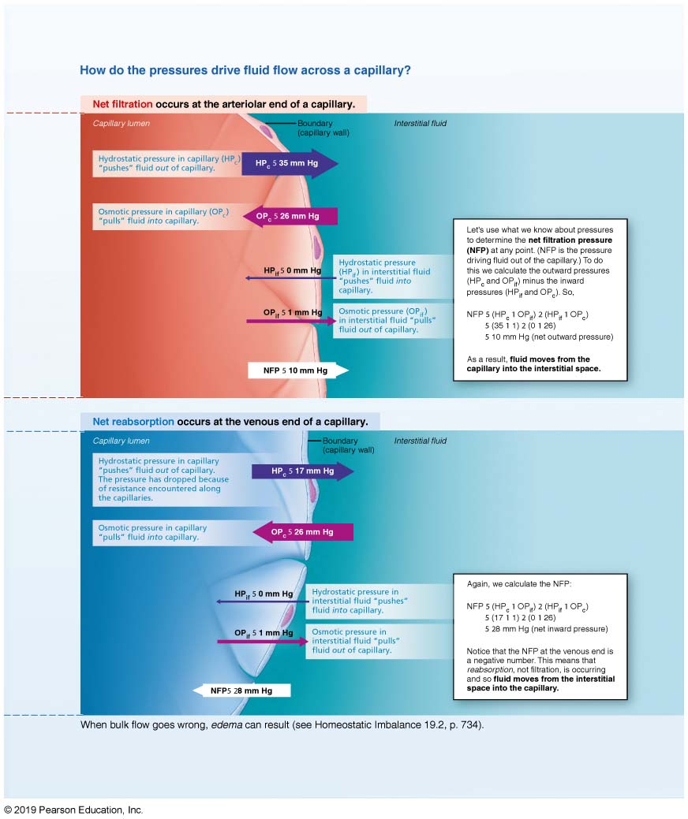
Bulk Fluid Flow Across Capillary Walls Causes Continuous Mixing of Fluid Between the Plasma and the Interstitial Fluid Compartments, and Maintains the Interstitial Environment
(3 of 4)
FOCUS FIGURE 19.1 Bulk Flow across Capillary Walls.

Slide 39
Bulk Fluid Flow Across Capillary Walls Causes Continuous Mixing of Fluid Between the Plasma and the Interstitial Fluid Compartments, and Maintains the Interstitial Environment
(3 of 4)
FOCUS FIGURE 19.1 Bulk Flow across Capillary Walls.

Slide 40
Clinical – Homeostatic Imbalance 19.2 (1 of 3)
Edema: abnormal increase in amount of interstitial fluid
Caused by either an increase in outward pressure (driving fluid out of the capillaries) or a decrease in inward pressure
  An increase in capillary hydrostatic pressure accelerates fluid loss from blood
    Could result from incompetent venous valves, localized blood vessel blockage, congestive heart failure, or high blood volume

Slide 41
Clinical – Homeostatic Imbalance 19.2 (2 of 3)
  An increase in interstitial fluid osmotic pressure can result from an inflammatory response
    Inflammation increases capillary permeability and allows proteins to leak into interstitial fluid
    Causes large amounts of fluid to be pulled into interstitial space
  A decrease in capillary colloid osmotic pressure hinders fluid return to blood
    Can be caused by hypoproteinemia, low levels of plasma proteins caused by malnutrition, liver disease, or glomerulonephritis (loss of plasma proteins from kidneys)

Slide 42
Clinical – Homeostatic Imbalance 19.2 (1 of 3)
  Edema also can be caused by decreased drainage of interstitial fluid through lymphatic vessels that have been blocked by disease or surgically removed
Excess interstitial fluid in subcutaneous tissues generally causes pitting edema
Edema can impair tissue function as a result of increased distance for diffusion of gases, nutrients and wastes between blood and cells
Slow fluid losses can be compensated for by renal mechanisms, but rapid onset may have serious effects on the circulation

Slide 43
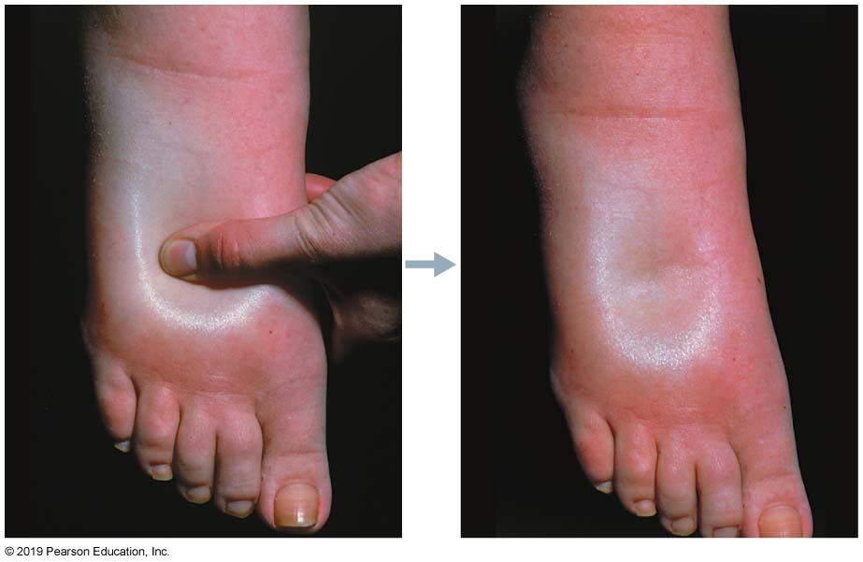
Pitting Edema
Figure 19.20 Pitting edema.

Slide 44
Part 3 Circulatory Pathways: Blood Vessels of the Body (1 of 3)
Vascular system consists of two main circulations:
  Pulmonary circulation: short loop that runs from heart to lungs and back to heart
  Systemic circulation: long loop to all parts of body and back to heart
    Heart pumps blood out to system via single systemic artery, the aorta
    Blood returning to heart is delivered via terminal systemic veins, superior and inferior vena cava, as well as coronary sinus

Slide 45
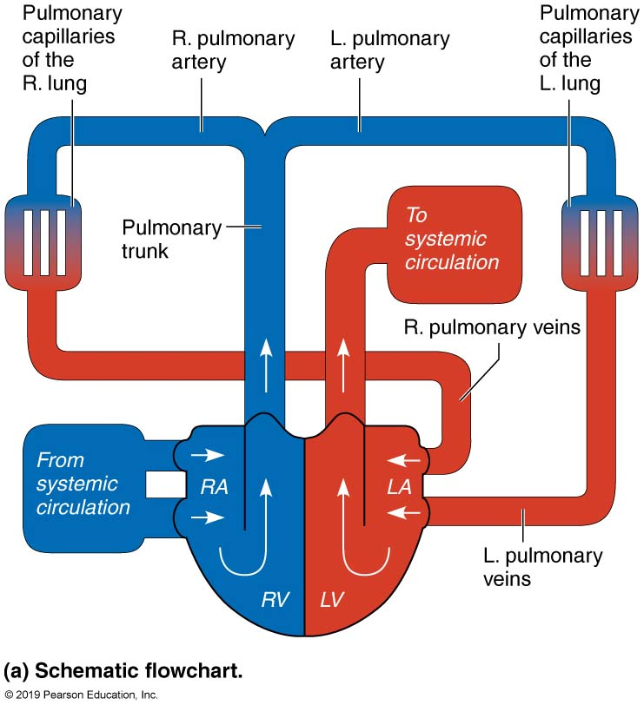
Pulmonary Circulation (1 of 2)
Figure 19.21a Pulmonary circulation.

Slide 46
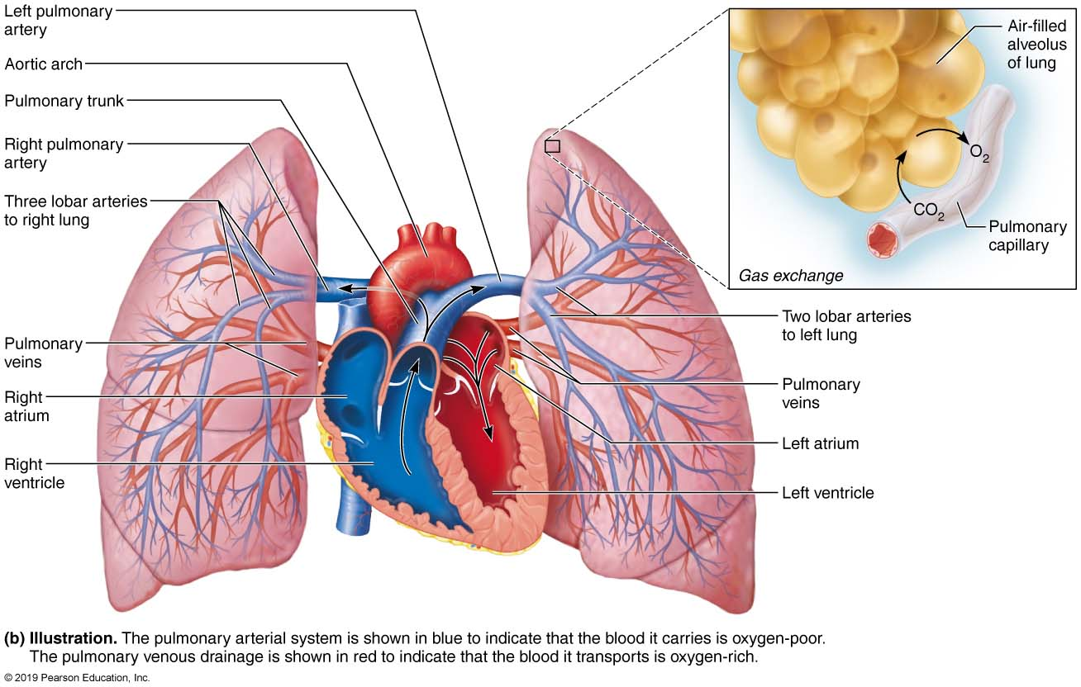
Pulmonary Circulation (2 of 2)
Figure 19.21b Pulmonary circulation.

Slide 47
Part 3 Circulatory Pathways: Blood Vessels of the Body (2 of 3)
Important differences between systemic arteries and veins:
  Arteries run deep, whereas veins are both deep and superficial
    Arteries run deep only, but veins run deep or superficial
      Deep veins share same name with corresponding artery
      Superficial veins do not correspond to names of any arteries

Slide 48
Part 3 Circulatory Pathways: Blood Vessels of the Body (3 of 3)
  Venous pathways are more interconnected
    Unlike arterial pathways, venous pathways have more interconnections
      Veins can have more than one name, making venous pathways harder to follow
  The brain and digestive systems have unique venous drainage systems
    Brain contains dural venous sinuses
    Venous system of the digestive system drains into hepatic portal system, which perfuses through liver before returning to heart

Slide 49
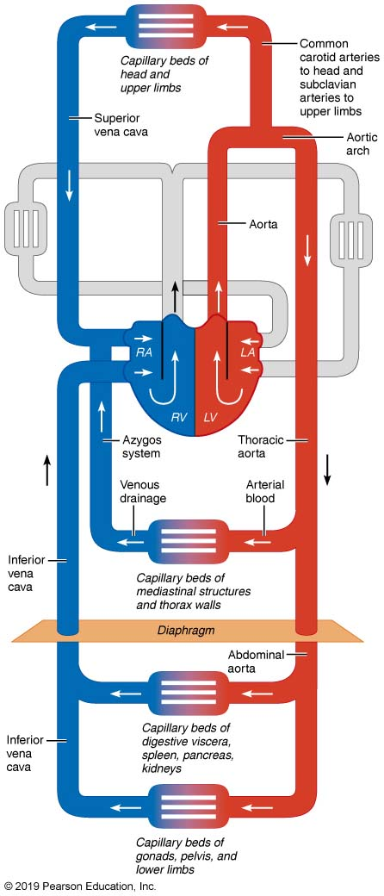
Schematic Flowchart Showing an Overview of the Systemic Circulation
Figure 19.22 Schematic flowchart showing an overview of the systemic circulation.

Slide 50
19.11 Principal Vessels of the Systemic Circulation (1 of 2)
Diagrams of oxygen-rich blood are shown in red, whereas oxygen-poor blood is shown in blue
Schematic flowcharts (pipe diagrams) show vessels that are closer to the surface in brighter colors, whereas vessels that are deeper are shown in darker shades
Tips for memorizing vessels:
  Name of vessel usually reflects body region being traversed (axillary, brachial, femoral, etc.), or organ served (renal, hepatic, gonadal), or bone being followed (vertebral, radial, tibial)

Slide 51
19.11 Principal Vessels of the Systemic Circulation (2 of 2)
Arteries and veins tend to run side by side, and, in many places, they also run with nerves
Systemic vessels do not always match on right and left sides of body
  Example: almost all vessels in head and limbs are bilaterally symmetrical, but some large, deep vessels of trunk are asymmetrical or unpaired

Slide 52
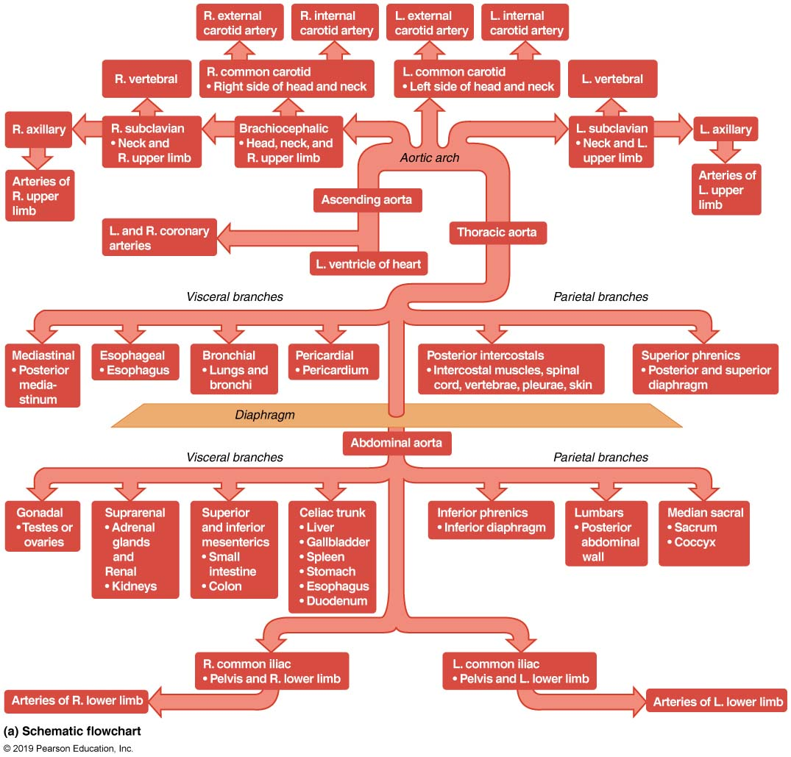
Major Arteries of the Systemic Circulation (1 of 2)
Figure 19.23a Major arteries of the systemic circulation.

Slide 53
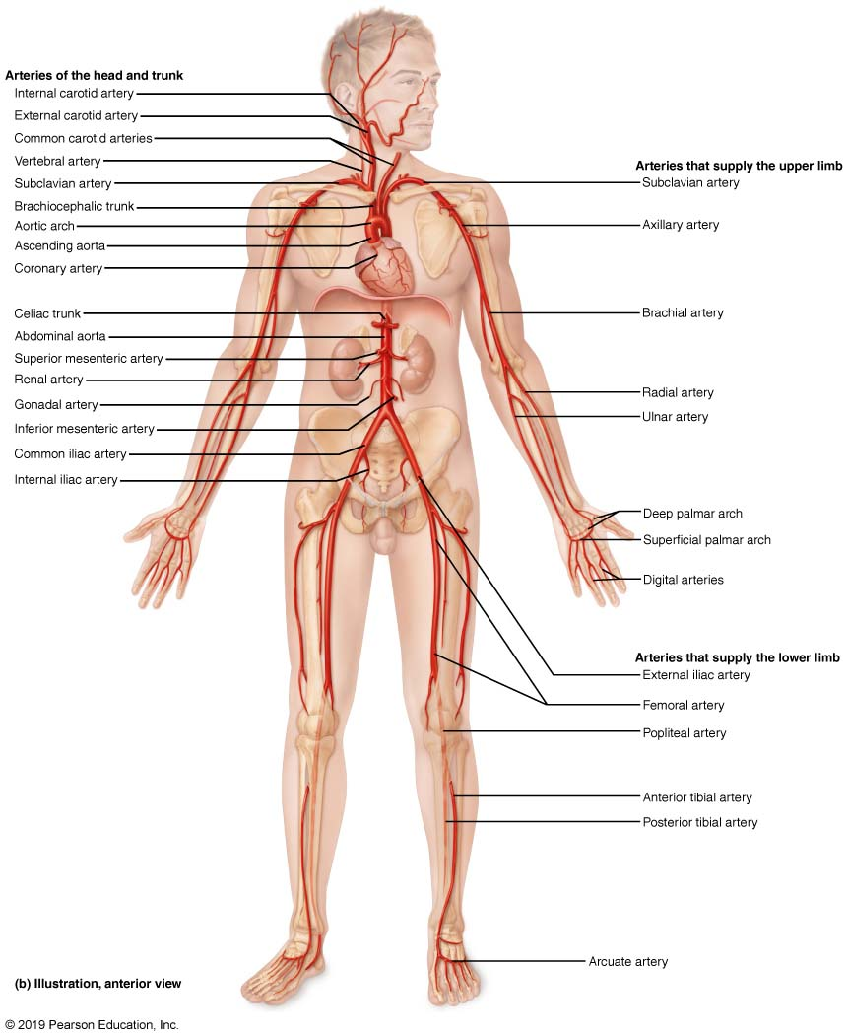
Major Arteries of the Systemic Circulation (2 of 2)
Figure 19.23b Major arteries of the systemic circulation.

Slide 54
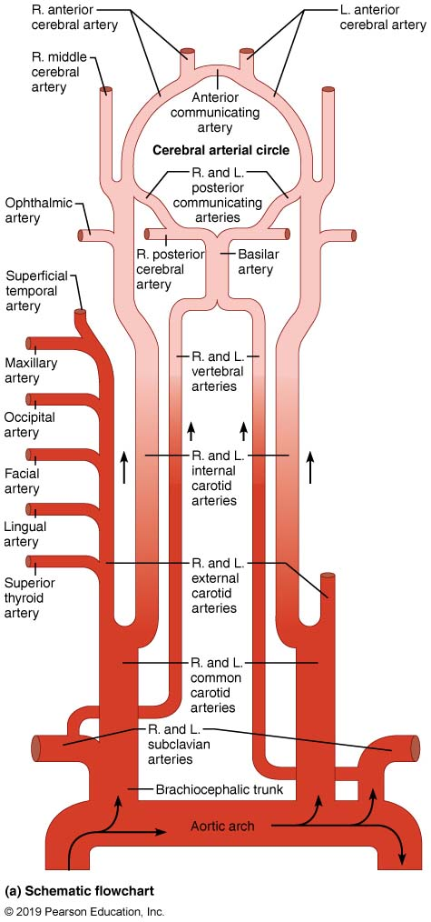
Arteries of the Head, Neck, and Brain (1 of 4)
Figure 19.24a Arteries of the head, neck, and brain.

Slide 55
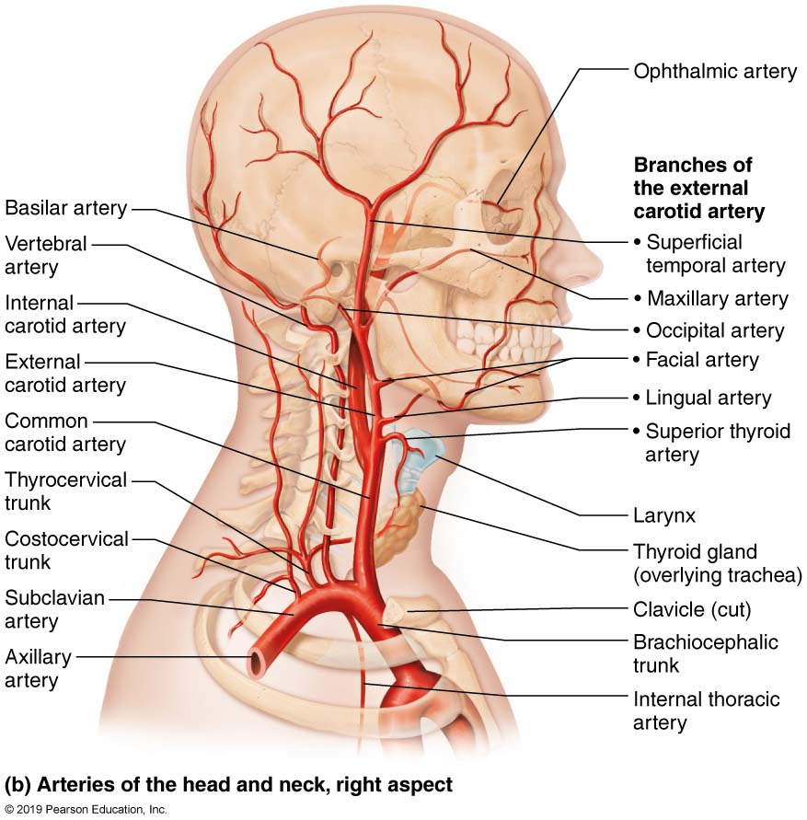
Arteries of the Head, Neck, and Brain (1 of 4)
Figure 19.24b Arteries of the head, neck, and brain.

Slide 56
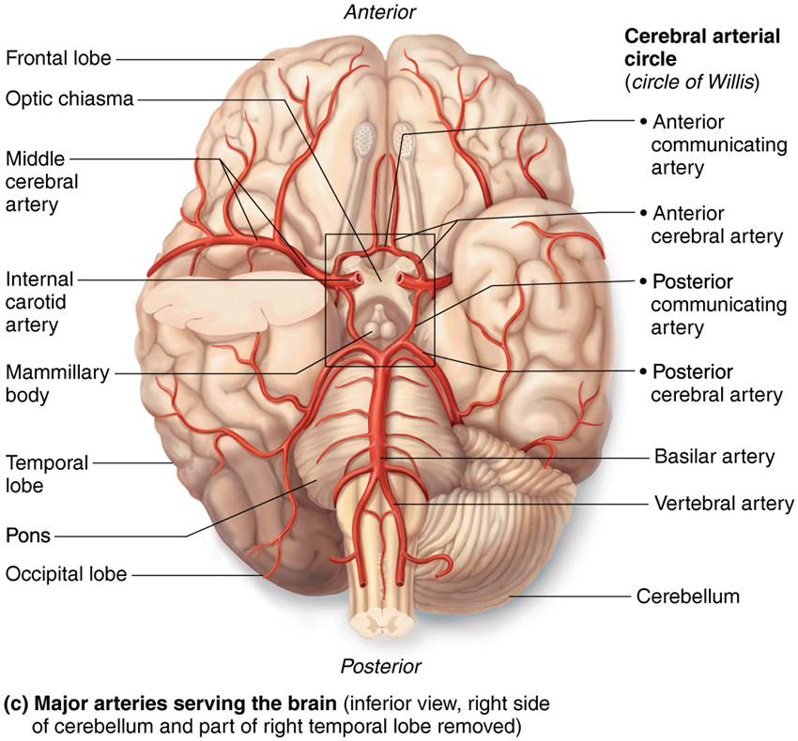
Arteries of the Head, Neck, and Brain (3 of 4)
Figure 19.24c Arteries of the head, neck, and brain.

Slide 57
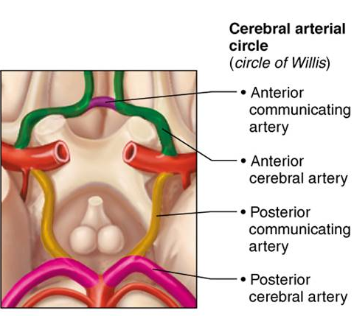
Arteries of the Head, Neck, and Brain (4 of 4)
Figure 19.24c Arteries of the head, neck, and brain.

Slide 58
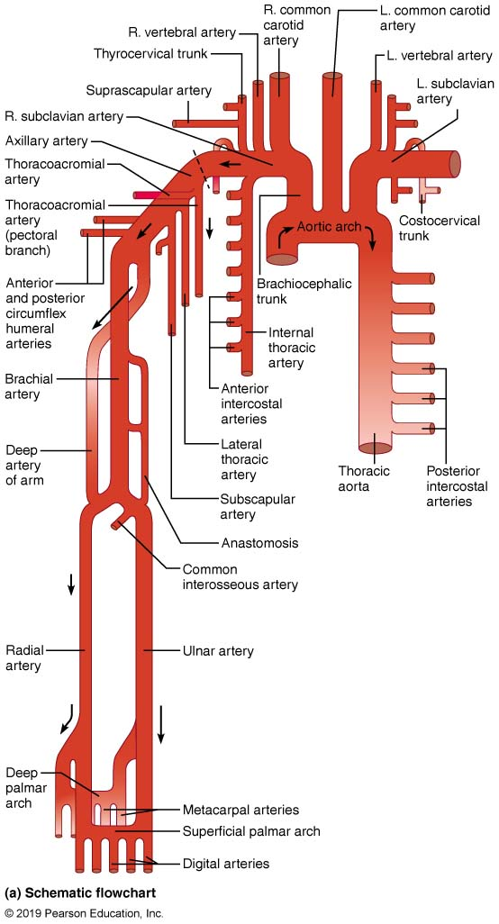
Arteries of the Right Upper Limb and Thorax (1 of 2)
Figure 19.25a Arteries of the right upper limb and thorax.

Slide 59
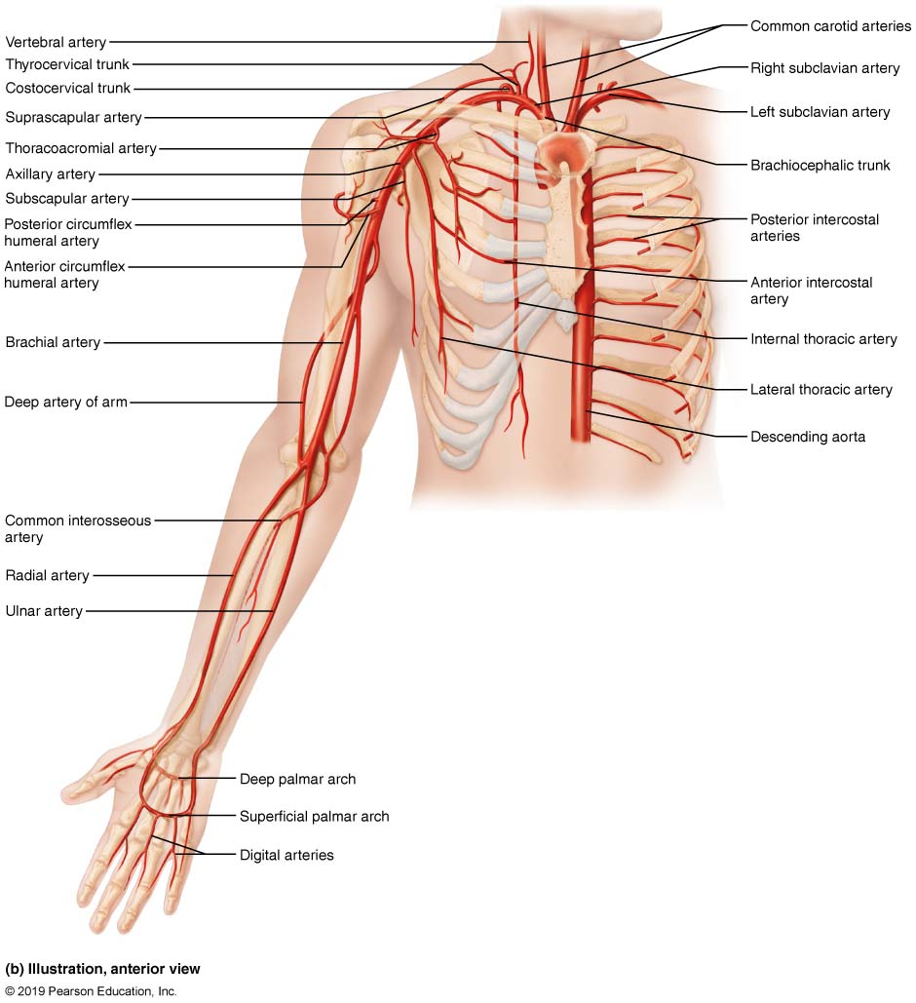
Arteries of the Right Upper Limb and Thorax (1 of 2)
Figure 19.25b Arteries of the right upper limb and thorax.

Slide 60
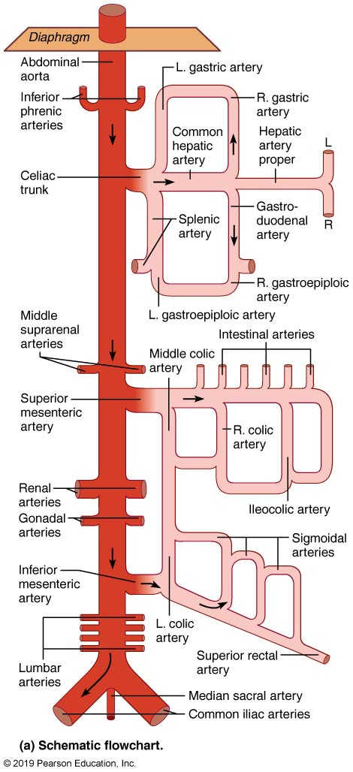
Arteries of the Abdomen (1 of 4)
Figure 19.26a Arteries of the abdomen.

Slide 61
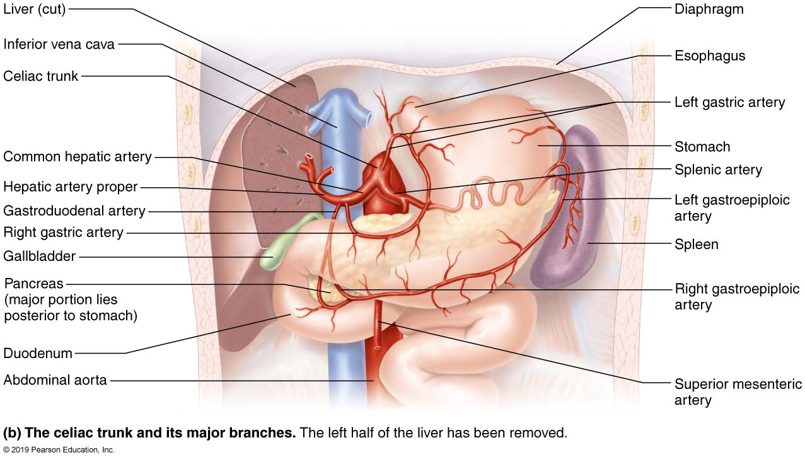
Arteries of the Abdomen (2 of 4)
Figure 19.26b Arteries of the abdomen.

Slide 62
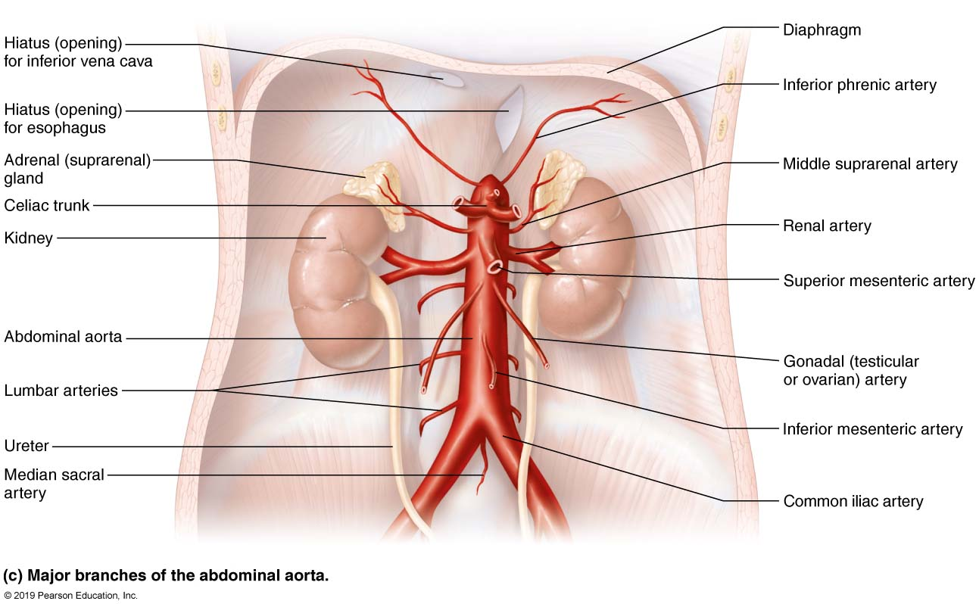
Arteries of the Abdomen (3 of 4)
Figure 19.26c Arteries of the abdomen.

Slide 63
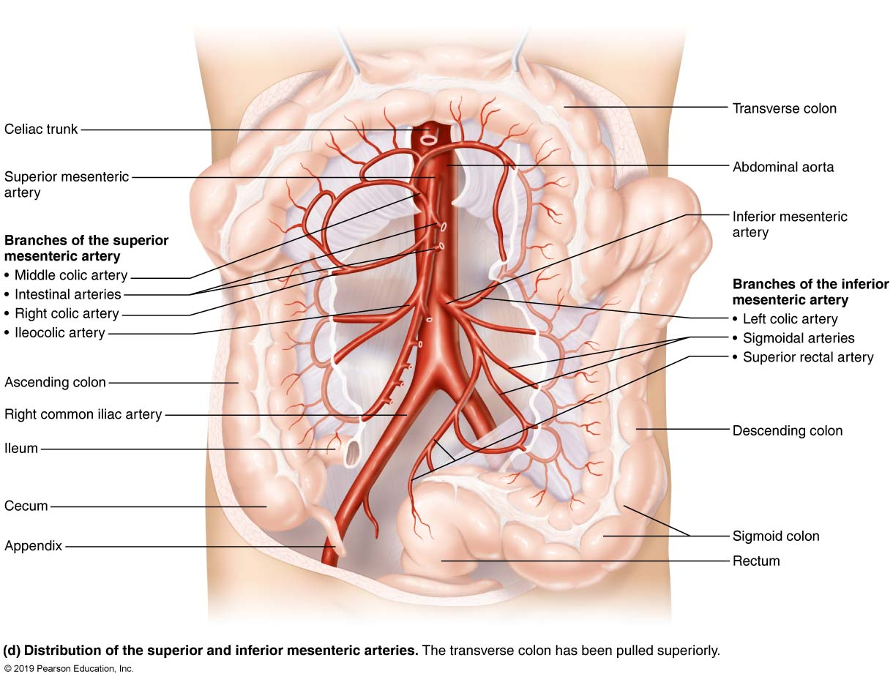
Arteries of the Abdomen (4 of 4)
Figure 19.26d Arteries of the abdomen.

Slide 64
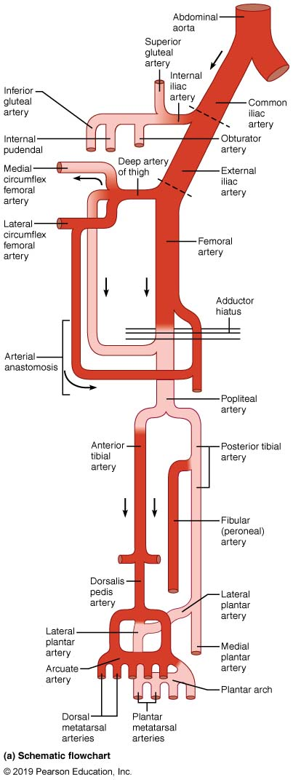
Arteries of the Right Pelvis and Lower Limb (1 of 3)
Figure 19.27a Arteries of the right pelvis and lower limb.

Slide 65
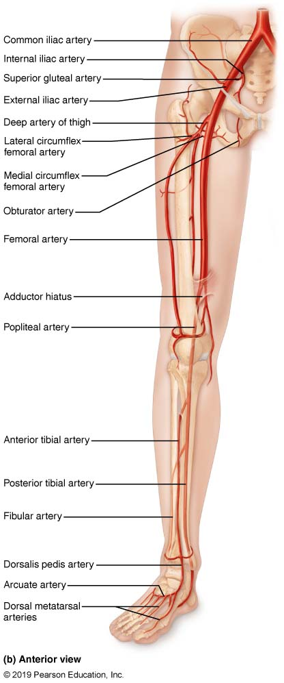
Arteries of the Right Pelvis and Lower Limb (2 of 3)
Figure 19.27b Arteries of the right pelvis and lower limb.

Slide 66
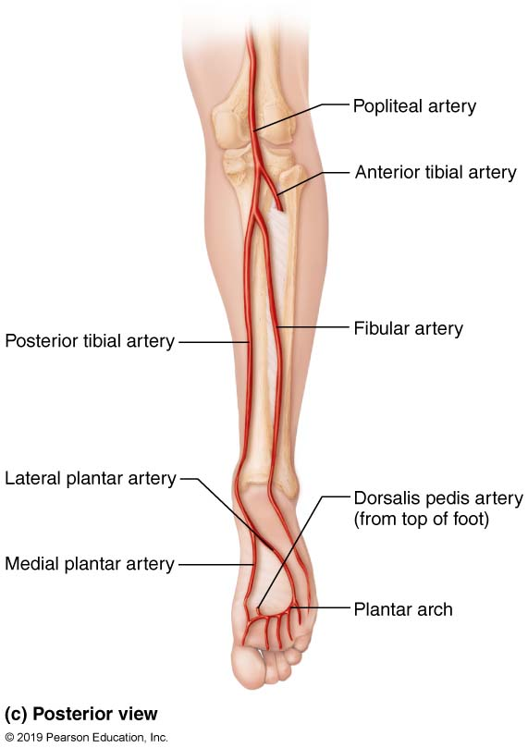
Arteries of the Right Pelvis and Lower
Limb (3 of 3)
Figure 19.27c Arteries of the right pelvis and lower limb.

Slide 67
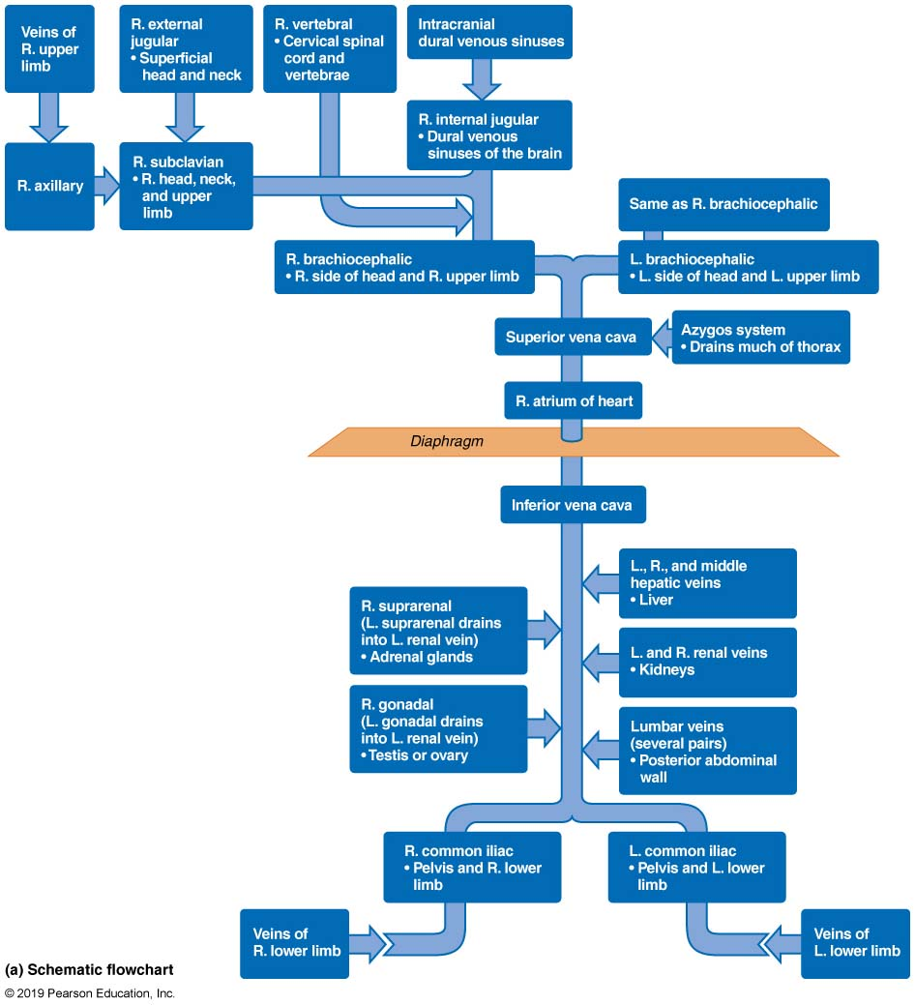
Major Veins of the Systemic Circulation (1 of 2)
Figure 19.28a Major veins of the systemic circulation.

Slide 68
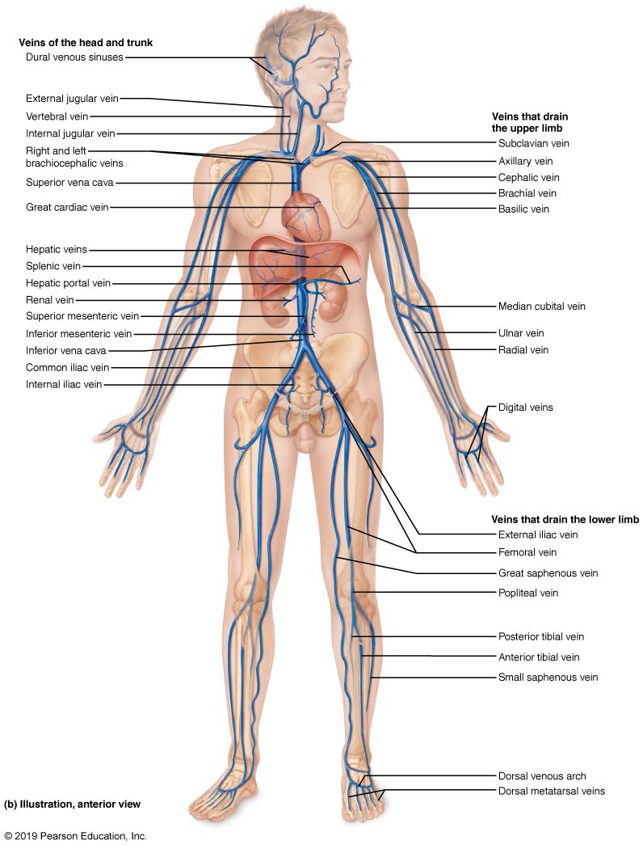
Major Veins of the Systemic Circulation (2 of 2)
Figure 19.28b Major veins of the systemic circulation.

Slide 69
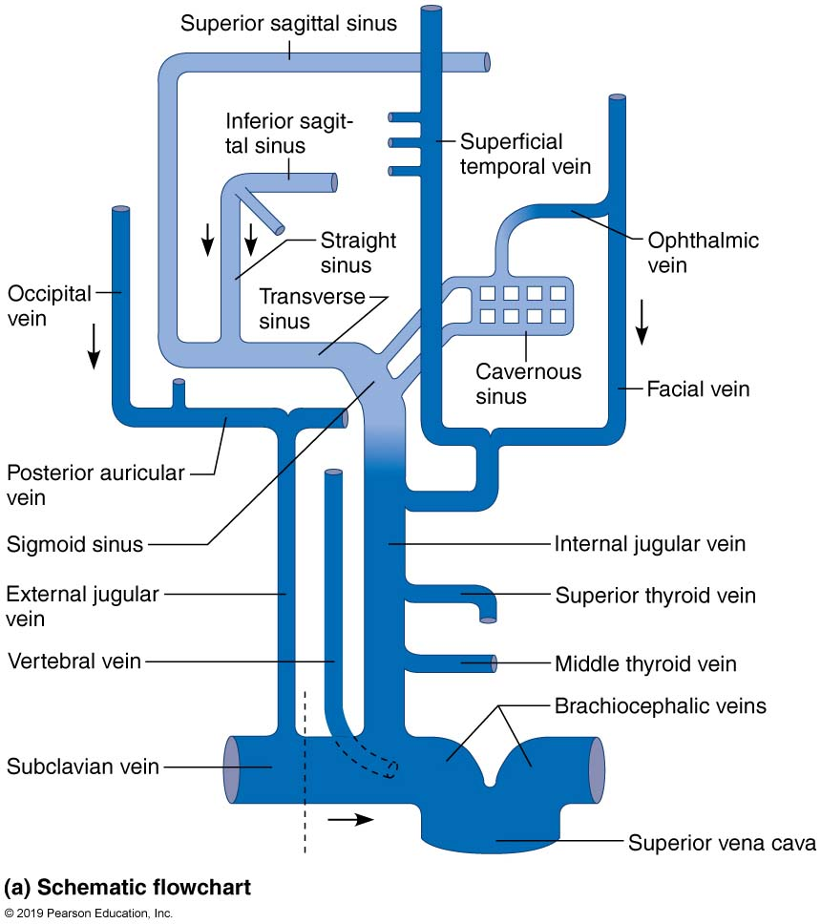
Venous Drainage of the Head, Neck, and Brain (1 of 3)
Figure 19.29a Venous drainage of the head, neck, and brain.

Slide 70
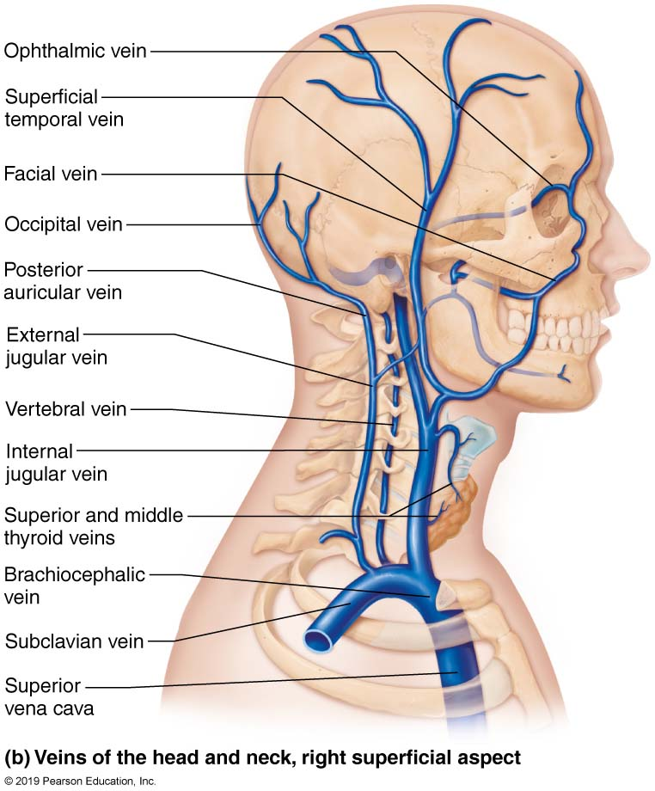
Venous Drainage of the Head, Neck, and Brain (2 of 3)
Figure 19.29b Venous drainage of the head, neck, and brain.

Slide 71
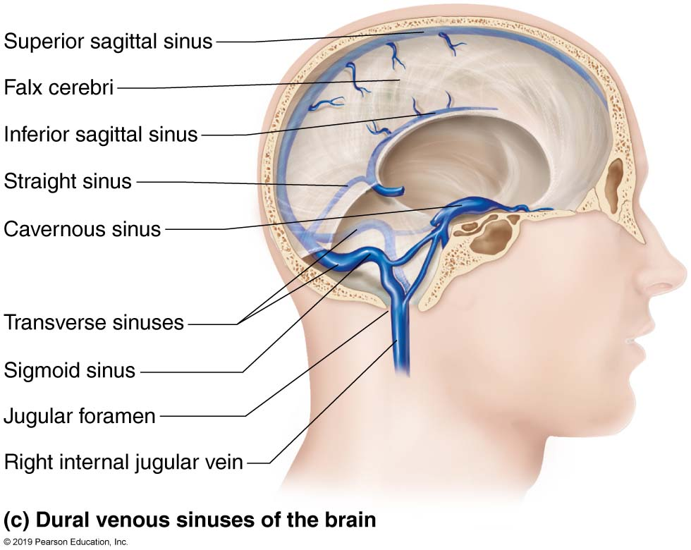
Venous Drainage of the Head, Neck, and Brain (3 of 3)
Figure 19.29c Venous drainage of the head, neck, and brain.

Slide 72
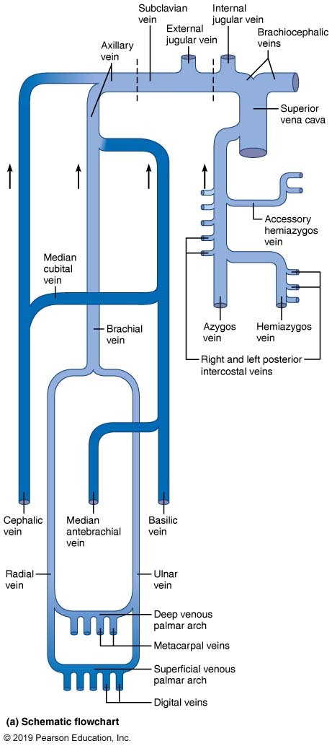
Veins of the Thorax and Right Upper Limb (1 of 2)
Figure 19.30a Veins of the thorax and right upper limb.

Slide 73
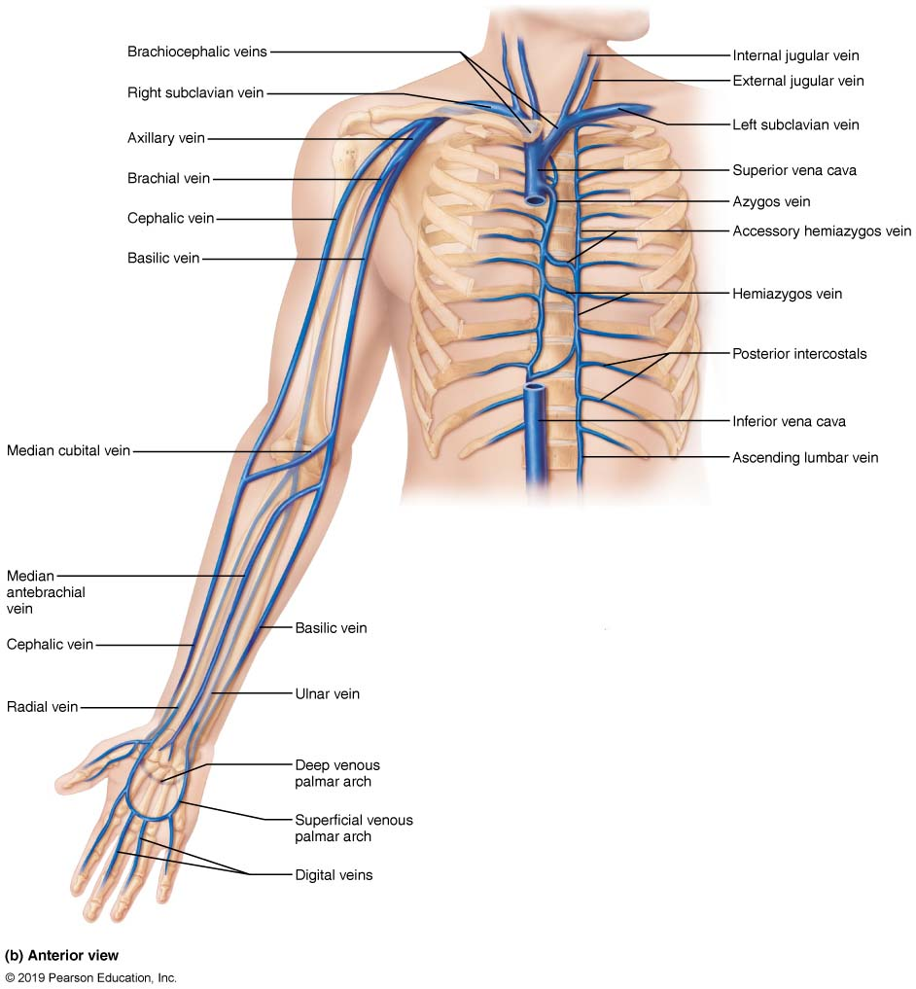
Veins of the Thorax and Right Upper
Limb (2 of 2)
Figure 19.30b Veins of the thorax and right upper limb.

Slide 74
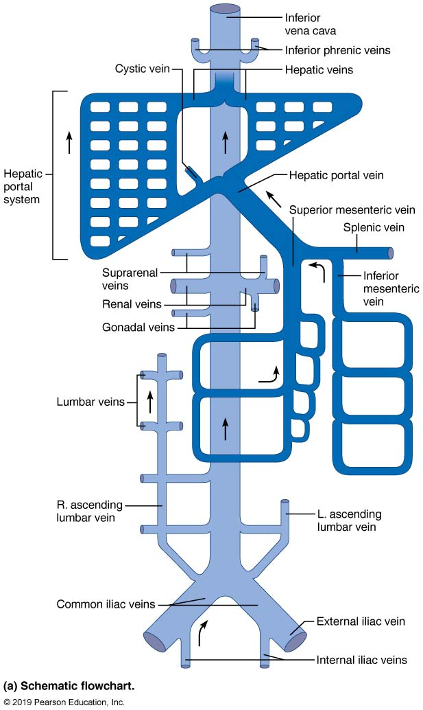
Veins of the Abdomen (1 of 3)
Figure 19.31a Veins of the abdomen.

Slide 75
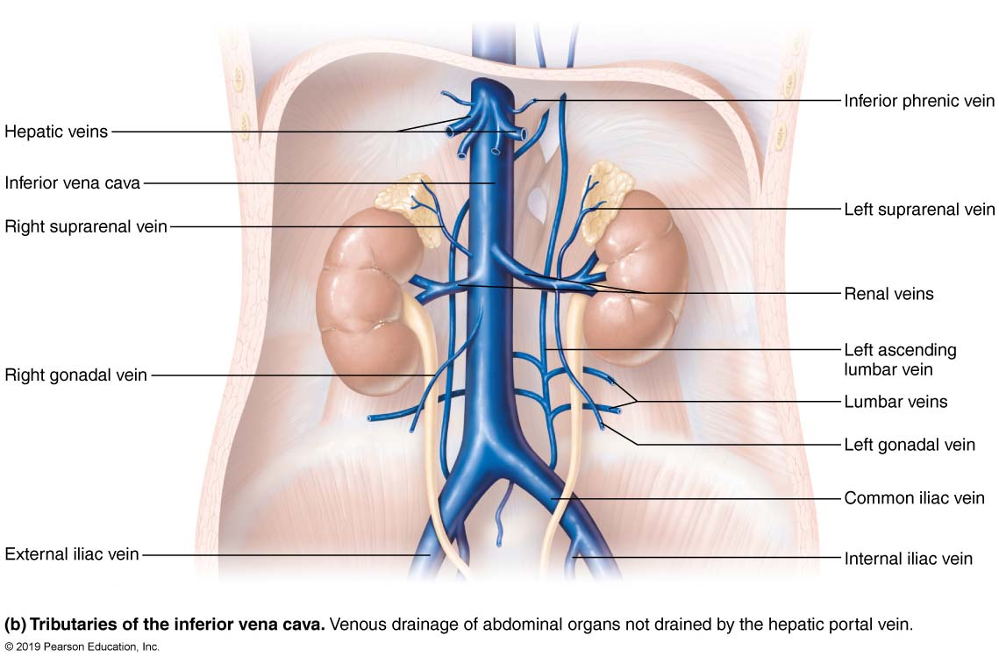
Veins of the Abdomen (2 of 3)
Figure 19.31b Veins of the abdomen.

Slide 76
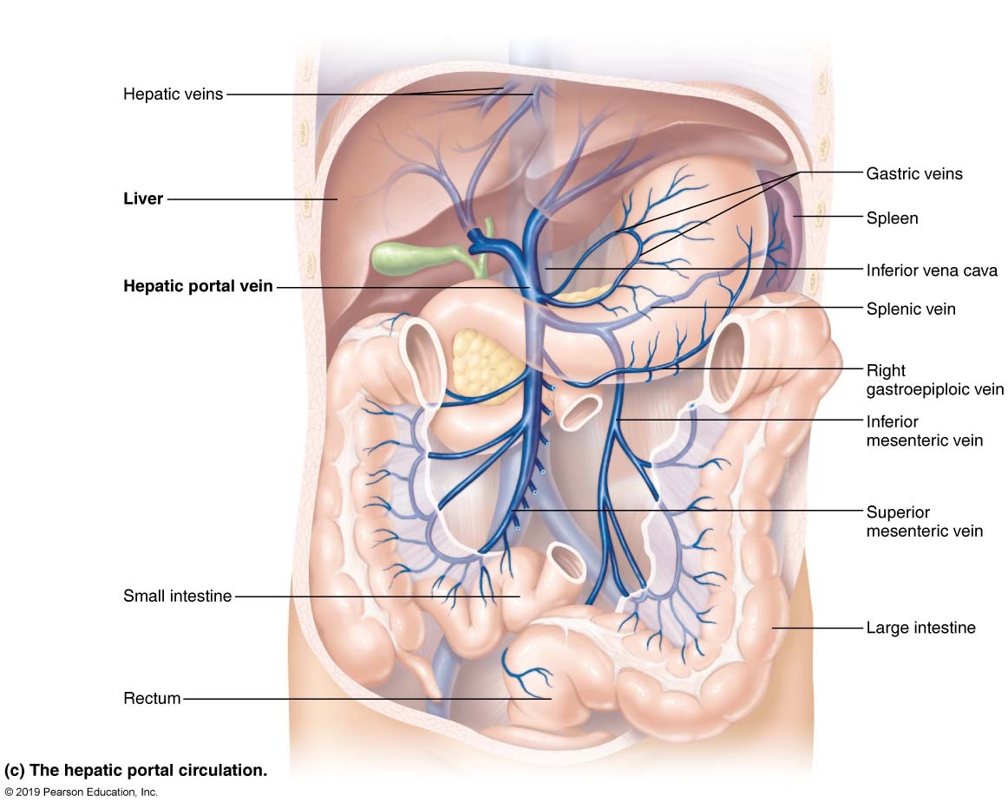
Veins of the Abdomen (3 of 3)
Figure 19.31c Veins of the abdomen.

Slide 77
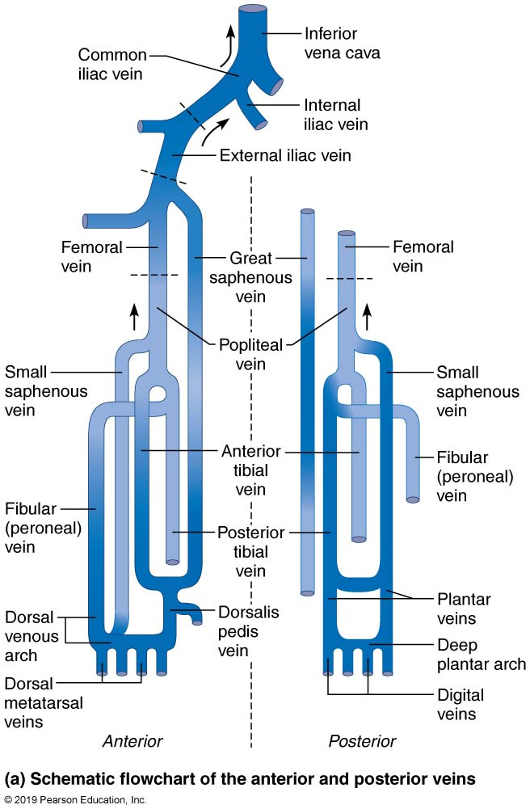
Veins of the Right Lower Limb (1 of 3)
Figure 19.32a Veins of the right lower limb.

Slide 78
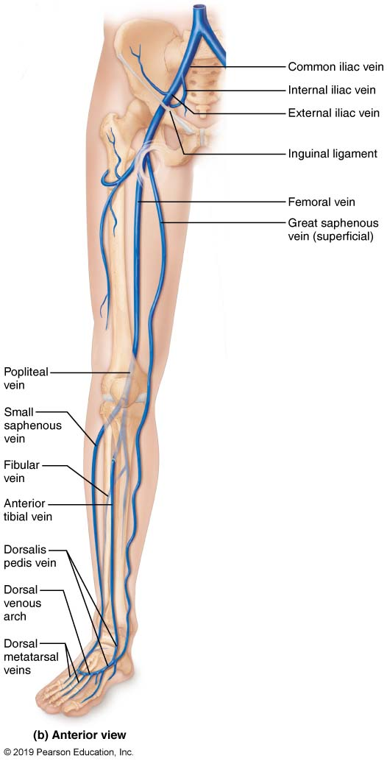
Veins of the Right Lower Limb (2 of 3)
Figure 19.32b Veins of the right lower limb.

Slide 79
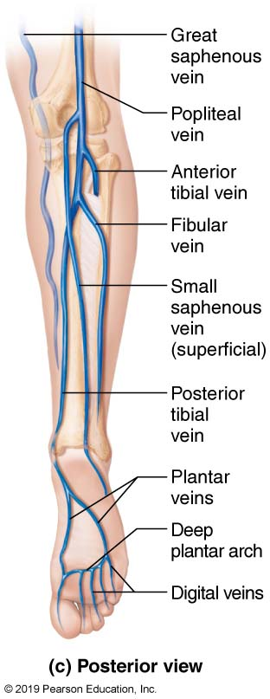
Veins of the Right Lower Limb (3 of 3)
Figure 19.32c Veins of the right lower limb.

Slide 80
Developmental Aspects of Blood Vessels (1 of 2)
Endothelial lining arises from mesodermal cells that collect in masses called blood islands
Blood islands form rudimentary vascular tubes, guided by cues
Vascular endothelial growth factor determines whether vessel becomes artery or vein
The heart pumps blood by the week 4 of development
Fetal shunts (foramen ovale and ductus arteriosus) bypass nonfunctional lungs

Slide 81
Developmental Aspects of Blood Vessels (2 of 2)
Ductus venosus bypasses liver
Umbilical vein and arteries circulate blood to and from placenta
Congenital vascular problems are rare
Vessel formation occurs to support body growth, support wound healing, or rebuild vessels lost during menstrual cycles
With aging, varicose veins, atherosclerosis, and increased blood pressure may arise

Slide 82

Copyright

