Slide 1
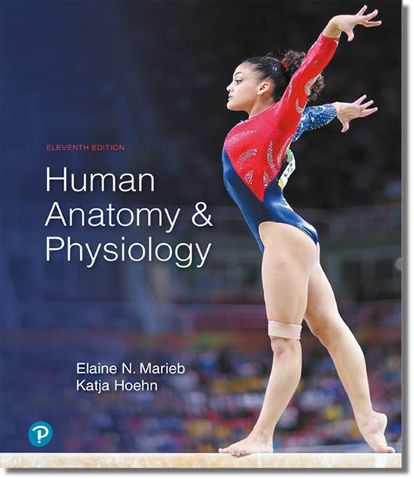
Human Anatomy and Physiology
Eleventh Edition
Chapter 19 Part B
The Cardiovascular System:
Blood Vessels
PowerPoint® Lectures Slides prepared by Karen Dunbar Kareiva, Ivy Tech Community College
Copyright © 2019, 2016, 2013 Pearson Education, Inc. All Rights Reserved

Slide 2
Part 2 Physiology of Circulation

Slide 3
19.6 Flow, Pressure, and Resistance

Slide 4
Definition of Terms (1 of 6)
Blood flow: volume of blood flowing through vessel, organ, or entire circulation in given period
  Measured in ml/min, it is equivalent to cardiac output (CO) for entire vascular system
  Overall is relatively constant when at rest, but at any given moment, varies at individual organ level, based on needs

Slide 5
Definition of Terms (2 of 6)
Blood pressure (BP): force per unit area exerted on wall of blood vessel by blood
  Expressed in mm Hg
  Measured as systemic arterial BP in large arteries near heart
  Pressure gradient provides driving force that keeps blood moving from higher- to
  lower-pressure areas

Slide 6
Definition of Terms (3 of 6)
Resistance (peripheral resistance): opposition to flow
  Measurement of amount of friction blood encounters with vessel walls, generally in peripheral (systemic) circulation
  Three important sources of resistance
    Blood viscosity
    Total blood vessel length
    Blood vessel diameter

Slide 7
Definition of Terms (4 of 6)
  Blood viscosity
    The thickness or “stickiness” of blood due to formed elements and plasma proteins
      The greater the viscosity, the less easily molecules are able to slide past each other
    Increased viscosity equals increased resistance
  Total blood vessel length
    The longer the vessel, the greater the resistance encountered

Slide 8
Definition of Terms (5 of 6)
  Blood vessel diameter
    Has greatest influence on resistance
    Frequent changes alter peripheral resistance
      Viscosity and blood vessel length are relatively constant
    Fluid close to walls moves more slowly than in middle of tube (called laminar flow)
    Resistance varies inversely with fourth power of vessel radius
      If radius increases, resistance decreases, and vice-versa
      Example: if radius is doubled, resistance drops to 1/16 as much

Slide 9
Definition of Terms (6 of 6)
  Blood vessel diameter (cont.)
    Small-diameter arterioles are major determinants of peripheral resistance
      Radius changes frequently, in contrast to larger arteries that do not change often
    Abrupt changes in vessel diameter or obstacles such as fatty plaques from atherosclerosis dramatically increase resistance
      Laminar flow is disrupted and becomes turbulent flow, irregular flow that causes increased resistance

Slide 10
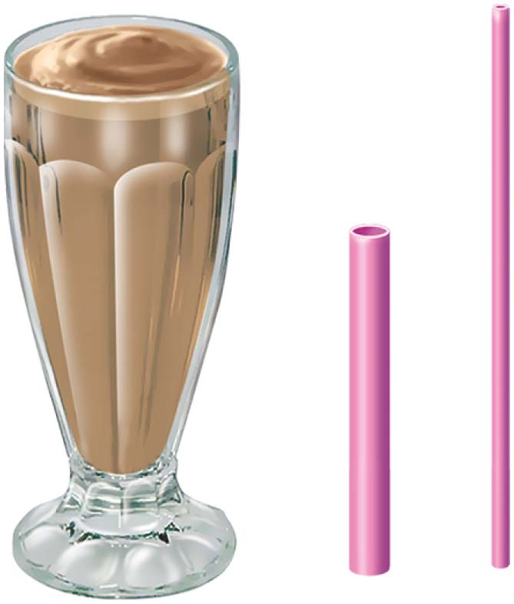
Milk Shake and 2 Different Straws

Slide 11
Relationship Between Flow, Pressure, and Resistance
Blood flow (F) is directly proportional to blood pressure gradient (ΔP)
  If ΔP increases, blood flow speeds up
Blood flow is inversely proportional to peripheral resistance (R)
  If R increases, blood flow decreases, so
R is more important in influencing local blood flow because it is easily changed by altering blood vessel diameter

Slide 12
19.7 Systemic Blood Pressure
Pumping action of heart generates blood flow
Pressure results when flow is opposed by resistance
Systemic pressure is highest in aorta and declines throughout pathway
  Steepest drop occurs in arterioles

Slide 13
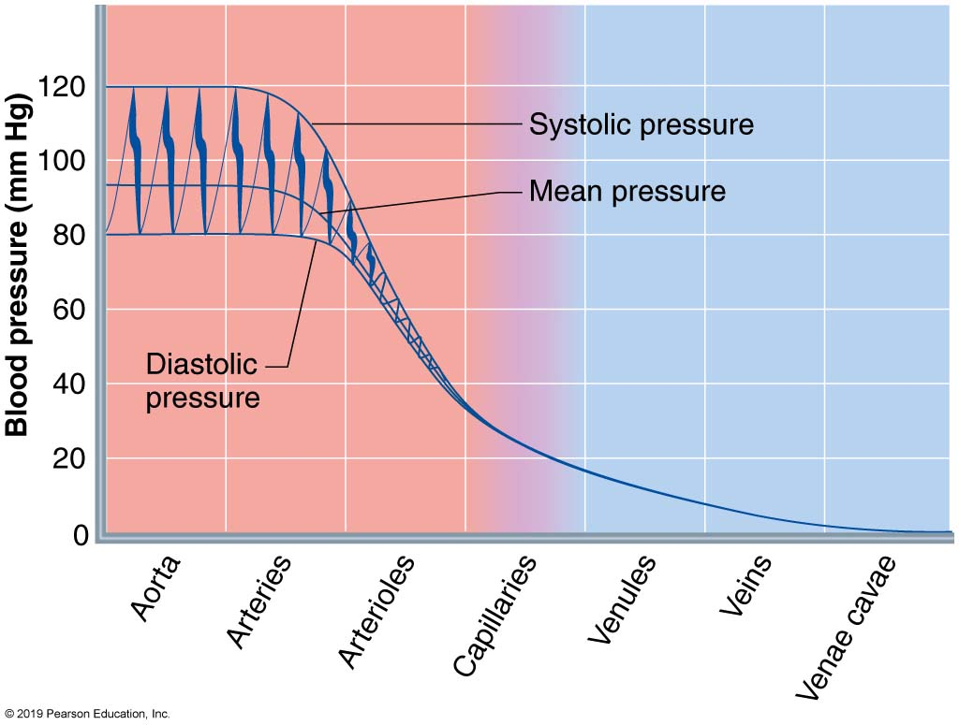
Blood Pressure in Various Blood Vessels of the Systemic Circulation
Figure 19.7 Blood pressure in various blood vessels of the systemic circulation.

Slide 14
Arterial Blood Pressure (1 of 7)
Determined by two factors:
  Elasticity (compliance or distensibility) of arteries close to heart
  Volume of blood forced into them at any time
Blood pressure near heart is pulsatile
  Rises and falls with each heartbeat

Slide 15
Arterial Blood Pressure (2 of 7)
Systolic pressure: pressure exerted in aorta during ventricular contraction
  Left ventricle pumps blood into aorta, imparting kinetic energy that stretches aorta
  Averages 120 mm Hg in normal adult
Diastolic pressure: lowest level of aortic pressure when heart is at rest
Pulse pressure: difference between systolic and diastolic pressure
Pulse: throbbing of arteries due to difference in pulse pressures, which can be felt under skin

Slide 16
Arterial Blood Pressure (3 of 7)
Mean arterial pressure (MAP): pressure that propels blood to tissues
  Pulse pressure phases out near end of arterial tree
  Flow is nonpulsatile with a steady MAP pressure
Heart spends more time in diastole, so not just a simple average of diastole and systole

Slide 17
Arterial Blood Pressure (4 of 7)
MAP is calculated by adding diastolic pressure + 1/3 pulse pressure
  Example:
    BP = 120/80
    Pulse Pressure = 120 − 80 = 40
    So MAP = 80 + (1/3)*40 = 80 + ~13 = 93 mm Hg
Pulse pressure and MAP both decline with increasing distance from heart

Slide 18
Arterial Blood Pressure (5 of 7)
Clinical monitoring of circulatory efficiency
  Vital signs: pulse and blood pressure, along with respiratory rate and body temperature
  Taking a pulse
    Radial pulse (taken at the wrist): most routinely used, but there are other clinically important pulse points
    Pressure points: areas where arteries are close to body surface
      Can be compressed to stop blood flow in event of hemorrhaging

Slide 19
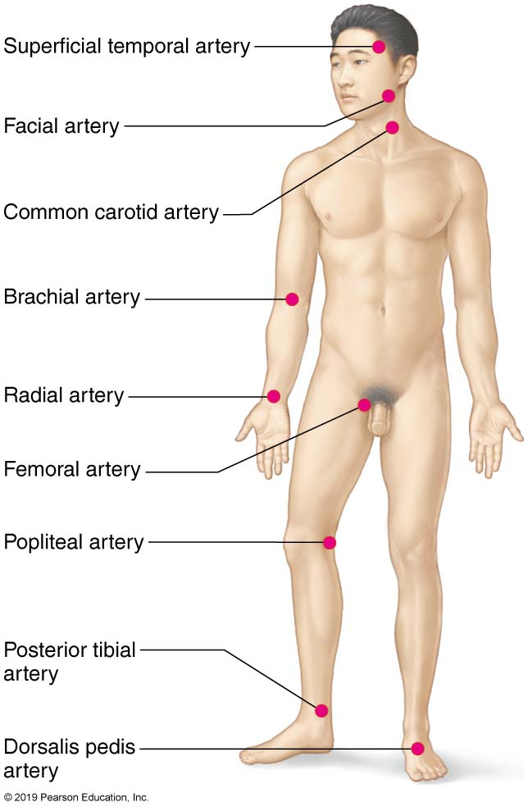
Body Sites Where the Pulse is Most Easily
Palpated
Figure 19.8 Body sites where the pulse is most easily palpated.

Slide 20
Arterial Blood Pressure (6 of 7)
  Measuring blood pressure
    Systemic arterial BP is measured indirectly by auscultatory methods using a sphygmomanometer
      Wrap cuff around arm superior to elbow
      Increase pressure in cuff until it exceeds systolic pressure in brachial artery
      Pressure is released slowly, and examiner listens for sounds of Korotkoff with a stethoscope

Slide 21
Arterial Blood Pressure (7 of 7)
  Measuring blood pressure (cont.)
    Systolic pressure: normally less than 120 mm Hg
      Pressure when sounds first occur as blood starts to spurt through artery
    Diastolic pressure: normally less than 80 mm Hg
      Pressure when sounds disappear because artery no longer constricted; blood flowing freely

Slide 22
Capillary Blood Pressure
Ranges from 35 mm Hg at beginning of capillary bed to ∼17 mm Hg at the end of the bed
Low capillary pressure is desirable because:
  High BP would rupture fragile, thin-walled capillaries
  Most capillaries are very permeable, so low pressure forces filtrate into interstitial spaces

Slide 23
Venous Blood Pressure (1 of 2)
Changes little during cardiac cycle
Small pressure gradient, only about 15 mm Hg
  If vein is cut, low pressure of venous system causes blood to flow out smoothly
  If artery cut, blood spurts out because pressure is higher
Low pressure is due to cumulative effects of peripheral resistance
  Energy of blood pressure is lost as heat during each circuit
Low pressure of venous side requires adaptations to help with venous return

Slide 24
Venous Blood Pressure (2 of 2)
Factors aiding venous return
  Muscular pump: contraction of skeletal muscles “milks” blood back toward heart;
  valves prevent backflow
  Respiratory pump: pressure changes during breathing move blood toward heart
  by squeezing abdominal veins as thoracic veins expand
  Sympathetic venoconstriction: under sympathetic control, smooth muscles
  constrict, pushing blood back toward heart

Slide 25
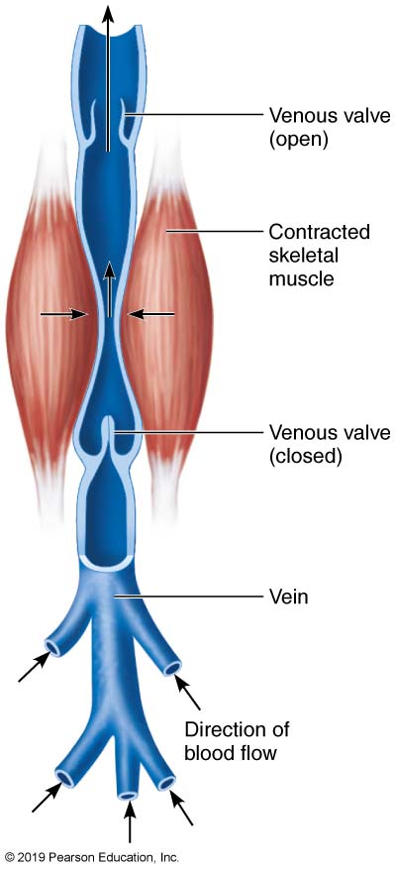
The Muscular Pump
Figure 19.9 The muscular pump.

Slide 26
19.8 Regulation of Blood Pressure (1 of 4)
Maintaining blood pressure requires cooperation of heart, blood vessels, and kidneys
  All supervised by brain
Three main factors regulating blood pressure
  Cardiac output (CO)
  Peripheral resistance (PR)
  Blood volume
Blood pressure varies directly with CO, PR, and blood volume

Slide 27
19.8 Regulation of Blood Pressure (2 of 4)
Remember:
and that F = CO, so substituting gives
and rearranging,
Shows that blood pressure (MAP) is directly proportional to CO and PR
  Changes in one variable are quickly compensated for by changes in other variables

Slide 28
19.8 Regulation of Blood Pressure (3 of 4)
Recall that CO = SV × HR, so if MAP = CO × R, then
Anything that increases SV, HR, or R will also increase MAP
  SV is effected by venous return (EDV)
  HR is maintained by medullary centers
  R is effected mostly by vessel diameter

Slide 29
19.8 Regulation of Blood Pressure (4 of 4)
Factors can be affected by:
  Short-term regulation: neural controls
  Short-term regulation: hormonal controls
  Long-term regulation: renal controls

Slide 30
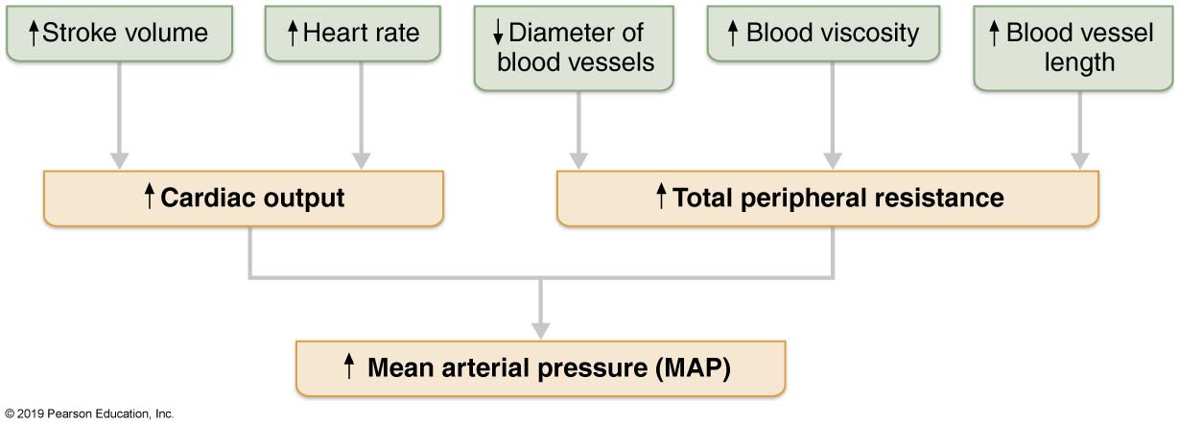
Major Factors That Increase MAP
Figure 19.10 Major factors that increase MAP.

Slide 31
Short-Term Regulation: Neural Controls
(1 of 9)
Two main neural mechanisms control peripheral resistance
  MAP is maintained by altering blood vessel diameter, which alters resistance
    Example: If blood volume drops, all vessels constrict (except those to heart and brain)
  Can alter blood distribution to organs in response to specific demands

Slide 32
Short-Term Regulation: Neural Controls
(2 of 9)
Neural controls operate via reflex arcs that involve:
  Cardiovascular center of medulla
  Baroreceptors
  Chemoreceptors
  Higher brain centers

Slide 33
Short-Term Regulation: Neural Controls
(3 of 9)
Role of the cardiovascular center
  Cardiovascular center: composed of clusters of sympathetic neurons in medulla
  Consists of:
    Cardiac centers: cardioinhibitory and cardioacceleratory centers
    Vasomotor center: sends steady impulses via sympathetic efferents called vasomotor fibers to blood vessels
      Cause continuous moderate constriction called vasomotor tone
  Receives inputs from baroreceptors, chemoreceptors, and higher brain centers

Slide 34
Short-Term Regulation: Neural Controls
(4 of 9)
Baroreceptor reflexes
  Located in carotid sinuses, aortic arch, and walls of large arteries of neck and thorax
  If MAP is high:
    Increased blood pressure stimulates baroreceptors to increase input to vasomotor center
    Inhibits vasomotor and cardioacceleratory centers
    Stimulates cardioinhibitory center
    Results in decreased blood pressure

Slide 35
Short-Term Regulation: Neural Controls
(5 of 9)
Baroreceptor reflexes (cont.)
  Resulting decrease in blood pressure due to two mechanisms:
    Vasodilation: decreased output from vasomotor center causes dilation
      Arteriolar vasodilation: reduces peripheral resistance, MAP falls
      Venodilation: shifts blood to venous reservoirs, decreasing venous return and CO

Slide 36
Short-Term Regulation: Neural Controls
(6 of 9)
Baroreceptor reflexes (cont.)
    Decreased cardiac output: impulses to cardiac centers inhibit sympathetic activity and stimulate parasympathetic
      Reduces heart rate and contractility; CO decrease causes decrease in MAP

Slide 37
Short-Term Regulation: Neural Controls
(7 of 9)
Baroreceptor reflexes (cont.)
  If MAP is low:
    Reflex vasoconstriction is initiated that increases CO and blood pressure
    Example: upon standing, BP falls and triggers:
      Carotid sinus reflex: baroreceptors that monitor BP to ensure enough blood to brain
      Aortic reflex maintains BP in systemic circuit
    Baroreceptors are ineffective if altered blood pressure is sustained
      Become adapted to hypertension, so not triggered by elevated BP levels

Slide 38
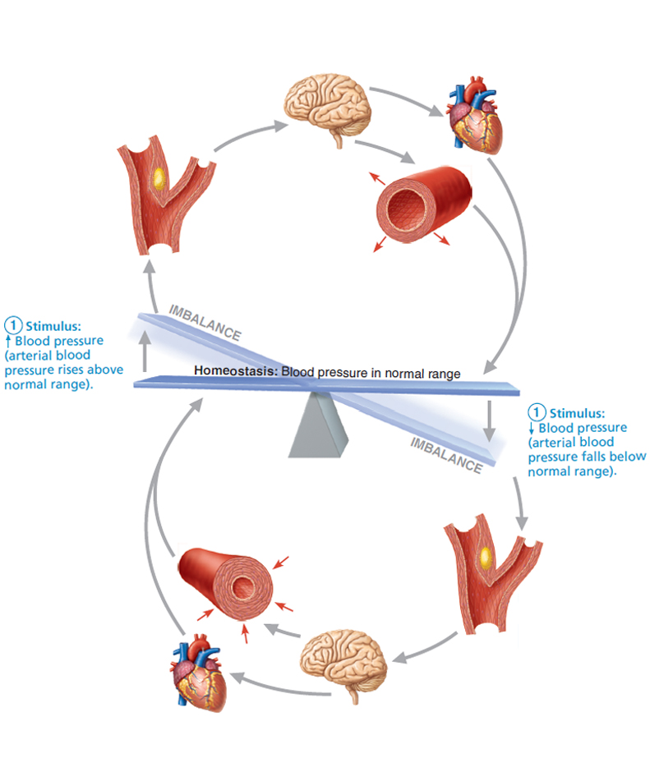
Baroreceptor Reflexes that Help Maintain Blood Pressure Homeostasis (1 of 5)
Figure 19.11 Baroreceptor reflexes that help maintain blood pressure homeostasis.

Slide 39
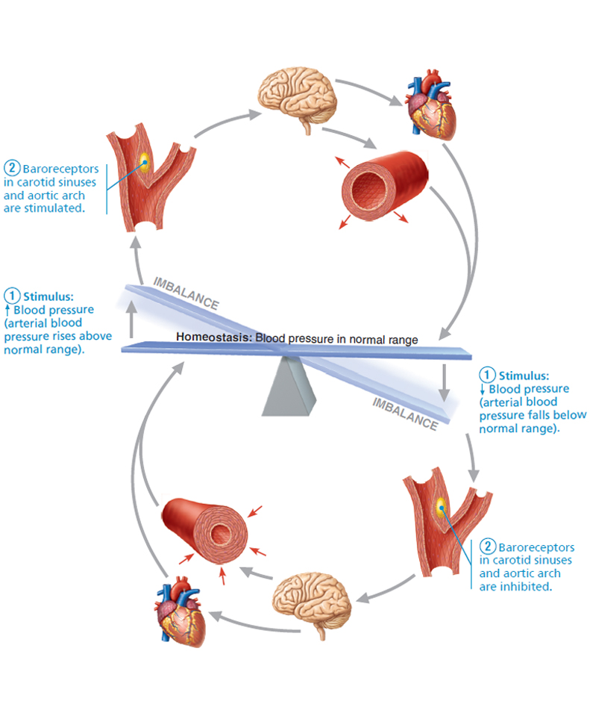
Baroreceptor Reflexes that Help Maintain Blood Pressure Homeostasis (2 of 5)
Figure 19.11 Baroreceptor reflexes that help maintain blood pressure homeostasis.

Slide 40
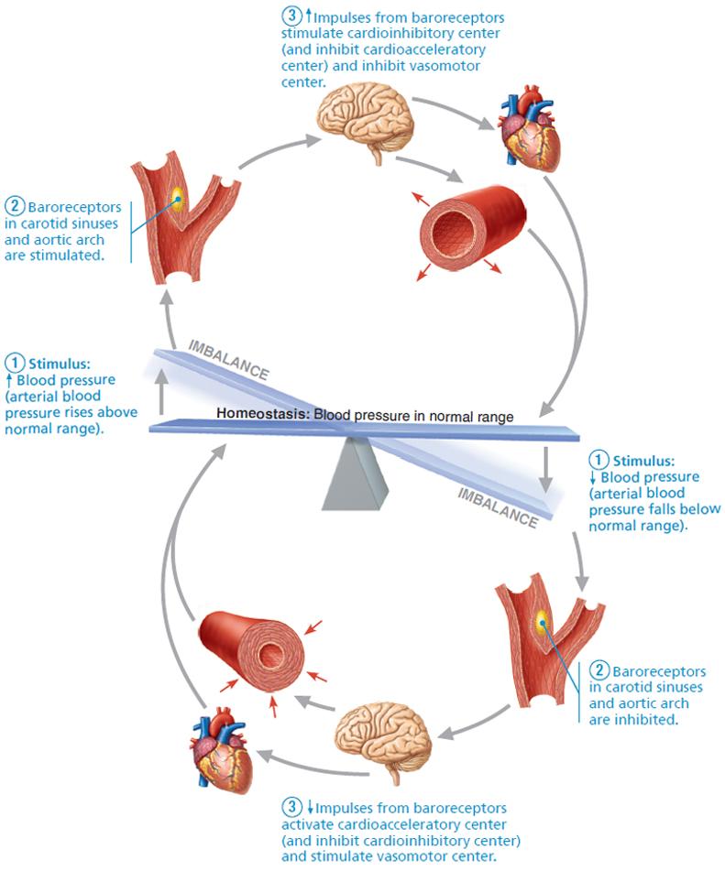
Baroreceptor Reflexes that Help Maintain Blood Pressure Homeostasis (3 of 5)
Figure 19.11 Baroreceptor reflexes that help maintain blood pressure homeostasis.

Slide 41
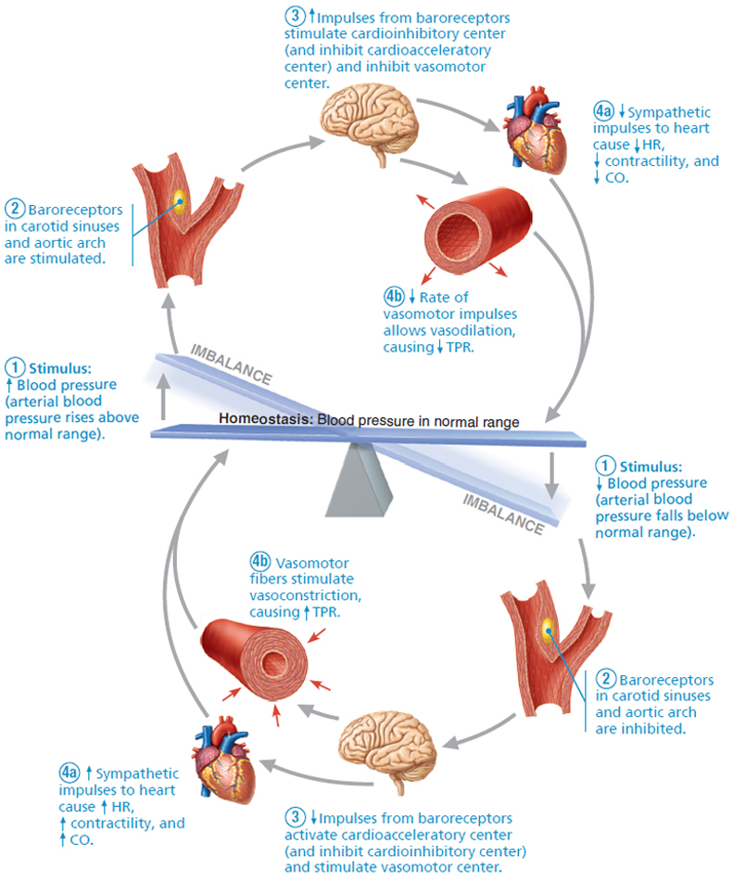
Baroreceptor Reflexes that Help Maintain Blood Pressure Homeostasis (4 of 5)
Figure 19.11 Baroreceptor reflexes that help maintain blood pressure homeostasis.

Slide 42
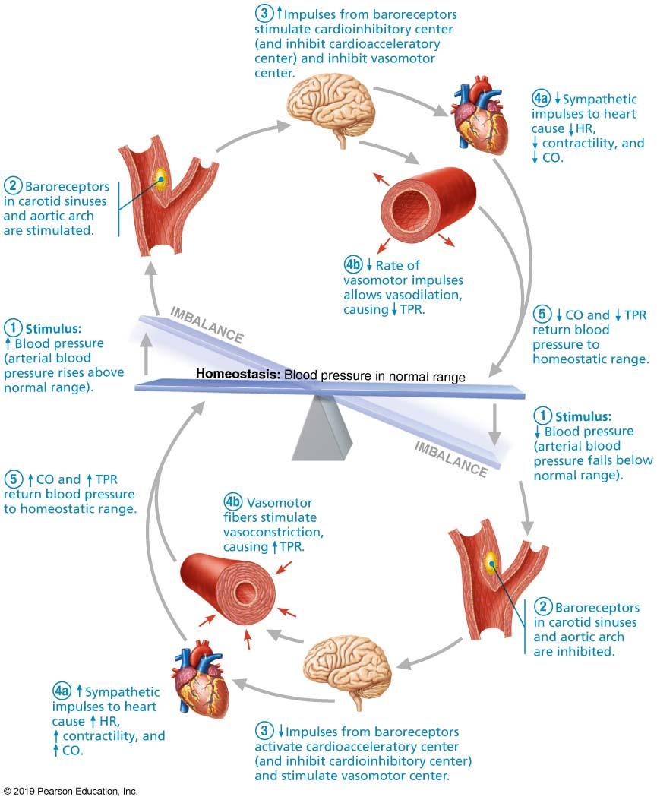
Baroreceptor Reflexes that Help Maintain Blood Pressure Homeostasis (5 of 5)
Figure 19.11 Baroreceptor reflexes that help maintain blood pressure homeostasis.

Slide 43
Short-Term Regulation: Neural Controls
(8 of 9)
Chemoreceptor reflexes
  Aortic arch and large arteries of neck detect increase in CO₂, or drop in pH or O₂
  Cause increased blood pressure by:
    Signaling cardioacceleratory center to increase CO
    Signaling vasomotor center to increase vasoconstriction

Slide 44
Short-Term Regulation: Neural Controls
(9 of 9)
Influence of higher brain centers
  Reflexes that regulate BP are found in medulla
  Hypothalamus and cerebral cortex can modify arterial pressure via relays to medulla
  Hypothalamus increases blood pressure during stress
  Hypothalamus mediates redistribution of blood flow during exercise and changes in body temperature

Slide 45
Short-Term Mechanisms: Hormonal Controls
Hormones regulate BP in short term via changes in peripheral resistance or long term via changes in blood volume
Adrenal medulla hormones
  Epinephrine and norepinephrine from adrenal gland increase CO and vasoconstriction
Angiotensin II stimulates vasoconstriction
ADH: high levels can cause vasoconstriction
Atrial natriuretic peptide decreases BP by antagonizing aldosterone, causing decreased blood volume

Slide 46
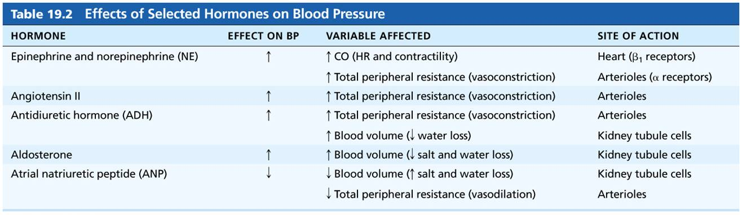
Table 19.2 Effects of Selected Hormones on Blood Pressure
Table 19.2 Effects of Selected Hormones on Blood Pressure

Slide 47
Long-Term Mechanisms: Renal Regulation (1 of 4)
Baroreceptors quickly adapt to chronic high or low BP so are ineffective for long-term regulation
Long-term mechanisms control BP by altering blood volume via kidneys
Kidneys regulate arterial blood pressure by:
  Direct renal mechanism
  Indirect renal mechanism (renin-angiotensin-aldosterone)

Slide 48
Long-Term Mechanisms: Renal Regulation (2 of 4)
Direct renal mechanism
  Alters blood volume independently of hormones
    Increased BP or blood volume causes elimination of more urine, thus reducing BP
    Decreased BP or blood volume causes kidneys to conserve water, and BP rises

Slide 49
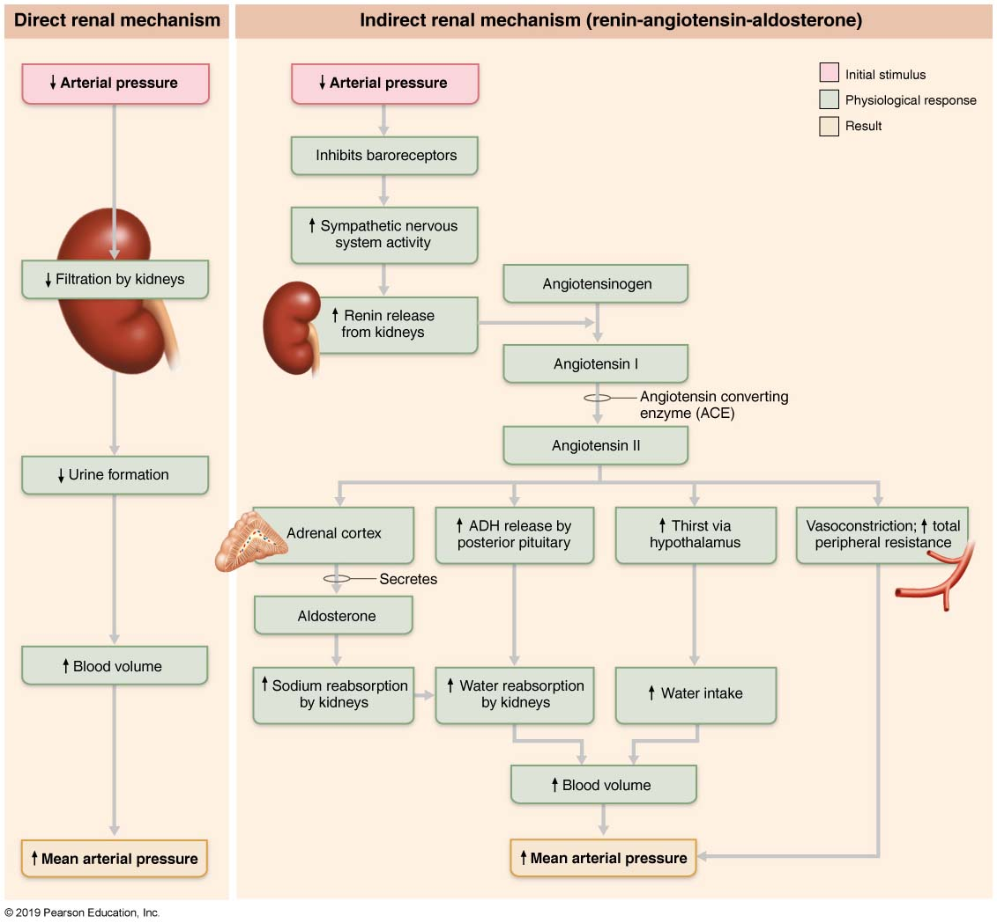
Direct and Indirect (Hormonal) Mechanisms for Renal Control of Blood Pressure (1 of 2)
Figure 19.12 Direct and indirect (hormonal) mechanisms for renal control of blood pressure.

Slide 50
Long-Term Mechanisms: Renal Regulation (3 of 4)
Indirect mechanism
  The renin-angiotensin-aldosterone mechanism
    Decreased arterial blood pressure causes release of renin from kidneys
    Renin enters blood and catalyzes conversion of angiotensinogen from liver to angiotensin I
    Angiotensin-converting enzyme, especially from lungs, converts angiotensin I to angiotensin II

Slide 51
Long-Term Mechanisms: Renal Regulation (4 of 4)
Indirect mechanism (cont.)
  Angiotensin II acts in four ways to stabilize arterial BP and ECF:
    Stimulates aldosterone secretion
    Causes ADH release from posterior pituitary
    Triggers hypothalamic thirst center to drink more water
    Acts as a potent vasoconstrictor, directly increasing blood pressure

Slide 52
Direct and Indirect (Hormonal) Mechanisms for Renal Control of Blood Pressure (2 of 2)
Figure 19.12 Direct and indirect (hormonal) mechanisms for renal control of blood pressure.

Slide 53
Summary of Blood Pressure Regulation
Goal of blood pressure regulation is to keep blood pressure high enough to provide adequate tissue perfusion, but not so high that blood vessels are damaged
  Example: If BP to brain is too low, perfusion is inadequate, and person loses consciousness
  If BP to brain is too high, person could have stroke

Slide 54
IP2: Factors Affecting Blood Pressure: Summary
Click here to view ADA compliant Animation:
IP2: Factors Affecting Blood Pressure: Summary
https://mediaplayer.pearsoncmg.com/assets/secs-ip2-fabp-sc11-summary

Slide 55
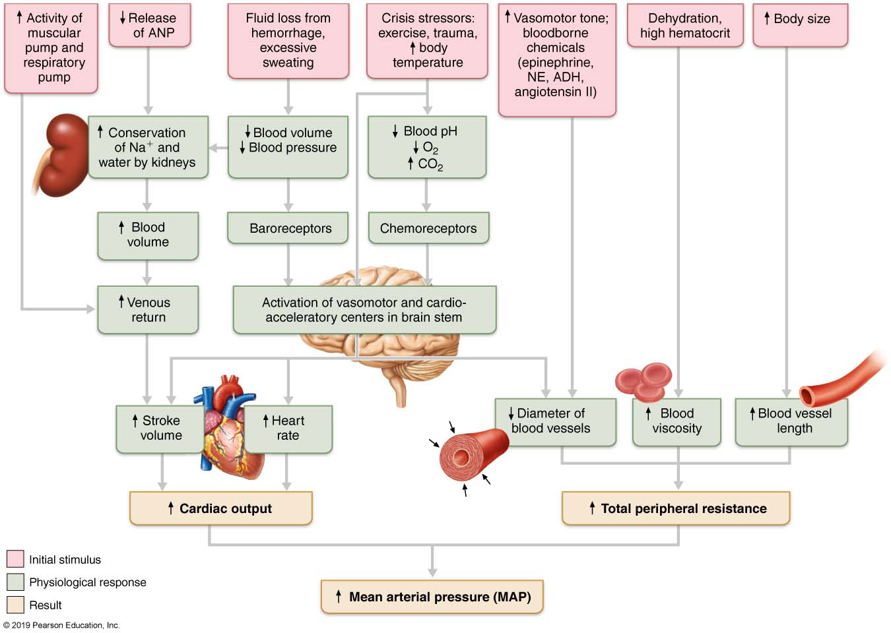
Factors that Increase MAP
Figure 19.13 Factors that increase MAP.

Slide 56
19.8 Regulation of Blood Pressure

Slide 57
Homeostatic Imbalances in Blood Pressure
(1 of 8)
Transient elevations in BP occur during changes in posture, physical exertion, emotional upset, fever
Age, sex, weight, race, mood, and posture may also cause BP to vary

Slide 58
Homeostatic Imbalances in Blood Pressure
(2 of 8)
Hypertension
  Sustained elevated arterial pressure of 140/90 mm Hg or higher
  Prehypertension if values elevated but not yet in hypertension range
    May be transient adaptations during fever, physical exertion, and emotional upset
    Often persistent in obese people

Slide 59
Homeostatic Imbalances in Blood Pressure
(3 of 8)
Hypertension (cont.)
  Prolonged hypertension is major cause of heart failure, vascular disease, renal failure, and stroke
    Heart must work harder; myocardium enlarges, weakens, and becomes flabby
    Also accelerates atherosclerosis

Slide 60
Homeostatic Imbalances in Blood Pressure
(4 of 8)
  Primary hypertension
    90% of hypertensive conditions
    No underlying cause identified
    Risk factors include heredity, diet, obesity, age, diabetes mellitus, stress, and smoking
    No cure but can be controlled
      Restrict salt, fat, cholesterol intake
      Increase exercise, lose weight, stop smoking
      Antihypertensive drugs

Slide 61
Homeostatic Imbalances in Blood Pressure
(5 of 8)
  Secondary hypertension
    Less common
    Due to identifiable disorders including obstructed renal arteries, kidney disease, and endocrine disorders such as hyperthyroidism and Cushing’s syndrome
    Treatment focuses on correcting underlying cause

Slide 62
Homeostatic Imbalances in Blood Pressure
(6 of 8)
Hypotension
  Low blood pressure below 90/60 mm Hg
  Usually not a concern unless it causes inadequate blood flow to tissues
  Often associated with long life and lack of cardiovascular illness

Slide 63
Homeostatic Imbalances in Blood Pressure
(7 of 8)
Hypotension (cont.)
  Orthostatic hypotension: temporary low BP and dizziness when suddenly rising from sitting or reclining position
  Chronic hypotension: hint of poor nutrition and warning sign for Addison’s disease or hypothyroidism
  Acute hypotension: important sign of circulatory shock

Slide 64
Homeostatic Imbalances in Blood Pressure
(8 of 8)
Circulatory shock
  Condition where blood vessels inadequately fill and cannot circulate blood normally
    Inadequate blood flow cannot meet tissue needs
  Hypovolemic shock results from large-scale blood loss
  Vascular shock results from extreme vasodilation and decreased peripheral resistance
  Cardiogenic shock results when an inefficient heart cannot sustain adequate circulation

Slide 65

Copyright

