Slide 1
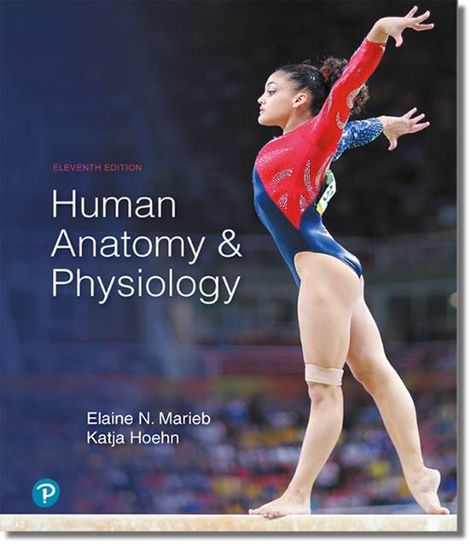
Human Anatomy and Physiology
Eleventh Edition
Chapter 19 Part A
The Cardiovascular System:
Blood Vessels
PowerPoint® Lectures Slides prepared by Karen Dunbar Kareiva, Ivy Tech Community College
Copyright © 2019, 2016, 2013 Pearson Education, Inc. All Rights Reserved

Slide 2
Why This Matters
Understanding how the body controls blood pressure helps to measure a patient’s blood pressure accurately

Slide 3
Video: Why This Matters (Career Connection)
Click here to view ADA compliant video:
Why This Matters (Career Connection)
https://mediaplayer.pearsoncmg.com/assets/secs_wtm_ch_19_peter_v2

Slide 4
Part 1 Blood Vessel Structure and Function
Blood vessels: delivery system of dynamic structures that begins and ends at heart
Work with lymphatic system to circulate fluids
Arteries: carry blood away from heart; oxygenated except for pulmonary circulation and umbilical vessels of fetus
Capillaries: direct contact with tissue cells; directly serve cellular needs
Veins: carry blood toward heart; deoxygenated except for pulmonary circulation and umbilical vessels of fetus

Slide 5
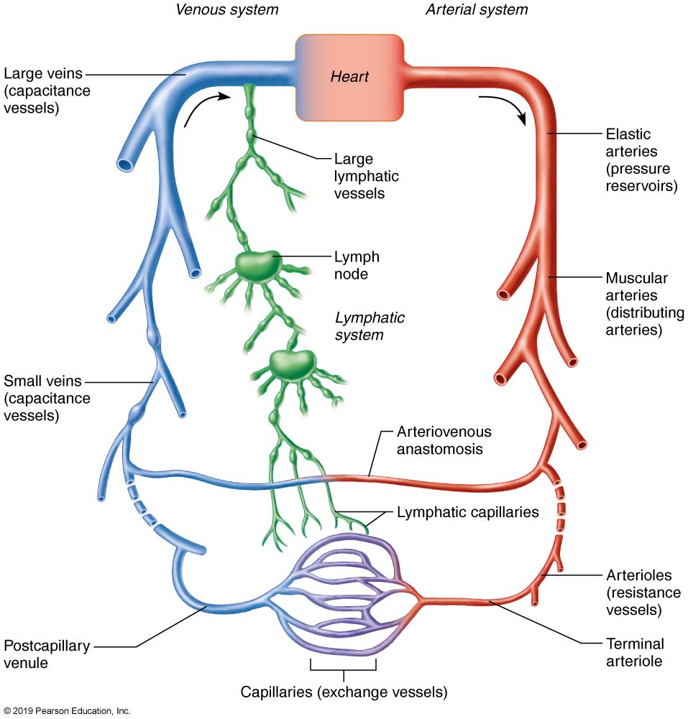
The Relationship of Blood Vessels to Each Other and to Lymphatic Vessels
Figure 19.1 The relationship of blood vessels to each other and to lymphatic vessels.

Slide 6
19.1 Structure of Blood Vessel Wall (1 of 4)
All vessels consist of a lumen, central blood-containing space, surrounded by a wall
Walls of all vessels, except capillaries, have three layers, or tunics:
Tunica intima
Tunica media
Tunica externa
Capillaries
Endothelium with sparse basal lamina

Slide 7
19.1 Structure of Blood Vessel Wall (2 of 4)
Tunica intima
Innermost layer that is in “intimate” contact with blood
Endothelium: simple squamous epithelium that lines lumen of all vessels
Continuous with endocardium
Slick surface reduces friction
Subendothelial layer: connective tissue basement membrane
Found only in vessels larger than 1 mm

Slide 8
19.1 Structure of Blood Vessel Wall (3 of 4)
Tunica media
Middle layer composed mostly of smooth muscle and sheets of elastin
Sympathetic vasomotor nerve fibers innervate this layer, controlling:
Vasoconstriction: decreased lumen diameter
Vasodilation: increased lumen diameter
Bulkiest layer responsible for maintaining blood flow and blood pressure

Slide 9
19.1 Structure of Blood Vessel Wall (4 of 4)
Tunica externa
Outermost layer of wall
Also called tunica adventitia
Composed mostly of loose collagen fibers that protect and reinforce wall and anchor it to surrounding structures
Infiltrated with nerve fibers, lymphatic vessels
Large veins also contain elastic fibers in this layer
Vasa vasorum: system of tiny blood vessels found in larger vessels
Function to nourish outermost external layer

Slide 10
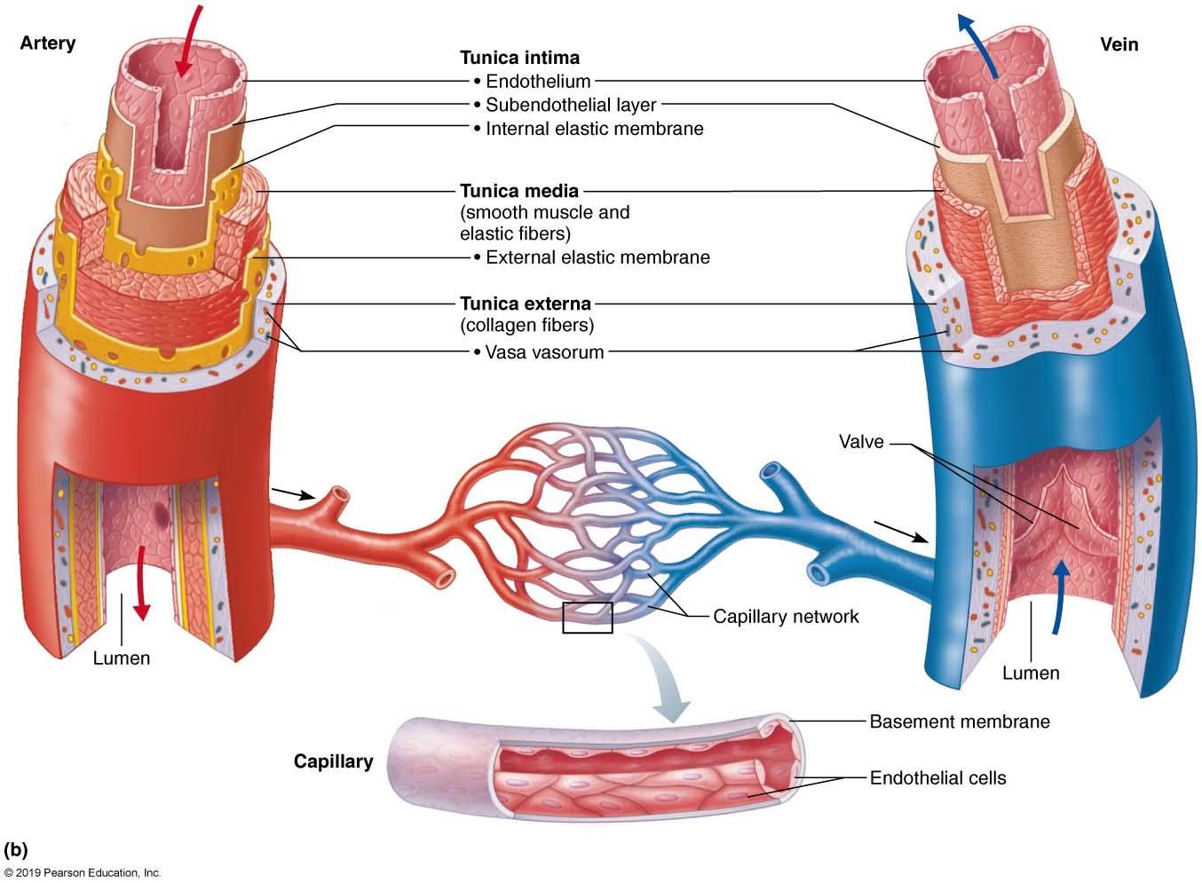
Generalized Structure of Arteries, Veins, and Capillaries (1 of 3)
Figure 19.2b Generalized structure of arteries, veins, and capillaries.

Slide 11
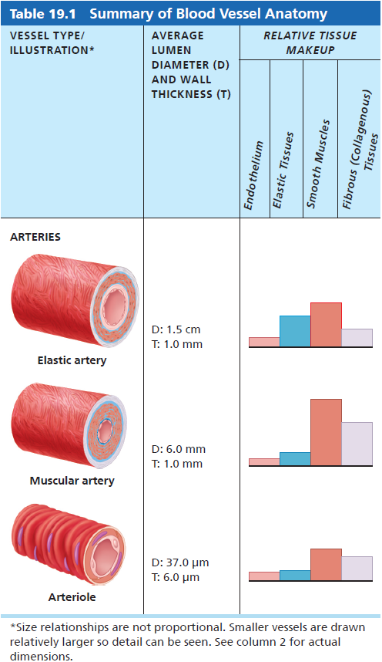
Table 19.1-1 Summary of Blood Vessel Anatomy (1 of 4)
Table 19.1-1 Summary of Blood Vessel Anatomy.

Slide 12
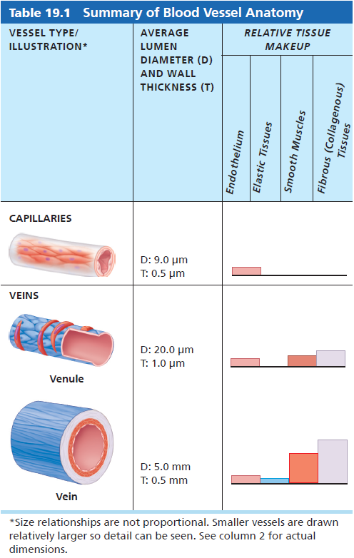
Table 19.1-2 Summary of Blood Vessel Anatomy (2 of 4)
Table 19.1-2 Summary of Blood Vessel Anatomy.

Slide 13
19.2 Arteries
Arteries divided into three groups, based on size and function
Elastic arteries
Muscular arteries
Arterioles

Slide 14
Elastic Arteries (1 of 2)
Elastic arteries: thick-walled with large, low-resistance lumen
Aorta and its major branches: also called conducting arteries because they conduct blood from heart to medium sized vessels
Elastin found in all three tunics, mostly tunica media
Contain substantial smooth muscle, but inactive in vasoconstriction

Slide 15
Elastic Arteries (2 of 2)
Act as pressure reservoirs that expand and recoil as blood is ejected from heart
Allows for continuous blood flow downstream even between heartbeats

Slide 16
Muscular Arteries
Elastic arteries give rise to muscular arteries
Also called distributing arteries because they deliver blood to body organs
Diameters range from pinky-finger size to pencil-lead size
Account for most of named arteries
Have thickest tunica media with more smooth muscle, but less elastic tissue
Tunica media sandwiched between elastic membranes
Active in vasoconstriction

Slide 17
Arterioles
Arterioles: smallest of all arteries
Larger arterioles contain all three tunics
Smaller arterioles are mostly single layer of smooth muscle surrounding endothelial cells
Control flow into capillary beds via vasodilation and vasoconstriction of smooth muscle
Also called resistance arteries because changing diameters change resistance to blood flow
Lead to capillary beds

Slide 18
19.3 Capillaries (1 of 2)
Microscopic vessels; diameters so small only single RBC can pass through at a time
Walls just thin tunica intima; in smallest vessels, one cell forms entire circumference
Pericytes: spider-shaped stem cells help stabilize capillary walls, control permeability, and play a role in vessel repair
Supply almost every cell, except for cartilage, epithelia, cornea, and lens of eye

Slide 19
19.3 Capillaries (2 of 2)
Functions: exchange of gases, nutrients, wastes, hormones, etc., between blood and interstitial fluid

Slide 20
Types of Capillaries (1 of 3)
All capillary endothelial cells are joined by tight junctions with gaps called intercellular clefts
Allow passage of fluids and small solutes
Three types of capillaries
Continuous capillaries
Abundant in skin, muscles, lungs, and CNS
Continuous capillaries of brain are unique
Form blood brain barrier, totally enclosed with tight junctions and no intercellular clefts

Slide 21
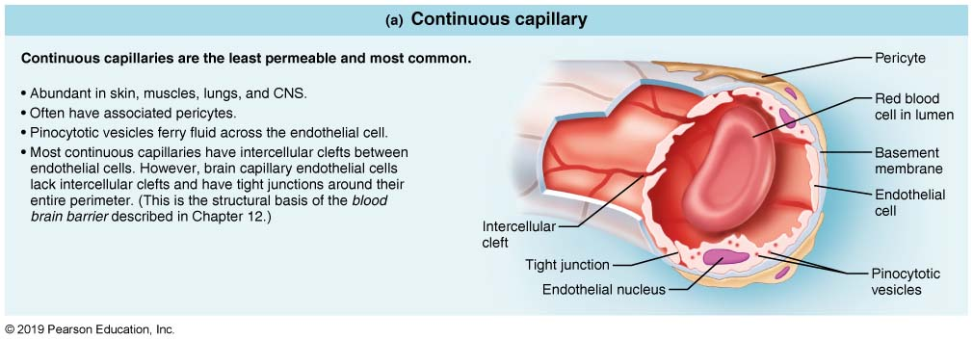
Capillary Structure (1 of 3)
Figure 19.3a Capillary structure.

Slide 22
Types of Capillaries (2 of 3)
Fenestrated capillary
Found in areas involved in active filtration (kidneys), absorption (intestines), or endocrine hormone secretion
Endothelial cells contain Swiss cheese–like pores called fenestrations
Allow for increased permeability
Fenestrations usually covered with thin glycoprotein diaphragm

Slide 23
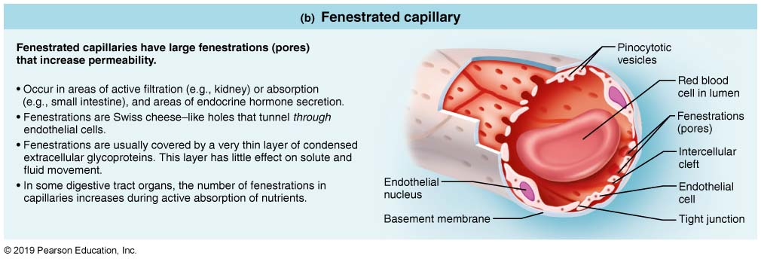
Capillary Structure (2 of 3)
Figure 19.3b Capillary structure.

Slide 24
Types of Capillaries (3 of 3)
Sinusoidal capillaries
Fewer tight junctions; usually fenestrated with larger intercellular clefts; incomplete basement membranes
Usually have larger lumens
Found only in the liver, bone marrow, spleen, and adrenal medulla
Blood flow is sluggish—allows time for modification of large molecules and blood cells that pass between blood and tissue
Contain macrophages in lining to capture and destroy foreign invaders

Slide 25
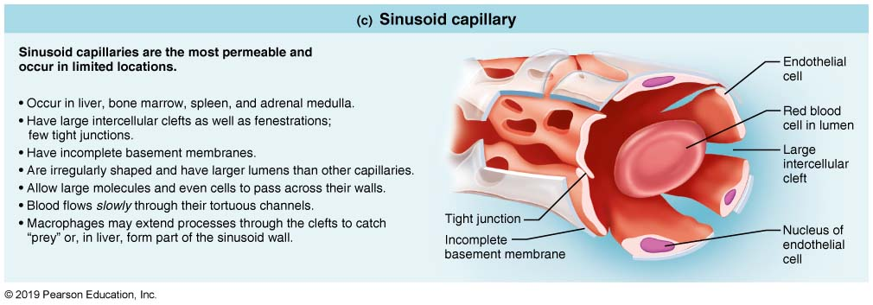
Capillary Structure (3 of 3)
Figure 19.3c Capillary structure.

Slide 26
Capillary Beds (1 of 3)
Capillary bed: interwoven network of capillaries between arterioles and venules
Microcirculation: flow of blood through bed from arteriole to venule
Terminal arteriole: branch off arteriole that further branches into 10 to 20 capillaries (exchange vessels) that form capillary bed
Exchange of gases, nutrients and wastes from surrounding tissue takes place in capillaries
Capillaries then drain into postcapillary venule

Slide 27
Capillary Beds (2 of 3)
Flow through bed controlled by diameter of terminal arteriole and upstream arterioles
Local chemical conditions and arteriolar vasomotor nerve fibers regulate amount of blood entering capillary bed
Arteriole and terminal arteriole dilated when blood needed; constricted to shunt blood away from bed when not needed

Slide 28
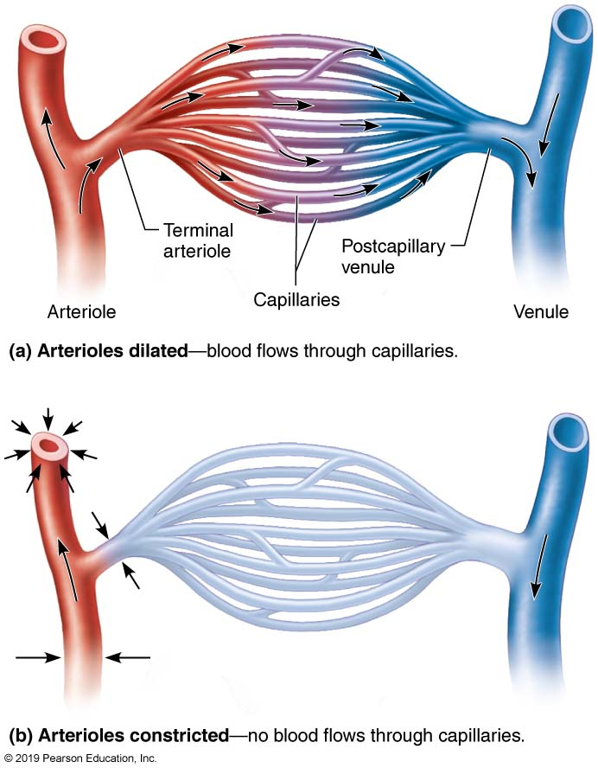
Anatomy of a Typical Capillary Bed
Figure 19.4 Anatomy of a typical capillary bed.

Slide 29
Capillary Beds (3 of 3)
Capillaries found in serous membranes of intestinal mesenteries have two additional features that form a special arrangement of capillaries:
Vascular shunt: channel that directly connects arteriole with venule (bypasses true capillaries)
- consists of metarteriole and thoroughfare channel
Precapillary sphincter: cuff of smooth muscle surrounding each true capillary that branches off metarteriole; acts as valve regulating blood flow into capillary bed
- Controlled by local chemical conditions (not innervated)

Slide 30
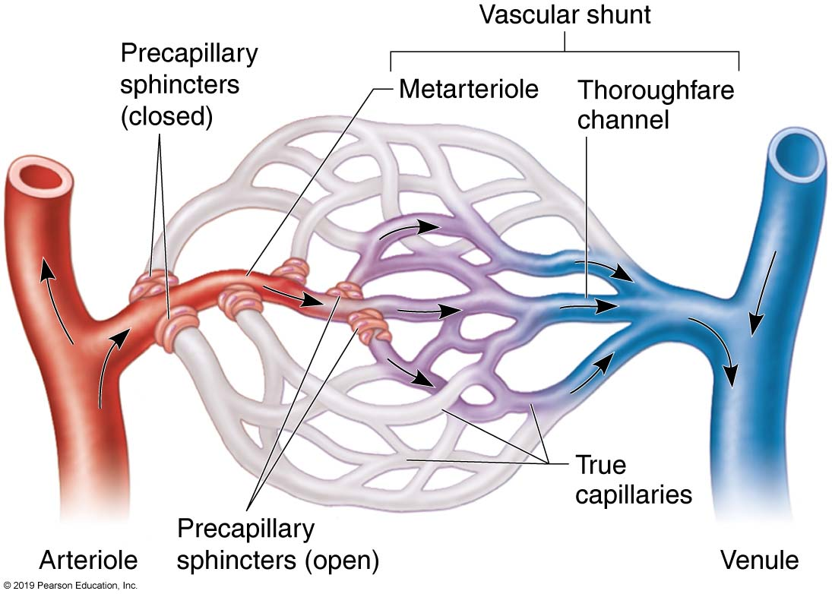
Anatomy of a Special (Mesenteric) Capillary Bed
Figure 19.5 Anatomy of a special (mesenteric) capillary bed.

Slide 31
19.4 Veins (1 of 3)
Veins: carry blood toward the heart
Formation begins when capillary beds unite in postcapillary venules and merge into larger and larger veins
Venules
Capillaries unite to form postcapillary venules
Consist of endothelium and a few pericytes
Very porous; allow fluids and WBCs into tissues
Larger venules have one or two layers of smooth muscle cells

Slide 32
19.4 Veins (2 of 3)
Formed when venules converge
Have all tunics, but thinner walls with large lumens compared with corresponding arteries
Tunica media is thin, but tunica externa is thick
Contain collagen fibers and elastic networks
Large lumen and thin walls make veins good storage vessels
Called capacitance vessels (blood reservoirs) because they contain up to 65% of blood supply

Slide 33
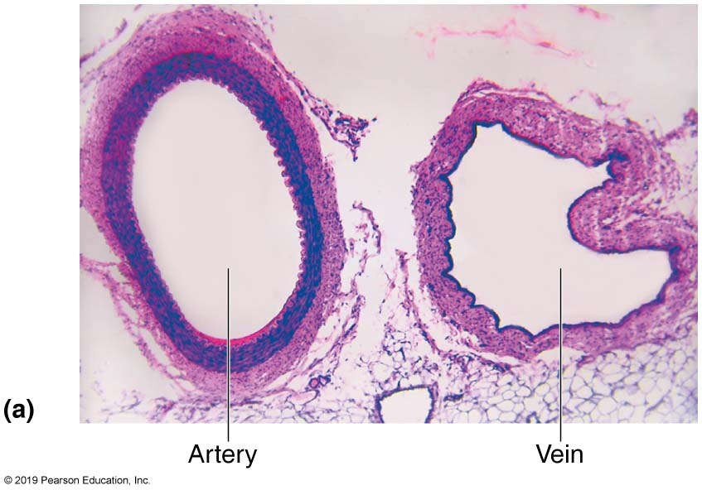
Generalized Structure of Arteries, Veins, and Capillaries (2 of 3)
Figure 19.2a Generalized structure of arteries, veins, and capillaries.

Slide 34
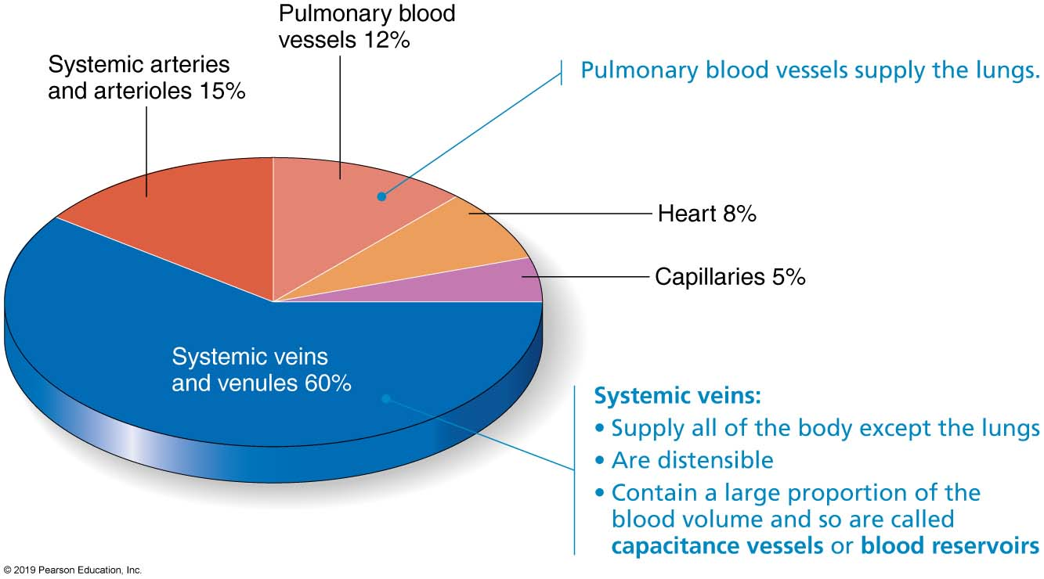
Relative Proportion of Blood Volume Throughout the Cardiovascular System
Figure 19.6 Relative proportion of blood volume throughout the cardiovascular system.

Slide 35
19.4 Veins (3 of 3)
Blood pressure lower than in arteries, so adaptations ensure return of blood to heart
Large-diameter lumens offer little resistance
Other adaptations
Venous valves
Prevent backflow of blood
Most abundant in veins of limbs
Venous sinuses
Flattened veins with extremely thin walls
Composed only of endothelium
Examples: coronary sinus of the heart and dural sinuses of the brain

Slide 36
Generalized Structure of Arteries, Veins, and Capillaries (3 of 3)
Figure 19.2b Generalized structure of arteries, veins, and capillaries.

Slide 37
Table 19.1-1 Summary of Blood Vessel Anatomy (3 of 4)
Table 19.1-1 Summary of Blood Vessel Anatomy.

Slide 38
Table 19.1-2 Summary of Blood Vessel Anatomy (4 of 4)
Table 19.1-2 Summary of Blood Vessel Anatomy.

Slide 39
Clinical – Homeostatic Imbalance 19.1 (1 of 2)
Varicose veins: dilated and painful veins due to incompetent (leaky) valves
Factors that contribute include heredity and conditions that hinder venous return
Example: prolonged standing in one position, obesity, or pregnancy; blood pools in lower limbs, weakening valves; affects more than 15% of adults

Slide 40
Clinical – Homeostatic Imbalance 19.1 (2 of 2)
Elevated venous pressure can cause varicose veins
Example: straining to deliver a baby or have a bowel movement raises intra-abdominal pressure, resulting in varicosities in anal veins called hemorrhoids

Slide 41
19.5 Anastomoses (1 of 2)
Vascular anastomoses: interconnections of blood vessels
Arterial anastomoses: provide alternate pathways (collateral channels) to ensure continuous flow, even if one artery is blocked
Common in joints, abdominal organs, brain, and heart; none in retina, kidneys, spleen

Slide 42
19.5 Anastomoses (2 of 2)
Arteriovenous anastomoses: shunts in capillaries; example: metarteriole–thoroughfare channel
Venous anastomoses: so abundant that occluded veins rarely block blood flow

Slide 43
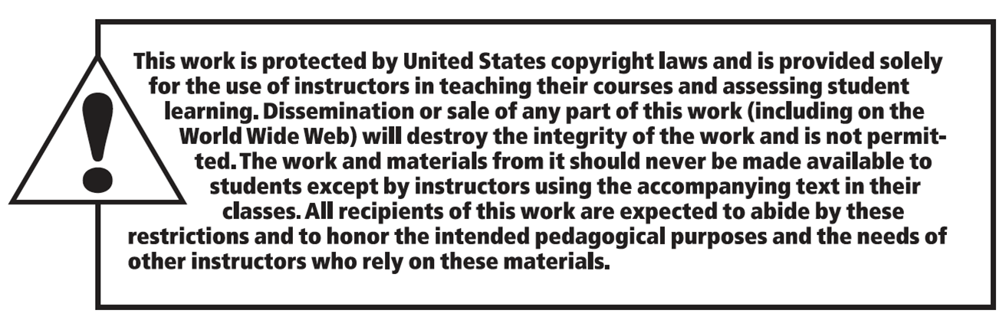
Copyright

