Slide 1
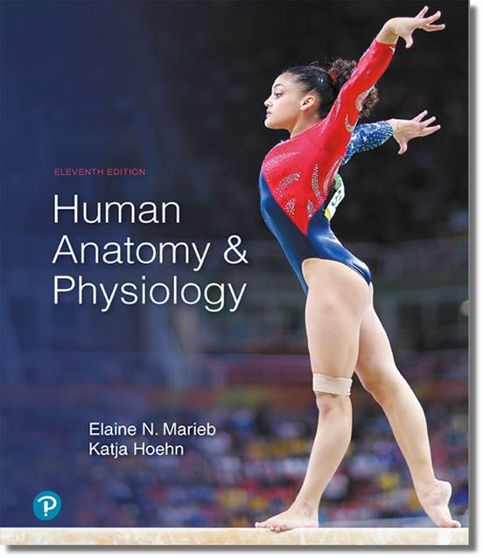
Human Anatomy and Physiology
Eleventh Edition
Chapter 18 Part B
The Cardiovascular System
PowerPoint® Lectures Slides prepared by Karen Dunbar Kareiva, Ivy Tech Community College
Copyright © 2019, 2016, 2013 Pearson Education, Inc. All Rights Reserved

Slide 2
18.5 Electrical Events of the Heart
Heart depolarizes and contracts without nervous system stimulation, although rhythm can be altered by autonomic nervous system

Slide 3
Setting the Basic Rhythm: The Intrinsic Conduction System (1 of 3)
Coordinated heartbeat is a function of:
Presence of gap junctions
Intrinsic cardiac conduction system
Network of noncontractile (autorhythmic) cells
Initiate and distribute impulses to coordinate depolarization and contraction of heart

Slide 4
Setting the Basic Rhythm: The Intrinsic Conduction System (2 of 3)
Action potential initiation by pacemaker cells
Cardiac pacemaker cells have unstable resting membrane potentials called pacemaker potentials or prepotentials
Three parts of action potential
Pacemaker potential: K⁺ channels are closed, but slow Na⁺ channels are open, causing interior to become more positive

Slide 5
Setting the Basic Rhythm: The Intrinsic Conduction System (3 of 3)
Action potential initiation by pacemaker cells (cont.)
Depolarization: Ca²⁺ channels open (around −40 mV), allowing huge influx of Ca²⁺, leading to rising phase of action potential
Repolarization: K⁺ channels open, allowing efflux of K⁺, and cell becomes more negative

Slide 6
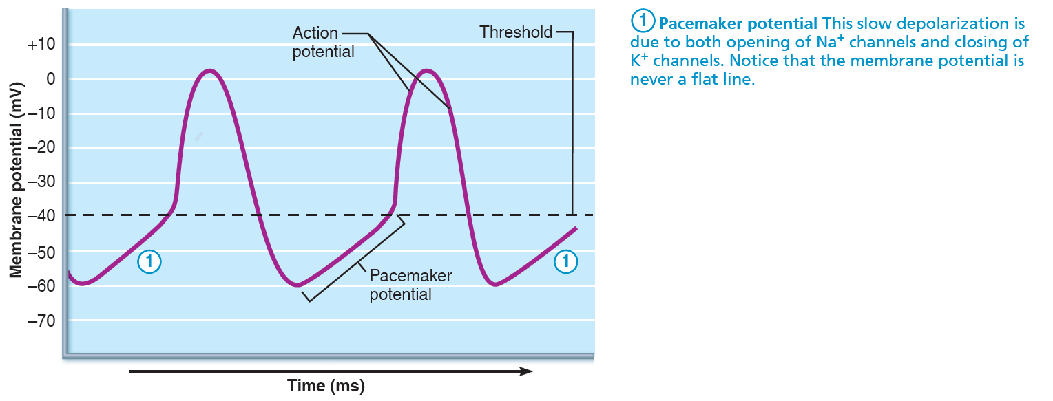
Pacemaker and Action Potentials of Typical Cardiac Pacemaker Cells (1 of 3)
Figure 18.12 Pacemaker and action potentials of typical cardiac pacemaker cells.

Slide 7
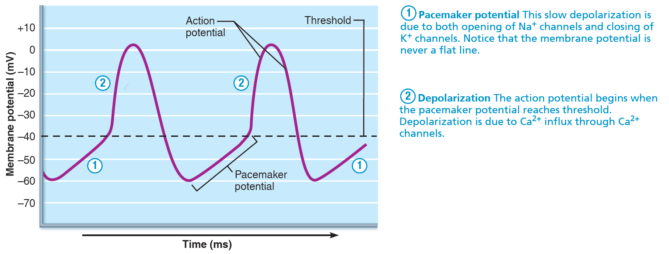
Pacemaker and Action Potentials of Typical Cardiac Pacemaker Cells (2 of 3)
Figure 18.12 Pacemaker and action potentials of typical cardiac pacemaker cells.

Slide 8
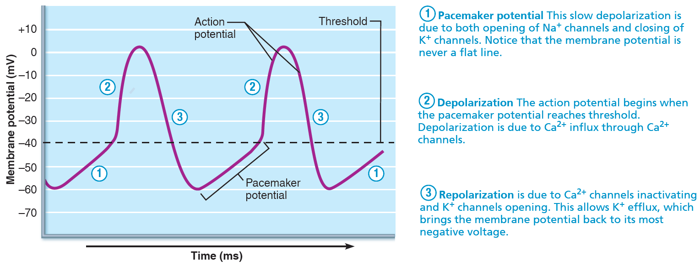
Pacemaker and Action Potentials of Typical Cardiac Pacemaker Cells (3 of 3)
Figure 18.12 Pacemaker and action potentials of typical cardiac pacemaker cells.

Slide 9
Setting the Basic Rhythm: The Intrinsic Conduction System (4 of 8)
Sequence of excitation
Cardiac pacemaker cells pass impulses, in following order, across heart in ~0.22 seconds
Sinoatrial node →
Atrioventricular node →
Atrioventricular bundle →
Right and left bundle branches →
Subendocardial conducting network (Purkinje fibers)

Slide 10
Setting the Basic Rhythm: The Intrinsic Conduction System (5 of 8)
Sinoatrial (SA) node
Pacemaker of heart in right atrial wall
Depolarizes faster than rest of myocardium
Generates impulses about 75×/minute (sinus rhythm)
Inherent rate of 100×/minute tempered by extrinsic factors
Impulse spreads across atria, and to AV node

Slide 11
Setting the Basic Rhythm: The Intrinsic Conduction System (6 of 8)
Atrioventricular (AV) node
In inferior interatrial septum
Delays impulses approximately 0.1 second
Because fibers are smaller in diameter, have fewer gap junctions
Allows atrial contraction prior to ventricular contraction
Inherent rate of 50×/minute in absence of SA node input

Slide 12
Setting the Basic Rhythm: The Intrinsic Conduction System (7 of 8)
Atrioventricular (AV) bundle (bundle of His)
In superior interventricular septum
Only electrical connection between atria and ventricles
Atria and ventricles not connected via gap junctions
Right and left bundle branches
Two pathways in interventricular septum
Carry impulses toward apex of heart

Slide 13
Setting the Basic Rhythm: The Intrinsic Conduction System (8 of 8)
Subendocardial conducting network
Also referred to as Purkinje fibers
Complete pathway through interventricular septum into apex and ventricular walls
More elaborate on left side of heart
AV bundle and subendocardial conducting network depolarize 30×/minute in absence of AV node input
Ventricular contraction immediately follows from apex toward atria
Process from initiation at SA node to complete contraction takes ~0.22 seconds

Slide 14
IP2: Pathway of Depolarization
Click here to view ADA compliant Animation:
IP2: Pathway of Depolarization
https://mediaplayer.pearsoncmg.com/assets/bDEJOOE3MAhFT7pkuKe5xSWVGFqgBPe_

Slide 15
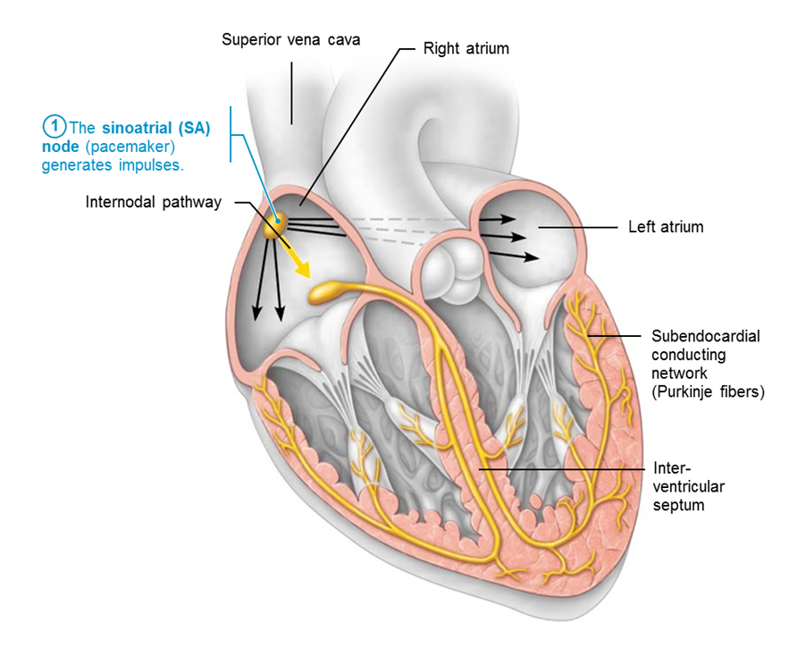
Intrinsic Cardiac Conduction System and Action Potential Succession During one Heartbeat (1 of 4)
Figure 18.13 The intrinsic cardiac conduction system.

Slide 16
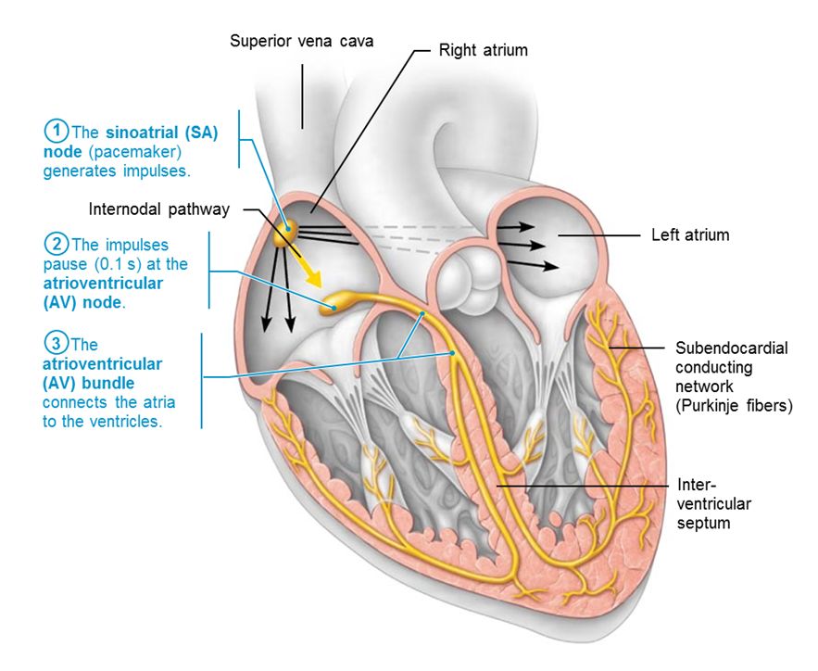
Intrinsic Cardiac Conduction System and Action Potential Succession During one Heartbeat (2 of 4)
Figure 18.13 The intrinsic cardiac conduction system.

Slide 17
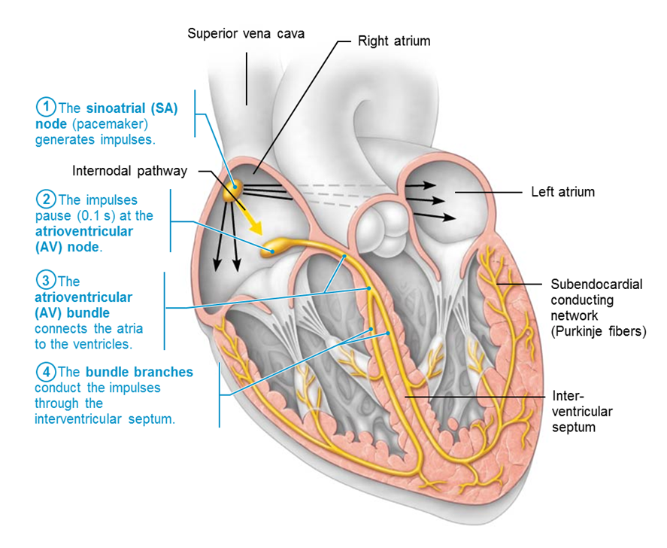
Intrinsic Cardiac Conduction System and Action Potential Succession During one Heartbeat (3 of 4)
Figure 18.13 The intrinsic cardiac conduction system.

Slide 18
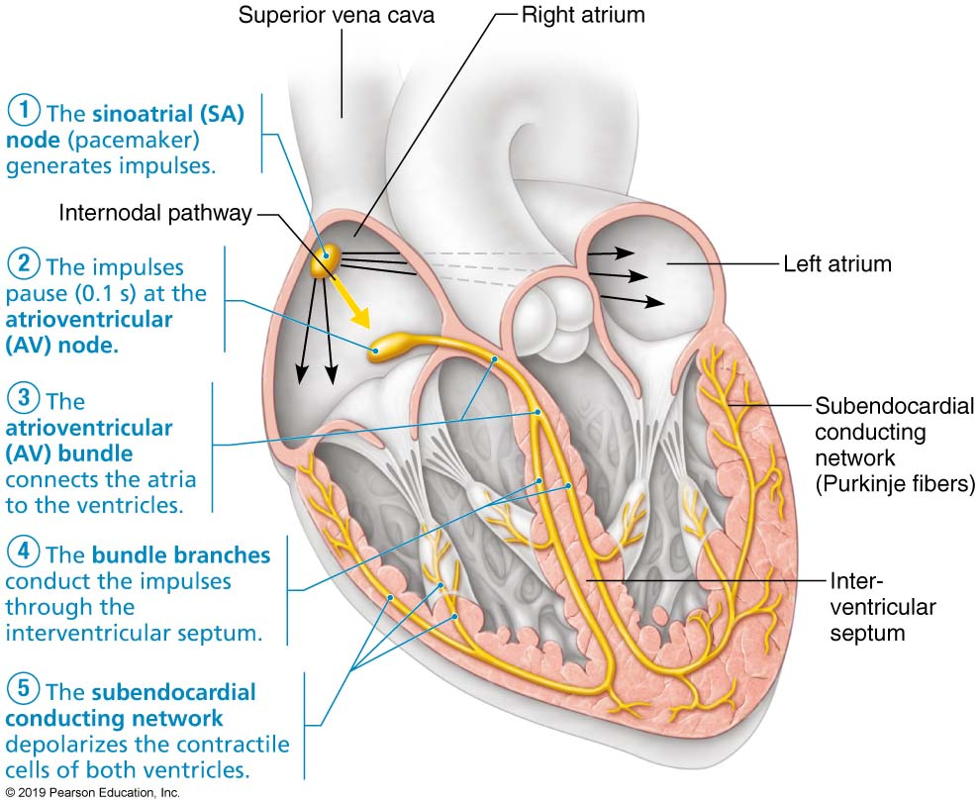
Intrinsic Cardiac Conduction System and Action Potential Succession During one Heartbeat (4 of 4)
Figure 18.13 The intrinsic cardiac conduction system.

Slide 19
Clinical – Homeostatic Imbalance 18.4 (1 of 3)
Defects in intrinsic conduction system may cause:
Arrhythmias: irregular heart rhythms
Uncoordinated atrial and ventricular contractions
Fibrillation: rapid, irregular contractions
Heart becomes useless for pumping blood, causing circulation to cease; may result in brain death
Treatment: defibrillation interrupts chaotic twitching, giving heart “clean slate” to start regular, normal depolarizations

Slide 20
Clinical – Homeostatic Imbalance 18.4 (2 of 3)
Defective SA node may cause ectopic focus, an abnormal pacemaker that takes over pacing
If AV node takes over, it sets junctional rhythm at 40–60 beats/min
Extrasystole (premature contraction): ectopic focus of small region of heart that triggers impulse before SA node can, causing delay in next impulse
Heart has longer time to fill, so next contraction is felt as thud as larger volume of blood is being pushed out
Can be from excessive caffeine or nicotine

Slide 21
Clinical – Homeostatic Imbalance 18.4 (3 of 3)
To reach ventricles, impulse must pass through AV node
If AV node is defective, may cause a heart block
Few impulses (partial block) or no impulses (total block) reach ventricles
Ventricles beat at their own intrinsic rate
Too slow to maintain adequate circulation
Treatment: artificial pacemaker, which recouples atria and ventricles

Slide 22
Modifying the Basic Rhthym: Extrinsic Innervation of the Heart
Heartbeat modified by ANS via cardiac centers in medulla oblongata
Cardioacceleratory center: sends signals through sympathetic trunk to increase both rate and force
Stimulates SA and AV nodes, heart muscle, and coronary arteries
Cardioinhibitory center: parasympathetic signals via vagus nerve to decrease rate
Inhibits SA and AV nodes via vagus nerves

Slide 23
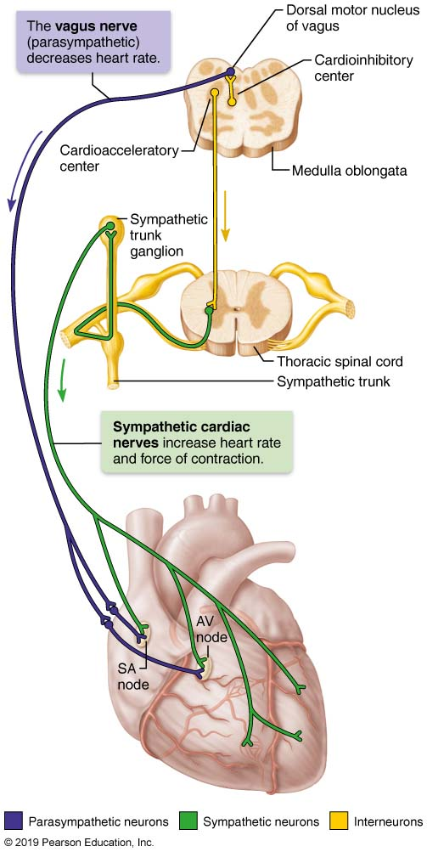
Autonomic Innervation of the Heart
Figure 18.14 Autonomic innervation of the heart.

Slide 24
Action Potentials of Contractile Cardiac Muscle Cells (1 of 3)
Contractile muscle fibers make up bulk of heart and are responsible for pumping action
Different from skeletal muscle contraction; cardiac muscle action potentials have plateau
Steps involved in AP:
Depolarization opens fast voltage-gated Na⁺ channels; Na⁺ enters cell
Positive feedback influx of Na⁺ causes rising phase of AP (from −90 mV to +30 mV)

Slide 25
Action Potentials of Contractile Cardiac Muscle Cells (2 of 3)
Depolarization by Na⁺ also opens slow Ca²⁺ channels
At +30 mV, Na⁺ channels close, but slow Ca²⁺ channels remain open, prolonging depolarization
Seen as a plateau
After about 200 ms, slow Ca²⁺ channels are closed, and voltage-gated K⁺ channels are open
Rapid efflux of K⁺ repolarizes cell to RMP
Ca²⁺ is pumped both back into SR and out of cell into extracellular space

Slide 26
Action Potentials of Contractile Cardiac Muscle Cells (3 of 3)
Difference between contractile muscle fiber and skeletal muscle fiber contractions
AP in skeletal muscle lasts 1–2 ms; in cardiac muscle it lasts 200 ms
Contraction in skeletal muscle lasts 15–100 ms; in cardiac contraction lasts over 200 ms
Benefit of longer AP and contraction:
Sustained contraction ensures efficient ejection of blood
Longer refractory period prevents tetanic contractions

Slide 27
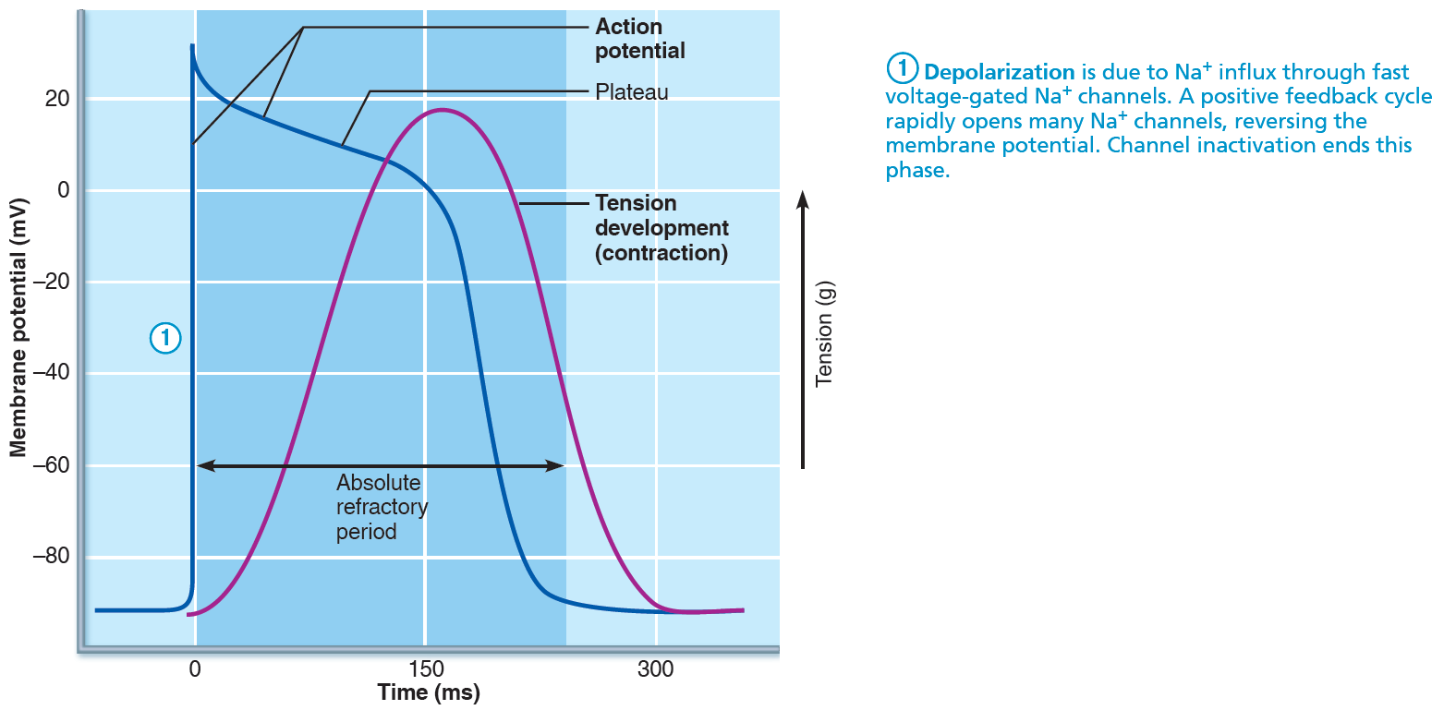
The Action Potential of Contractile Cardiac Muscle Cells (1 of 3)
Figure 18.15 The action potential of contractile cardiac muscle cells.

Slide 28
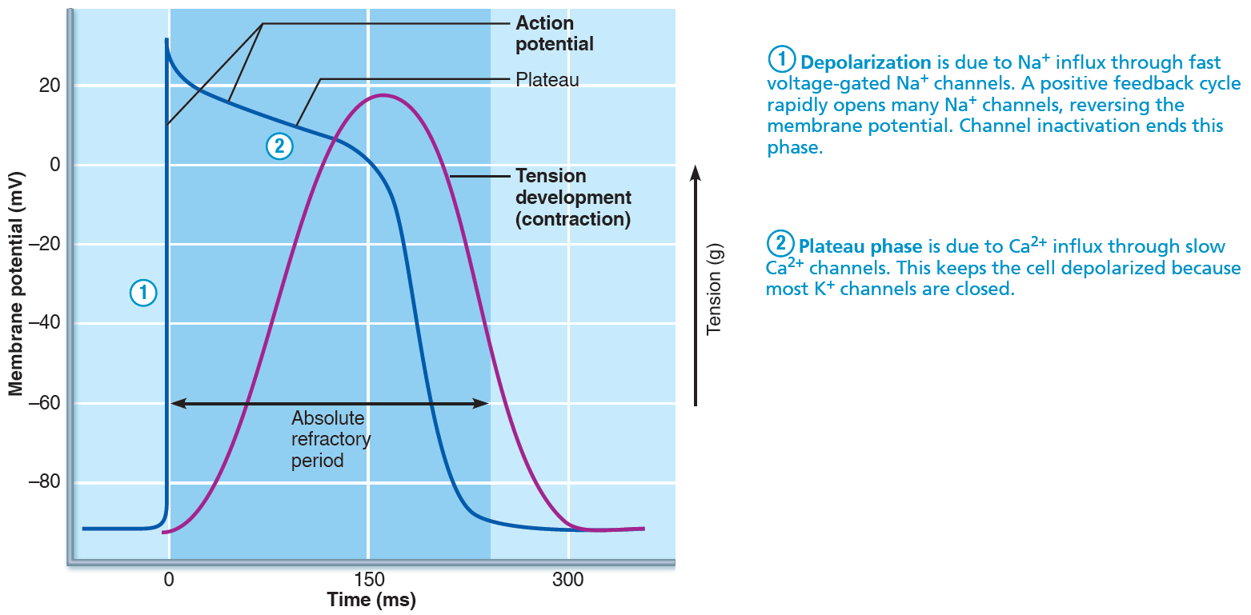
The Action Potential of Contractile Cardiac Muscle Cells (2 of 3)
Figure 18.15 The action potential of contractile cardiac muscle cells.

Slide 29
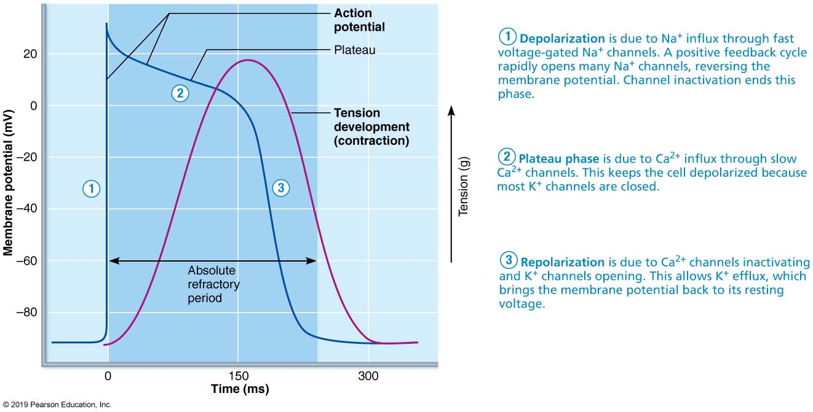
The Action Potential of Contractile Cardiac Muscle Cells (3 of 3)
Figure 18.15 The action potential of contractile cardiac muscle cells.

Slide 30
Electrocardiography (1 of 2)
Electrocardiograph can detect electrical currents generated by heart
Electrocardiogram (ECG or EKG) is a graphic recording of electrical activity
Composite of all action potentials at given time; not a tracing of a single AP
Electrodes are placed at various points on body to measure voltage differences
12 lead ECG is most typical

Slide 31
Electrocardiography (2 of 2)
Main features:
P wave: depolarization of SA node and atria
QRS complex: ventricular depolarization and atrial repolarization
T wave: ventricular repolarization
P-R interval: beginning of atrial excitation to beginning of ventricular excitation
S-T segment: entire ventricular myocardium depolarized
Q-T interval: beginning of ventricular depolarization through ventricular repolarization

Slide 32
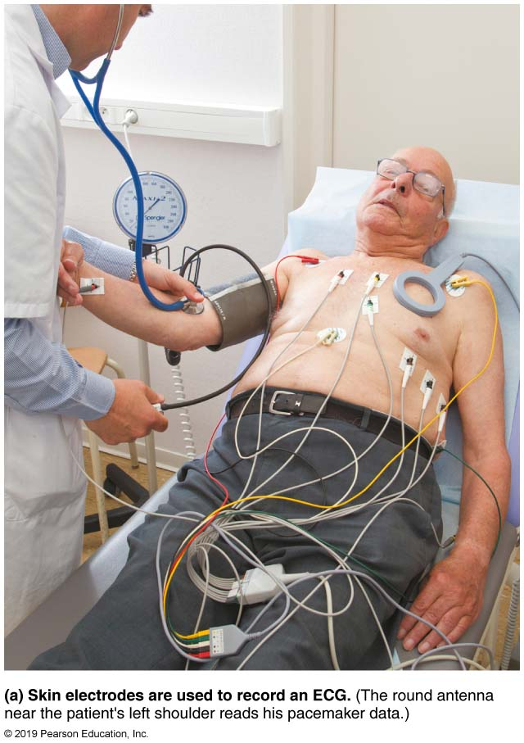
The Electrocardiogram (ECG) (1 of 2)
Figure 18.16a The electrocardiogram (ECG).

Slide 33
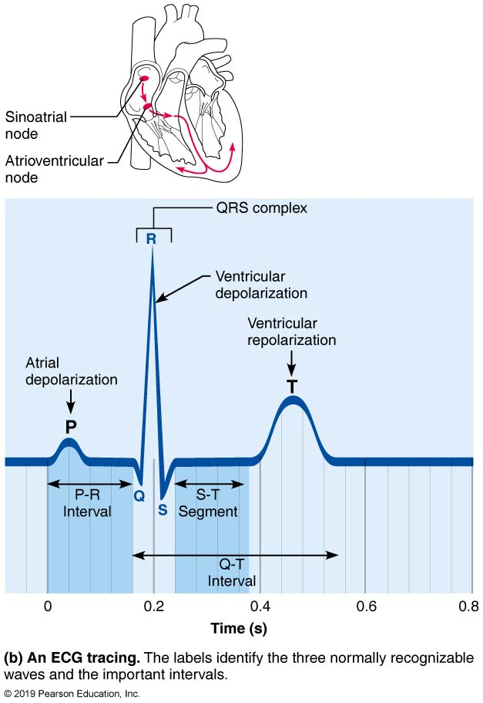
The Electrocardiogram (ECG) (2 of 2)
Figure 18.16b The electrocardiogram (ECG).

Slide 34
IP2: Electrocardiogram (ECGs)
Click here to view ADA compliant Animation:
IP2: Electrocardiogram (ECGs)
https://mediaplayer.pearsoncmg.com/assets/vBHgVGWh8ghoafbzR73p_nEESG2EpQjI

Slide 35
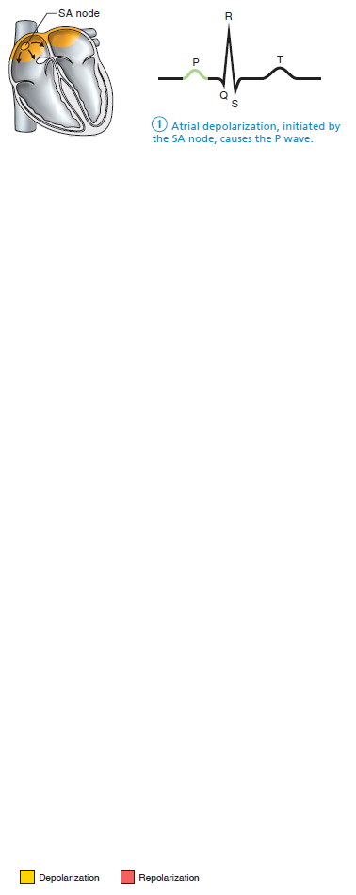
The Sequence of Depolarization and Repolarization of the Heart Related to the Deflection Waves of an ECG Tracing (1 of 6)
Figure 18.17 The sequence of depolarization and repolarization of the heart related to the ECG waves.

Slide 36
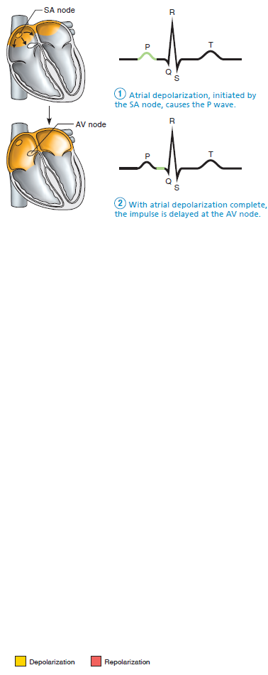
The Sequence of Depolarization and Repolarization of the Heart Related to the Deflection Waves of an ECG Tracing (2 of 6)
Figure 18.17 The sequence of depolarization and repolarization of the heart related to the ECG waves.

Slide 37
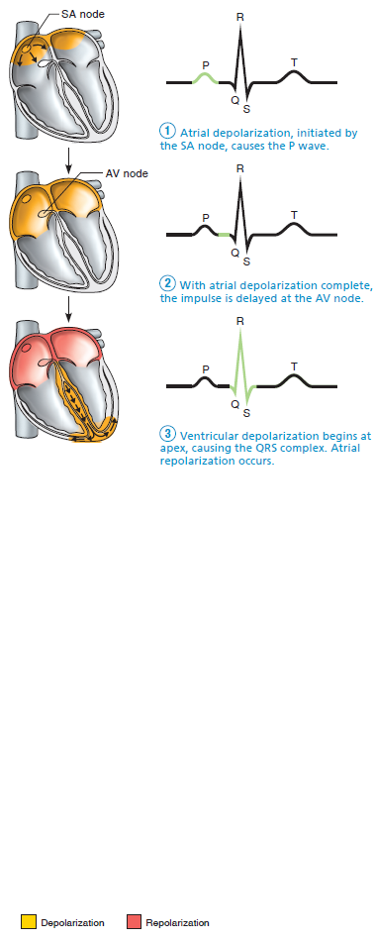
The Sequence of Depolarization and Repolarization of the Heart Related to the Deflection Waves of an ECG Tracing (3 of 6)
Figure 18.17 The sequence of depolarization and repolarization of the heart related to the ECG waves.

Slide 38
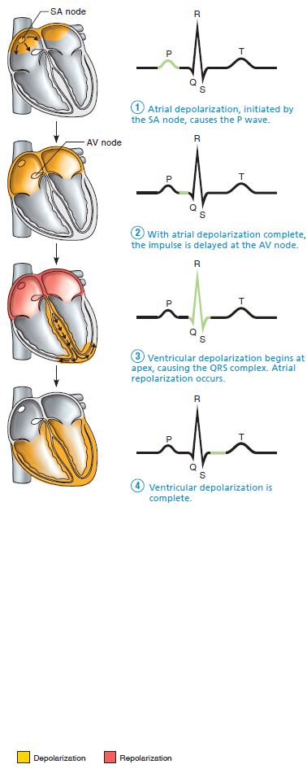
The Sequence of Depolarization and Repolarization of the Heart Related to the Deflection Waves of an ECG Tracing (4 of 6)
Figure 18.17 The sequence of depolarization and repolarization of the heart related to the ECG waves.

Slide 39
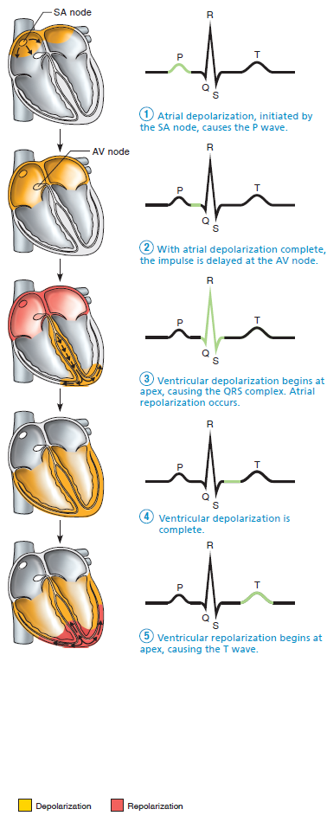
The Sequence of Depolarization and Repolarization of the Heart Related to the Deflection Waves of an ECG Tracing (5 of 6)
Figure 18.17 The sequence of depolarization and repolarization of the heart related to the ECG waves.

Slide 40
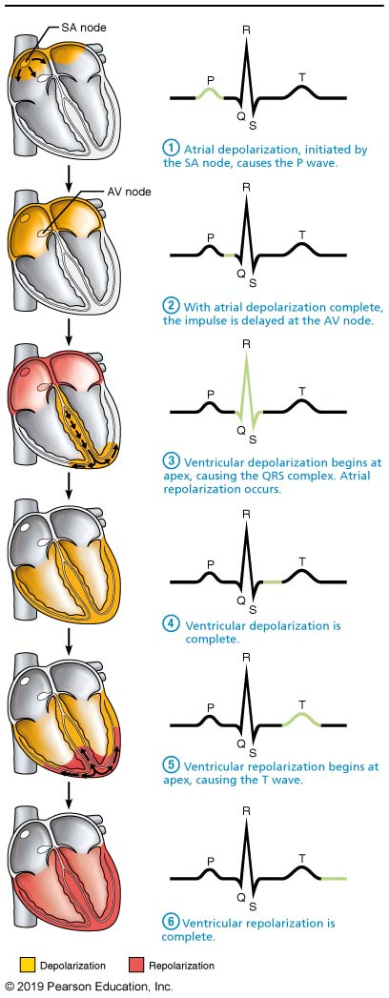
The Sequence of Depolarization and Repolarization of the Heart Related to the Deflection Waves of an ECG Tracing (6 of 6)
Figure 18.17 The sequence of depolarization and repolarization of the heart related to the ECG waves.

Slide 41
Clinical – Homeostatic Imbalance 18.5 (1 of 2)
Changes in patterns or timing of ECG may reveal diseased or damaged heart, or problems with heart’s conduction system
Problems that can be detected:
Enlarged R waves may indicate enlarged ventricles
Elevated or depressed S-T segment indicates cardiac ischemia

Slide 42
Clinical – Homeostatic Imbalance 18.5 (2 of 2)
Problems that can be detected: (cont.)
Prolonged Q-T interval reveals a repolarization abnormality that increases risk of ventricular arrhythmias

Slide 43
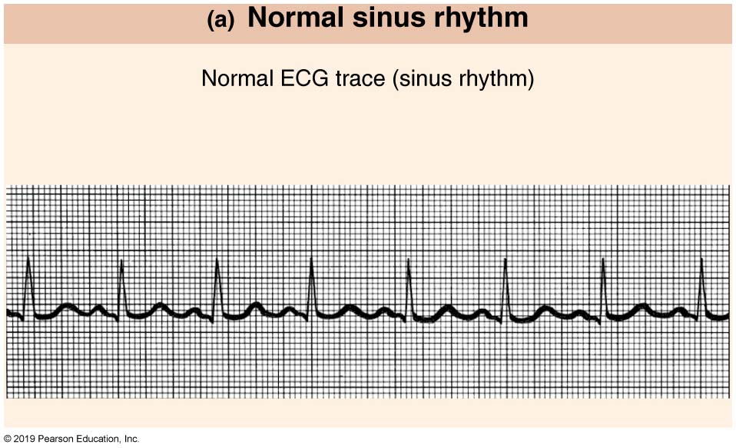
Normal and Abnormal ECG Tracings (1 of 4)
Figure 18.18a Normal and abnormal ECG tracings.

Slide 44
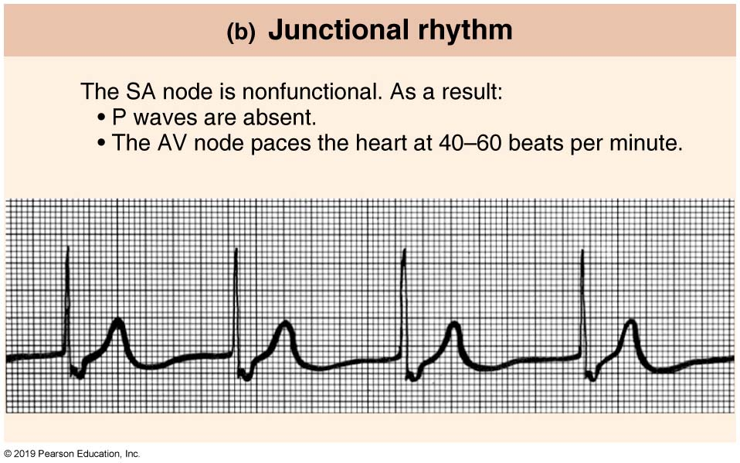
Normal and Abnormal ECG Tracings (2 of 4)
Figure 18.18b Normal and abnormal ECG tracings.

Slide 45
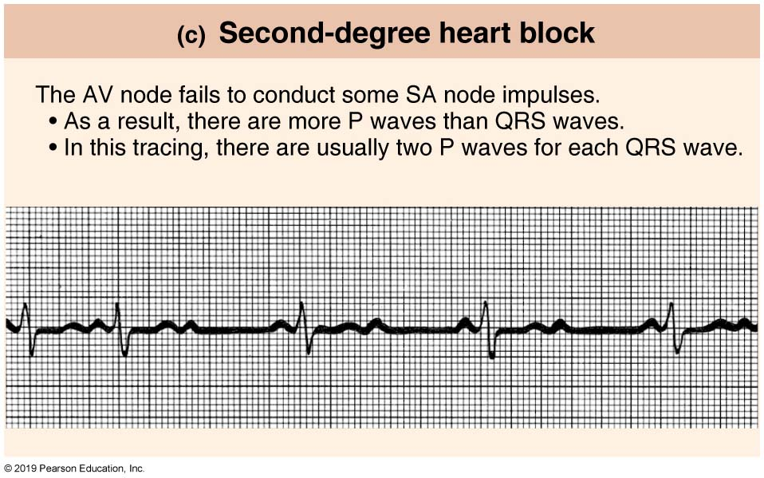
Normal and Abnormal ECG Tracings (3 of 4)
Figure 18.18c Normal and abnormal ECG tracings.

Slide 46
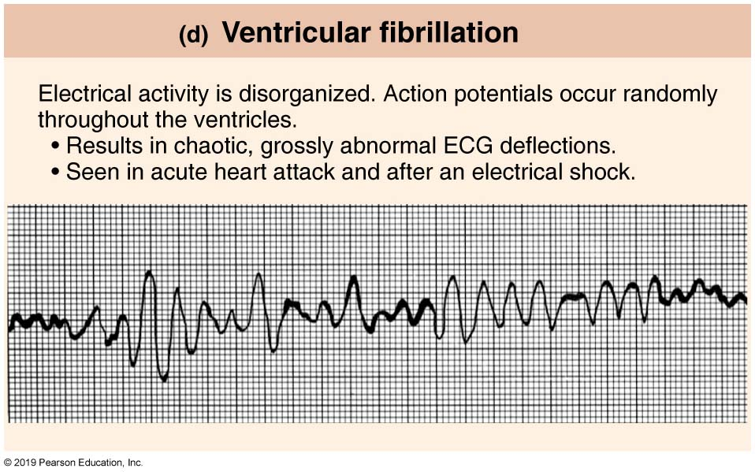
Normal and Abnormal ECG Tracings (4 of 4)
Figure 18.18d Normal and abnormal ECG tracings.

Slide 47
18.6 Mechanical Events of Heart (1 of 5)
Systole: period of heart contraction
Diastole: period of heart relaxation
Cardiac cycle: blood flow through heart during one complete heartbeat
Atrial systole and diastole are followed by ventricular systole and diastole
Cycle represents series of pressure and blood volume changes
Mechanical events follow electrical events seen on ECG
Three phases of the cardiac cycle (following left side, starting with total relaxation)

Slide 48
18.6 Mechanical Events of Heart (2 of 5)
Ventricular filling: mid-to-late diastole
Pressure is low; 80% of blood passively flows from atria through open AV valves into ventricles from atria (SL valves closed)
Atrial depolarization triggers atrial systole (P wave), atria contract, pushing remaining 20% of blood into ventricle
End diastolic volume (EDV): volume of blood in each ventricle at end of ventricular diastole
Depolarization spreads to ventricles (QRS wave)
Atria finish contracting and return to diastole while ventricles begin systole

Slide 49
18.6 Mechanical Events of Heart (3 of 5)
Isovolumetric contraction
Atria relax; ventricles begin to contract
Rising ventricular pressure causes closing of AV valves
Isovolumetric contraction phase is split-second period when ventricles are completely closed (all valves closed), volume remains constant, ventricles continue to contract
When ventricular pressure exceeds pressure in large arteries, SL valves are forced open
Pressure in aorta reaches about 120 mm Hg

Slide 50
18.6 Mechanical Events of Heart (4 of 5)
Isovolumetric relaxation: early diastole
Following ventricular repolarization (T wave), ventricles relax
End systolic volume (ESV): volume of blood remaining in each ventricle after systole
Ventricular pressure drops causing backflow of blood from aorta and pulmonary trunk that triggers closing of SL valves
Ventricles are completely closed chambers momentarily
Referred to as isovolumetric relaxation phase

Slide 51
18.6 Mechanical Events of Heart (5 of 5)
Closure of aortic valve raises aortic pressure as backflow rebounds off closed valve cusps
Referred to as dicrotic notch
Atria continue to fill during ventricular systole and when atrial pressure exceeds ventricular pressure, AV valves open; cycle begins again
Heart beats around 75 times per minute
Cardiac cycle lasts about 0.8 seconds
Atrial systole lasts about 0.1 seconds
Ventricular systole lasts about 0.3 seconds
Quiescent period is total heart relaxation that lasts about 0.4 seconds

Slide 52
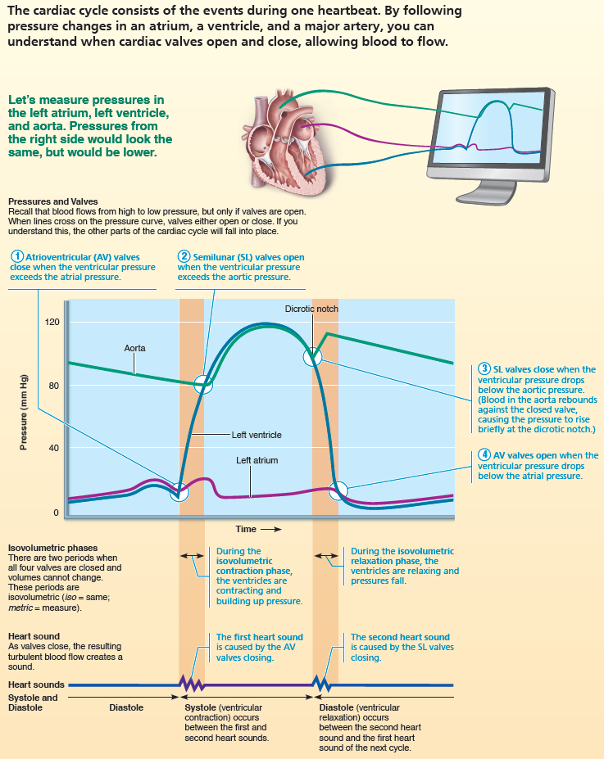
The Cardiac Cycle (1 of 2)
FOCUS FIGURE 18.2 The Cardiac Cycle

Slide 53
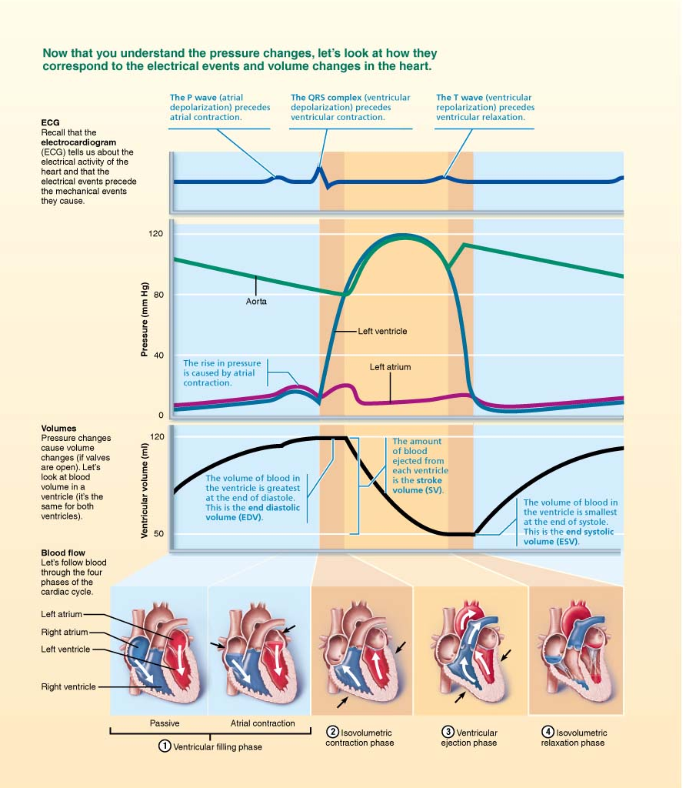
The Cardiac Cycle (2 of 2)
FOCUS FIGURE 18.2 The Cardiac Cycle

Slide 54
IP2: Events of the Cardiac Cycle
Click here to view ADA compliant Animation:
IP2: Events of the Cardiac Cycle
https://mediaplayer.pearsoncmg.com/assets/secs-ip2-cc-events-cardiac-cycle

Slide 55
Heart Sounds (1 of 2)
Two sounds (lub-dup) associated with closing of heart valves
First sound is closing of AV valves at beginning of ventricular systole
Second sound is closing of SL valves at beginning of ventricular diastole
Pause between lub-dups indicates heart relaxation

Slide 56
Heart Sounds (2 of 2)
Mitral valve closes slightly before tricuspid, and aortic closes slightly before pulmonary valve
Differences allow auscultation of each valve when stethoscope is placed in four different regions

Slide 57
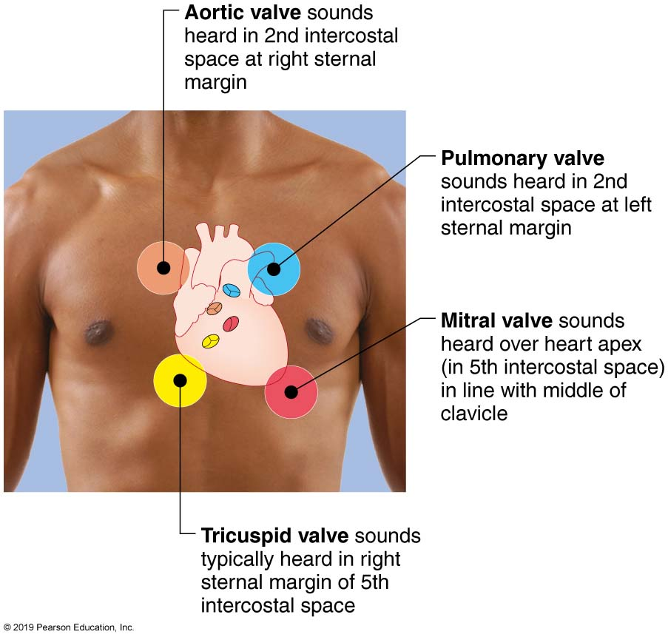
Areas of the Thoracic Surface Where the Sounds of Individual Valves are Heard Most Clearly
Figure 18.19 Areas of the thoracic surface where the sounds of individual valves are heard most clearly.

Slide 58
Clinical – Homeostatic Imbalance 18.6
Heart murmurs: abnormal heart sounds heard when blood hits obstructions
Usually indicate valve problems
Incompetent (or insufficient) valve: fails to close completely, allowing backflow of blood
Causes swishing sound as blood regurgitates backward from ventricle into atria
Stenotic valve: fails to open completely, restricting blood flow through valve
Causes high-pitched sound or clicking as blood is forced through narrow valve

Slide 59
18.7 Regulation of Pumping (1 of 2)
Cardiac output: amount of blood pumped out by each ventricle in 1 minute
Equals heart rate (HR) times stroke volume (SV)
Stroke volume: volume of blood pumped out by one ventricle with each beat
Correlates with force of contraction
At rest:

Slide 60
18.7 Regulation of Pumping (2 of 2)
Maximal CO is 4–5 times resting CO in nonathletic people (20–25 L/min)
Maximal CO may reach 35 L/min in trained athletes
Cardiac reserve: difference between resting and maximal CO
CO changes (increases/decreases) if either or both SV or HR is changed
CO is affected by factors leading to:
Regulation of stroke volume
Regulation of heart rates

Slide 61
IP2: Cardiac Output
Click here to view ADA compliant Animation:
IP2: Cardiac Output
https://mediaplayer.pearsoncmg.com/assets/_video.true/lc9qVhJHpL19jNH1pOaWb3HaTlPH7H29

Slide 62
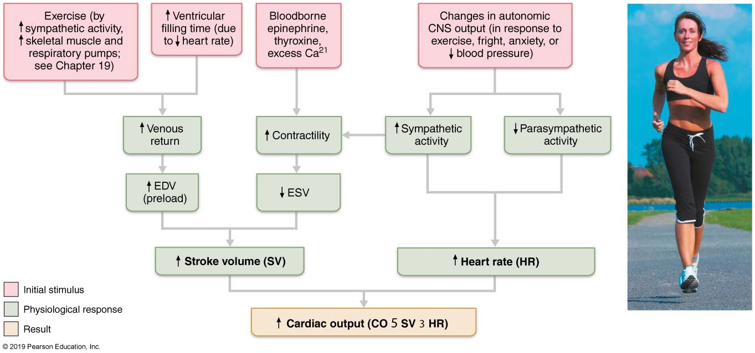
Factors Involved in Determining Cardiac Output (1 of 2)
Figure 18.20 Factors involved in determining cardiac output.

Slide 63
Regulation of Stroke Volume (1 of 5)
Mathematically: SV = EDV − ESV
EDV is affected by length of ventricular diastole and venous pressure (~120 ml/beat)
ESV is affected by arterial BP and force of ventricular contraction (~50 ml/beat)
Normal SV = 120 ml − 50 ml = 70 ml/beat
Three main factors that affect SV:
Preload
Contractility
Afterload

Slide 64
Regulation of Stroke Volume (2 of 5)
Preload: degree of stretch of heart muscle
Preload: degree to which cardiac muscle cells are stretched just before they contract
Changes in preload cause changes in SV
Affects EDV
Relationship between preload and SV called Frank-Starling law of
the heart
Cardiac muscle exhibits a length-tension relationship
At rest, cardiac muscle cells are shorter than optimal length; leads to dramatic increase in contractile force

Slide 65
Regulation of Stroke Volume (3 of 5)
Preload (cont.)
Most important factor in preload stretching of cardiac muscle is venous return—amount of blood returning to heart
Slow heartbeat and exercise increase venous return
Increased venous return distends (stretches) ventricles and increases contraction force
Venous Return → EDV → SV → CO
Frank-Starling Law

Slide 66
Regulation of Stroke Volume (4 of 5)
Contractility
Contractile strength at given muscle length
Independent of muscle stretch and EDV
Increased contractility lowers ESV; caused by:
Sympathetic epinephrine release stimulates increased Ca²⁺ influx, leading to more cross bridge formations
Positive inotropic agents increase contractility
Thyroxine, glucagon, epinephrine, digitalis, high extracellular Ca²⁺
Decreased by negative inotropic agents
Acidosis (excess H⁺), increased extracellular K⁺, calcium channel blockers

Slide 67
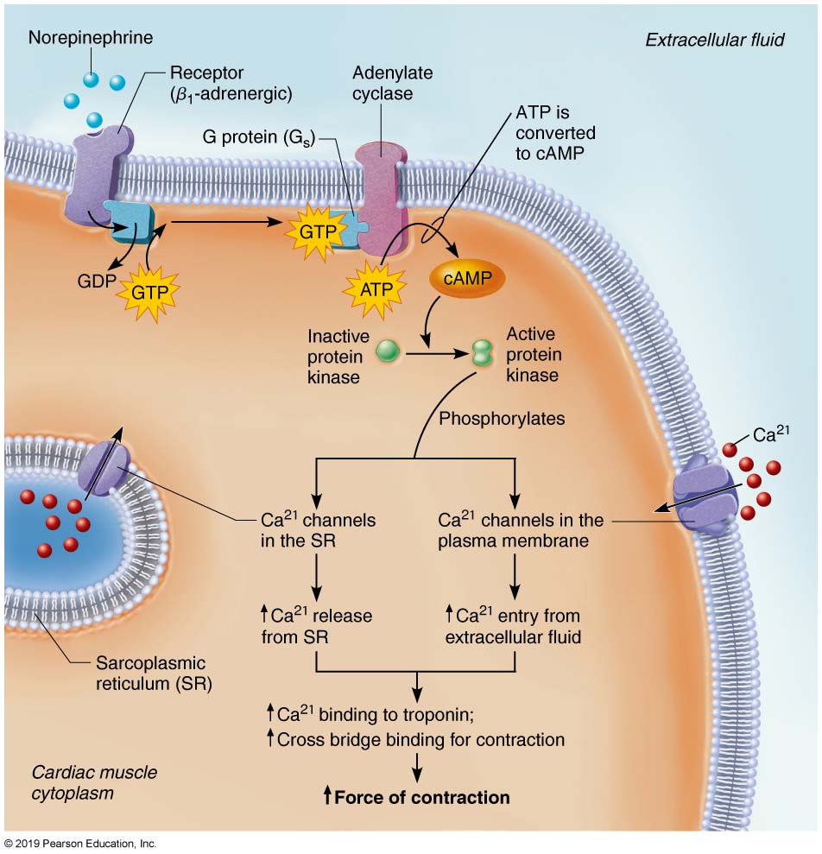
Norepinephrine Increases Heart Contractility Via a Cyclic AMP Second Messenger System
Figure 18.21 Norepinephrine increases heart contractility via a cyclic AMP second messenger system.

Slide 68
Regulation of Stroke Volume (5 of 5)
Afterload: back pressure exerted by arterial blood
Afterload is pressure that ventricles must overcome to eject blood
Back pressure from arterial blood pushing on SL valves is major pressure
Aortic pressure is around 80 mm Hg
Pulmonary trunk pressure is around 10 mm Hg
Hypertension increases afterload, resulting in increased ESV and reduced SV

Slide 69
Regulation of Heart Rate (1 of 7)
If SV decreases as a result of decreased blood volume or weakened heart, CO can be maintained by increasing HR and contractility
Positive chronotropic factors increase heart rate
Negative chronotropic factors decrease heart rate
Heart rate can be regulated by:
Autonomic nervous system
Chemicals
Other factors

Slide 70
Regulation of Heart Rate (2 of 7)
Autonomic nervous system regulation of heart rate
Sympathetic nervous system can be activated by emotional or physical stressors
Norepinephrine is released and binds to β₁-adrenergic receptors on heart, causing:
Pacemaker to fire more rapidly, increasing HR
EDV decreased because of decreased fill time
Increased contractility
ESV decreased because of increased volume of ejected blood

Slide 71
Regulation of Heart Rate (3 of 7)
Autonomic nervous system regulation of heart rate (cont.)
Because both EDV and ESV decrease, SV can remain unchanged
Parasympathetic nervous system opposes sympathetic effects
Acetylcholine hyperpolarizes pacemaker cells by opening K⁺ channels, which slows HR
Has little to no effect on contractility

Slide 72
Regulation of Heart Rate (4 of 7)
Autonomic nervous system regulation of heart rate (cont.)
Heart at rest exhibits vagal tone
Parasympathetic is dominant influence on heart rate
Decreases rate about 25 beats/min
Cutting vagal nerve leads to HR of ~100

Slide 73
Regulation of Heart Rate (5 of 7)
Autonomic nervous system regulation of heart rate (cont.)
When sympathetic is activated, parasympathetic is inhibited, and vice-versa
Atrial (Bainbridge) reflex: sympathetic reflex initiated by increased venous return, hence increased atrial filling
Atrial walls are stretched with increased volume
Stimulates SA node, which increases HR
Also stimulates atrial stretch receptors that activate sympathetic reflexes

Slide 74
Factors Involved in Determining Cardiac Output (2 of 2)
Figure 18.20 Factors involved in determining cardiac output.

Slide 75
Regulation of Heart Rate (6 of 7)
Chemical regulation of heart rate
Hormones
Epinephrine from adrenal medulla increases heart rate and contractility
Thyroxine increases heart rate; enhances effects of norepinephrine and epinephrine
Ions
Intra- and extracellular ion concentrations (e.g., Ca²⁺ and K⁺) must be maintained for normal heart function
Imbalances are very dangerous to heart

Slide 76
Clinical – Homeostatic Imbalance 18.7
Hypocalcemia: depresses heart
Hypercalcemia: increases HR and contractility
Hyperkalemia: alters electrical activity, which can lead to heart block and cardiac arrest
Hypokalemia: results in feeble heartbeat; arrhythmias

Slide 77
Regulation of Heart Rate (7 of 7)
Other factors that influence heart rate
Age
Fetus has fastest HR; declines with age
Gender
Females have faster HR than males
Exercise
Increases HR
Trained atheles can have slow HR
Body temperature
HR increases with increased body temperature

Slide 78
Clinical – Homeostatic Imbalance 18.8
Tachycardia: abnormally fast heart rate (>100 beats/min)
If persistent, may lead to fibrillation
Bradycardia: heart rate slower than 60 beats/min
May result in grossly inadequate blood circulation in nonathletes
May be desirable result of endurance training

Slide 79
Homeostatic Imbalance of Cardiac Output (1 of 3)
Congestive heart failure (CHF)
Progressive condition; CO is so low that blood circulation is inadequate to meet tissue needs
Reflects weakened myocardium caused by:
Coronary atherosclerosis: clogged arteries caused by fat buildup; impairs oxygen delivery to cardiac cells
Heart becomes hypoxic, contracts inefficiently

Slide 80
Homeostatic Imbalance of Cardiac Output (2 of 3)
Congestive heart failure (CHF) (cont.)
Persistent high blood pressure: aortic pressure >90 mmHg causes myocardium to exert more force
Chronic increased ESV causes myocardium hypertrophy and weakness
Multiple myocardial infarcts: heart becomes weak as contractile cells are replaced with scar tissue
Dilated cardiomyopathy (DCM): ventricles stretch and become flabby, and myocardium deteriorates
Drug toxicity or chronic inflammation may play a role

Slide 81
Homeostatic Imbalance of Cardiac Output (3 of 3)
Congestive heart failure (CHF) (cont.)
Either side of heart can be affected:
Left-sided failure results in pulmonary congestion
Blood backs up in lungs
Right-sided failure results in peripheral congestion
Blood pools in body organs, causing edema
Failure of either side ultimately weakens other side
Leads to decompensated, seriously weakened heart
Treatment: removal of fluid, drugs to reduce afterload and increase contractility

Slide 82
Developmental Aspects of the Heart (1 of 3)
Human heart is derived from mesoderm
Begins as two endothelial chambers that fuse to form single actively pumping chamber by day 22
Tube develops four bulges that represent earliest chambers
Sinus venosus: gives rise to right atrium, coronary sinus, and SA node
Atrium: becomes pectinate muscles of atria
Ventricle: becomes left ventricle
Bulbus cordis: gives rise to aorta, pulmonary trunk, and right ventricle

Slide 83
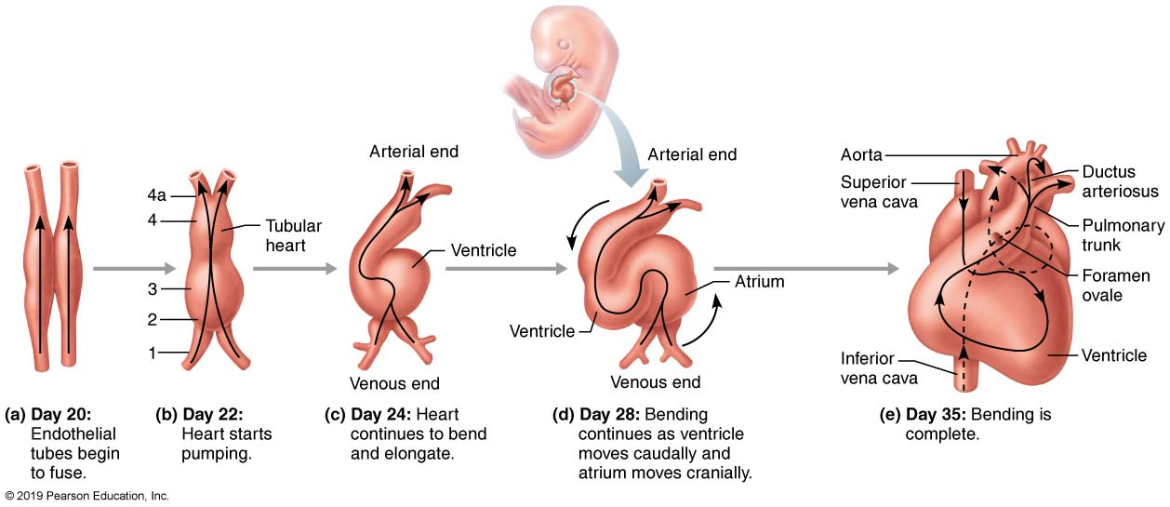
Development of the Human Heart
Figure 18.22 Development of the human heart.

Slide 84
Developmental Aspects of the Heart (2 of 3)
Heart tube contorts, and structural changes convert into a four-chambered heart by day 35
Two fetal heart structures bypass pulmonary circulation
Foramen ovale: opening that connects atria
Remnant is fossa ovalis in adult
Ductus arteriosus connects pulmonary trunk to aorta
Remnant: ligamentum arteriosum in adult
Close at or shortly after birth

Slide 85
Clinical – Homeostatic Imbalance 18.9
Congenital heart defects are most common birth defects (∼40,000 per year)
Corrected with surgery
Most defects are one of two types:
Mixing of oxygen-poor and oxygen-rich blood, as in septal defects, patent ductus arteriosus
Narrowed valves or vessels that cause increased workload on heart, as in coarctation of aorta
Tetralogy of Fallot
Both types of disorders present

Slide 86
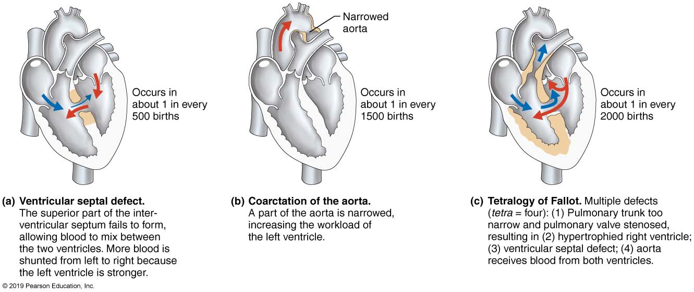
Three Examples of Congenital Heart Defects
Figure 18.23 Three examples of congenital heart defects.

Slide 87
Developmental Aspects of the Heart (3 of 3)
Age-Related Changes Affecting the Heart
Regular exercise can keep heart healthy
Age-related changes include:
Sclerosis and thickening of valve flaps: lead to heart murmurs
Decline in cardiac reserve: heart becomes less efficient
Fibrosis of cardiac muscle: leads to stiffened heart, arrhythmias caused by conduction system problems
Atherosclerosis: may be averted by good diet

Slide 88

Copyright

