Slide 1
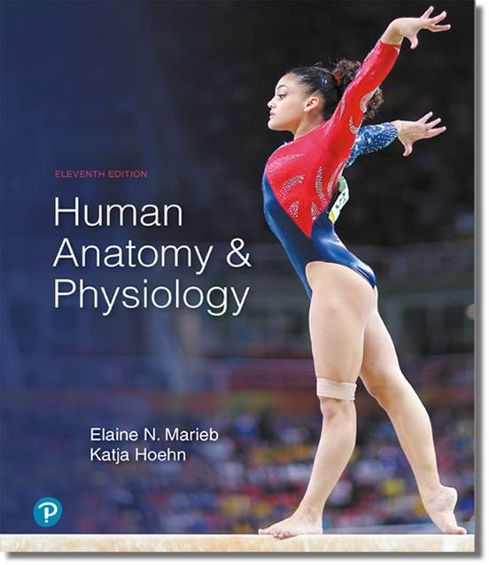
Human Anatomy and Physiology
Eleventh Edition
Chapter 18 Part A
The Cardiovascular System
PowerPoint® Lectures Slides prepared by Karen Dunbar Kareiva, Ivy Tech Community College
Copyright © 2019, 2016, 2013 Pearson Education, Inc. All Rights Reserved

Slide 2
Why This Matters
How the anatomy and physiology of the heart affect the sounds heard through a stethoscope

Slide 3
Video: Why This Matters (Career Connection)
Click here to view ADA compliant video:
Why This Matters (Career Connection)
https://mediaplayer.pearsoncmg.com/assets/secs_wtm_ch18

Slide 4
18.1 Heart Anatomy

Slide 5
The Pulmonary and Systemic Circuits (1 of 2)
Heart is a transport system consisting of two side-by-side pumps
Right side receives oxygen-poor blood from tissues
Pumps blood to lungs to get rid of CO₂, pick up O₂, via pulmonary circuit
Left side receives oxygenated blood from lungs
Pumps blood to body tissues via systemic circuit

Slide 6
The Pulmonary and Systemic Circuits (2 of 2)
Receiving chambers of heart
Right atrium
Receives blood returning from systemic circuit
Left atrium
Receives blood returning from pulmonary circuit
Pumping chambers of heart
Right ventricle
Pumps blood through pulmonary circuit
Left ventricle
Pumps blood through systemic circuit

Slide 7
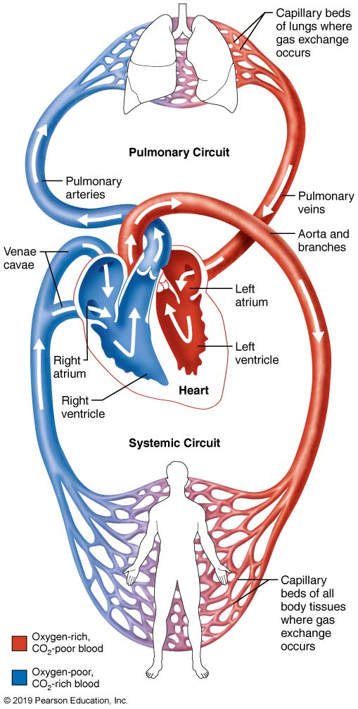
The Systemic and Pulmonary Circuits
Figure 18.1 The systemic and pulmonary circuits.

Slide 8
Size, Location, and Orientation of Heart (1 of 2)
Approximately the size of a fist
Weighs less than 1 pound
Location
In mediastinum between second rib and fifth intercostal space
On superior surface of diaphragm
Two-thirds of heart to left of midsternal line
Anterior to vertebral column, posterior to sternum

Slide 9
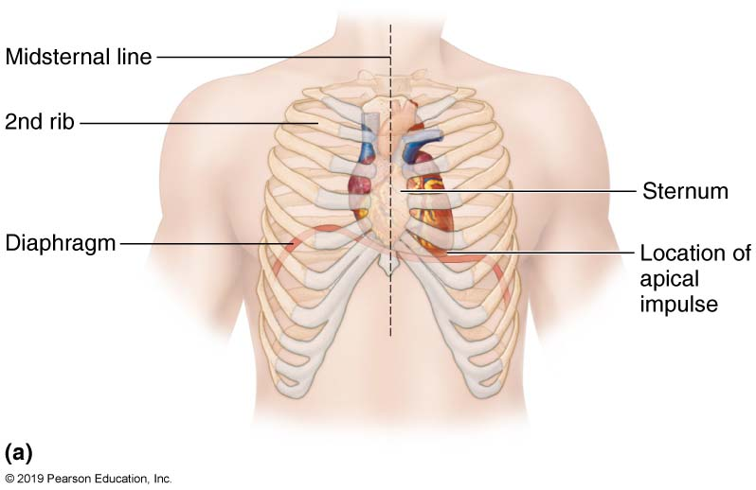
Location of the Heart in the Mediastinum (1 of 4)
Figure 18.2a Location of the heart in the mediastinum.

Slide 10
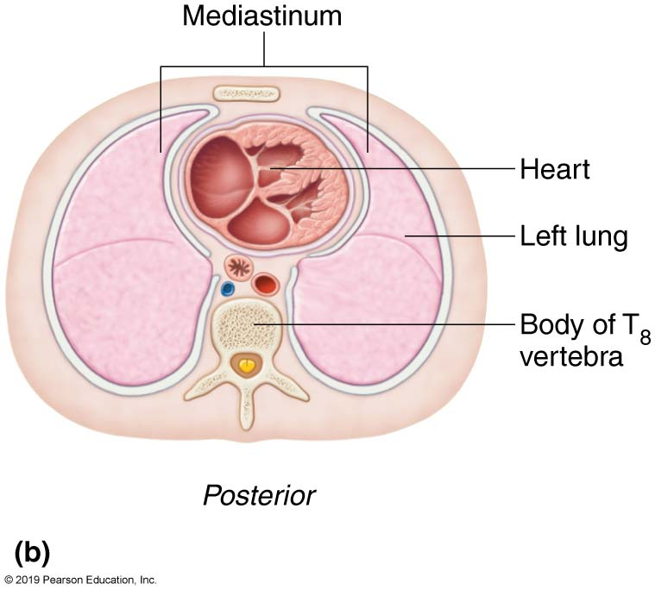
Location of the Heart in the Mediastinum (2 of 4)
Figure 18.2b Location of the heart in the mediastinum.

Slide 11
Size, Location, and Orientation of Heart (2 of 2)
Base (posterior surface) leans toward right shoulder
Apex points toward left hip
Apical impulse palpated between fifth and sixth ribs, just below left nipple

Slide 12
Location of the Heart in the Mediastinum (3 of 4)
Figure 18.2a Location of the heart in the mediastinum.

Slide 13
Location of the Heart in the Mediastinum (4 of 4)
Figure 18.2b Location of the heart in the mediastinum.

Slide 14
Coverings of the Heart
Pericardium: double-walled sac that surrounds heart; made up of two layers
Superficial fibrous pericardium: functions to protect, anchor heart to surrounding structures, and prevent overfilling
Deep two-layered serous pericardium
Parietal layer lines internal surface of fibrous pericardium
Visceral layer (epicardium) on external surface of heart
Two layers separated by fluid-filled pericardial cavity (decreases friction)

Slide 15
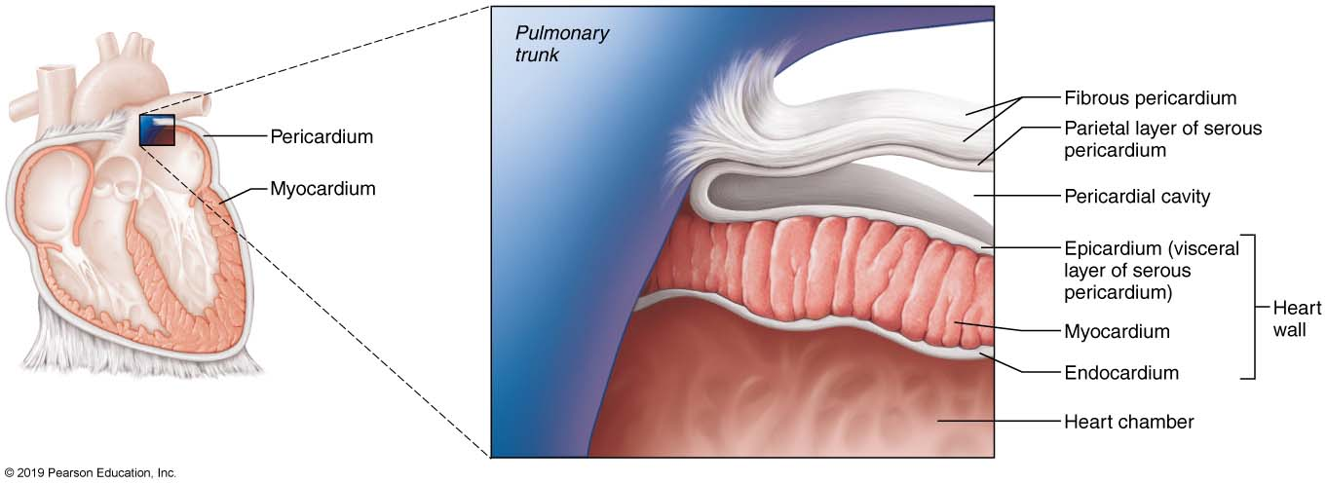
The Layers of the Pericardium and of the Heart Wall (1 of 2)
Figure 18.3 The layers of the pericardium and of the heart wall.

Slide 16
Clinical – Homeostatic Imbalance 18.1
Pericarditis
Inflammation of pericardium
Roughens membrane surfaces, causing pericardial friction rub (creaking sound) heard with stethoscope
Cardiac tamponade
Excess fluid that leaks into pericardial space
Can compress heart’s pumping ability
Treatment: fluid is drawn out of cavity (usually with syringe)

Slide 17
Layers of the Heart Wall (1 of 2)
Three layers of heart wall
Epicardium: visceral layer of serous pericardium
Myocardium: circular or spiral bundles of contractile cardiac muscle cells
Cardiac skeleton: crisscrossing, interlacing layer of connective tissue
Anchors cardiac muscle fibers
Supports great vessels and valves
Limits spread of action potentials to specific paths

Slide 18
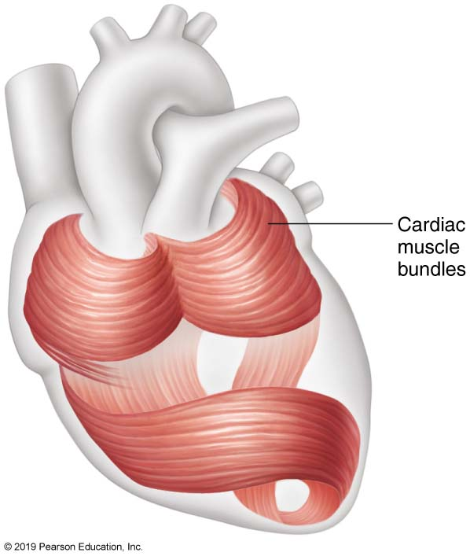
The Circular and Spiral Arrangement of Cardiac Muscle Bundles in the Myocardium of the Heart
Figure 18.4 The circular and spiral arrangement of cardiac muscle bundles in the myocardium of the heart.

Slide 19
Layers of the Heart Wall (2 of 2)
Endocardium: innermost layer; is continuous with endothelial lining of blood vessels
Lines heart chambers and covers cardiac skeleton of valves

Slide 20
The Layers of the Pericardium and of the Heart Wall (2 of 2)
Figure 18.3 The layers of the pericardium and of the heart wall.

Slide 21
Chambers and Associated Great Vessels (1 of 6)
Internal features
Four chambers
Two superior atria
Two inferior ventricles
Interatrial septum: separates atria
Fossa ovalis: remnant of foramen ovale of fetal heart
Interventricular septum: separates ventricles

Slide 22
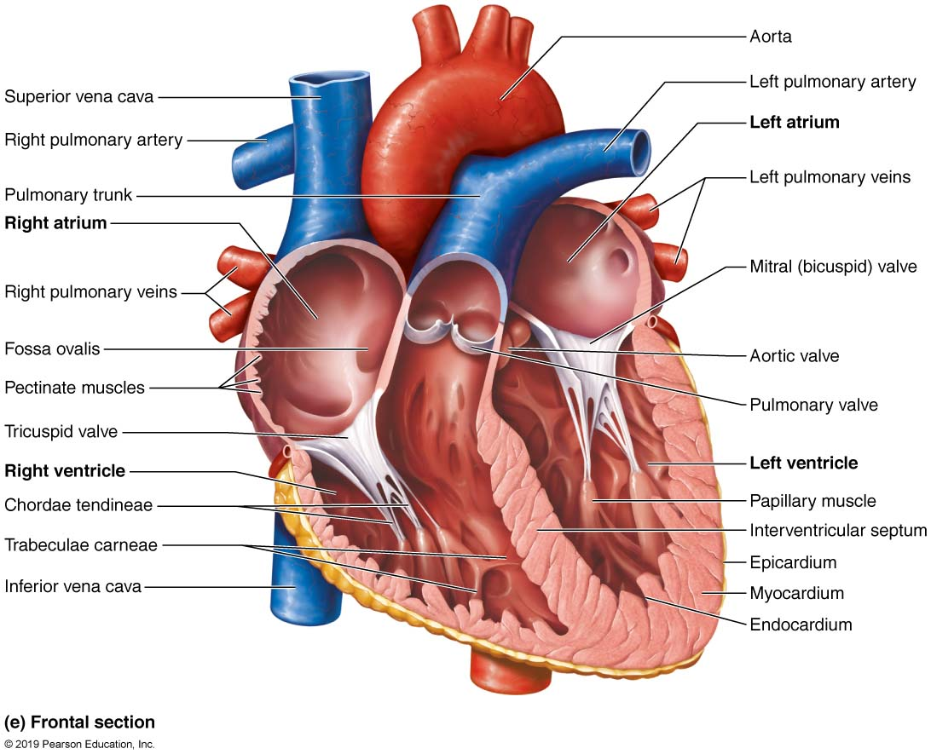
Gross Anatomy of the Heart (1 of 9)
Figure 18.5e Gross anatomy of the heart.

Slide 23
Chambers and Associated Great Vessels (2 of 6)
Surface features
Coronary sulcus (atrioventricular groove)
Encircles junction of atria and ventricles
Anterior interventricular sulcus
Anterior position of interventricular septum
Posterior interventricular sulcus
Landmark on posteroinferior surface

Slide 24
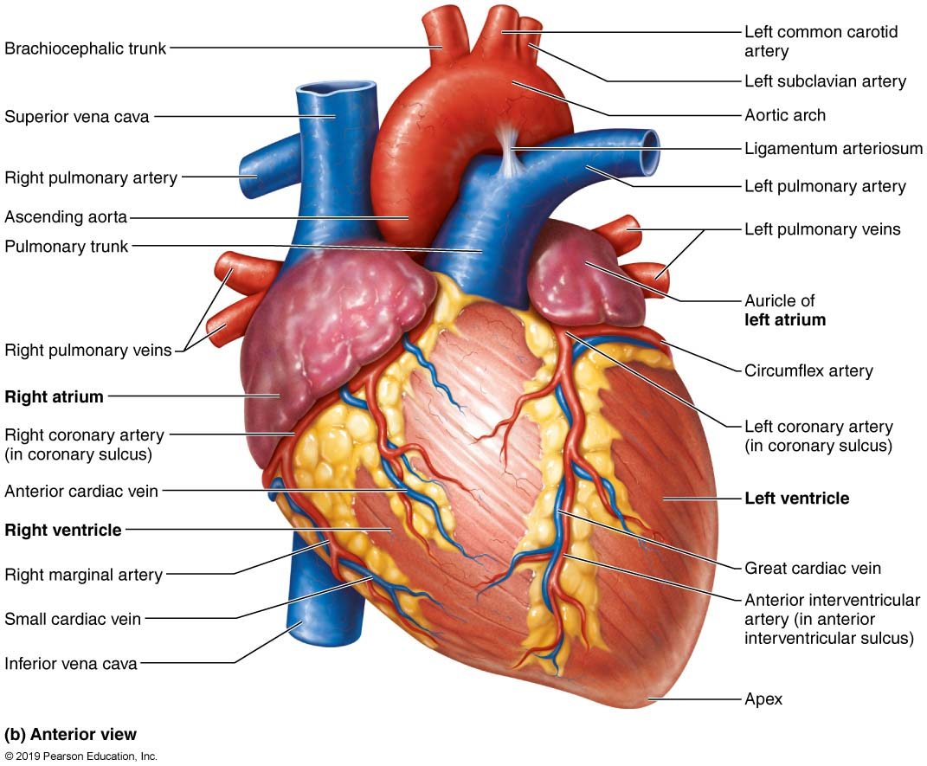
Gross Anatomy of the Heart (2 of 9)
Figure 18.5b Gross anatomy of the heart.

Slide 25
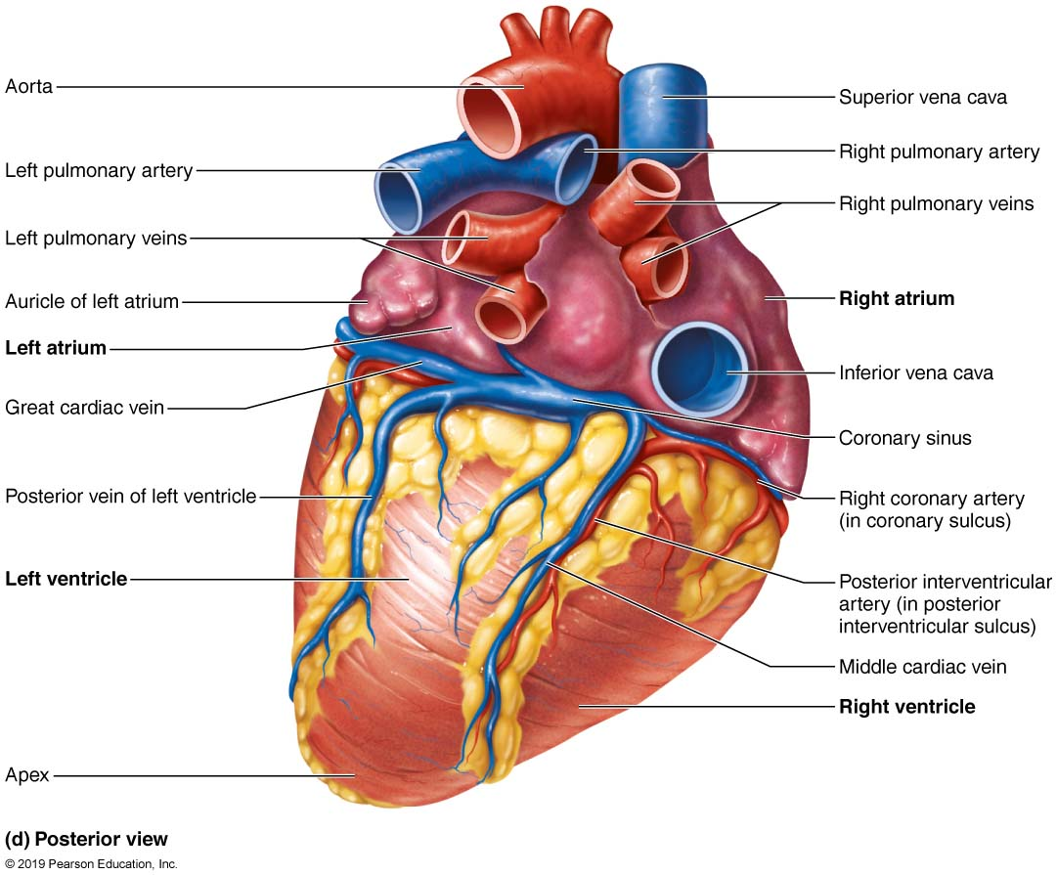
Gross Anatomy of the Heart (3 of 9)
Figure 18.5d Gross anatomy of the heart.

Slide 26
Chambers and Associated Great Vessels (3 of 6)
Atria: the receiving chambers
Small, thin-walled chambers; contribute little to propulsion of blood
Auricles: appendages that increase atrial volume
Right atrium: receives deoxygenated blood from body
Anterior portion is smooth-walled
Posterior portion contains ridges formed by pectinate muscles
Posterior and anterior regions are separated by crista terminalis

Slide 27
Chambers and Associated Great Vessels (4 of 6)
Atria: the receiving chambers (cont.)
Three veins empty into right atrium:
Superior vena cava: returns blood from body regions above the diaphragm
Inferior vena cava: returns blood from body regions below the diaphragm
Coronary sinus: returns blood from coronary veins
Left atrium: receives oxygenated blood from lungs
Pectinate muscles found only in auricles
Four pulmonary veins return blood from lungs

Slide 28
Gross Anatomy of the Heart (4 of 9)
Figure 18.5e Gross anatomy of the heart.

Slide 29
Chambers and Associated Great Vessels (5 of 6)
Ventricles: the discharging chambers
Make up most of the volume of heart
Right ventricle: most of anterior surface
Left ventricle: posteroinferior surface
Trabeculae carneae: irregular ridges of muscle on ventricular walls
Papillary muscles: project into ventricular cavity
Anchor chordae tendineae that are attached to heart valves

Slide 30
Chambers and Associated Great Vessels (6 of 6)
Ventricles: the discharging chambers (cont.)
Thicker walls than atria
Actual pumps of heart
Right ventricle
Pumps blood into pulmonary trunk
Left ventricle
Pumps blood into aorta (largest artery in body)

Slide 31
Gross Anatomy of the Heart (5 of 9)
Figure 18.5e Gross anatomy of the heart.

Slide 32
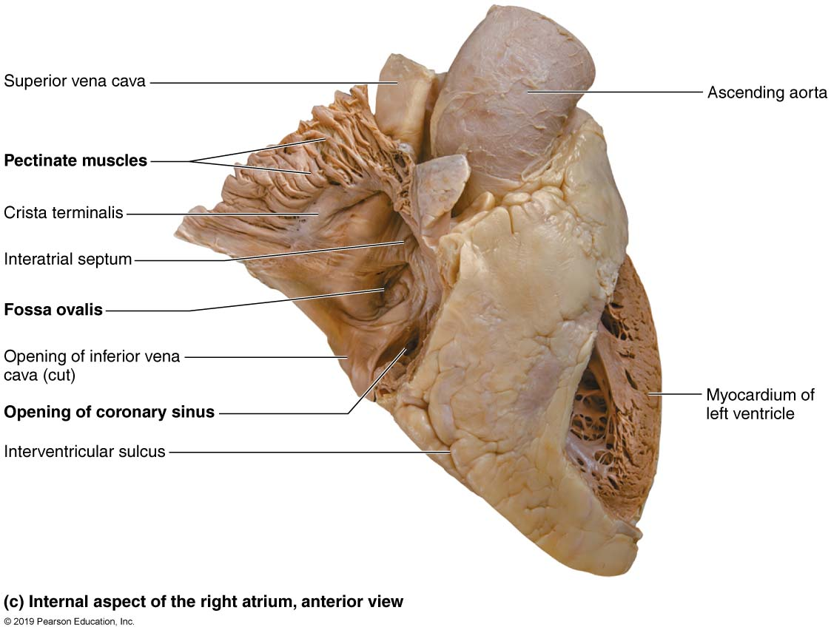
Gross Anatomy of the Heart (6 of 9)
Figure 18.5c Gross anatomy of the heart.

Slide 33
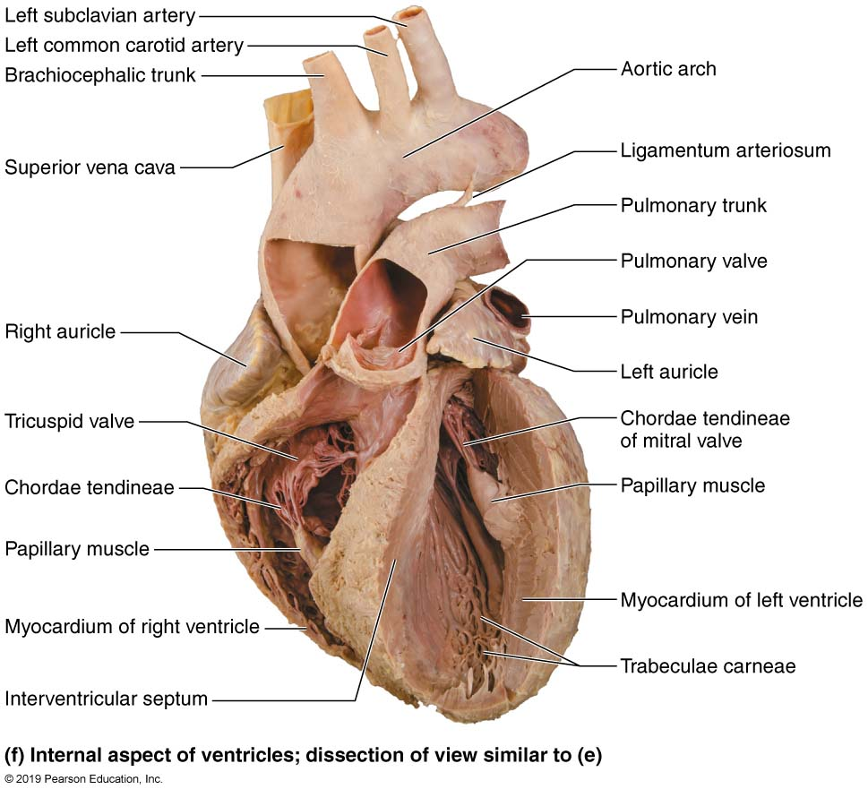
Gross Anatomy of the Heart (7 of 9)
Figure 18.5f Gross anatomy of the heart.

Slide 34
Animation – Rotating Heart Sectioned
Click here to view ADA compliant Animation:
Rotating Heart Sectioned
https://mediaplayer.pearsoncmg.com/assets/rotating-model-heart-sectioned

Slide 35
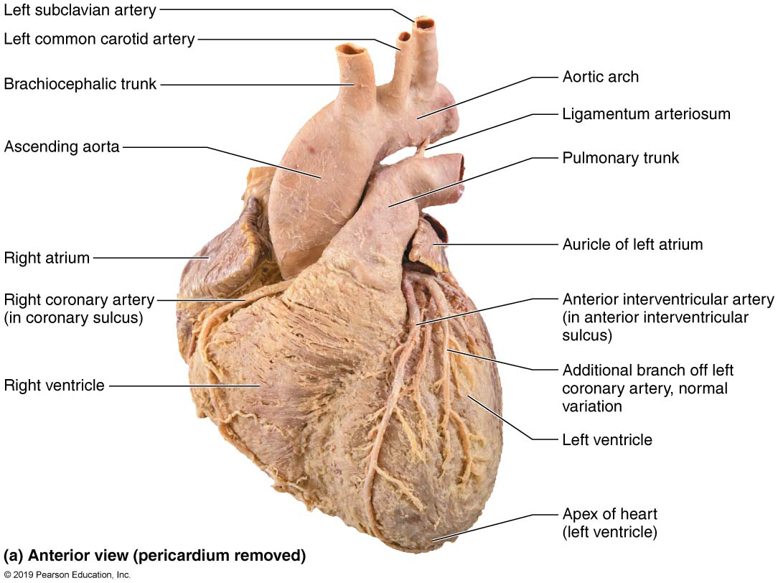
Gross Anatomy of the Heart (8 of 9)
Figure 18.5a Gross anatomy of the heart.

Slide 36
Animation – Rotating Heart
Click here to view ADA compliant Animation:
Rotating Heart
https://mediaplayer.pearsoncmg.com/assets/rotating-model-heart

Slide 37
18.2 Heart Valves (1 of 2)
Ensure unidirectional blood flow through heart
Open and close in response to pressure changes
Two major types of valves
Atrioventricular valves located between atria and ventricles
Semilunar valves located between ventricles and major arteries

Slide 38
18.2 Heart Valves (2 of 2)
No valves are found between major veins and atria; not a problem because:
Inertia of incoming blood prevents backflow
Heart contractions compress venous openings

Slide 39
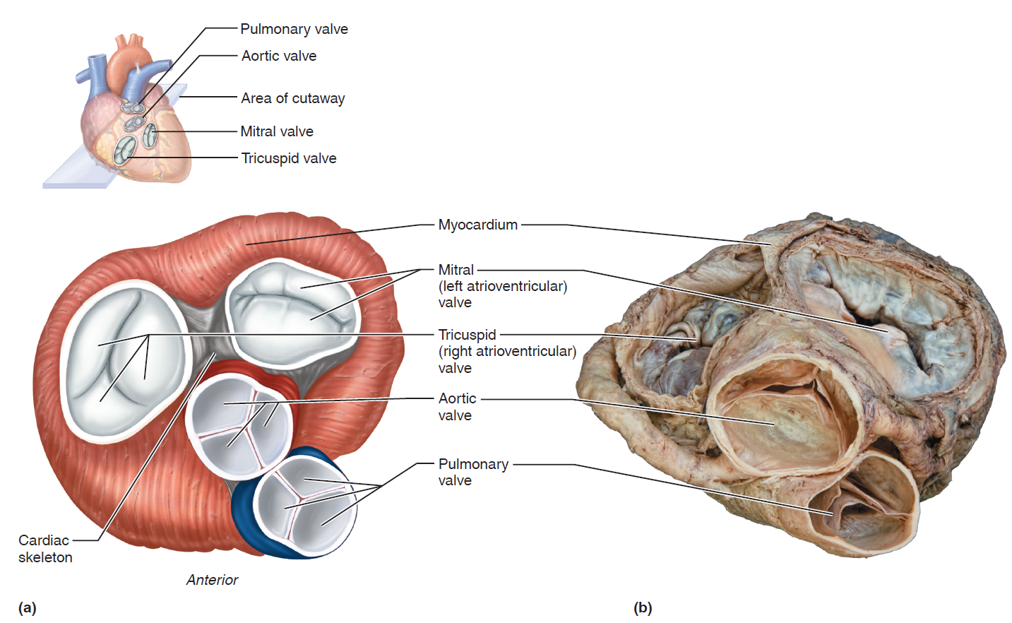
Heart Valves (1 of 3)
Figure 18.6a, b Heart valves.

Slide 40
Atrioventricular (AV) Valves
Two atrioventricular (AV) valves prevent backflow into atria when ventricles contract
Tricuspid valve (right AV valve): made up of three cusps and lies between right atria and ventricle
Mitral valve (left AV valve, bicuspid valve): made up of two cusps and lies between left atria and ventricle
Chordae tendineae: anchor cusps of AV valves to papillary muscles that function to:
Hold valve flaps in closed position
Prevent flaps from everting back into atria

Slide 41
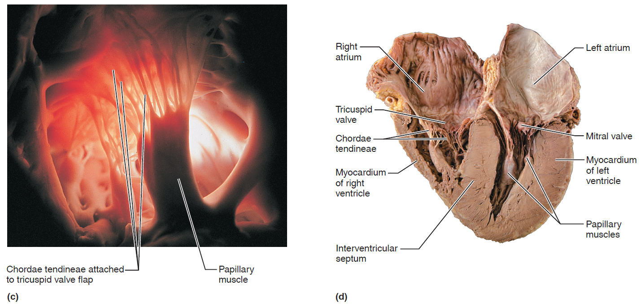
Heart Valves (2 of 3)
Figure 18.6c, d Heart valves.

Slide 42
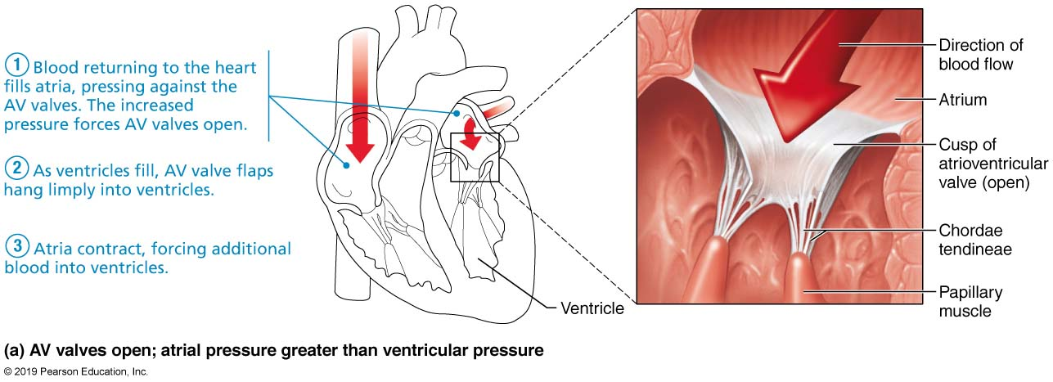
The Function of the Atrioventricular (AV) Valves (1 of 2)
Figure 18.7a The function of the atrioventricular (AV) valves.

Slide 43
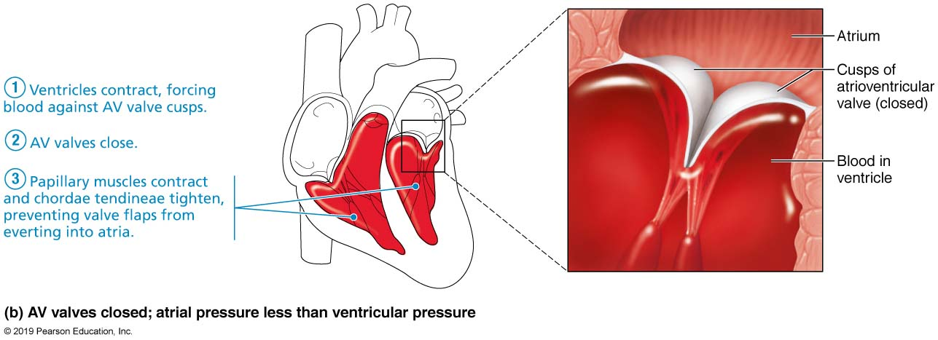
The Function of the Atrioventricular (AV) Valves (2 of 2)
Figure 18.7b The function of the atrioventricular (AV) valves.

Slide 44
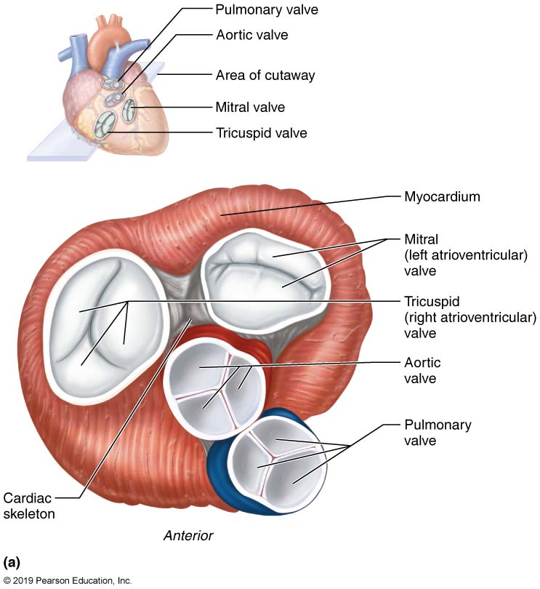
Heart Valves (3 of 3)
Figure 18.6a Heart valves.

Slide 45
Semilunar (SL) Valves
Two semilunar (SL) valves prevent backflow from major arteries back into ventricles
Open and close in response to pressure changes
Each valve consists of three cusps that roughly resemble a half moon
Pulmonary semilunar valve: located between right ventricle and pulmonary trunk
Aortic semilunar valve: located between left ventricle and aorta

Slide 46
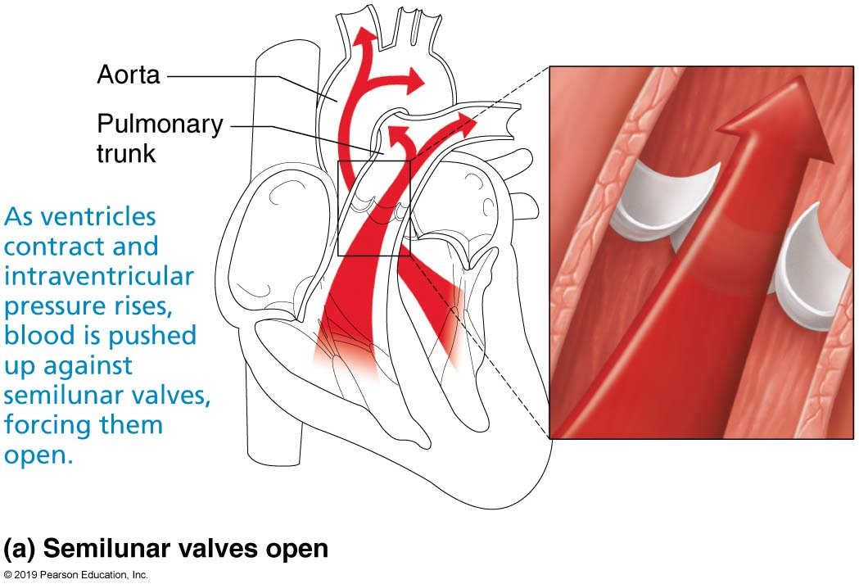
The Function of the Semilunar (SL) Valves (1 of 2)
Figure 18.8a The function of the semilunar (SL) valves.

Slide 47
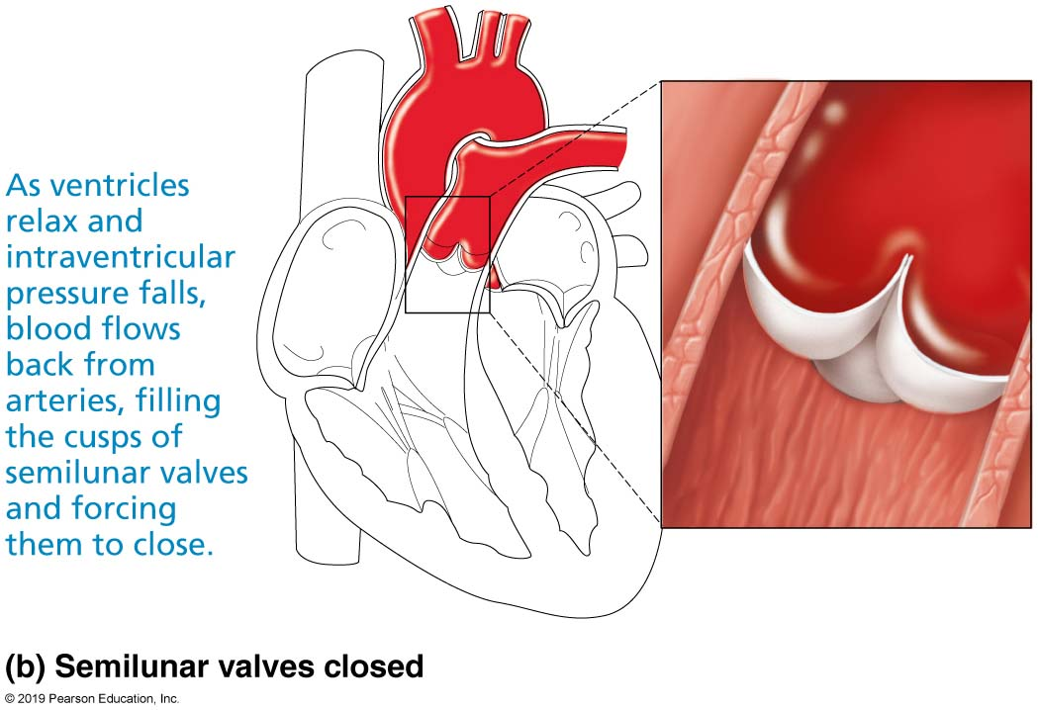
The Function of the Semilunar (SL) Valves (2 of 2)
Figure 18.8b The function of the semilunar (SL) valves.

Slide 48
Clinical – Homeostatic Imbalance 18.2
Two conditions severely weaken heart:
Incompetent valve
Blood backflows so heart repumps same blood over and over
Valvular stenosis
Stiff flaps that constrict opening
Heart needs to exert more force to pump blood
Defective valve can be replaced with mechanical, animal, or cadaver valve

Slide 49
18.3 Pathway of Blood Through Heart (1 of 3)
Right side of the heart
Superior vena cava (SVC), inferior vena cava (IVC), and coronary sinus →
Right atrium →
Tricuspid valve →
Right ventricle →
Pulmonary semilunar valve →
Pulmonary trunk →
Pulmonary arteries →
Lungs

Slide 50
18.3 Pathway of Blood Through Heart (2 of 3)
Left side of the heart
Four pulmonary veins →
Left atrium →
Mitral valve →
Left ventricle →
Aortic semilunar valve →
Aorta →
Systemic circulation

Slide 51
Figure Animation: Blood Flow Through the Heart
Click here to view ADA compliant Animation:
Blood Flow Through the Heart
https://mediaplayer.pearsoncmg.com/assets/sci-ap-blood-flow-through-the-heart

Slide 52
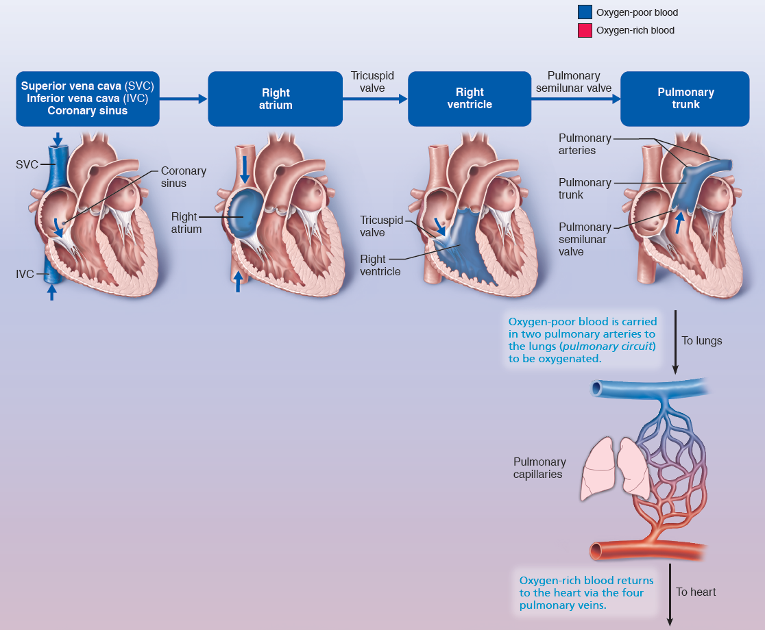
The Heart is a Double Pump, Each Side Supplying its Own Circuit (1 of 3)
FOCUS FIGURE 18.1 Blood Flow through the Heart

Slide 53
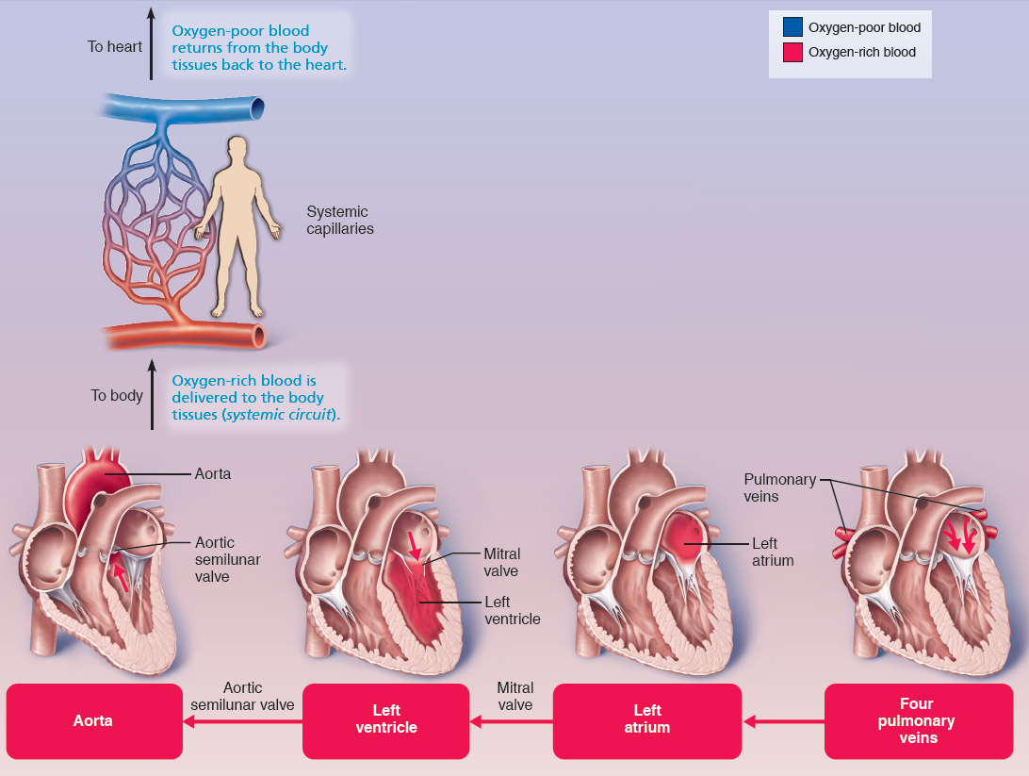
The Heart is a Double Pump, Each Side Supplying its Own Circuit (2 of 3)
FOCUS FIGURE 18.1 Blood Flow through the Heart

Slide 54
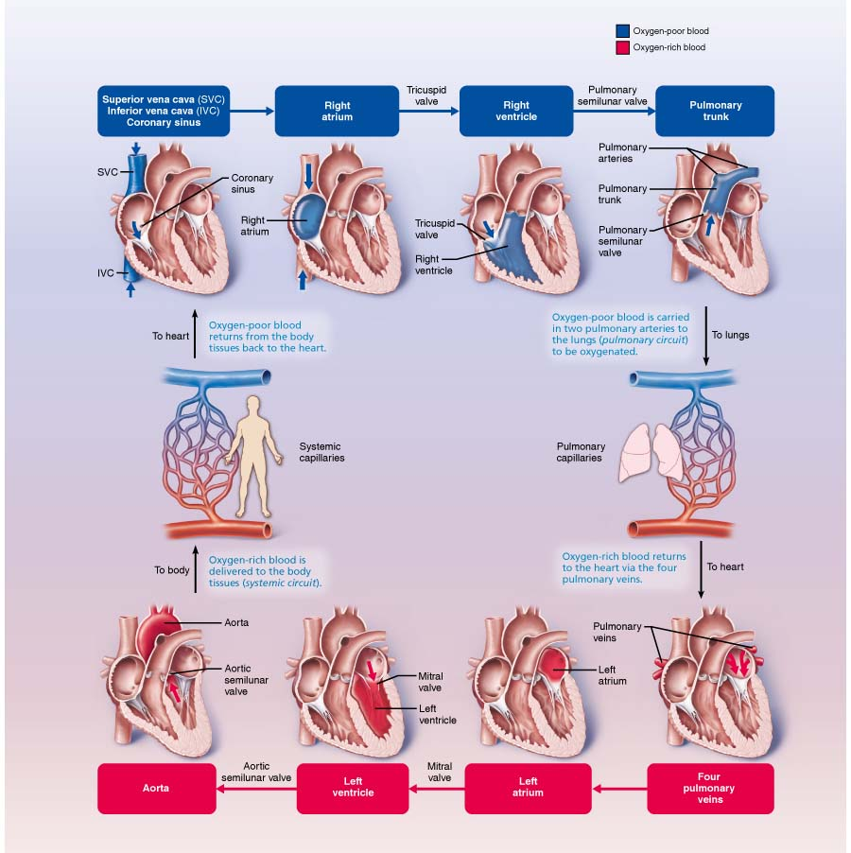
The Heart is a Double Pump, Each Side Supplying its Own Circuit (3 of 3)
FOCUS FIGURE 18.1 Blood Flow through the Heart

Slide 55
18.3 Pathway of Blood Through Heart (3 of 3)
Equal volumes of blood are pumped to pulmonary and systemic circuits
Pulmonary circuit is short, low-pressure circulation
Systemic circuit is long, high-friction circulation
Anatomy of ventricles reflects differences
Left ventricle walls are 3× thicker than right
Pumps with greater pressure

Slide 56
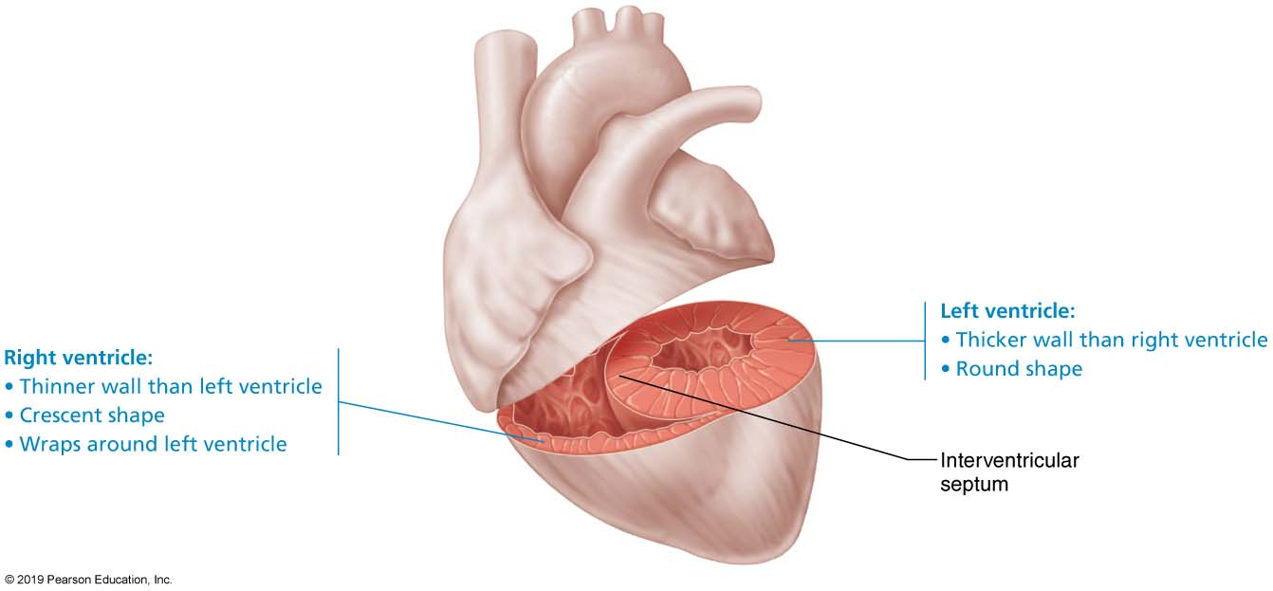
Anatomical Differences Between the Right and Left Ventricles
Figure 18.9 Anatomical differences between the right and left ventricles.

Slide 57
Coronary Circulation (1 of 6)
Coronary circulation
Functional blood supply to heart muscle itself
Shortest circulation in body
Delivered when heart is relaxed
Left ventricle receives most of coronary blood supply

Slide 58
Coronary Circulation (2 of 6)
Coronary arteries
Both left and right coronary arteries arise from base of aorta and supply arterial blood to heart
Both encircle heart in coronary sulcus
Branching of coronary arteries varies among individuals
Arteries contain many anastomoses (junctions)
Provide additional routes for blood delivery
Cannot compensate for coronary artery occlusion
Heart receives 1/20th of body’s blood supply

Slide 59
Coronary Circulation (3 of 6)
Coronary arteries (cont.)
Left coronary artery supplies interventricular septum, anterior ventricular walls, left atrium, and posterior wall of left ventricle; has two branches:
Anterior interventricular artery
Circumflex artery
Right coronary artery supplies right atrium and most of right ventricle; has two branches:
Right marginal artery
Posterior interventricular artery

Slide 60
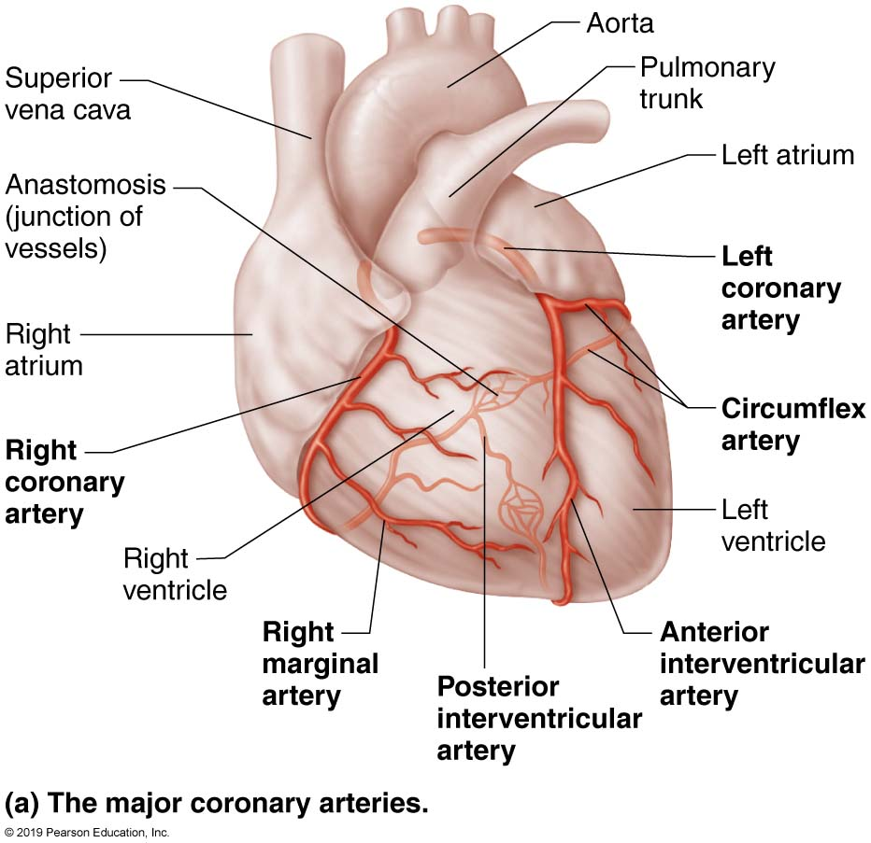
Coronary Circulation (4 of 6)
Figure 18.10a Coronary circulation.

Slide 61
Coronary Circulation (5 of 6)
Coronary veins
Cardiac veins collect blood from capillary beds
Coronary sinus empties into right atrium; formed by merging cardiac veins
Great cardiac vein of anterior interventricular sulcus
Middle cardiac vein in posterior interventricular sulcus
Small cardiac vein from inferior margin
Several anterior cardiac veins empty directly into right atrium anteriorly

Slide 62
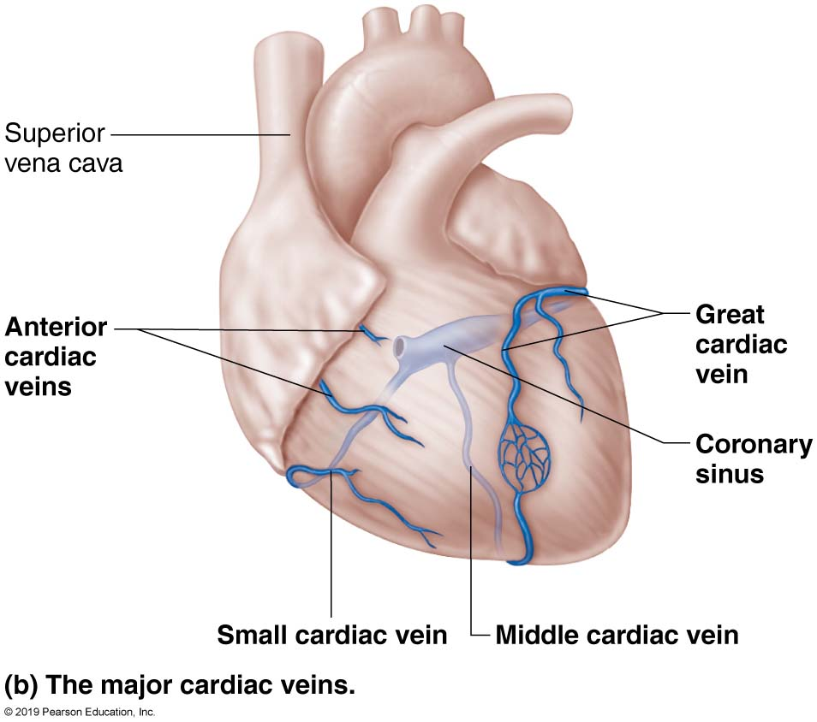
Coronary Circulation (6 of 6)
Figure 18.10b Coronary circulation.

Slide 63
Gross Anatomy of the Heart (9 of 9)
Figure 18.5d Gross anatomy of the heart.

Slide 64
Clinical – Homeostatic Imbalance 18.3
Angina pectoris
Thoracic pain caused by fleeting deficiency in blood delivery to myocardium
Cells are weakened
Myocardial infarction (heart attack)
Prolonged coronary blockage
Areas of cell death are repaired with noncontractile scar tissue

Slide 65
18.4 Cardiac Muscle Fibers

Slide 66
Microscopic Anatomy (1 of 3)
Cardiac muscle cells: striated, short, branched, fat, interconnected
One central nucleus (at most, 2 nuclei)
Contain numerous large mitochondria (25–35% of cell volume) that afford resistance to fatigue
Rest of volume composed of sarcomeres
Z discs, A bands, and I bands all present
T tubules are wider, but less numerous
Enter cell only once at Z disc
SR simpler than in skeletal muscle; no triads

Slide 67
Microscopic Anatomy (2 of 3)
Intercalated discs are connecting junctions between cardiac cells that contain:
Desmosomes: hold cells together; prevent cells from separating during contraction
Gap junctions: allow ions to pass from cell to cell; electrically couple adjacent cells
Allows heart to be a functional syncytium, a single coordinated unit

Slide 68
Microscopic Anatomy (3 of 3)
Intercellular space between cells has connective tissue matrix (endomysium)
Contains numerous capillaries
Connects cardiac muscle to cardiac skeleton, giving cells something to pull against

Slide 69
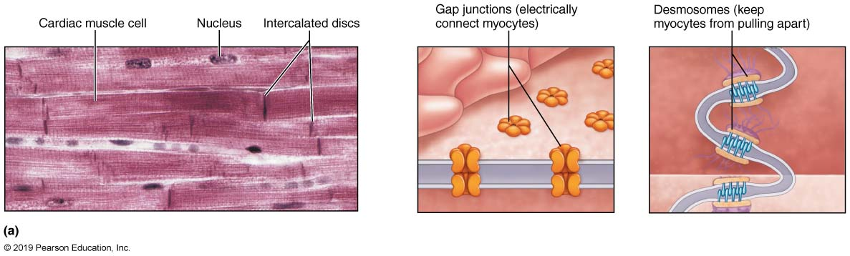
Microscopic Anatomy of Cardiac Muscle (1 of 2)
Figure 18.11a Microscopic anatomy of cardiac muscle.

Slide 70
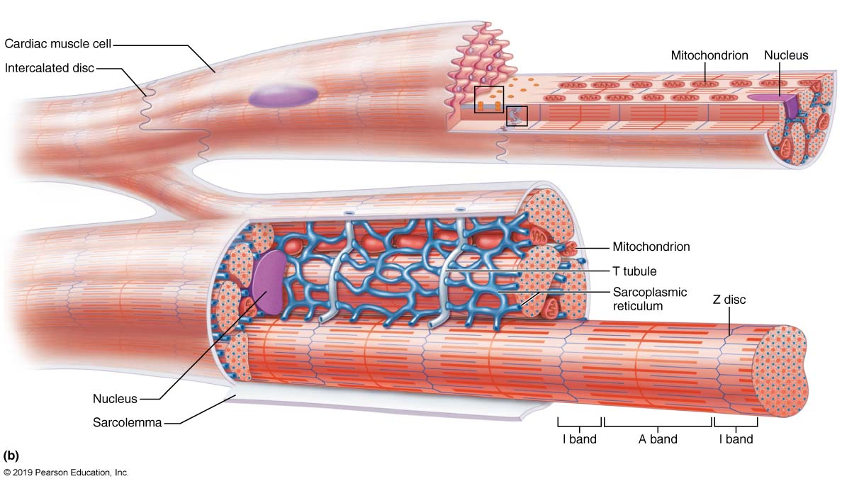
Microscopic Anatomy of Cardiac Muscle (2 of 2)
Figure 18.11b Microscopic anatomy of cardiac muscle.

Slide 71
How Does the Physiology of Skeletal and Cardiac Muscle Differ? (1 of 5)
Similarities with skeletal muscle
Muscle contraction is preceded by depolarizing action potential
Depolarization wave travels down T tubules; causes sarcoplasmic reticulum (SR) to release Ca²⁺
Excitation-contraction coupling occurs
Ca²⁺ binds troponin causing filaments to slide

Slide 72
How Does the Physiology of Skeletal and Cardiac Muscle Differ? (2 of 5)
Differences between cardiac and skeletal muscle
Some cardiac muscle cells are self-excitable
Two kinds of myocytes
Contractile cells: responsible for contraction
Pacemaker cells: noncontractile cells that spontaneously depolarize
Initiate depolarization of entire heart
Do not need nervous system stimulation, in contrast to skeletal muscle fibers

Slide 73
How Does the Physiology of Skeletal and Cardiac Muscle Differ? (3 of 5)
Heart contracts as a unit
All cardiomyocytes contract as unit (functional syncytium), or none contract
Contraction of all cardiac myocytes ensures effective pumping action
Skeletal muscles contract independently
Influx of Ca²⁺ from extracellular fluid triggers Ca²⁺ release from SR
Depolarization opens slow Ca²⁺ channels in sarcolemma, allowing Ca²⁺ to enter cell
Extracellular Ca²⁺ then causes SR to release its intracellular Ca²⁺
Skeletal muscles do not use extracellular Ca²⁺

Slide 74
How Does the Physiology of Skeletal and Cardiac Muscle Differ? (4 of 5)
Tetanic contractions cannot occur in cardiac muscles
Cardiac muscle fibers have longer absolute refractory period than skeletal muscle fibers
Absolute refractory period is almost as long as contraction itself
Prevents tetanic contractions
Allows heart to relax and fill as needed to be an efficient pump

Slide 75
How Does the Physiology of Skeletal and Cardiac Muscle Differ? (5 of 5)
The heart relies almost exclusively on aerobic respiration
Cardiac muscle has more mitochondria than skeletal muscle so has greater dependence on oxygen
Cannot function without oxygen
Skeletal muscle can go through fermentation when oxygen not present
Both types of tissues can use other fuel sources
Cardiac is more adaptable to other fuels, including lactic acid, but must have oxygen

Slide 76
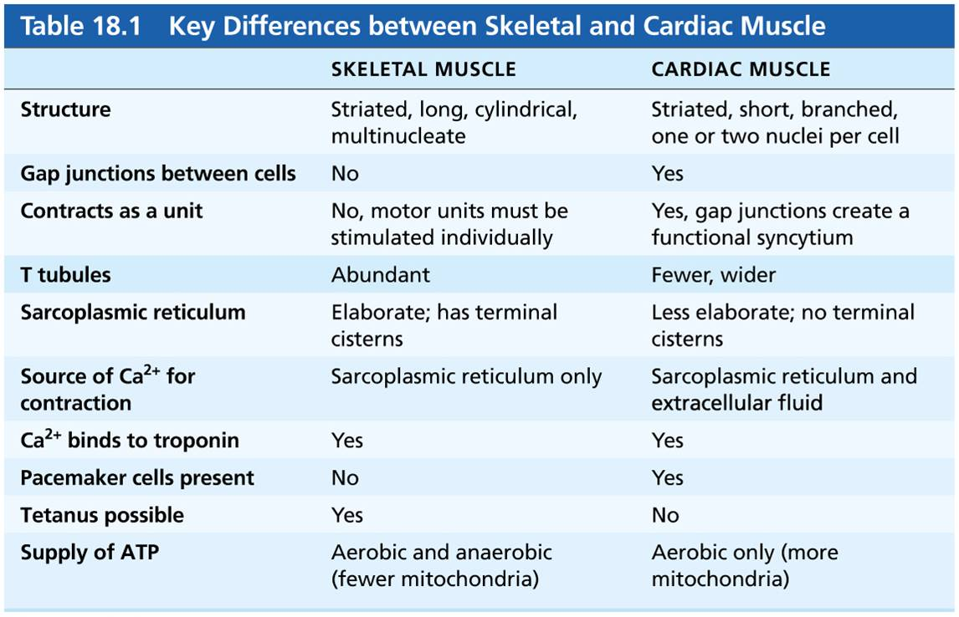
Table 18.1 Key Differences between Skeletal and Cardiac Muscle
Table 18.1 Key Differences between Skeletal and Cardiac Muscle

Slide 77
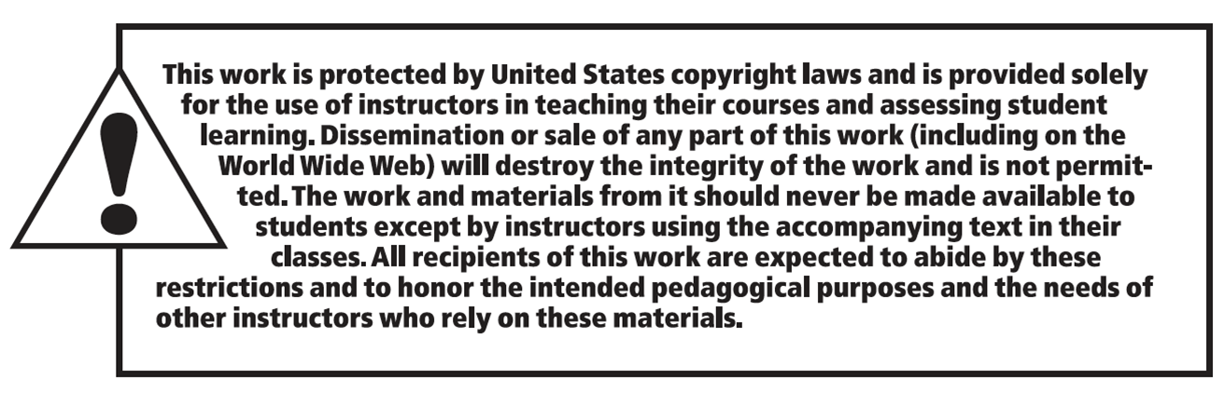
Copyright

