Slide 1

Human Anatomy and Physiology
Eleventh Edition
Chapter 17
Blood
PowerPoint® Lectures Slides prepared by Karen Dunbar Kareiva, Ivy Tech Community College
Copyright © 2019, 2016, 2013 Pearson Education, Inc. All Rights Reserved

Slide 2
Why This Matters
Understanding the anatomy and physiology of blood helps you to advise patients on activities to prevent blood clots during hospital stays

Slide 3
Video: Why This Matters (Career Connection)
Click here to view ADA compliant video:
Why This Matters (Career Connection)
https://mediaplayer.pearsoncmg.com/assets/secs_wtm_ch_17_christian_v2

Slide 4
Blood – Internal Transport System
Blood is the life-sustaining transport vehicle of the cardiovascular system

Slide 5
17.1 Functions of Blood
Functions include
  Transport
  Regulation
  Protection

Slide 6
Transport
Transport functions include:
  Delivering O₂ and nutrients to body cells
  Transporting metabolic wastes to lungs and kidneys for elimination
  Transporting hormones from endocrine organs to target organs

Slide 7
Regulation
Regulation functions include:
  Maintaining body temperature by absorbing and distributing heat
  Maintaining normal pH using buffers; alkaline reserve of bicarbonate ions
  Maintaining adequate fluid volume in circulatory system

Slide 8
Protection
Protection functions include:
  Preventing blood loss
    Plasma proteins and platelets in blood initiate clot formation
  Preventing infection
    Agents of immunity are carried in blood
      Antibodies
      Complement proteins
      White blood cells

Slide 9
17.2 Composition of Blood (1 of 2)
Blood is the only fluid tissue in body
Type of connective tissue
  Matrix is nonliving fluid called plasma
  Cells are living blood cells called formed elements
    Cells are suspended in plasma
    Formed elements
      Erythrocytes (red blood cells, or RBCs)
      Leukocytes (white blood cells, or WBCs)
      Platelets

Slide 10
17.2 Composition of Blood (2 of 2)
Spun tube of blood yields three layers:
  Erythrocytes on bottom (~45% of whole blood)
    Hematocrit: percent of blood volume that is RBCs
      Normal values:
        Males: 47% ± 5%
        Females: 42% ± 5%
  WBCs and platelets in Buffy coat (< 1%)
    Thin, whitish layer between RBCs and plasma layers
  Plasma on top (~55%)

Slide 11
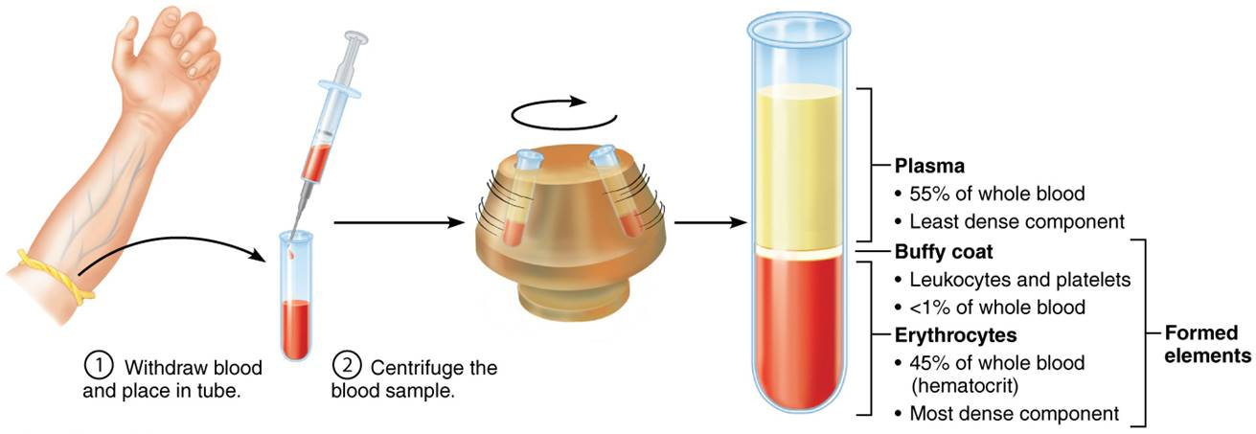
The Major Components of Whole Blood
Figure 17.1 The major components of whole blood.

Slide 12
Physical Characteristics and Volume
Blood is a sticky, opaque fluid with metallic taste
Color varies with O₂ content
  High O₂ levels show a scarlet red
  Low O₂ levels show a dark red
pH 7.35–7.45
Makes up ~8% of body weight
Average volume:
  Males: 5–6 L
  Females: 4–5 L

Slide 13
Blood Plasma
Blood plasma is straw-colored sticky fluid
  About 90% water
Over 100 dissolved solutes
  Nutrients, gases, hormones, wastes, proteins, inorganic ions
  Plasma proteins are most abundant solutes
    Remain in blood; not taken up by cells
    Proteins produced mostly by liver
    Albumin: makes up 60% of plasma proteins
      Functions as carrier of other molecules, as blood buffer, and contributes to plasma osmotic pressure

Slide 14
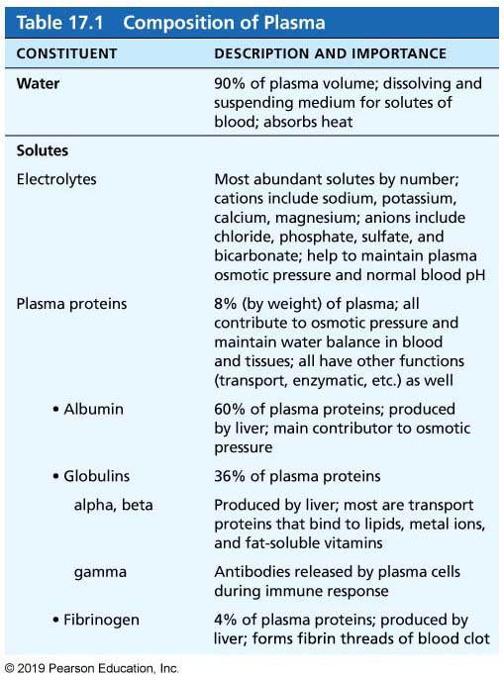
Table 17.1-1 Composition of Plasma
Table 17.1 Composition of Plasma.

Slide 15
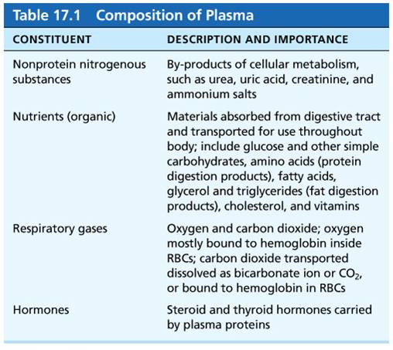
Table 17.1-2 Composition of Plasma
Table 17.1 Composition of Plasma.

Slide 16
Formed Elements
Formed elements are RBCs, WBCs, and platelets
Only WBCs are complete cells
  RBCs have no nuclei or other organelles
  Platelets are cell fragments
Most formed elements survive in bloodstream only few days
Most blood cells originate in bone marrow and do not divide

Slide 17
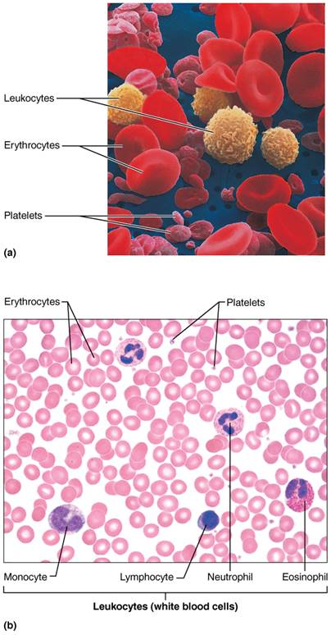
Blood Cells (1 of 3)
Figure 17.2 Blood cells.

Slide 18
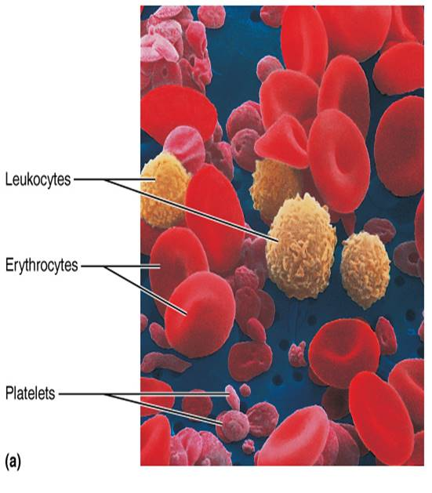
Blood Cells (2 of 3)
Figure 17.2a Blood cells.

Slide 19
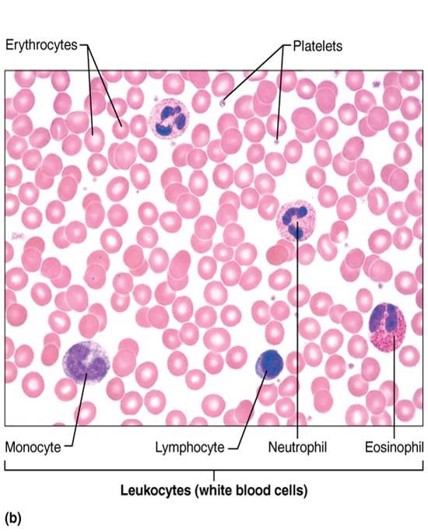
Blood Cells (3 of 3)
Figure 17.2b Blood cells.

Slide 20
17.3 Erythrocytes

Slide 21
Structural Characteristics (1 of 2)
Erythrocytes are small-diameter (7.5 μm) cells that contribute to gas transport
Cell has biconcave disc shape, is anucleate, and essentially has no organelles
Filled with hemoglobin (Hb) for gas transport
RBC diameters are larger than some capillaries
Contain plasma membrane protein spectrin and other proteins
  Spectrin provides flexibility to change shape

Slide 22
Structural Characteristics (2 of 2)
Superb example of complementarity of structure and function
Three features make for efficient gas transport:
  Biconcave shape offers huge surface area relative to volume for gas exchange
  Hemoglobin makes up 97% of cell volume (not counting water)
  RBCs have no mitochondria
    ATP production is anaerobic, so they do not consume O₂ they transport

Slide 23
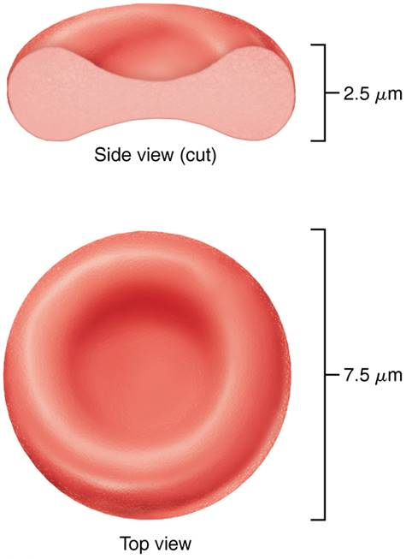
Structure of Erythrocytes (Red Blood Cells)
Figure 17.3 Structure of erythrocytes (red blood cells).

Slide 24
Function of Erythrocytes (1 of 2)
RBCs are dedicated to respiratory gas transport
Hemoglobin binds reversibly with oxygen
Normal values: Males 13–18g/100ml; Females: 12–16 g/100ml
Hemoglobin consists of red heme pigment bound to the protein globin
  Globin is composed of four polypeptide chains
    Two alpha and two beta chains
  A heme pigment is bonded to each globin chain
    Gives blood red color
    Each heme’s central iron atom binds one O₂

Slide 25
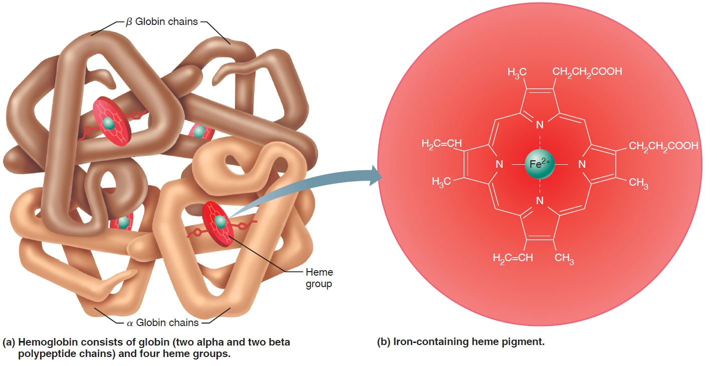
Structure of Hemoglobin (1 of 3)
Figure 17.4 Structure of hemoglobin.

Slide 26
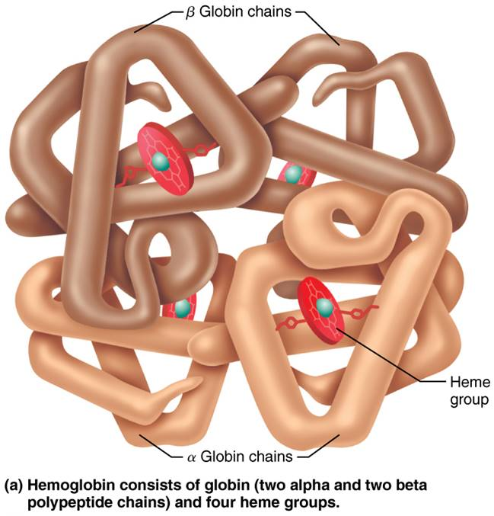
Structure of Hemoglobin (2 of 3)
Figure 17.4a Structure of hemoglobin.

Slide 27
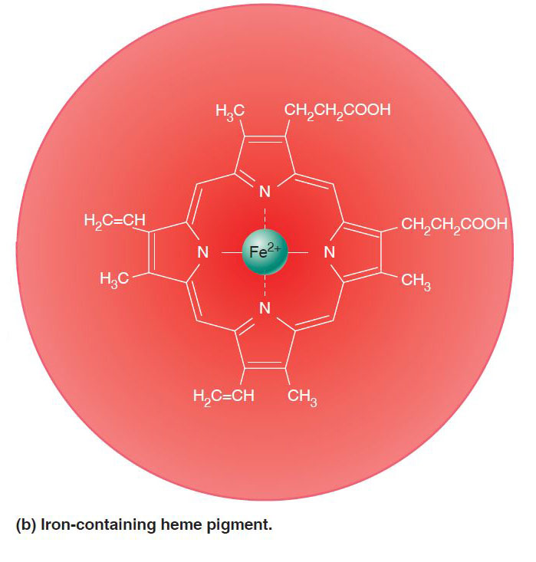
Structure of Hemoglobin (3 of 3)
Figure 17.4b Structure of hemoglobin.

Slide 28
Function of Erythrocytes (2 of 2)
Each Hb molecule can transport four O₂
Each RBC contains 250 million Hb molecules
O₂ loading in lungs
  Produces oxyhemoglobin (ruby red)
O₂ unloading in tissues
  Produces deoxyhemoglobin, or reduced hemoglobin (dark red)
CO₂ loading in tissues
  20% of CO₂ in blood binds to Hb, producing carbaminohemoglobin

Slide 29
Production of Erythrocytes (1 of 3)
Hematopoiesis: formation of all blood cells
Occurs in red bone marrow; composed of reticular connective tissue and blood sinusoids
  In adult, found in axial skeleton, girdles, and proximal epiphyses of humerus and femur
Hematopoietic stem cells (hemocytoblasts)
  Stem cell that gives rise to all formed elements
  Hormones and growth factors push cell toward specific pathway of blood cell development
  Committed cells cannot change
New blood cells enter blood sinusoids

Slide 30
Production of Erythrocytes (2 of 3)
Stages of erythropoiesis
  Erythropoiesis: process of formation of RBCs that takes about 15 days
  Stages of transformations
    Hematopoietic stem cell: transforms into myeloid stem cell
    Myeloid stem cell: transforms into proerythroblast
    Proerythroblast: divides many times, transforming into basophilic
    erythroblasts
    Basophilic erythroblasts: synthesize many ribosomes, which stain blue

Slide 31
Production of Erythrocytes (3 of 3)
    Stages of erythropoiesis (cont.)
    Polychromatic erythroblasts: synthesize large amounts of red-hued hemoglobin; cell now shows both pink and blue areas
    Orthochromatic erythroblasts: contain mostly hemoglobin, so appear just pink; eject most organelles; nucleus degrades, causing concave shape
    Reticulocytes: still contain small amount of ribosomes
    Mature erythrocyte: in 2 days, ribosomes degrade, transforming into mature RBC
  Reticulocyte count indicates rate of RBC formation

Slide 32
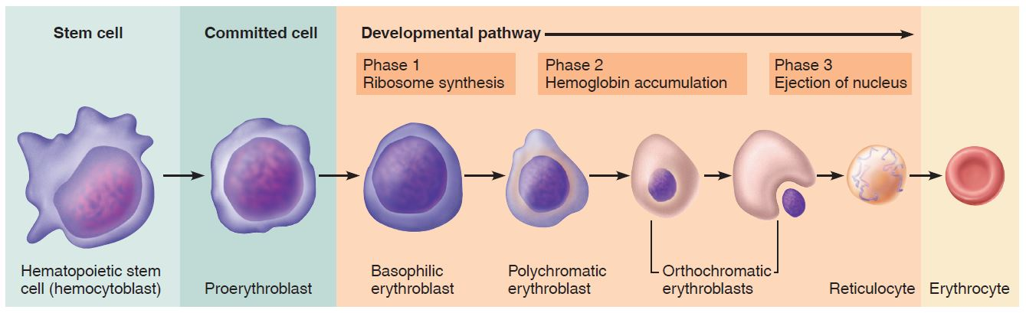
Erythropoiesis: Formation of Red Blood Cells
Figure 17.5 Erythropoiesis: formation of red blood cells.

Slide 33
Regulation and Requirements of Erythropoiesis (1 of 5)
Too few RBCs lead to tissue hypoxia
Too many RBCs increase blood viscosity
> 2 million RBCs are made per second
Balance between RBC production and destruction depends on:
  Hormonal controls
  Dietary requirements

Slide 34
Regulation and Requirements of Erythropoiesis (2 of 5)
Hormonal control
  Erythropoietin (EPO): hormone that stimulates formation of RBCs
    Always small amount of EPO in blood to maintain basal rate
    Released by kidneys (some from liver) in response to hypoxia
      At low O₂ levels, oxygen-sensitive enzymes in kidney cells cannot degrade hypoxia-inducible factor (HIF)
      HIF can accumulate, which triggers synthesis of EPO

Slide 35
Regulation and Requirements of Erythropoiesis (3 of 5)
Hormonal control (cont.)
  Causes of hypoxia:
    Decreased RBC numbers due to hemorrhage or increased destruction
    Insufficient hemoglobin per RBC (example: iron deficiency)
    Reduced availability of O₂ (example: high altitudes or lung problems such as pneumonia)

Slide 36
Regulation and Requirements of Erythropoiesis (4 of 5)
Hormonal control (cont.)
  Too many erythrocytes or high oxygen levels in blood inhibit EPO production
  EPO causes erythrocytes to mature faster
    Testosterone enhances EPO production, resulting in higher RBC counts in males

Slide 37
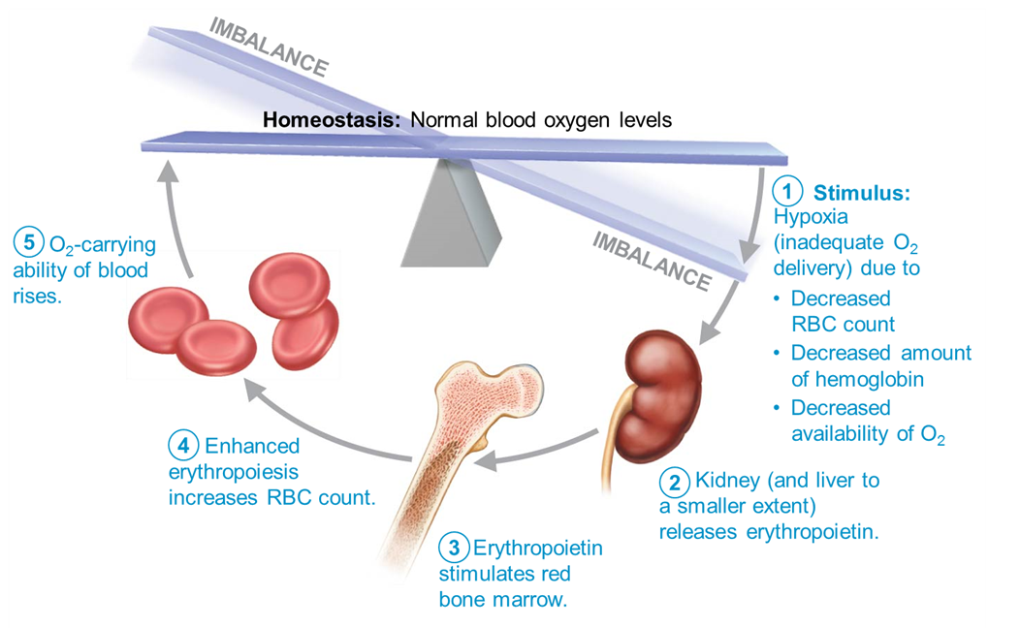
Erythropoietin (EPO) Mechanism for Regulating Erythropoiesis (1 of 6)
Figure 17.6 Erythropoietin (EPO) mechanism for regulating erythropoiesis.

Slide 38
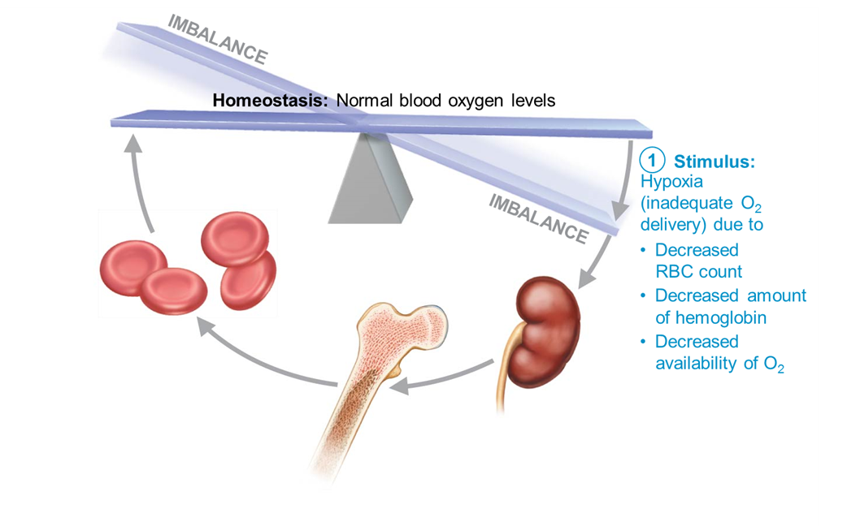
Erythropoietin (EPO) Mechanism for Regulating Erythropoiesis (2 of 6)
Figure 17.6 Erythropoietin (EPO) mechanism for regulating erythropoiesis.

Slide 39
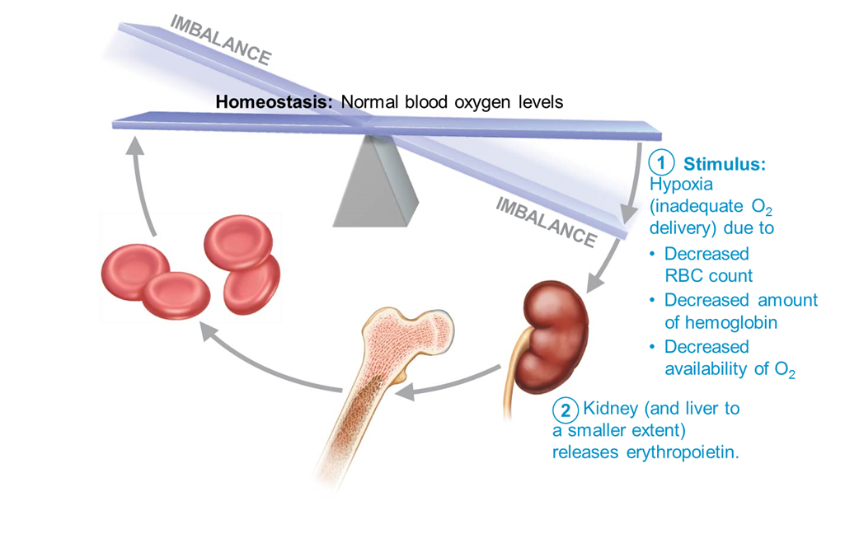
Erythropoietin (EPO) Mechanism for Regulating Erythropoiesis (3 of 6)
Figure 17.6 Erythropoietin (EPO) mechanism for regulating erythropoiesis.

Slide 40

Erythropoietin (EPO) Mechanism for Regulating Erythropoiesis (4 of 6)
Figure 17.6 Erythropoietin (EPO) mechanism for regulating erythropoiesis.

Slide 41
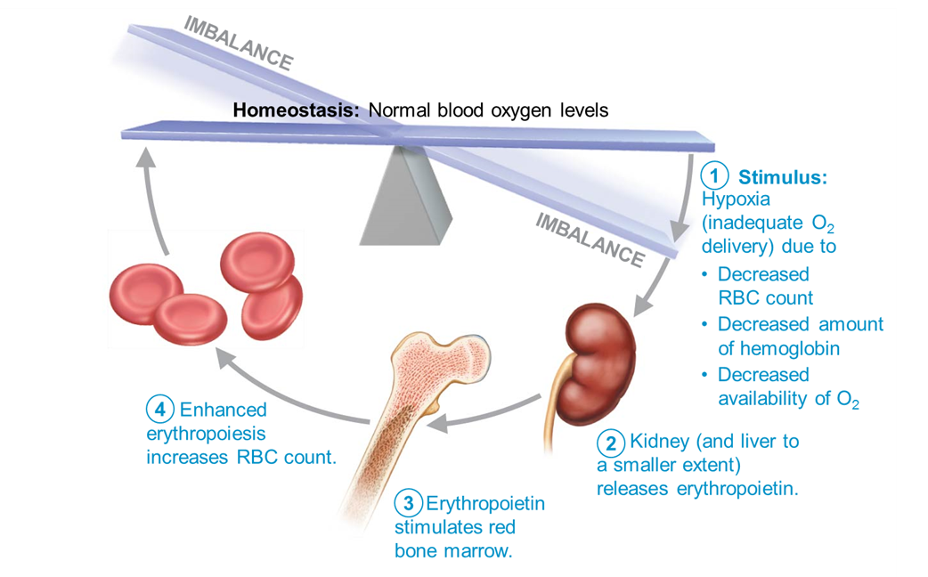
Erythropoietin (EPO) Mechanism for Regulating Erythropoiesis (5 of 6)
Figure 17.6 Erythropoietin (EPO) mechanism for regulating erythropoiesis.

Slide 42
Erythropoietin (EPO) Mechanism for Regulating Erythropoiesis (6 of 6)
Figure 17.6 Erythropoietin (EPO) mechanism for regulating erythropoiesis.

Slide 43
Clinical – Homeostatic Imbalance 17.1
Some athletes abuse artificial EPO
  Use of EPO increases hematocrit, which allows athlete to increase stamina and performance
Dangerous consequences:
  EPO can increase hematocrit from 45% up to even 65%, with dehydration concentrating blood even more
  Blood becomes like sludge and can cause clotting, stroke, or heart failure

Slide 44
Regulation and Requirements of Erythropoiesis (5 of 5)
Dietary requirements for erythropoiesis
  Amino acids, lipids, and carbohydrates
  Iron: available from diet
    65% of iron is found in hemoglobin, with the rest in liver, spleen, and bone marrow
    Free iron ions are toxic so iron is bound with proteins:
      Stored in cells as ferritin and hemosiderin
      Transported in blood bound to protein transferrin
  Vitamin B₁₂ and folic acid are necessary for DNA synthesis for rapidly dividing cells such as developing RBCs

Slide 45
Fate and Destruction of Erythrocytes (1 of 2)
Life span: 100–120 days
RBCs are anucleate, so cannot synthesize new proteins, or grow or divide
Old RBCs become fragile, and Hb begins to degenerate
Can get trapped in smaller circulatory channels, especially in spleen
Macrophages in spleen engulf and breakdown dying RBCs

Slide 46
Fate and Destruction of Erythrocytes (2 of 2)
RBC breakdown: heme, iron, and globin are separated
  Iron binds to ferridin or hemosiderin and is stored for reuse
  Heme is degraded to yellow pigment bilirubin
    Liver secretes bilirubin (in bile) into intestines, where it is degraded to pigment urobilinogen
      Urobilinogen is transformed into brown pigment stercobilin that leaves body in feces
  Globin is metabolized into amino acids
    Released into circulation

Slide 47
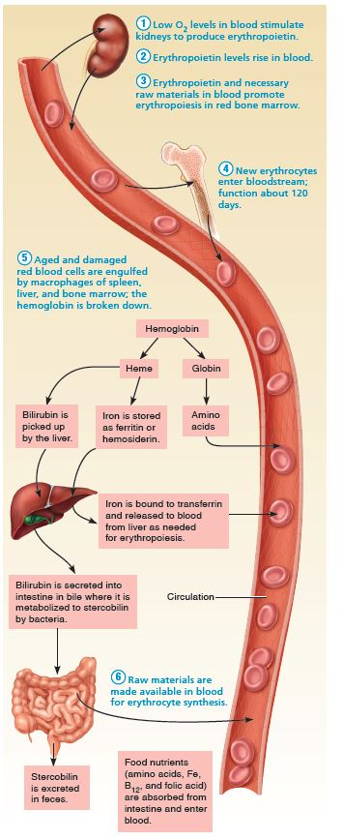
Life Cycle of Red Blood Cells (1 of 7)
Figure 17.7 Life cycle of red blood cells.

Slide 48
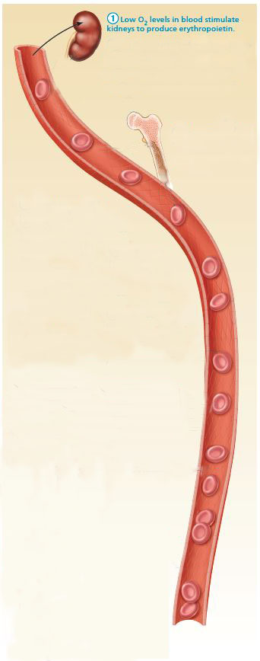
Life Cycle of Red Blood Cells (2 of 7)
Figure 17.7 Life cycle of red blood cells.

Slide 49
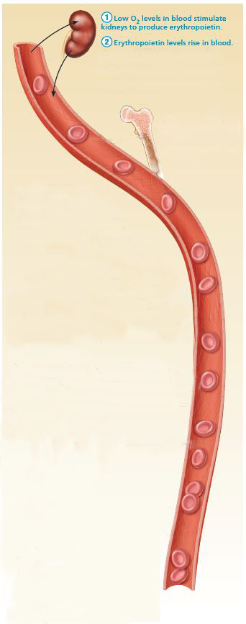
Life Cycle of Red Blood
Cells (3 of 7)
Figure 17.7 Life cycle of red blood cells.

Slide 50
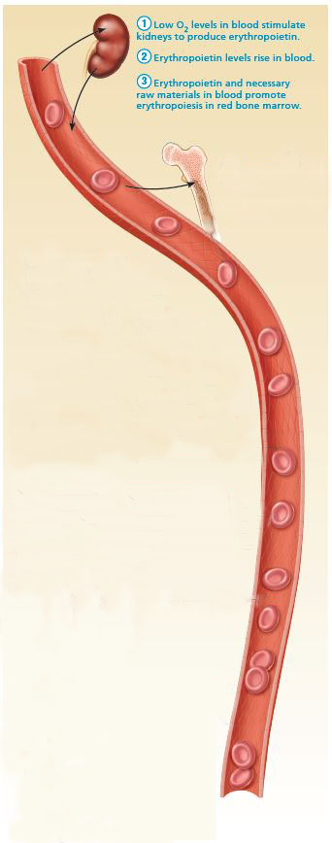
Life Cycle of Red Blood
Cells (4 of 7)
Figure 17.7 Life cycle of red blood cells.

Slide 51
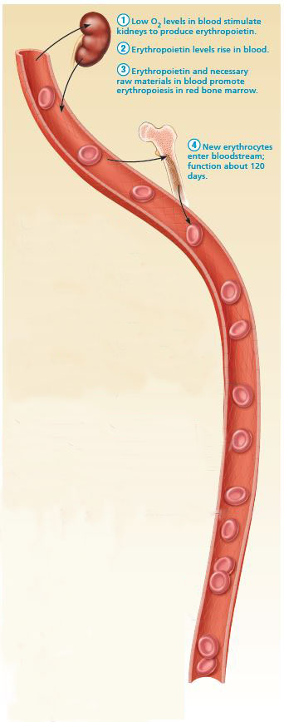
Life Cycle of Red Blood
Cells (5 of 7)
Figure 17.7 Life cycle of red blood cells.

Slide 52
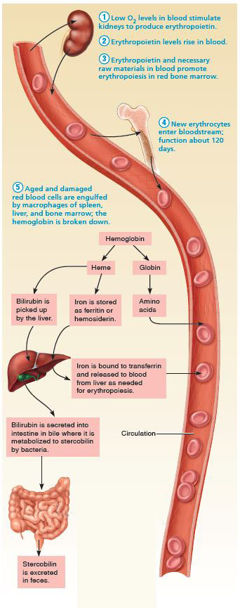
Life Cycle of Red Blood
Cells (6 of 7)
Figure 17.7 Life cycle of red blood cells.

Slide 53
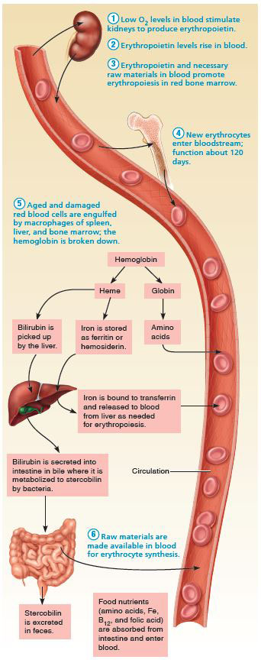
Life Cycle of Red Blood
Cells (7 of 7)
Figure 17.7 Life cycle of red blood cells.

Slide 54
Erythrocyte Disorders (1 of 13)
Most erythrocyte disorders are classified as either anemia or polycythemia
Anemia
  Blood has abnormally low O₂-carrying capacity that is too low to support normal metabolism
  Sign of problem rather than disease itself
  Symptoms: fatigue, pallor, dyspnea, and chills
  Three groups based on cause
    Blood loss
    Not enough RBCs produced
    Too many RBCs being destroyed

Slide 55
Erythrocyte Disorders (2 of 13)
Anemia (cont.)
  Blood loss
    Hemorrhagic anemia
      Rapid blood loss (example: severe wound)
      Treated by blood replacement
    Chronic hemorrhagic anemia
      Slight but persistent blood loss
        Example: hemorrhoids, bleeding ulcer
      Primary problem must be treated to stop blood loss

Slide 56
Erythrocyte Disorders (3 of 13)
Anemia (cont.)
  Not enough RBCs being produced
    Iron-deficiency anemia
      Can be caused by hemorrhagic anemia, but also by low iron intake or impaired absorption
      RBCs produced are called microcytes
        Small, pale in color
        Cannot synthesize hemoglobin because there is a lack of iron
      Treatment: iron supplements

Slide 57
Erythrocyte Disorders (4 of 13)
Anemia (cont.)
  Not enough RBCs being produced (cont.)
    Pernicious anemia
      Autoimmune disease that destroys stomach mucosa that produces intrinsic factor
      Intrinsic factor needed to absorb B₁₂
      B₁₂ is needed to help RBCs divide
      Without B₁₂ RBCs enlarge but cannot divide, resulting in large macrocytes
      Treatment: B₁₂ injections or nasal gel
      Can also be caused by low dietary intake of B₁₂
        Can be a problem for vegetarians

Slide 58
Erythrocyte Disorders (5 of 13)
Anemia (cont.)
  Not enough RBCs being produced (cont.)
    Renal anemia
      Caused by lack of EPO
      Often accompanies renal disease
        Kidneys cannot produce enough EPO
      Treatment: synthetic EPO

Slide 59
Erythrocyte Disorders (6 of 13)
Anemia (cont.)
  Not enough RBCs being produced (cont.)
    Aplastic anemia
      Destruction or inhibition of red bone marrow
      Can be caused by drugs, chemicals, radiation, or viruses
        Usually cause is unknown
      All formed element cell lines are affected
        Results in anemia as well as clotting and immunity defects
      Treatment: short-term with transfusions, long-term with transplanted stem cells

Slide 60
Erythrocyte Disorders (7 of 13)
Anemia (cont.)
  Too many RBCs destroyed:
    Premature lysis of RBCs
      Referred to as hemolytic anemias
    Can be caused by:
      Incompatible transfusions or infections
      Hemoglobin abnormalities: usually genetic disorder resulting in abnormal globin
        Thalassemias
        Sickle-cell anemia

Slide 61
Erythrocyte Disorders (8 of 13)
Anemia (cont.)
  Too many RBCs destroyed:
    Thalassemias
      Typically found in people of Mediterranean ancestry
      One globin chain is absent or faulty
      RBCs are thin, delicate, and deficient in hemoglobin
      Many subtypes that range in severity from mild to extremely severe
        Very severe cases may require monthly blood transfusions

Slide 62
Erythrocyte Disorders (9 of 13)
Anemia (cont.)
  Too many RBCs destroyed:
    Sickle-cell anemia
      Hemoglobin S: mutated hemoglobin
        Only 1 amino acid is wrong in a globin beta chain of 146 amino acids
      RBCs become crescent shaped when O₂ levels are low
        Example: during exercise
      Misshaped RBCs rupture easily and block small vessels
        Results in poor O₂ delivery and pain

Slide 63
Erythrocyte Disorders (10 of 13)
Anemia (cont.)
  Too many RBCs destroyed:
      Sickle-cell anemia (cont.)
      Prevalent in black people of the African malarial belt and their descendants
      Possible benefit: people with sickle cell do not contract malaria
        Kills 1 million each year
        Individuals with two copies of Hb-S can develop sickle-cell anemia
        Individuals with only one copy have milder disease and better chance of surviving malaria

Slide 64
Erythrocyte Disorders (11 of 13)
Anemia (cont.)
  Too many RBCs destroyed:
      Sickle-cell anemia (cont.)
      Treatment: acute crisis treated with transfusions; inhaled nitric oxide
      Prevention of sickling:
        Hydroxyurea induces formation of fetal hemoglobin (which does not sickle)
        Stem cell transplants
        Gene therapy
        Nitric oxide for vasodilation

Slide 65
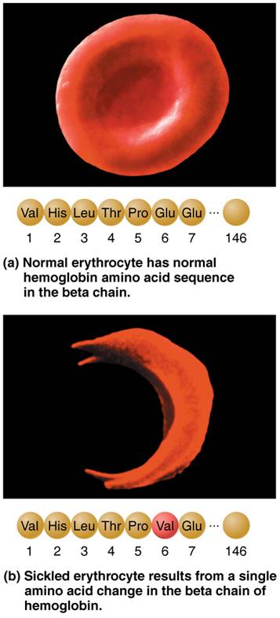
Sickle-Cell Anemia (1 of 3)
Figure 17.8 Sickle-cell anemia.

Slide 66
Erythrocyte Disorders (12 of 13)
Polycythemia
  Abnormal excess of RBCs; increases blood viscosity, causing sluggish blood flow
  Polycythemia vera: Bone marrow cancer leading to excess RBCs
    Hematocrit may go as high as 80%
    Treatment: therapeutic phlebotomy
  Secondary polycythemia: caused by low O₂ levels (example: high altitude) or increased EPO production

Slide 67
Erythrocyte Disorders (13 of 13)
Polycythemia (cont.)
  Blood doping: athletes remove, store, and reinfuse RBCs before an event to increase O₂ levels for stamina

Slide 68
17.4 Leukocytes

Slide 69
General Structure and Functional Characteristics (1 of 2)
Leukocytes, or WBCs, are only formed element that is complete cell with nuclei and organelles
Make up <1% of total blood volume
  4800 to 10,800 WBCs per µl blood
Function in defense against disease
  Can leave capillaries via diapedesis
  Move through tissue spaces by amoeboid motion and positive chemotaxis

Slide 70
General Structure and Functional Characteristics (2 of 2)
Leukocytosis: WBC count over 11,000 per μl
Increase is a normal response to infection
Leukocytes grouped into two major categories:
  Granulocytes: contain visible cytoplasmic granules (neutrophils, eosinophils, basophils)
  Agranulocytes: do not contain visible cytoplasmic granules (lymphocytes, monocytes)
Mnemonic to remember decreasing abundance in blood: Never let monkeys eat bananas (neutrophils, lymphocytes, monocytes, eosinophils, basophils)

Slide 71
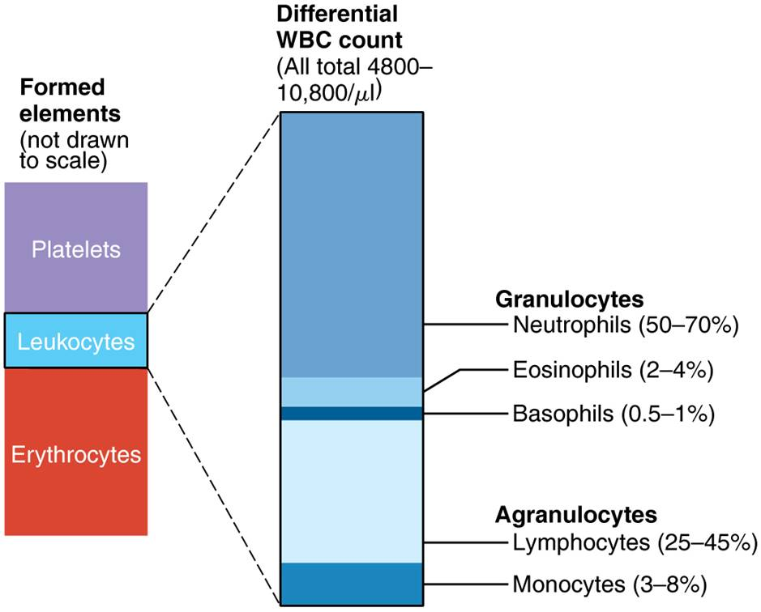
Types and Relative Percentages of Leukocytes in Normal Blood
Figure 17.9 Types and relative percentages of leukocytes in normal blood.

Slide 72
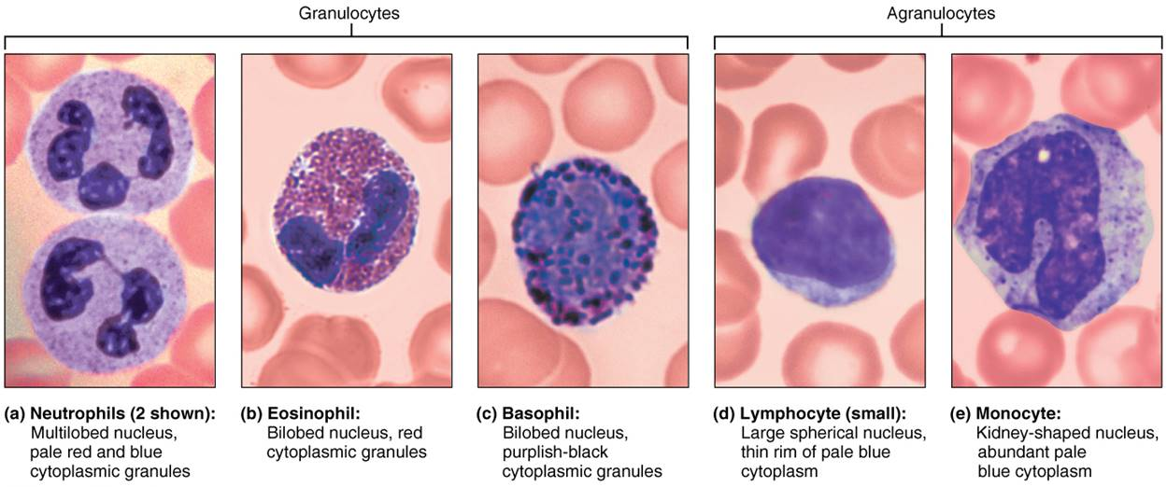
Leukocytes (1 of 7)
Figure 17.10 Leukocytes.

Slide 73
Granulocytes (1 of 5)
Granulocytes: three types
  Neutrophils, eosinophils, basophils
Larger and shorter-lived than RBCs
Contain lobed, rather than circular, nuclei
Cytoplasmic granules stain specifically with Wright’s stain
All are phagocytic to some degree

Slide 74
Granulocytes (2 of 5)
Neutrophils
  Most numerous WBCs
    Account for 50–70% of WBCs
  About twice the size of RBCs
  Granules stain with both acid and basic dyes
  Granules contain either hydrolytic enzymes or antimicrobial proteins, defensins
  Also called polymorphonuclear leukocytes (PMNs or polys) because nucleus is lobular
    Cell has anywhere from three to six lobes

Slide 75
Granulocytes (3 of 5)
  Neutrophils (cont.)
  Very phagocytic
    Referred to as “bacteria slayers”
    Kill microbes by process called respiratory burst
      Cell synthesizes potent oxidizing substances (bleach or hydrogen peroxide)
  Defensin granules merge with phagosome
    Form “spears” that pierce holes in membrane of ingested microbe

Slide 76
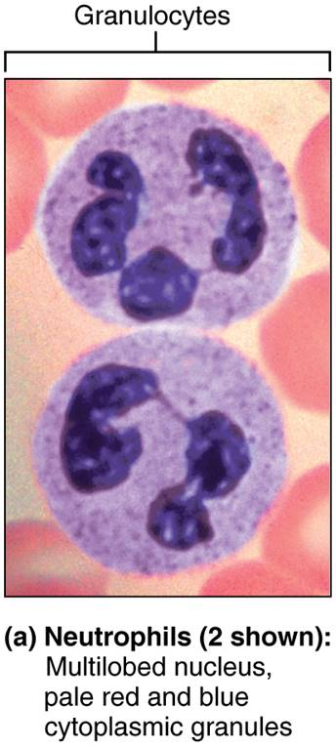
Leukocytes (2 of 7)
Figure 17.10a Leukocytes.

Slide 77
Granulocytes (4 of 5)
Eosinophils
  Account for 2–4% of all leukocytes
  Nucleus has two lobes connected by a broad band; resembles ear muffs
  Red-staining granules contain digestive enzymes
    Release enzymes on large parasitic worms, digesting their surface
  Also play role in allergies and asthma, as well as immune response modulators

Slide 78
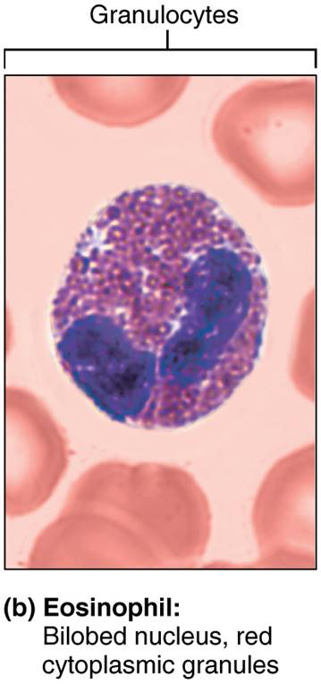
Leukocytes (3 of 7)
Figure 17.10b Leukocytes.

Slide 79
Granulocytes (5 of 5)
Basophils
  Rarest WBCs, accounting for only 0.5–1% of leukocytes
  Nucleus deep purple with one to two constrictions
  Large, purplish black (basophilic) granules contain histamine
    Histamine: inflammatory chemical that acts as vasodilator and attracts WBCs to inflamed sites
  Are functionally similar to mast cells

Slide 80
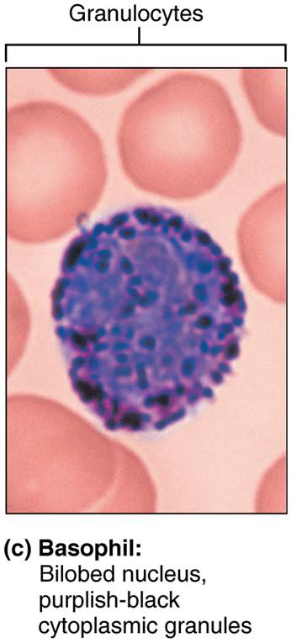
Leukocytes (4 of 7)
Figure 17.10c Leukocytes.

Slide 81
Agranulocytes (1 of 3)
Agranulocytes lack visible cytoplasmic granules
Two types: lymphocytes and monocytes
Both have spherical or kidney-shaped nuclei

Slide 82
Agranulocytes (2 of 3)
Lymphocytes
  Second most numerous WBC, accounts for 25%
  Large, dark purple, circular nuclei with thin rim of blue cytoplasm
  Mostly found in lymphoid tissue (example: lymph nodes, spleen), but a few circulate in blood
  Crucial to immunity
  Two types of lymphocytes
    T lymphocytes (T cells) act against virus-infected cells and tumor cells
    B lymphocytes (B cells) give rise to plasma cells, which produce antibodies

Slide 83
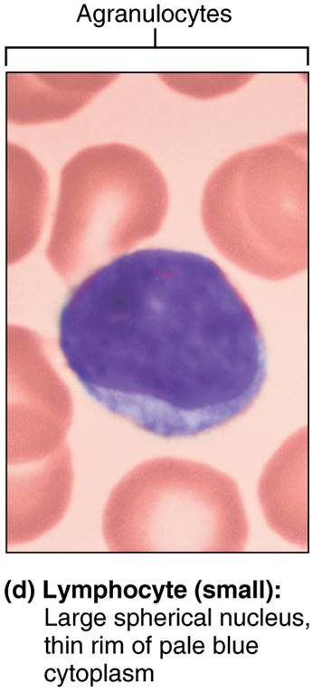
Leukocytes (5 of 7)
Figure 17.10d Leukocytes.

Slide 84
Agranulocytes (3 of 3)
Monocytes
  Largest of all leukocytes; 3–8% of all WBCs
  Abundant pale blue cytoplasm
  Dark purple-staining, U- or kidney-shaped nuclei
  Leave circulation, enter tissues, and differentiate into macrophages
    Actively phagocytic cells; crucial against viruses, intracellular bacterial parasites, and chronic infections
  Activate lymphocytes to mount an immune response

Slide 85
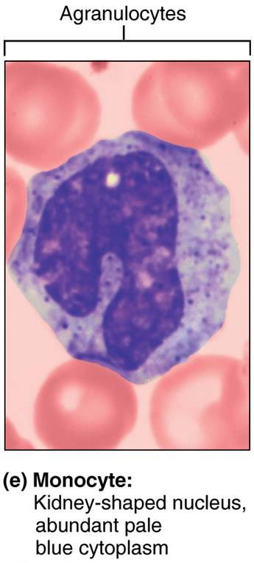
Leukocytes (6 of 7)
Figure 17.10e Leukocytes.

Slide 86
Leukocytes (7 of 7)
Figure 17.10 Leukocytes.

Slide 87
Production and Life Span of Leukocytes
(1 of 3)
Leukopoiesis: production of WBCs are stimulated by two types of chemical messengers from red bone marrow and mature WBCs
  Interleukins are numbered (e.g., IL-3, IL-5)
  Colony-stimulating factors (CSFs) are named for WBC type they stimulate (e.g., granulocyte-CSF stimulates granulocytes)
All leukocytes originate from hemocytoblast stem cell that branches into two pathways:
  Lymphoid stem cells produces lymphocytes
  Myeloid stem cells produce all other elements

Slide 88
Production and Life Span of Leukocytes
(2 of 3)
Granulocyte production:
  Myeloblasts: arise from myeloid line stem cells
  Promyelocytes: accumulate lysosomes
  Myelocytes: accumulate granules
  Band cells: nuclei form curved arc
  Mature granulocyte: nuclei become segmented before being released in blood
    10× more are stored in bone marrow than in blood
    3× more WBCs are formed than RBCs, because WBCs have a shorter life, cut short by fighting microbes

Slide 89
Production and Life Span of Leukocytes
(3 of 3)
Agranulocyte production:
  Monocytes: derived from myeloid line
    Monoblast → promonocyte → monocyte
    Share common precursor with neutrophils
    Can live for several months
  Lymphocytes: derived from lymphoid line
    T lymphocyte precursors give rise to immature T lymphocytes that mature in thymus
    B lymphocyte precursors give rise to immature B lymphocytes that mature within bone marrow
    Lymphocytes live from a few hours to decades

Slide 90
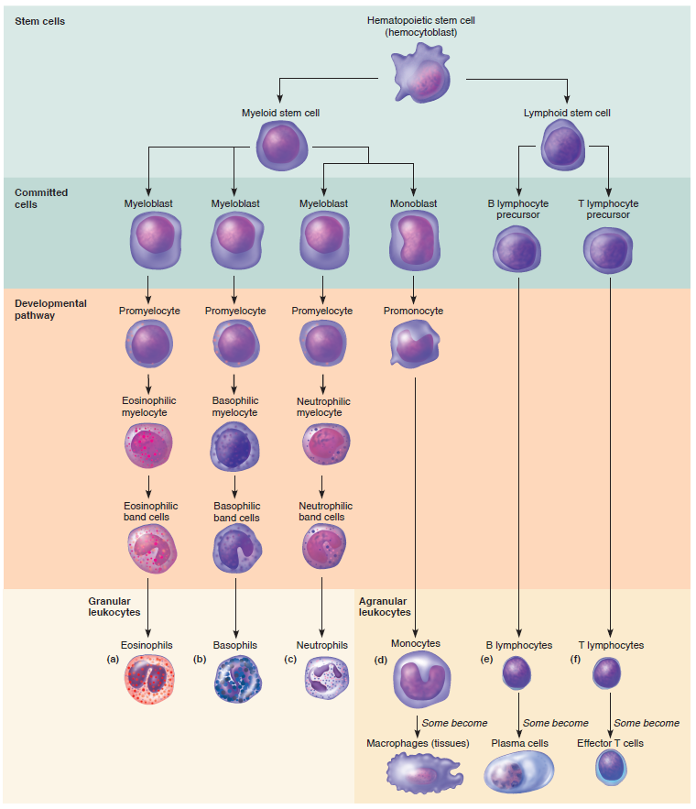
Leukocyte
Formation
Figure 17.11 Leukocyte formation.

Slide 91
Clinical – Homeostatic Imbalance 17.2
Many hematopoietic hormones (EPO and CSFs) are used clinically
Can stimulate bone marrow of cancer patients receiving chemotherapy or stem cell transplants
Also used to increase protective immune responses of AIDS patients

Slide 92
Leukocyte Disorders (1 of 5)
Overproduction of abnormal WBC: leukemias and infectious mononucleosis
Abnormally low WBC count: leukopenia
  Can be drug induced, particularly by anticancer drugs or glucocorticoids

Slide 93
Leukocyte Disorders (2 of 5)
Leukemias
  Cancerous condition involving overproduction of abnormal WBCs
    Usually involve clones of single abnormal cell
  Named according to abnormal WBC clone involved
    Myeloid leukemia involves myeloblast descendants
    Lymphocytic leukemia involves lymphocytes

Slide 94
Leukocyte Disorders (3 of 5)
  Leukemias (cont.)
  Acute (quickly advancing) leukemia derives from stem cells
    Primarily affects children
  Chronic (slowly advancing) leukemia involves proliferation of later cell stages
    More prevalent in older people

Slide 95
Leukocyte Disorders (4 of 5)
  Leukemias (cont.)
  Without treatment, all leukemias are fatal
  Immature, nonfunctional WBCs flood bloodstream
  Cancerous cells fill red bone marrow, crowding out other cell lines
    Leads to anemia and bleeding
  Death is usually from internal hemorrhage or overwhelming infections
  Treatments: irradiation, antileukemic drugs; stem cell transplants

Slide 96
Leukocyte Disorders (5 of 5)
Infectious mononucleosis
  Highly contagious viral disease (“kissing disease”)
    Usually seen in young adults
  Caused by Epstein-Barr virus
  Results in high numbers of typical agranulocytes
    Involve lymphocytes that become enlarged
    Originally thought cells were monocytes, so disease named mononucleosis
  Symptoms
    Tired, achy, chronic sore throat, low fever
  Runs course with rest in 4–6 weeks

Slide 97
17.5 Platelets (1 of 2)
Platelet: fragments of larger megakaryocyte
Blue-staining outer region; purple granules
Contain several chemicals involved in clotting process
  Serotonin, calcium, enzymes, ADP, platelet-derived growth factor
Function: form temporary platelet plug that helps seal breaks in blood vessels
Circulating platelets are kept inactive and mobile by nitric oxide (NO) and prostacyclin from endothelial cells lining blood vessels

Slide 98
17.5 Platelets (2 of 2)
Platelet formation is regulated by thrombopoietin
Formed in myeloid line from megakaryoblast (stage I megakaryocyte)
  Mitosis occurs but no cytokinesis, resulting in large stage IV cell with multilobed nucleus
Stage IV megakaryocyte sends cytoplasmic projections into lumen of capillary
  Projections break off into platelet fragments
Platelets age quickly and degenerate in about 10 days
Normal = 150,000– 400,000 platelets/ml of blood

Slide 99
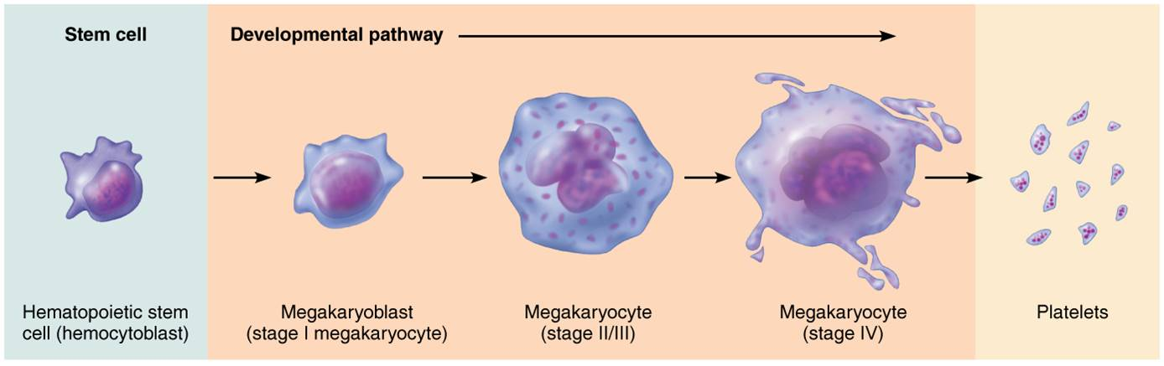
Formation of Platelets
Figure 17.12 Formation of platelets.

Slide 100
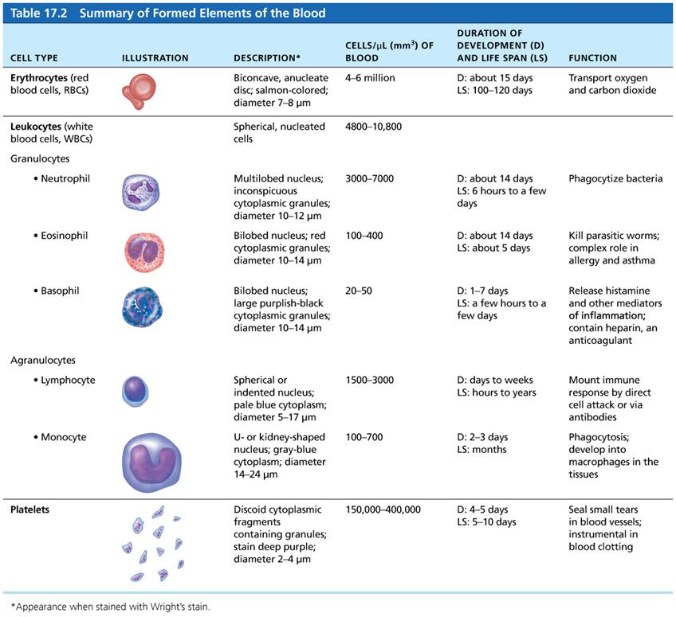
Table 17.2 Summary of Formed Elements of the Blood (2 of 2)
Table 17.2 Summary of Formed Elements of the Blood.

Slide 101
17.6 Hemostasis
Hemostasis: fast series of reactions for stoppage of bleeding
Requires clotting factors and substances released by platelets and injured tissues
Three steps involved
  Step 1: Vascular spasm
  Step 2: Platelet plug formation
  Step 3: Coagulation (blood clotting)

Slide 102
Step 1: Vascular Spasm
Vessel responds to injury with vasoconstriction
Vascular spams are triggered by:
  Direct injury to vascular smooth muscle
  Chemicals released by endothelial cells and platelets
  Pain reflexes
Most effective in smaller blood vessels
Can significantly reduce blood flow until other mechanisms can kick in

Slide 103
Step 2: Platelet Plug Formation (1 of 2)
Platelets stick to collagen fibers that are exposed when vessel is damaged
  Platelets do not stick to intact vessel walls because collagen is not exposed
  Also prostacyclins and nitric oxide secreted by endothelial cells act to prevent platelet sticking
von Willebrand factor helps to stabilize platelet-collagen adhesion

Slide 104
Step 2: Platelet Plug Formation (2 of 2)
When activated, platelets swell, become spiked and sticky, and release chemical messengers:
  ADP causes more platelets to stick and release their contents
  Serotonin and thromboxane A₂ enhance vascular spasm and platelet aggregation
Positive feedback cycle: as more platelets stick, they release more chemicals, which cause more platelets to stick and release more chemicals
Platelet plugs are fine for small vessel tears, but larger breaks in vessels need additional step

Slide 105
Step 3: Coagulation (1 of 5)
Coagulation (blood clotting) reinforces platelet plug with fibrin threads
  Blood clots are effective in sealing larger vessel breaks
Blood is transformed from liquid to gel
Series of reactions use clotting factors (procoagulants), mostly plasma proteins
  Numbered I to XIII in order of discovery
  Vitamin K needed to synthesize four factors
Coagulation occurs in three phases

Slide 106
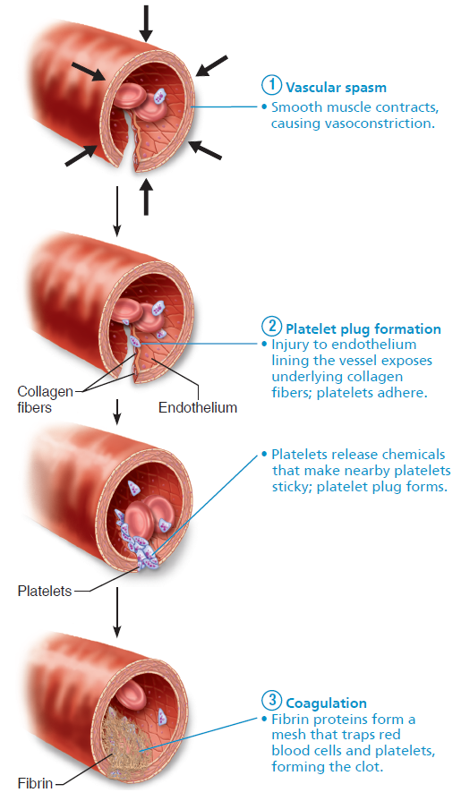
Events of Hemostasis (1 of 4)
Figure 17.13 Events of hemostasis.

Slide 107
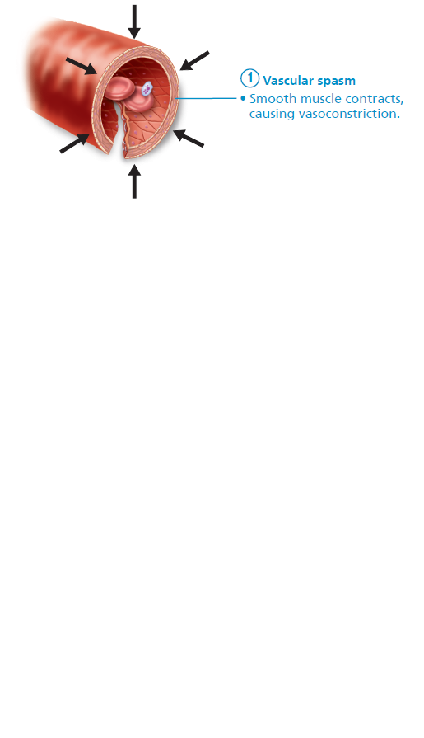
Events of Hemostasis (2 of 4)
Figure 17.13 Events of hemostasis.

Slide 108
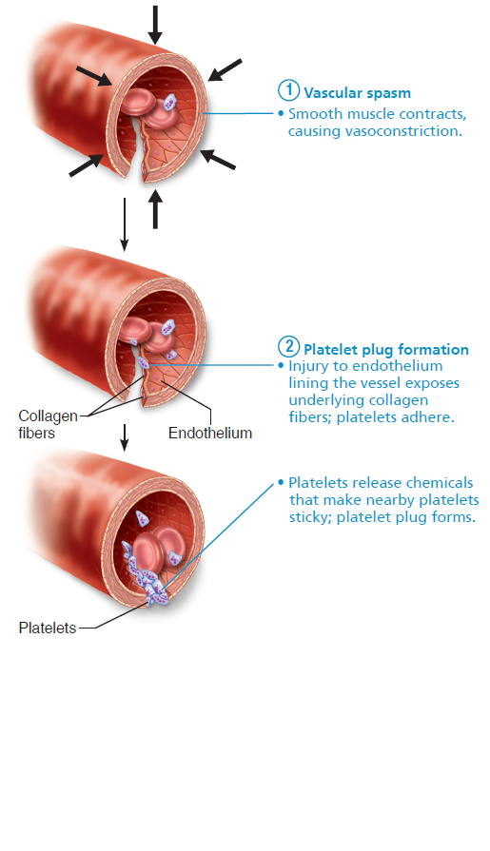
Events of Hemostasis (3 of 4)
Figure 17.13 Events of hemostasis.

Slide 109
Events of Hemostasis (4 of 4)
Figure 17.13 Events of hemostasis.

Slide 110
Step 3: Coagulation (2 of 5)
Phase 1: Two pathways to prothrombin activator
  Initiated by either intrinsic or extrinsic pathway (usually both)
    Triggered by tissue-damaging events
    Involves a series of procoagulants
    Each pathway cascades toward and ends with the activation of factor X
  Factor X then complexes with Ca²⁺, PF₃ (platelet factor 3), and factor V to form prothrombin activator

Slide 111
Step 3: Coagulation (3 of 5)
  Intrinsic pathway
    Called “intrinsic” because clotting factors are present within the blood
    Triggered by negatively charged surfaces such as activated platelets, collagen, or even glass of a test tube
  Extrinsic pathway
    Called “extrinsic” because factors needed for clotting are located outside blood
    Triggered by exposure to tissue factor (TF); also called factor III
    Bypasses several steps of intrinsic pathway, so faster pathway

Slide 112
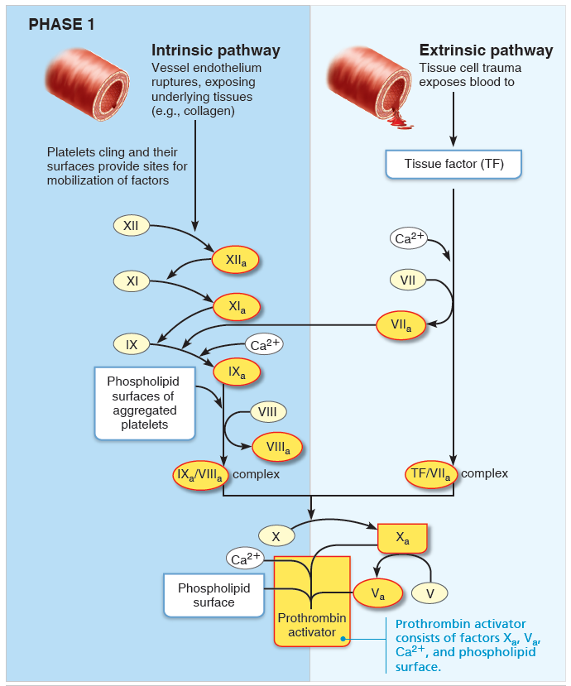
The Intrinsic and Extrinsic Pathways of Blood Clotting (Coagulation) (1 of 4)
Figure 17.14 The intrinsic and extrinsic pathways of blood clotting (coagulation).

Slide 113
Step 3: Coagulation (4 of 5)
Phase 2: Pathway to thrombin
  Prothrombin activator catalyzes transformation of prothrombin to active enzyme thrombin

Slide 114
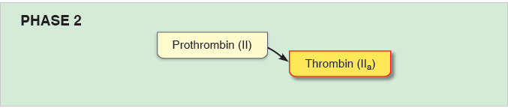
The Intrinsic and Extrinsic Pathways of Blood Clotting (Coagulation) (2 of 4)
Figure 17.14 The intrinsic and extrinsic pathways of blood clotting (coagulation).

Slide 115
Step 3: Coagulation (5 of 5)
Phase 3: Common pathway to the fibrin mesh
  Thrombin converts soluble fibrinogen to fibrin
  Fibrin strands form structural basis of clot
  Fibrin causes plasma to become a gel-like trap catching formed elements
  Thrombin (along with Ca²⁺) activates factor XIII (fibrin stabilizing factor), which:
    Cross-links fibrin
    Strengthens and stabilizes clot
  Anticoagulants: factors that normally dominate in blood to inhibit coagulation

Slide 116
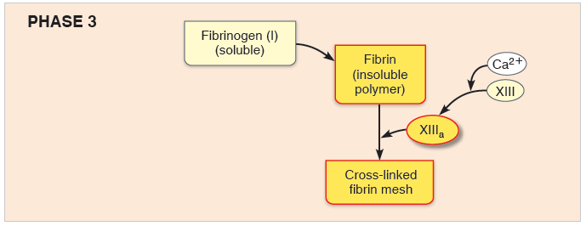
The Intrinsic and Extrinsic Pathways of Blood Clotting (Coagulation) (3 of 4)
Figure 17.14 The intrinsic and extrinsic pathways of blood clotting (coagulation).

Slide 117
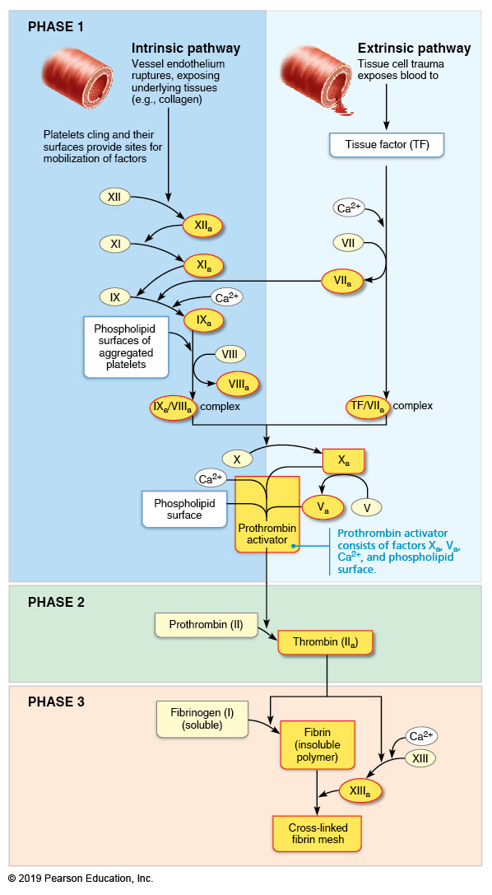
The Intrinsic and Extrinsic Pathways of Blood Clotting (Coagulation) (4 of 4)
Figure 17.14 The intrinsic and extrinsic pathways of blood clotting (coagulation).

Slide 118
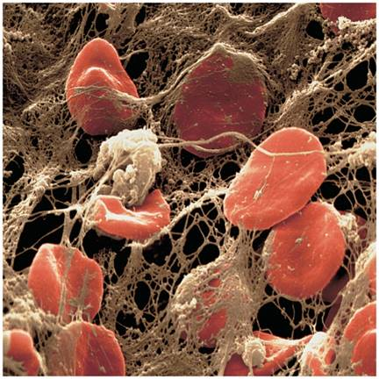
Scanning Electron Micrograph of Erythrocytes Trapped in a Fibrin Mesh
Figure 17.15 Scanning electron micrograph of erythrocytes trapped in a fibrin mesh.

Slide 119
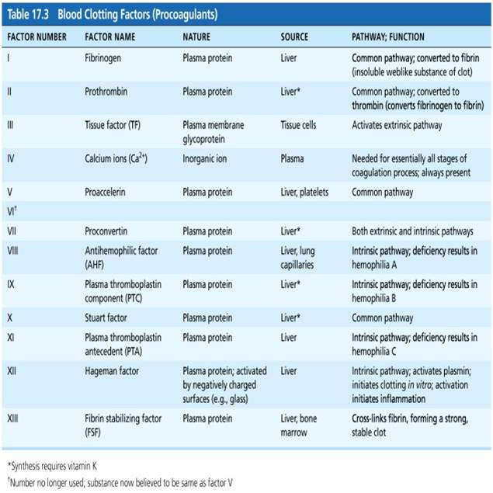
Table 17.3 Blood Clotting Factors (Procoagulants)
Table 17.3 Blood Clotting Factors (Procoagulants).

Slide 120
Clot Retraction and Fibrinolysis (1 of 3)
Clot must be stabilized and removed when damage has been repaired
Clot retraction
  Actin and myosin in platelets contract within 30–60 minutes
  Contraction pulls on fibrin strands, squeezing serum from clot
    Serum is plasma minus the clotting proteins
  Draws ruptured blood vessel edges together

Slide 121
Clot Retraction and Fibrinolysis (2 of 3)
Vessel is healing even as clot retraction occurs
Platelet-derived growth factor (PDGF) is released by platelets
  Stimulates division of smooth muscle cells and fibroblasts to rebuild blood vessel wall
Vascular endothelial growth factor (VEGF) stimulates endothelial cells to multiply and restore endothelial lining

Slide 122
Clot Retraction and Fibrinolysis (3 of 3)
Fibrinolysis
  Process whereby clots are removed after repair is completed
  Begins within 2 days and continues for several days until clot is dissolved
  Plasminogen, plasma protein that is trapped in clot, is converted to plasmin, a fibrin-digesting enzyme
    Tissue plasminogen activator (tPA), factor XII, and thrombin all play a role in conversion process

Slide 123
Factors Limiting Clot Growth or Formation
(1 of 2)
Factors limiting normal clot growth
  Two mechanisms limit clot size
    Swift removal and dilution of clotting factors
    Inhibition of activated clotting factors
  Limited amount of thrombin is restricted to clot by fibrin threads, preventing clot from getting too big or escaping into bloodstream
    Antithrombin III inactivates any unbound thrombin that escapes into bloodstream
    Heparin in basophil and mast cells inhibits thrombin by enhancing antithrombin III

Slide 124
Factors Limiting Clot Growth or Formation
(2 of 3)
Factors preventing undesirable clotting
  Factors preventing platelet adhesion
    Smooth endothelium of blood vessels prevents platelets from clinging
    Endothelial cells secrete antithrombic substances such as nitric oxide and prostacyclin
    Vitamin E quinone, formed when vitamin E reacts with oxygen, is a potent anticoagulant

Slide 125
Disorders of Hemostasis (1 of 7)
Two major types of disorders
  Thromboembolic disorders: result in undesirable clot formation
  Bleeding disorders: abnormalities that prevent normal clot formation
Disseminated intravascular coagulation (DIC)
  Involves both types of disorders

Slide 126
Disorders of Hemostasis (2 of 7)
Thromboembolic conditions
  Thrombi and emboli
    Thrombus: clot that develops and persists in unbroken blood vessel
      May block circulation, leading to tissue death
    Embolus: thrombus freely floating in bloodstream
    Embolism: embolus obstructing a vessel Example: pulmonary or cerebral emboli
    Risk factors: atherosclerosis, inflammation, slowly flowing blood or blood stasis from immobility

Slide 127
Disorders of Hemostasis (3 of 7)
Thromboembolic conditions (cont.)
  Anticoagulant drugs: used to prevent undesirable clotting
    Aspirin: antiprostaglandin that inhibits
    thromboxane A₂; lowers heart attack incidence by 50%
    Heparin: used clinically for pre- and postoperative cardiac care as well as to prevent venous thrombosis
    Warfarin and direct oral anticoagulants: reduce risk of stroke in patients prone to atrial fibrillation in which blood pools in heart
      Interferes with action of vitamin K

Slide 128
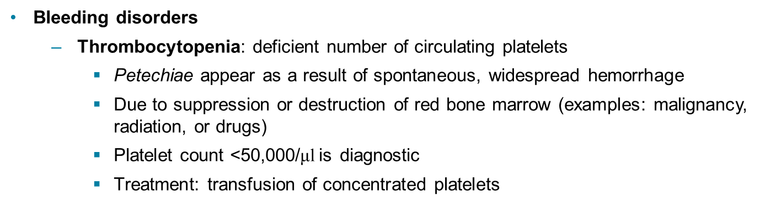
Disorders of Hemostasis (4 of 7)
Bleeding disorders
  Thrombocytopenia: deficient number of circulating platelets
    Petechiae appear as a result of spontaneous, widespread hemorrhage
    Due to suppression or destruction of red bone marrow (examples: malignancy, radiation, or drugs)
    Platelet count <50,000/μl is diagnostic
    Treatment: transfusion of concentrated platelets

Slide 129
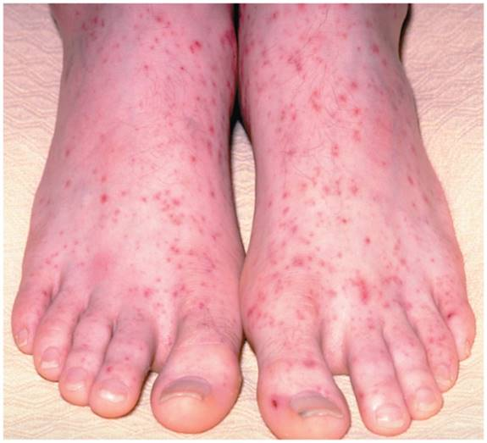
Petechiae
Figure 17.16 Petechiae.

Slide 130
Disorders of Hemostasis (5 of 7)
Bleeding disorders (cont.)
  Impaired liver function
    Inability to synthesize procoagulants (clotting factors)
    Causes include vitamin K deficiency, hepatitis, or cirrhosis
    Liver disease can also prevent liver from producing bile, which is needed to absorb fat and vitamin K

Slide 131
Disorders of Hemostasis (6 of 7)
Bleeding disorders (cont.)
  Hemophilia
    Includes several similar hereditary bleeding disorders
      Hemophilia A: most common type (77% of all cases) due to factor VIII deficiency
      Hemophilia B: factor IX deficiency
      Hemophilia C: factor XI deficiency, milder
    Symptoms include prolonged bleeding, especially into joint cavities
    Treatment: injections of genetically engineered factors; has eliminated need for plasma transfusion and risk of contracting hepatitis or HIV

Slide 132
Disorders of Hemostasis (7 of 7)
Disseminated intravascular coagulation (DIC)
  Involves both widespread clotting and severe bleeding
    Widespread clotting occurs in intact blood vessels, blocking blood flow
    Severe bleeding follows because residual blood is unable to clot because clotting factors are being depleted
  Can occur in septicemia, incompatible blood transfusions, or complications in pregnancy

Slide 133
17.7 Blood Transfusions
Cardiovascular system minimizes effects of blood loss by:
  reducing volume of affected blood vessels
  stepping up production of RBCs
Body can compensate for only so much blood loss
Loss of 15–30% causes pallor and weakness
Loss of more than 30% results in potentially fatal severe shock

Slide 134
Restoring Blood Volume
Death from shock may result from low blood volume
Volume must be replaced immediately with
  Normal saline or multiple-electrolyte solution (Ringer’s solution) that mimics plasma electrolyte composition
Replacement of volume restores adequate circulation but does not replace oxygen-carrying capacities of RBCs

Slide 135
Transfusing Red Blood Cells (1 of 8)
Whole-blood transfusions are used only when blood loss is rapid and substantial
Infusions of packed red blood cells, or PRBCs (plasma and WBCs removed), are preferred to restore oxygen-carrying capacity
Blood banks usually separate donated blood into components; shelf life of blood is about 35 days
Human blood groups of donated blood must be determined because transfusion reactions can be fatal
  Blood typing determines groups

Slide 136
Transfusing Red Blood Cells (2 of 8)
Human blood groups
  RBC membranes bear different many antigens
    Antigen: anything perceived as foreign that can generate an immune response
    RBC antigens are referred to as agglutinogens because they promote agglutination
  Mismatched transfused blood is perceived as foreign and may be agglutinated and destroyed
    Potentially fatal reaction

Slide 137
Transfusing Red Blood Cells (3 of 8)
  Human blood groups (cont.)
  Humans have at least 30 naturally occurring RBC antigens
  Presence or absence of each antigen is used to classify blood cells into different groups
  Some blood groups (MNS, Duffy, Kell, and Lewis) are only weak agglutinogens
    Not usually typed unless patient will need several transfusions
  Antigens of ABO and Rh blood groups cause most vigorous transfusion reactions; therefore, they are major groups typed

Slide 138
Transfusing Red Blood Cells (4 of 8)
  ABO blood groups
    Based on presence or absence of two agglutinogens (A and B) on surface of RBCs
      Type A has only A agglutinogen
      Type B has only B agglutinogen
      Type AB has both A and B agglutinogens
      Type O has neither A nor B agglutinogens
    Blood may contain preformed anti-A or anti-B antibodies (agglutinins)
      Act against transfused RBCs with ABO antigens not present on recipient's RBCs
    Anti-A or anti-B form in blood at about 2 months of age, reaching adult levels by 8–10 years of age

Slide 139
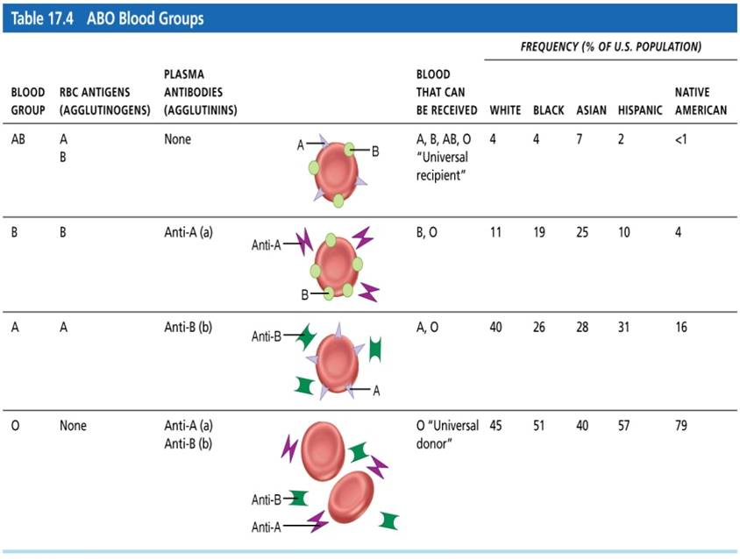
Table 17.4 ABO Blood Groups
Table 17.4 ABO Blood Groups.

Slide 140
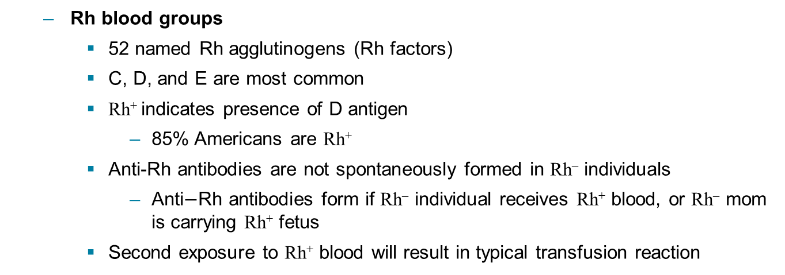
Transfusing Red Blood Cells (5 of 8)
  Rh blood groups
    52 named Rh agglutinogens (Rh factors)
    C, D, and E are most common
    Rh⁺ indicates presence of D antigen
      85% Americans are Rh⁺
    Anti-Rh antibodies are not spontaneously formed in Rh– individuals
      Anti$−$Rh antibodies form if Rh– individual receives Rh⁺ blood, or Rh– mom is carrying Rh⁺ fetus
    Second exposure to Rh⁺ blood will result in typical transfusion reaction

Slide 141
Clinical – Homeostatic Imbalance 17.3
Hemolytic disease of newborn, also called erythroblastosis fetalis only occurs in Rh– mom with Rh⁺ fetus
First pregnancy: Rh– mom exposed to Rh⁺ blood of fetus during delivery; first baby born healthy, but mother synthesizes anti-Rh antibodies
Second pregnancy: Mom’s anti-Rh antibodies cross placenta and destroy RBCs of Rh⁺ baby
Baby treated with prebirth transfusions and exchange transfusions after birth
RhoGAM serum containing anti-Rh can prevent Rh– mother from becoming sensitized

Slide 142
Transfusing Red Blood Cells (6 of 8)
Transfusion reactions
  Occur if mismatched blood is infused
  Donor’s cells are attacked by recipient’s plasma agglutinins
    Agglutinate and clog small vessels
    Rupture and release hemoglobin into bloodstream
  Result in:
    Diminished oxygen-carrying capacity
    Decreased blood flow beyond blocked vessel
    Hemoglobin in kidney tubules can lead to renal failure

Slide 143
Transfusing Red Blood Cells (7 of 8)
  Transfusion reactions (cont.)
  Symptoms: fever, chills, low blood pressure, rapid heartbeat, nausea, vomiting
  Treatment: preventing kidney damage with fluids and diuretics to wash out hemoglobin
  Type O universal donor: no A or B antigens
  Type AB universal recipient: no anti-A or anti-B antibodies
    Misleading as other agglutinogens that cause transfusion reactions must also be considered
  Autologous transfusions: patient predonates own blood that is stored and available if needed

Slide 144
Transfusing Red Blood Cells (8 of 8)
Blood typing
  Donor blood is mixed with antibodies against common agglutinogens
    If agglutinogen is present, clumping of RBCs will occur
  Blood is typed for ABO and for Rh factor in same manner
  Cross matching: typing between specific donor and specific recipient
    Mix recipient’s serum with donor RBCs
    Mix recipient’s RBCs with donor serum

Slide 145
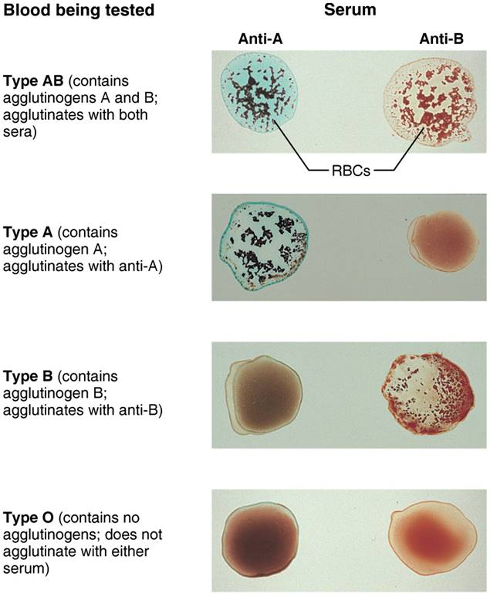
Blood Typing of ABO Blood Types
Figure 17.17 Blood typing of ABO blood types.

Slide 146
17.8 Diagnostic Blood Tests (1 of 2)
Examination of blood can yield information on persons health:
  Low hematocrit seen in cases of anemia
  Blood glucose tests check for diabetes
  Leukocytosis can signal infection
Microscopic examination of blood can reveal any variations in size or shape of RBCs
  Abnormal size, shape, or color could indicate anemia

Slide 147
17.8 Diagnostic Blood Tests (2 of 2)
Differential WBC count looks at relative proportions of each WBC
  Increases in specific WBC can help with diagnosis
Prothrombin time and platelet counts assess hemostasis
CMP (comprehensive medical panel): blood chemistry profile that checks various blood chemical levels
  Abnormal results could indicate liver or kidney disorders
Complete blood count (CBC) checks formed elements, hematocrit, hemoglobin

Slide 148
Developmental Aspects of Blood
Fetal blood cells form in yolk sac, liver, and spleen
Red bone marrow is primary hematopoietic area by seventh month
Blood cells develop from mesenchymal cells called blood islands
The fetus forms hemoglobin F, which has higher affinity for O₂ than hemoglobin A formed after birth
Blood diseases of aging
  Chronic leukemias, anemias, clotting disorders
  Usually precipitated by disorders of heart, blood vessels, or immune system

Slide 149
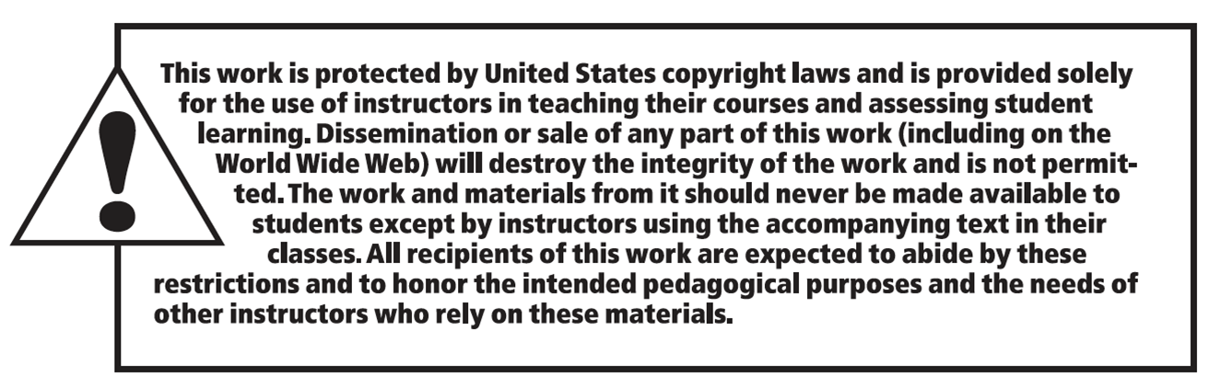
Copyright

