Slide 1

Human Anatomy and Physiology
Eleventh Edition
Chapter 09 Part C
Muscles and Muscle Tissue
PowerPoint® Lectures Slides prepared by Karen Dunbar Kareiva, Ivy Tech Community College
Copyright © 2019, 2016, 2013 Pearson Education, Inc. All Rights Reserved

Slide 2
9.7 Factors of Muscle Contraction
Force of Muscle Contractions
Force of contraction depends on number of cross bridges attached, which is affected by four factors:
  Number of muscle fibers stimulated (recruitment): the more motor units recruited, the greater the force.
  Relative size of fibers: the bulkier the muscle, the more tension it can develop
    Muscle cells can increase in size (hypertrophy) with regular exercise

Slide 3
Force of Muscle Contractions
  Frequency of stimulation: the higher the frequency, the greater the force
    Stimuli are added together
  Degree of muscle stretch: muscle fibers with sarcomeres that are 80–120% their normal resting length generate more force
    If sarcomere is less than 80% resting length, filaments overlap too much, and force decreases
    If sarcomere is greater than 120% of resting length, filaments do not overlap enough so force decreases

Slide 4
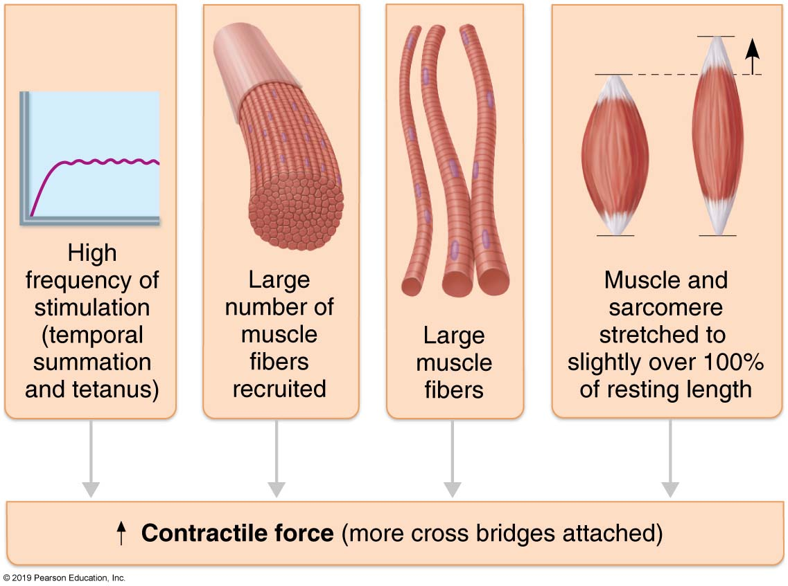
  Factors that Increase the Force of Skeletal Muscle Contraction
Figure 9.18 Factors that increase the force of skeletal muscle contraction.

Slide 5
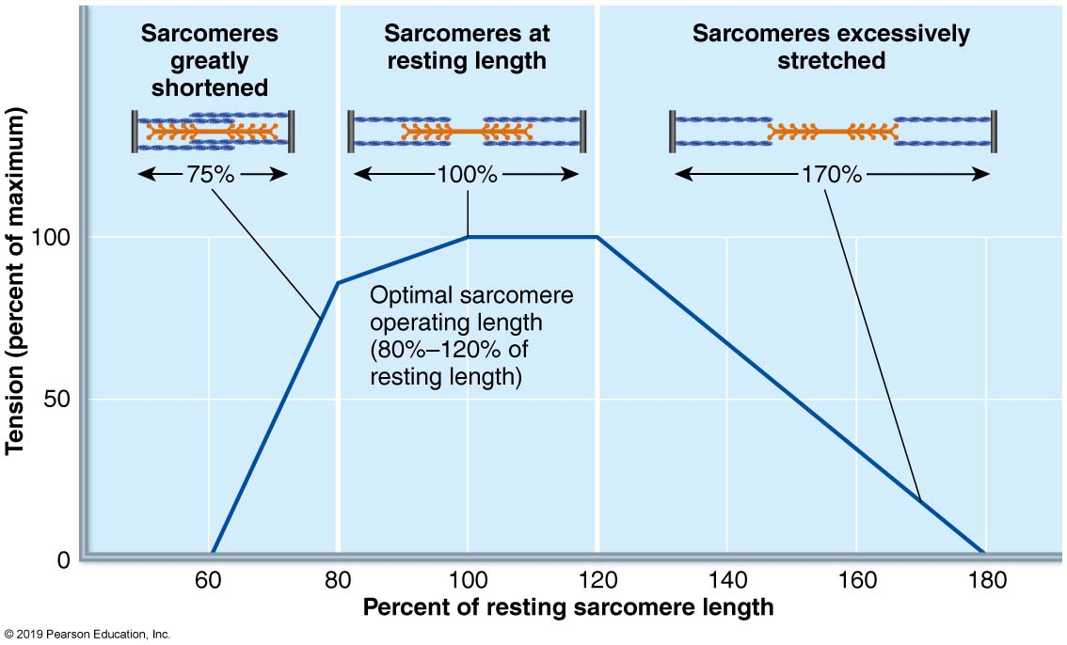
  Length-Tension Relationships of Sarcomeres in Skeletal Muscles
Figure 9.19 Length-tension relationships of sarcomeres in skeletal muscles.

Slide 6
  Velocity and Duration of Contraction (1 of 5)
How fast a muscle contracts and how long it can stay contracted is influenced by:
  Muscle fiber type
  Load
  Recruitment

Slide 7
Velocity and Duration of Contraction (2 of 5)
Muscle fiber type
  Classified according to two characteristics
    Speed of contraction – slow or fast fibers
    according to:
  Speed at which myosin ATPases split ATP
  Pattern of electrical activity of motor neurons
    Metabolic pathways used for ATP synthesis
  Oxidative fibers: use aerobic pathways
  Glycolytic fibers: use anaerobic glycolysis

Slide 8
Velocity and Duration of Contraction (3 of 5)
Muscle fiber type (cont.)
  Based on these two criteria, skeletal muscle fibers can be classified into three types:
    Slow oxidative fibers, fast oxidative fibers, or fast glycolytic fibers
  Most muscles contain mixture of fiber types, resulting in a range of contractile speed and fatigue resistance
    All fibers in one motor unit are the same type
    Genetics dictate individual’s percentage of each

Slide 9
Velocity and Duration of Contraction (4 of 5)
Muscle fiber type (cont.)
  Different muscle types are better suited for different jobs
    Slow oxidative fibers: low-intensity, endurance activities
      Example: maintaining posture
    Fast oxidative fibers: medium-intensity activities
      Example: sprinting or walking
    Fast glycolytic fibers: short-term intense or powerful movements
      Example: hitting a baseball

Slide 10
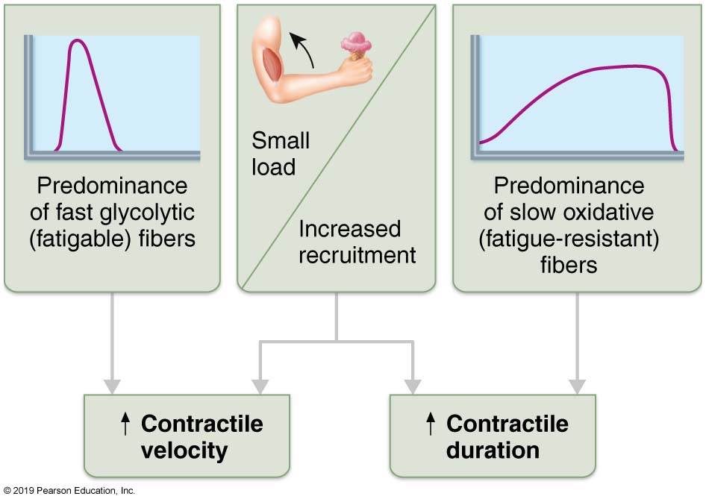
  Factors Influencing Velocity and Duration of Skeletal Muscle Contraction
Figure 9.20 Factors influencing velocity and duration of skeletal muscle contraction.

Slide 11
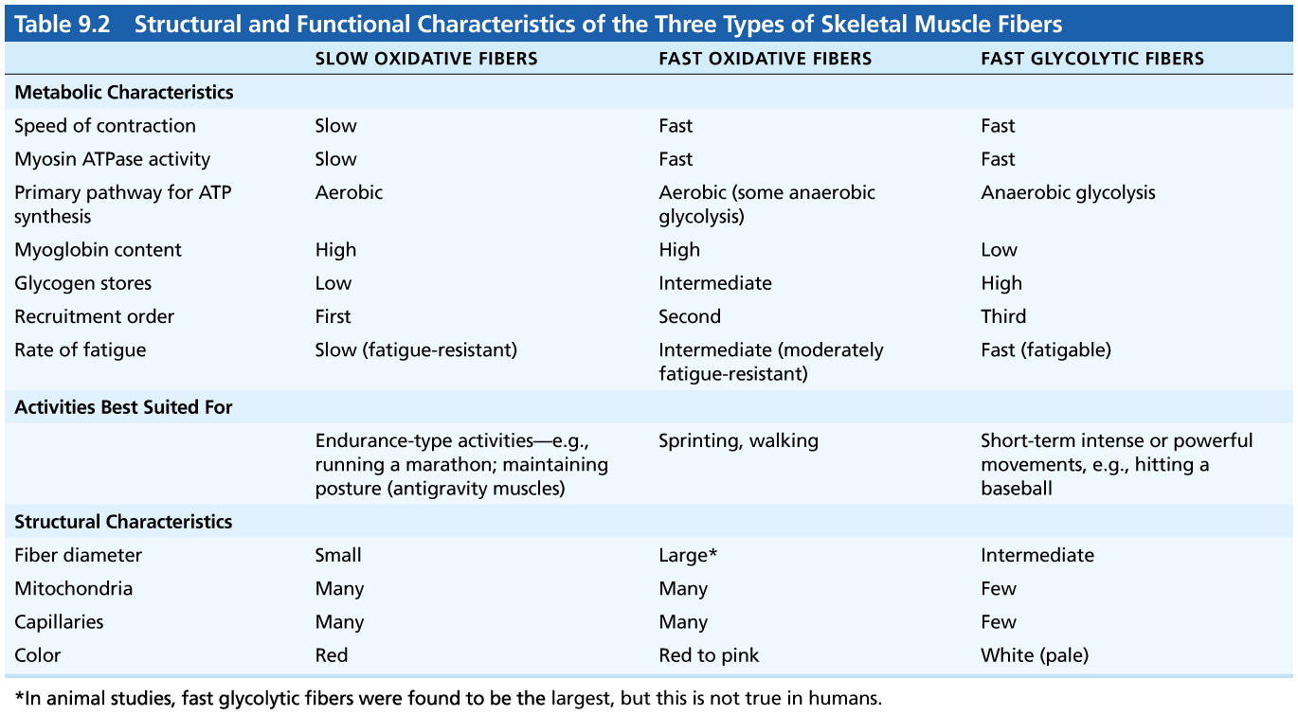
  Table 9.2 Structural and Functional Characteristics of the Three Types of Skeletal Muscle Fibers
Table 9.2 Structural and Functional Characteristics of the Three Types of Skeletal Muscle Fibers

Slide 12
Velocity and Duration of Contraction (5 of 5)
Load and recruitment
  Load: muscles contract fastest when no load is added
    The greater the load, the shorter the duration of contraction
    The greater the load, the slower the contraction
  Recruitment: the more motor units contracting, the faster and more prolonged the contraction

Slide 13
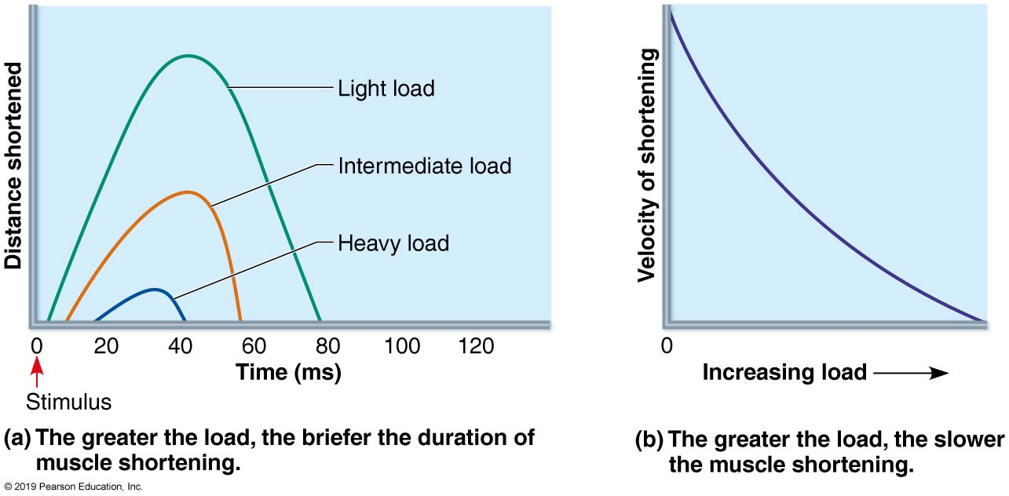
  Influence of Load on Duration and Velocity of Muscle Shortening
Figure 9.21 Influence of load on duration and velocity of muscle shortening.

Slide 14
9.8 Adaptation to Exercise
Aerobic (Endurance) Exercise
Aerobic (endurance) exercise, such as jogging, swimming, biking leads to increased:
    Muscle capillaries
    Number of mitochondria
    Myoglobin synthesis
  Results in greater endurance, strength, and resistance to fatigue
  May convert fast glycolytic fibers into fast oxidative fibers

Slide 15
Resistance Exercise
Resistance exercise (typically anaerobic), such as weight lifting or isometric exercises, leads to
  Muscle hypertrophy
    Due primarily to increase in fiber size
  Increased mitochondria, myofilaments, glycogen stores, and connective tissue
  Increased muscle strength and size

Slide 16
Clinical – Homeostatic Imbalance 9.4
Muscles must be active to remain healthy
Disuse atrophy (degeneration and loss of mass)
  Due to immobilization or loss of neural stimulation
  Can begin almost immediately.
Muscle strength can decline 5% per day
Paralyzed muscles may atrophy to one-fourth initial size
Fibrous connective tissue replaces lost muscle tissue
Rehabilitation is impossible at this point

Slide 17
  9.9 Smooth Muscle (1 of 2)
Found in walls of most hollow organs:
  Respiratory, digestive, urinary, reproductive, circulatory (except in smallest of blood vessels) except heart
  Not found in heart – heart contains cardiac muscle, not smooth
Most smooth muscle organized into sheets of tightly packed fibers

Slide 18
  9.9 Smooth Muscle (2 of 2)
Most organs contain two layers of sheets with fibers oriented at right angles to each other.
  Longitudinal layer: fibers run parallel to long axis of organ
    Contraction causes organ to shorten
  Circular layer: fibers run around circumference of organ
    Contraction causes lumen of organ to constrict
Alternating contractions and relaxations of layers mix and squeeze substances through lumen of hollow organs

Slide 19
  Differences between Smooth and Skeletal Muscle Fibers (1 of 6)
Smooth muscle fibers are spindle-shaped fibers
  thin and short compared with skeletal muscle fibers which are wider and much longer
  Only one nucleus, no striations
Lacks connective tissue sheaths
  Contains endomysium only

Slide 20
Differences between Smooth and Skeletal Muscle Fibers (2 of 6)
Contain varicosities (bulbous swellings) of nerve fibers instead of neuromuscular junctions
  Varicosities store and release neurotransmitters into a wide synaptic cleft referred to as a diffuse junction
  Innervated by the autonomic nervous system

Slide 21
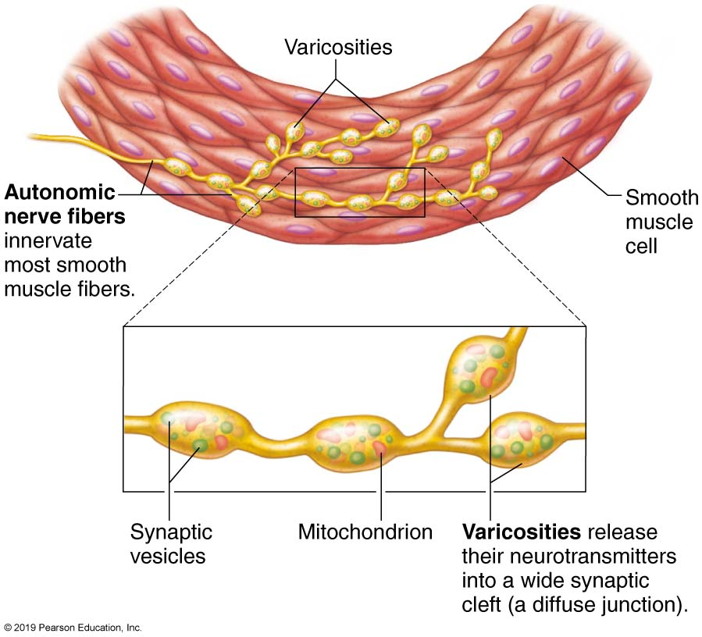
  Innervation of Smooth Muscle
Figure 9.23 Innervation of smooth muscle.

Slide 22
  Differences between Smooth and Skeletal Muscle Fibers (3 of 6)
Smooth muscle has less elaborate SR, and no T tubules
  SR is less developed than in skeletal muscle
    SR does store intracellular Ca²⁺, but most calcium used for contraction has extracellular origins
Sarcolemma contains pouchlike infoldings called caveolae
  Caveolae contain numerous Ca²⁺ channels that open to allow rapid influx of extracellular Ca²⁺

Slide 23
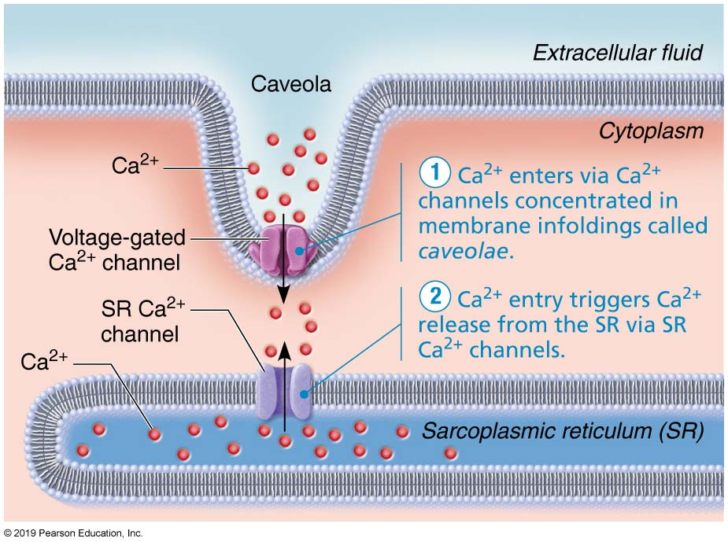
  Sources of Ca²⁺ for Smooth Muscle Contraction
Figure 9.24 Sources of Ca²⁺ for smooth muscle contraction.

Slide 24
Differences between Smooth and Skeletal Muscle Fibers (4 of 6)
Smooth muscle fibers are usually electrically connected via gap junctions whereas skeletal muscle fibers are electrically isolated
  Gap junctions are specialized cell connections that allow depolarization to spread from cell to cell
There are no striations and no sarcomeres, but they do contain overlapping thick and thin filaments

Slide 25
Differences between Smooth and Skeletal Muscle Fibers (5 of 6)
Smooth muscle also differs from skeletal muscle in following ways:
  Thick filaments are fewer and have myosin heads along entire length
    Ratio of thick to thin filaments (1:13) is much lower than in skeletal muscle (1:2)
    Thick filaments have heads along entire length, making smooth muscle as powerful as skeletal muscle
  No troponin complex
    Does contain tropomyosin, but not troponin
    Protein calmodulin binds Ca²⁺

Slide 26
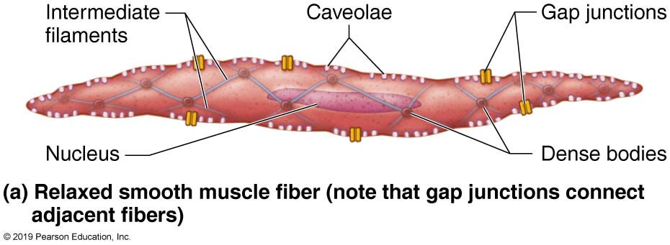
  Intermediate Filaments and Dense Bodies of Smooth Muscle Fibers Harness the Pull Generated by Myosin Cross Bridges (1 of 2)
Figure 9.25a Intermediate filaments and dense bodies of smooth muscle fibers harness the pull generated by myosin cross bridges.

Slide 27
Differences between Smooth and Skeletal Muscle Fibers (6 of 6)
  Thick and thin filaments arranged diagonally
    Myofilaments are spirally arranged, causing smooth muscle to contract in corkscrew manner
  Intermediate filament–dense body network
    Contain lattice-like arrangement of non contractile intermediate filaments that resist tension
    Dense bodies: proteins that anchor filaments to sarcolemma at regular intervals
      Correspond to Z discs of skeletal muscle
    During contraction, areas of sarcolemma between dense bodies bulge outward
      Make muscle cell look puffy

Slide 28
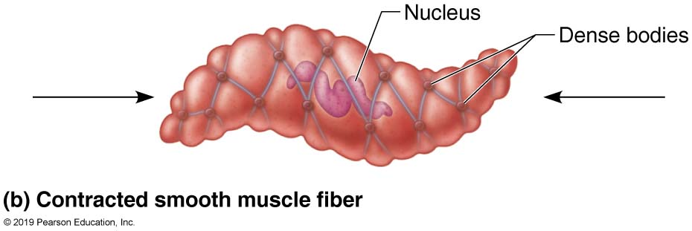
  Intermediate Filaments and Dense Bodies of Smooth Muscle Fibers Harness the Pull Generated by Myosin Cross Bridges (2 of 2)
Figure 9.25b Intermediate filaments and dense bodies of smooth muscle fibers harness the pull generated by myosin cross bridges.

Slide 29
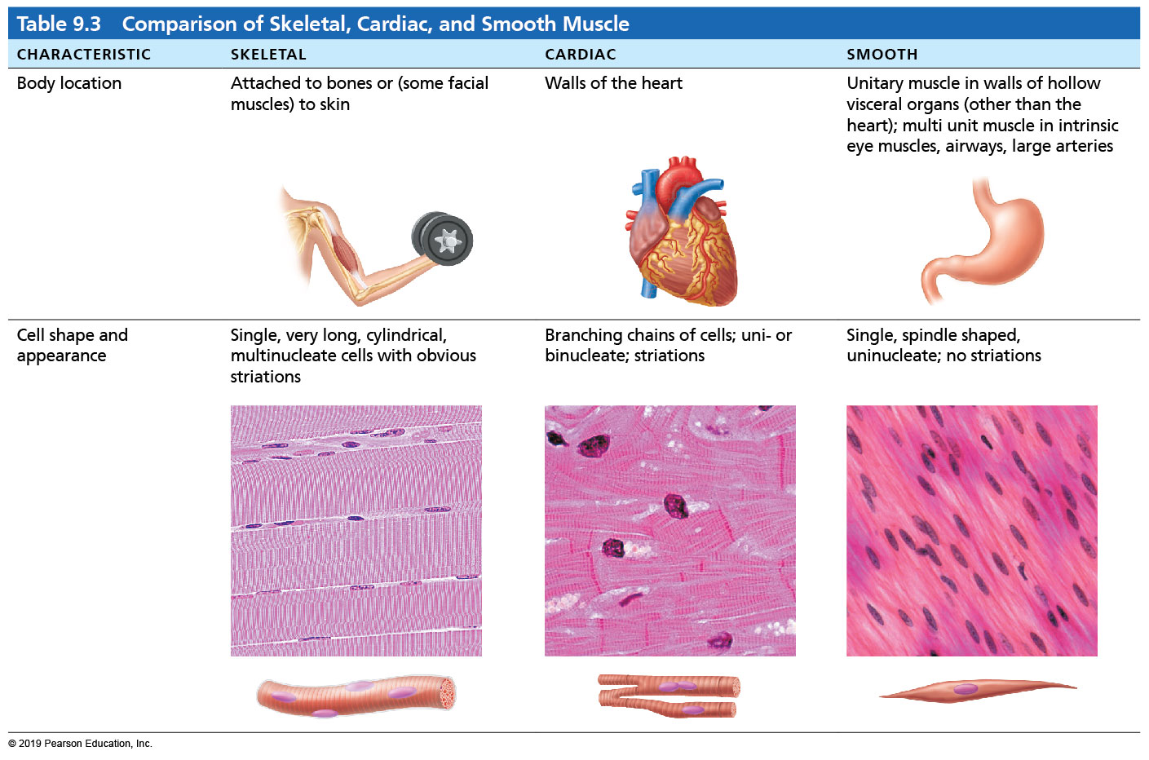
  Table 9.3-1 Comparison of Skeletal, Cardiac, and Smooth Muscle
Table 9.3 Comparison of Skeletal, Cardiac, and Smooth Muscle

Slide 30
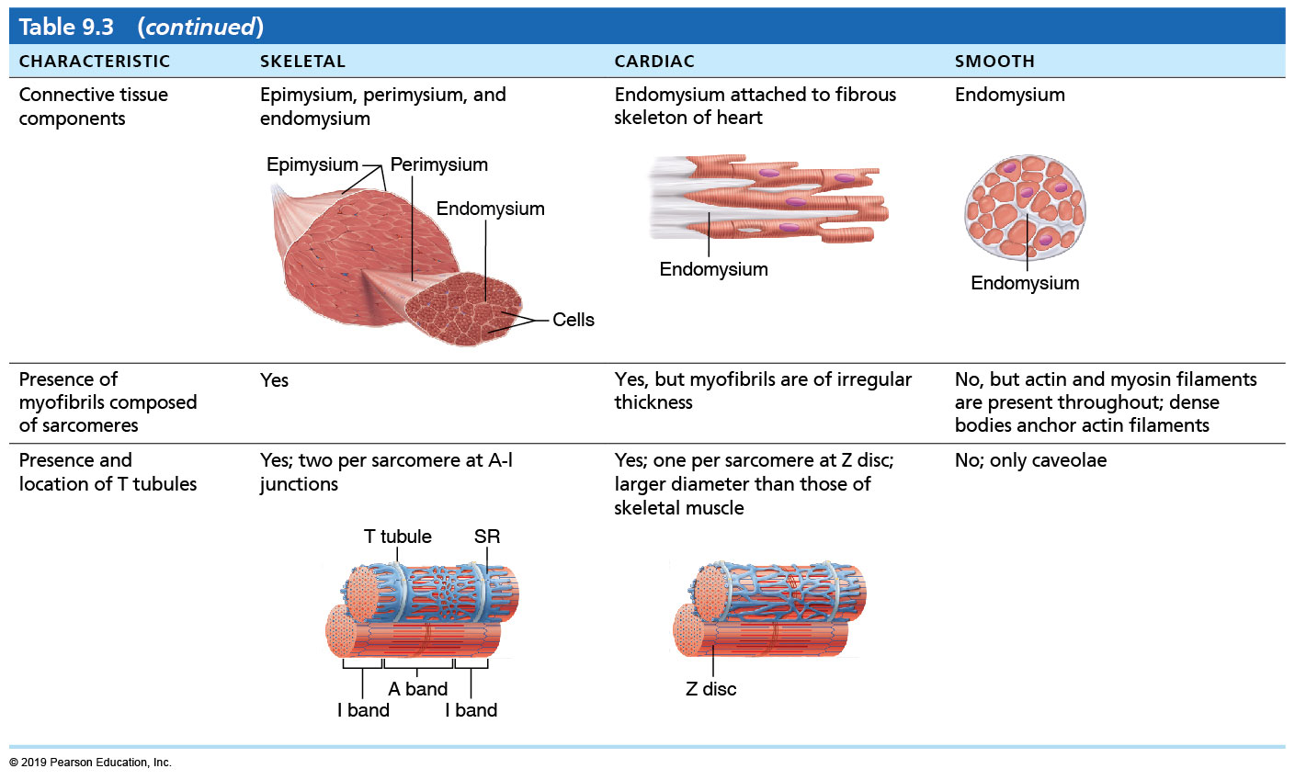
  Table 9.3-2 Comparison of Skeletal, Cardiac, and Smooth Muscle
Table 9.3 Comparison of Skeletal, Cardiac, and Smooth Muscle

Slide 31
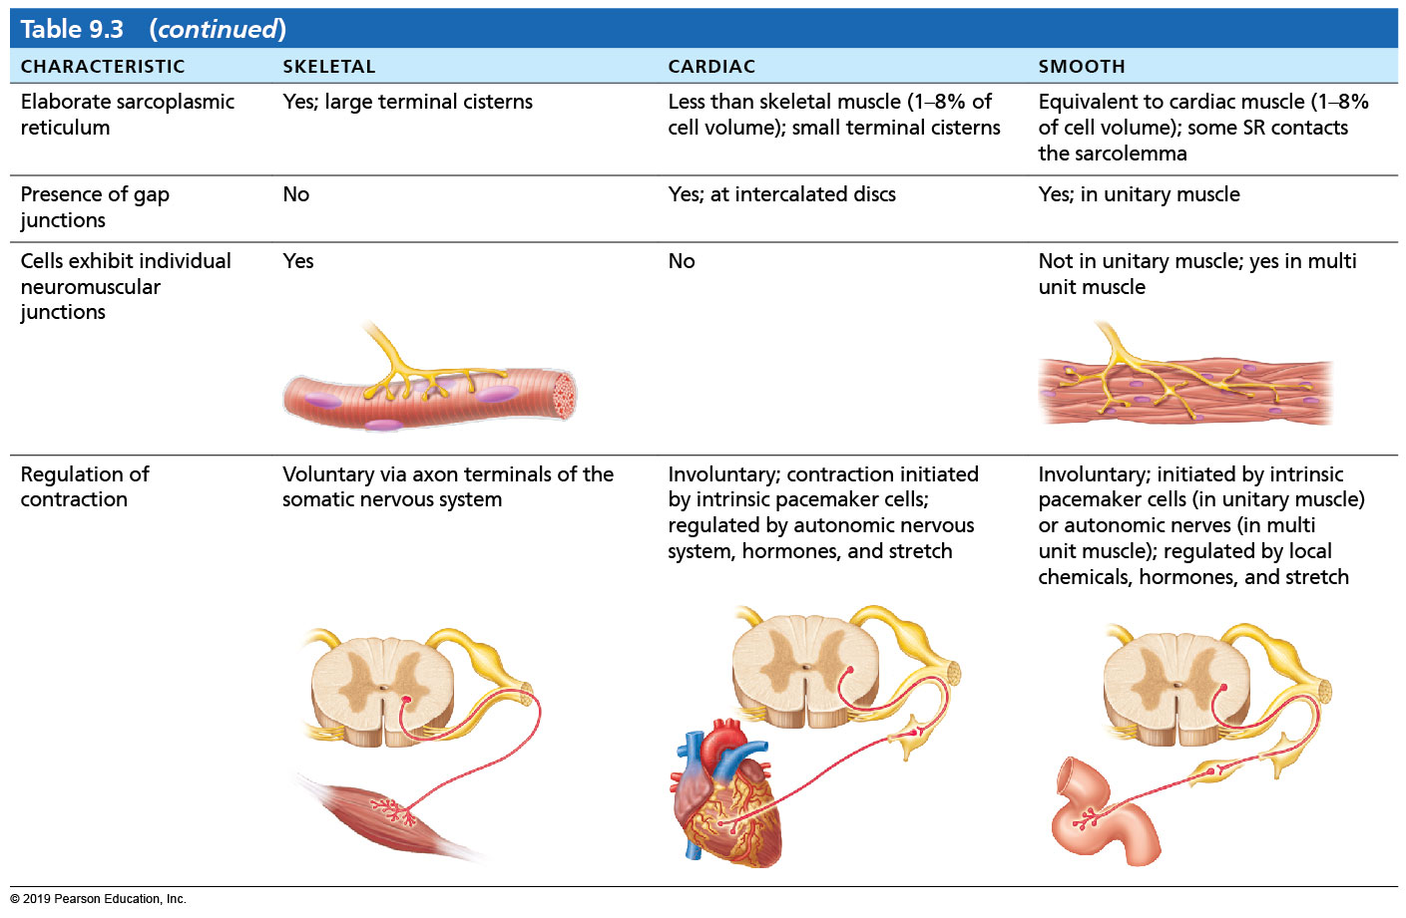
  Table 9.3-3 Comparison of Skeletal, Cardiac, and Smooth Muscle
Table 9.3 Comparison of Skeletal, Cardiac, and Smooth Muscle

Slide 32
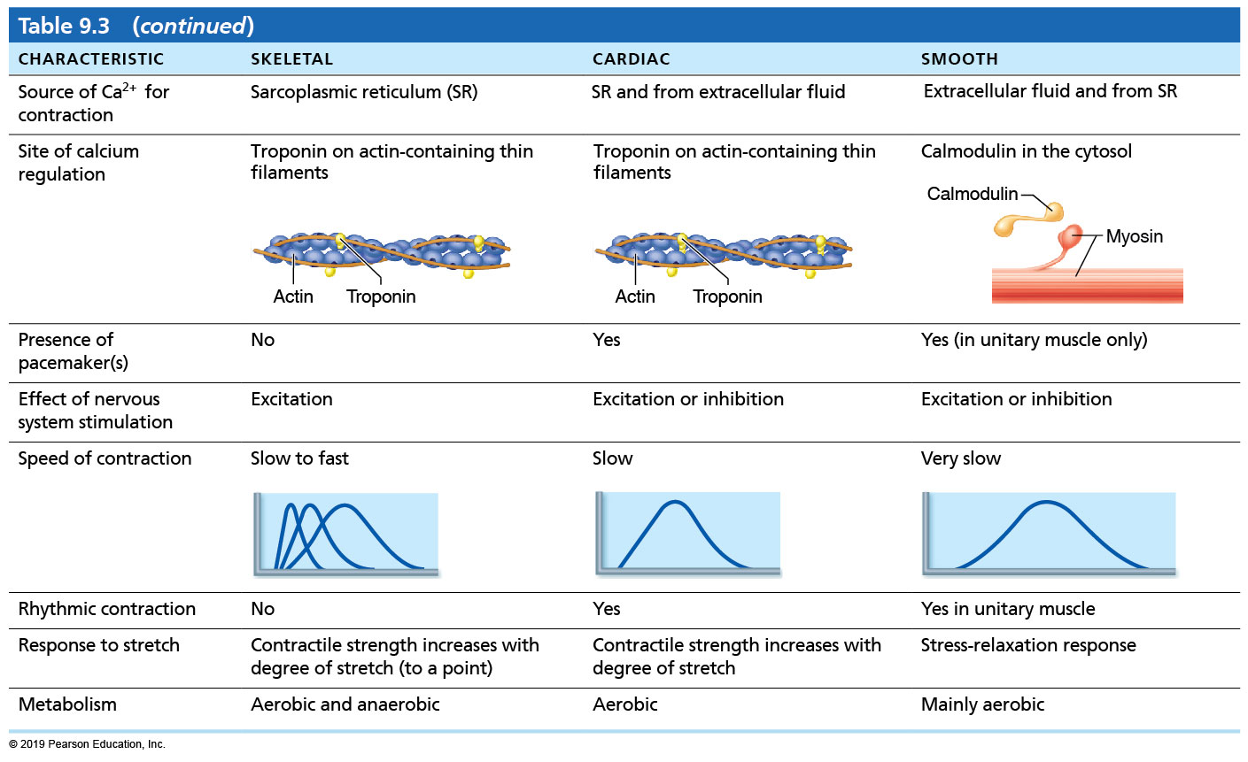
  Table 9.3-4 Comparison of Skeletal, Cardiac, and Smooth Muscle
Table 9.3 Comparison of Skeletal, Cardiac, and Smooth Muscle

Slide 33
Contraction of Smooth Muscle (1 of 8)
Mechanism of contraction
  Slow, synchronized contractions
  Cells electrically coupled by gap junctions
    Action potentials transmitted from fiber to fiber
  Some cells are self-excitatory (depolarize without external stimuli)
    Act as pacemakers for sheets of muscle
    Rate and intensity of contraction may be modified by neural and chemical stimuli

Slide 34
Contraction of Smooth Muscle (2 of 8)
Mechanism of contraction (cont.)
  Contraction in smooth muscle is similar to skeletal muscle contraction in following ways:
    Actin and myosin interact by sliding filament mechanism
    Final trigger is increased intracellular Ca²⁺ level
    ATP energizes sliding process
    Contraction stops when Ca²⁺ is no longer available

Slide 35
Contraction of Smooth Muscle (3 of 8)
Mechanism of contraction (cont.)
  Contraction in smooth muscle is different from skeletal muscle in following ways:
    Some Ca²⁺ still obtained from SR, but mostly comes from extracellular space
    Ca²⁺ binds to calmodulin, not troponin
    Activated calmodulin then activates myosin kinase (myosin light chain kinase)
    Activated myosin kinase phosphorylates myosin head, activating it
      Leads to crossbridge formation with actin

Slide 36
Contraction of Smooth Muscle (4 of 8)
Mechanism of contraction (cont.)
  Stopping smooth muscle contraction requires more steps than skeletal muscle
    Relaxation requires:
      Ca²⁺ detachment from calmodulin
      Active transport of Ca²⁺ into SR and extracellularly
      Dephosphorylation of myosin to inactive myosin

Slide 37
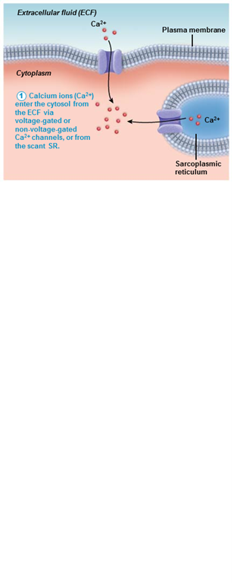
  Sequence of Events in Excitation-Contraction Coupling of Smooth Muscle
  (1 of 5)
Figure 9.26 Sequence of events in excitation-contraction coupling of smooth muscle.

Slide 38
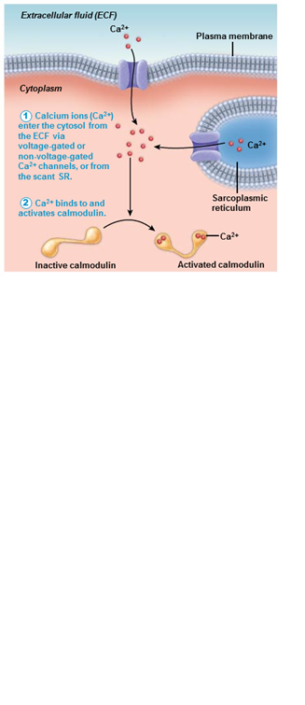
  Sequence of Events in Excitation-Contraction Coupling of Smooth Muscle
  (2 of 5)
Figure 9.26 Sequence of events in excitation-contraction coupling of smooth muscle.

Slide 39
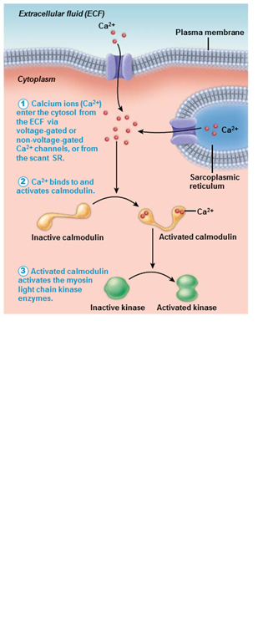
  Sequence of Events in Excitation-Contraction Coupling of Smooth Muscle
  (3 of 5)
Figure 9.26 Sequence of events in excitation-contraction coupling of smooth muscle.

Slide 40
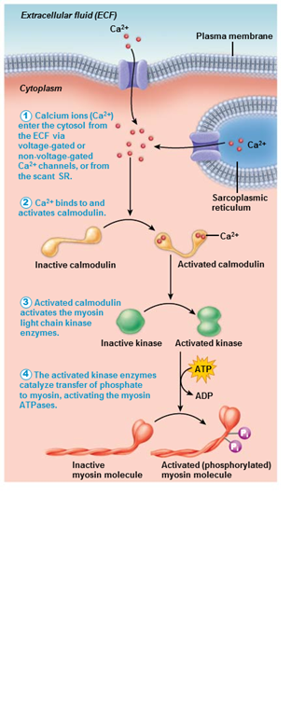
  Sequence of Events in Excitation-Contraction Coupling of Smooth Muscle
  (4 of 5)
Figure 9.26 Sequence of events in excitation-contraction coupling of smooth muscle.

Slide 41
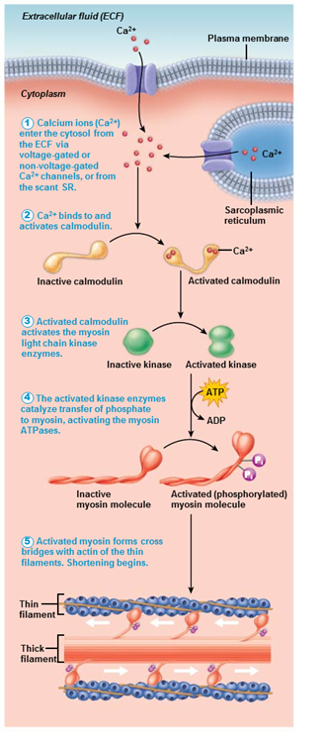
  Sequence of Events in Excitation-Contraction Coupling of Smooth Muscle
  (5 of 5)
Figure 9.26 Sequence of events in excitation-contraction coupling of smooth muscle.

Slide 42
Contraction of Smooth Muscle (5 of 8)
Energy efficiency of smooth muscle contraction
  Slower to contract and relax but maintains contraction for prolonged periods with little energy cost
    Slower ATPases
    Myofilaments may latch together to save energy
  Most smooth muscle maintain moderate degree of contraction constantly without fatiguing
    Referred to as smooth muscle tone
  Makes ATP via aerobic respiration pathways

Slide 43
Contraction of Smooth Muscle (6 of 8)
Regulation of contraction
  Controlled by nerves, hormones, or local chemical changes
  Neural regulation
    Neurotransmitter binding causes either graded (local) potential or action potential
      Results in increases in Ca²⁺ concentration in sarcoplasm
      Response depends on neurotransmitter released and type of receptor molecules
        One neurotransmitter can have a stimulatory effect on smooth muscle in one organ, but an inhibitory effect in a different organ

Slide 44
Contraction of Smooth Muscle (7 of 8)
Regulation of contraction (cont.)
  Hormones and local chemicals
    Some smooth muscle cells have no nerve supply
      Depolarize spontaneously or in response to chemical stimuli that bind to G protein–linked receptors
      Chemical factors can include hormones, high CO₂, pH, low oxygen
    Some smooth muscles respond to both neural and chemical stimuli

Slide 45
  Contraction of Smooth Muscle (8 of 8)
Special features of smooth muscle contraction
  Response to stretch
    Stress-relaxation response: responds to stretch only briefly, then adapts to new length
      Retains ability to contract on demand
      Enables organs such as stomach and bladder to temporarily store contents
  Length and tension changes
    Can contract when between half and twice its resting length
      Allows organ to have huge volume changes without becoming flabby when relaxed

Slide 46
  Types of Smooth Muscle (1 of 3)
Smooth muscle varies in different organs by:
  Fiber arrangement and organization
  Innervation
  Responsiveness to various stimuli
All smooth muscle is categorized as either:
  Unitary
  Multiunit

Slide 47
  Types of Smooth Muscle (2 of 3)
Unitary smooth muscle
  Commonly referred to as visceral muscle
  Found in all hollow organs except heart
  Possess all common characteristics of smooth muscle:
    Arranged in opposing (longitudinal and circular) sheets
    Innervated by varicosities
    Often exhibit spontaneous action potentials
    Electrically coupled by gap junctions
    Respond to various chemical stimuli

Slide 48
Types of Smooth Muscle (3 of 3)
Multiunit smooth muscle
  Located in large airways in lungs, large arteries, arrector pili muscles, and iris of eye
  Very few gap junctions, and spontaneous depolarization is rare
  Similar to skeletal muscle in some features
    Consists of independent muscle fibers
    Innervated by autonomic nervous system, forming motor units
    Graded contractions occur in response to neural stimuli that involve recruitment
  Different from skeletal muscle because, like unitary smooth muscle, it is controlled by autonomic nervous system and hormones

Slide 49
  Developmental Aspects of Muscle (1 of 5)
All muscle tissues develop from embryonic myoblasts
Multinucleated skeletal muscle cells form by fusion of many myoblasts
Growth factor stimulates clustering of ACh receptors at neuromuscular junctions
Cardiac and smooth muscle myoblasts do not fuse, but develop gap junctions
  Cardiac muscle cells start pumping when embryo is 3 weeks old

Slide 50
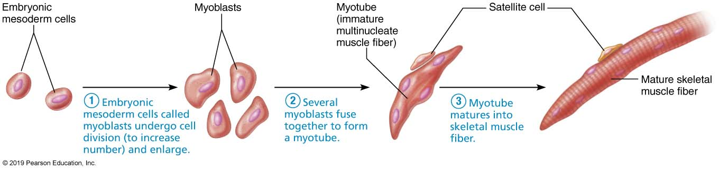
  Myoblasts Fuse to Form a Multinucleate Skeletal Muscle Fiber
Figure 9.27 Myoblasts fuse to form a multinucleate skeletal muscle fiber.

Slide 51
Developmental Aspects of Muscle (2 of 5)
Regeneration of muscle:
  Myoblast-like skeletal muscle satellite cells have limited regenerative ability
  Cardiomyocytes can divide at modest rate, but injured heart muscle is mostly replaced by connective tissue
  Smooth muscle regenerates throughout life
Cardiac and skeletal muscle can lengthen and thicken in growing child
  In adults, leads to hypertrophy

Slide 52
Developmental Aspects of Muscle (3 of 5)
Muscular development in infants reflects neuromuscular coordination
  Development occurs head to toe, and proximal to distal
    A baby can lift its head before it is able to walk
Peak natural neural control occurs by midadolescence
  Athletics and training can continue to improve neuromuscular control

Slide 53
Developmental Aspects of Muscle (4 of 5)
Difference in muscle mass between sexes:
  Female skeletal muscle makes up 36% of body mass
  Male skeletal muscle makes up 42% of body mass, primarily as a result of testosterone
    Males have greater ability to enlarge muscle fibers, also because of testosterone
  Body strength per unit muscle mass is the same in both sexes

Slide 54
Developmental Aspects of Muscle (5 of 5)
Aging muscles:
  With age, connective tissue increases, and muscle fibers decrease
  By age 30, loss of muscle mass (sarcopenia) begins
  Regular exercise reverses sarcopenia
  Atherosclerosis may block distal arteries, leading to intermittent claudication (limping) and severe pain in leg muscles

Slide 55

Copyright

