Slide 1
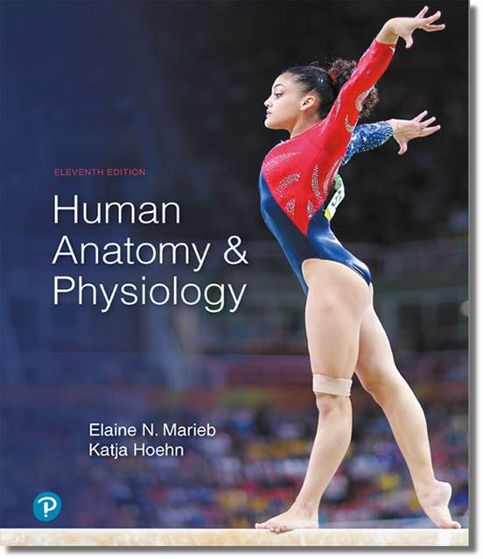
Human Anatomy and Physiology
Eleventh Edition
Chapter 09 Part A
Muscles and Muscle Tissue
PowerPoint® Lectures Slides prepared by Karen Dunbar Kareiva, Ivy Tech Community College
Copyright © 2019, 2016, 2013 Pearson Education, Inc. All Rights Reserved

Slide 2
Why This Matters
Understanding skeletal muscle tissue helps you to treat strained muscles effectively with RICE

Slide 3
Video: Why This Matters (Career Connection)
Click here to view ADA compliant video:
Why This Matters (Career Connection)
https://mediaplayer.pearsoncmg.com/assets/secs_wtm_ch_09_christian_v2

Slide 4
9.1 Overview of Muscle Tissue
Nearly half of body’s mass
Can transform chemical energy (ATP) into directed mechanical energy, which is capable of exerting force
To investigate muscle, we look at:
  Types of muscle tissue
  Characteristics of muscle tissue
  Muscle functions

Slide 5
Types of Muscle Tissue (1 of 4)
Terminologies: Myo, mys, and sarco are prefixes for muscle
  Example: sarcoplasm: muscle cell cytoplasm
Three types of muscle tissue
  Skeletal
  Cardiac
  Smooth
Only skeletal and smooth muscle cells are elongated and referred to as muscle fibers

Slide 6
Types of Muscle Tissue (2 of 4)
Skeletal muscle
  Skeletal muscle tissue is packaged into skeletal muscles: organs that are attached to bones and skin
  Skeletal muscle fibers are longest of all muscle and have striations (stripes)
  Also called voluntary muscle: can be consciously controlled
  Contract rapidly; tire easily; powerful
  Key words for skeletal muscle: skeletal, striated, and voluntary

Slide 7
Types of Muscle Tissue (3 of 4)
Cardiac muscle
  Cardiac muscle tissue is found only in heart
    Makes up bulk of heart walls
  Striated
  Involuntary: cannot be controlled consciously
    Contracts at steady rate due to heart’s own pacemaker, but nervous system can increase rate
  Key words for cardiac muscle: cardiac, striated, and involuntary

Slide 8
Types of Muscle Tissue (4 of 4)
Smooth muscle
  Smooth muscle tissue: found in walls of hollow organs
    Examples: stomach, urinary bladder, and airways
  Not striated
  Involuntary: cannot be controlled consciously
  Key words for smooth muscle: visceral, nonstriated and involuntary

Slide 9
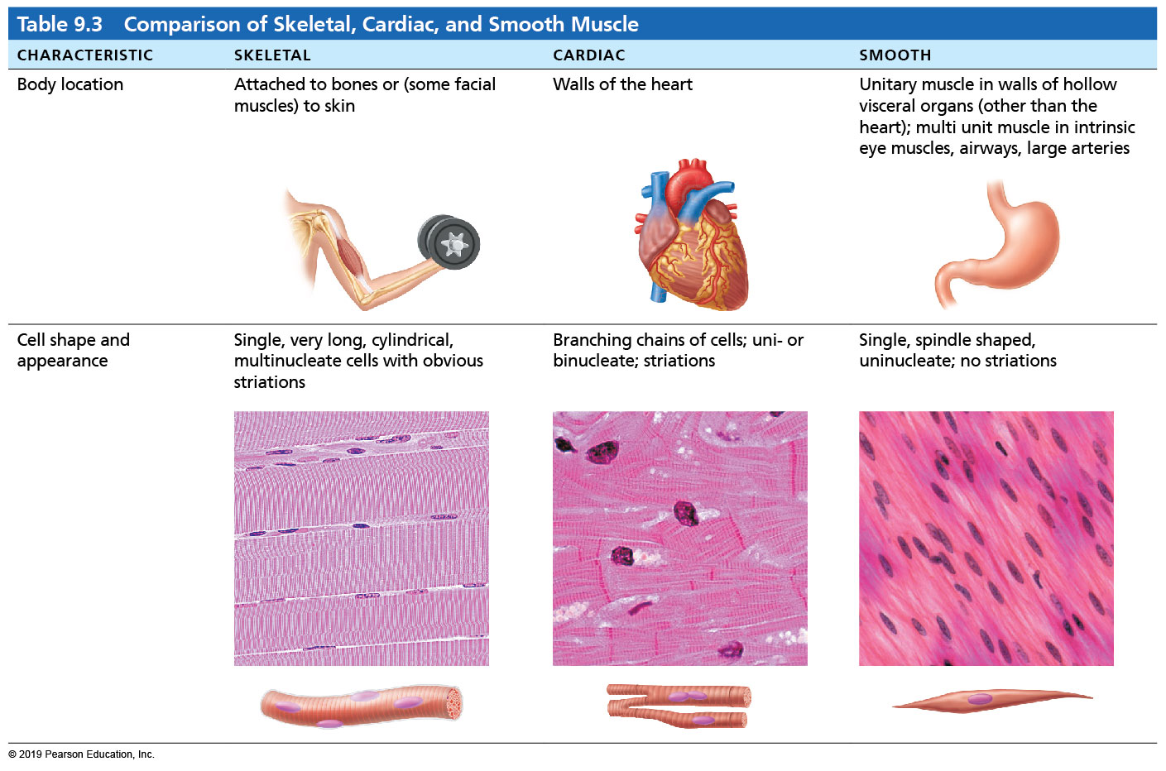
  Table 9.3-1 Comparison of Skeletal, Cardiac, and Smooth Muscle
Table 9.3 Comparison of Skeletal, Cardiac, and Smooth Muscle

Slide 10
Characteristics of Muscle Tissue
All muscles share four main characteristics:
  Excitability (responsiveness): ability to receive and respond to stimuli
  Contractility: ability to shorten forcibly when stimulated
  Extensibility: ability to be stretched
  Elasticity: ability to recoil to resting length

Slide 11
Muscle Functions
Four important functions
  Produce movement: responsible for all locomotion and manipulation
    Example: walking, digesting, pumping blood
  Maintain posture and body position
  Stabilize joints
  Generate heat as they contract

Slide 12
9.2 Skeletal Muscle Anatomy
Skeletal muscle is an organ made up of different tissues with three features: nerve and blood supply, connective tissue sheaths, and attachments

Slide 13
  Nerve and Blood Supply
Each muscle receives a nerve, artery, and veins
  Consciously controlled skeletal muscle has nerves supplying every fiber to control activity
Contracting muscle fibers require huge amounts of oxygen and nutrients
  Also need waste products removed quickly

Slide 14
  Connective Tissue Sheaths
Each skeletal muscle, as well as each muscle fiber, is covered in connective tissue
Support cells and reinforce whole muscle
Sheaths from external to internal:
  Epimysium: dense irregular connective tissue surrounding entire muscle; may blend with fascia
  Perimysium: fibrous connective tissue surrounding fascicles (groups of muscle fibers)
  Endomysium: fine areolar connective tissue surrounding each muscle fiber

Slide 15
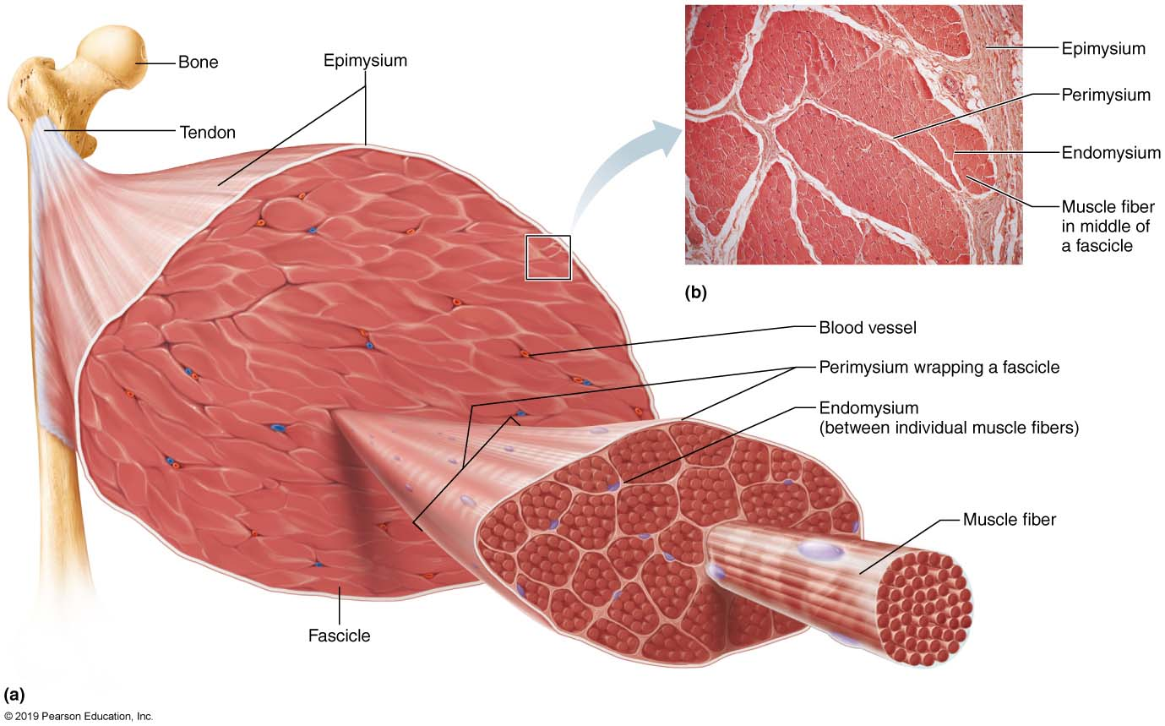
  Connective Tissue Sheaths of Skeletal Muscle: Epimysium, Perimysium, and Endomysium (1 of 2)
Figure 9.1 Connective tissue sheaths of skeletal muscle: epimysium, perimysium, and endomysium.

Slide 16
Attachments
Muscles span joints and attach to bones
Muscles attach to bone in at least two places
  Insertion: attachment to movable bone
  Origin: attachment to immovable or less movable bone
Attachments can be direct or indirect
  Direct (fleshy): epimysium fused to periosteum of bone or perichondrium of cartilage
  Indirect: connective tissue wrappings extend beyond muscle as ropelike tendon or sheetlike aponeurosis

Slide 17
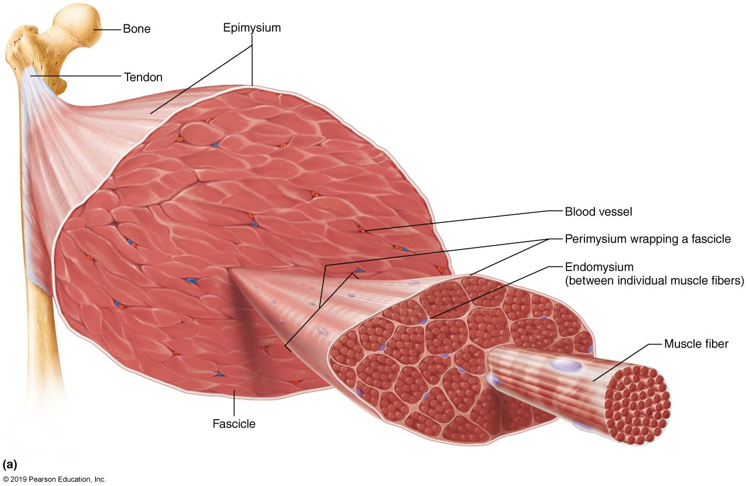
  Connective Tissue Sheaths of Skeletal Muscle: Epimysium, Perimysium, and Endomysium (2 of 2)
Figure 9.1a Connective tissue sheaths of skeletal muscle: epimysium, perimysium, and endomysium.

Slide 18
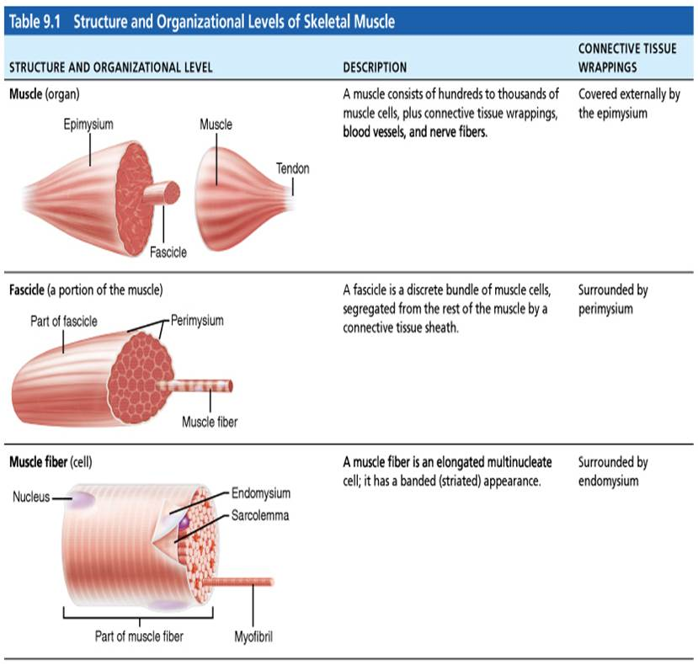
  Table 9.1-1 Structure and Organizational Levels of Skeletal Muscle
Table 9.1 Structure and Organizational Levels of Skeletal Muscle

Slide 19
  9.3 Muscle Fiber Microanatomy and Sliding Filament Model
Skeletal muscle fibers are long, cylindrical cells that contain multiple nuclei
Sarcolemma: muscle fiber plasma membrane
Sarcoplasm: muscle fiber cytoplasm
Contains many glycosomes for glycogen storage, as well as myoglobin for O₂ storage
Modified organelles
  Myofibrils
  Sarcoplasmic reticulum
  T tubules

Slide 20
Myofibrils (1 of 7)
Myofibrils are densely packed, rodlike elements
  Single muscle fiber can contain 1000s
  Accounts for ~80% of muscle cell volume
Myofibril features
  Striations
  Sarcomeres
  Myofilaments
  Molecular composition of myofilaments

Slide 21
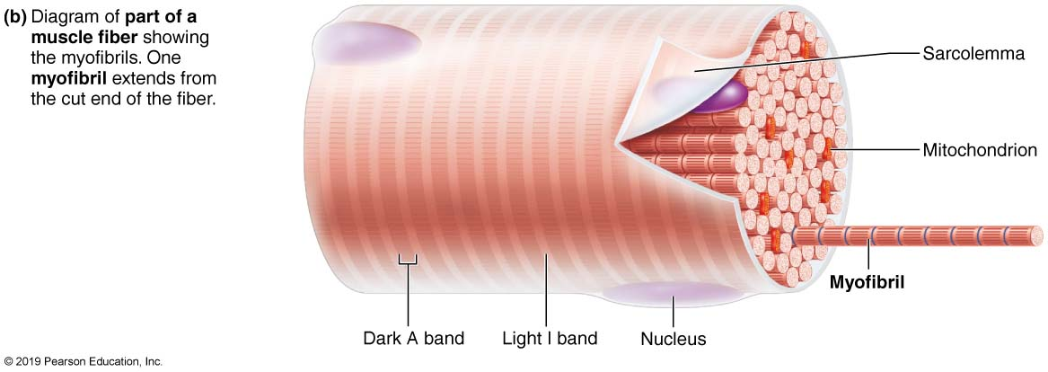
  Microscopic Anatomy of a Skeletal Muscle Fiber (1 of 4)
Figure 9.2b Microscopic anatomy of a skeletal muscle fiber.

Slide 22
Myofibrils (2 of 7)
Striations: stripes formed from repeating series of dark and light bands along length of each myofibril
  A bands: dark regions
    H zone: lighter region in middle of dark A band
      M line: line of protein (myomesin) that bisects H zone vertically
  I bands: lighter regions
    Z disc (line): coin-shaped sheet of proteins on midline of light I band

Slide 23
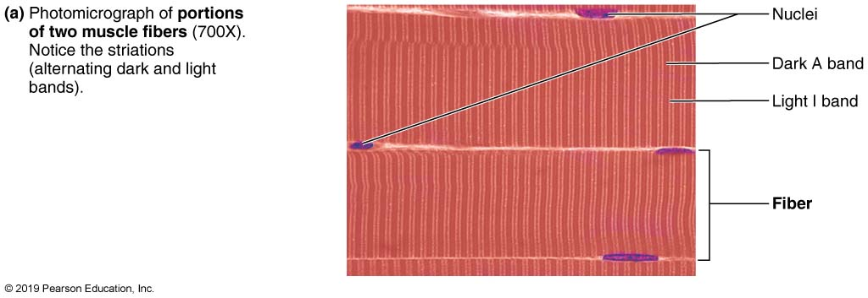
  Microscopic Anatomy of a Skeletal Muscle Fiber (2 of 4)
Figure 9.2a Microscopic anatomy of a skeletal muscle fiber.

Slide 24
Myofibrils (3 of 7)
Sarcomere
  Smallest contractile unit (functional unit) of muscle fiber
  Contains A band with half of an I band at each end
    Consists of area between Z discs
  Individual sarcomeres align end to end along myofibril, like boxcars of train

Slide 25
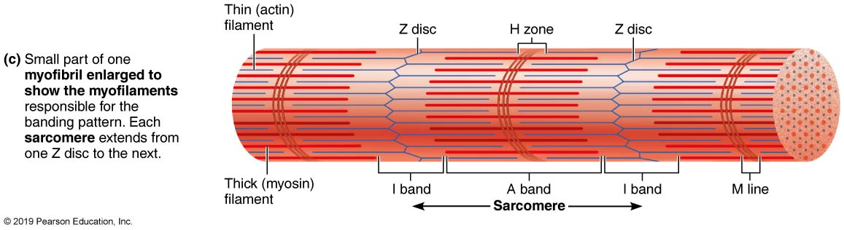
  Microscopic Anatomy of a Skeletal Muscle Fiber (3 of 4)
Figure 9.2c Microscopic anatomy of a skeletal muscle fiber.

Slide 26
Myofibrils (4 of 7)
Myofilaments
  Orderly arrangement of actin and myosin myofilaments within sarcomere
  Actin myofilaments: thin filaments
    Extend across I band and partway in A band
    Anchored to Z discs
  Myosin myofilaments: thick filaments
    Extend length of A band
    Connected at M line
  Sarcomere cross section shows hexagonal arrangement of one thick filament surrounded by six thin filaments

Slide 27
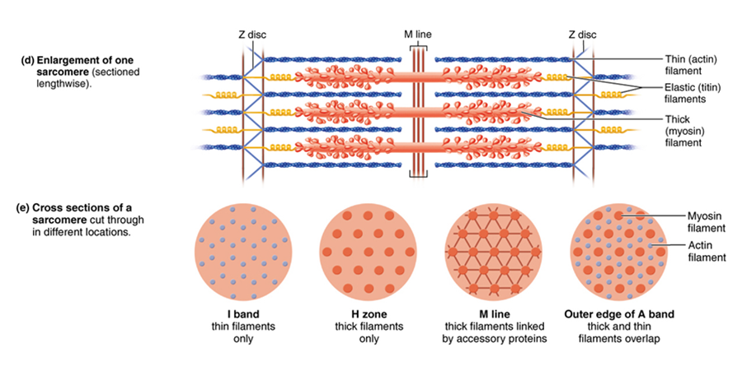
  Microscopic Anatomy of a Skeletal Muscle Fiber (4 of 4)
Figure 9.2d, e Microscopic anatomy of a skeletal muscle fiber.

Slide 28
Myofibrils (5 of 7)
Molecular composition of myofilaments
  Thick filaments: composed of protein myosin that contains two heavy and four light polypeptide chains
    Heavy chains intertwine to form myosin tail
    Light chains form myosin globular head
  During contraction, heads link thick and thin filaments together, forming cross bridges
    Myosins are offset from each other, resulting in staggered array of heads at different points along thick filament

Slide 29
Myofibrils (6 of 7)
Molecular composition of myofilaments (cont.)
  Thin filaments: composed of fibrous protein actin
    Actin is polypeptide made up of kidney-shaped G actin (globular) subunits
  G actin subunits bears active sites for myosin head attachment during contraction
    G actin subunits link together to form long, fibrous F actin (filamentous)
    Two F actin strands twist together to form a thin filament
  Tropomyosin and troponin: regulatory proteins bound to actin

Slide 30
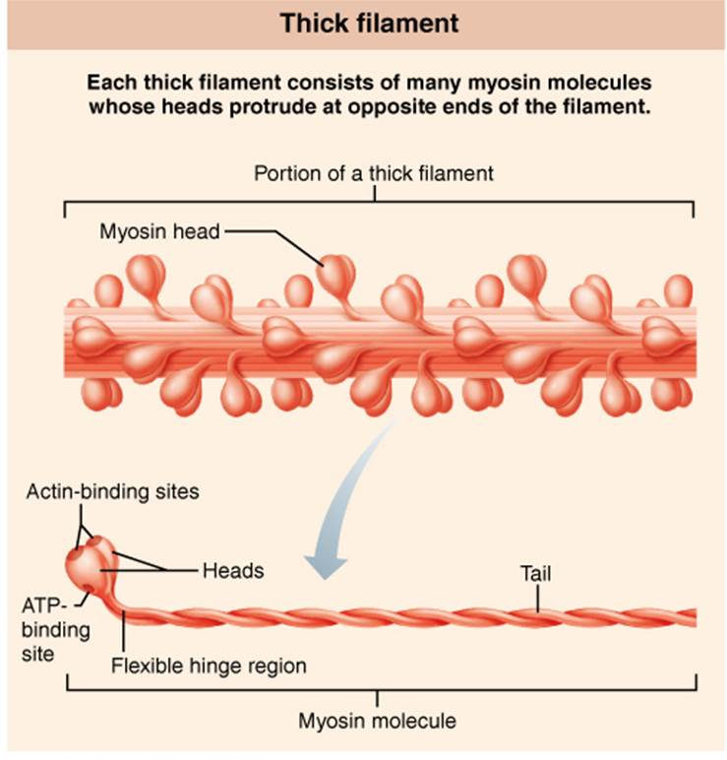
  Composition of Thick and Thin Filaments
  (1 of 4)
Figure 9.3 Composition of thick and thin filaments.

Slide 31
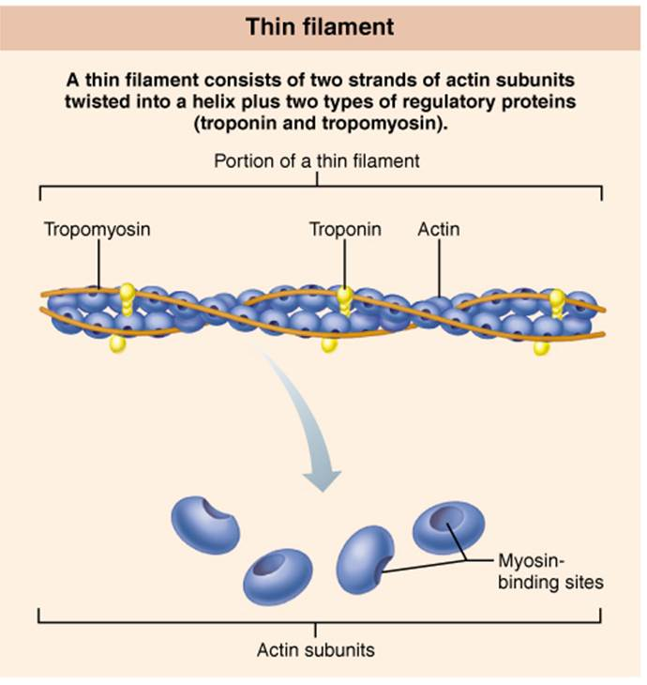
  Composition of Thick and Thin Filaments
  (2 of 4)
Figure 9.3 Composition of thick and thin filaments.

Slide 32
Myofibrils (7 of 7)
Molecular composition of myofilaments (cont.)
  Other proteins help form the structure of the myofibril
    Elastic filament: composed of protein titin
      Holds thick filaments in place; helps recoil after stretch; resists excessive stretching
    Dystrophin
      Links thin filaments to proteins of sarcolemma
    Nebulin, myomesin, C proteins bind filaments or sarcomeres together
      Maintain alignment of sarcomere

Slide 33
  Clinical – Homeostatic Imbalance 9.1 (1 of 3)
Duchenne muscular dystrophy (DMD) is most common and serious form of muscular dystrophies, muscle-destroying diseases that generally appear during childhood
Inherited as a sex-linked recessive disease, so almost exclusively in males (1 in 3600 births)
Appears between 2 and 7 years old when boy becomes clumsy and falls frequently
Disease progresses from extremities upward, finally affecting head, chest muscles, and cardiac muscle.
With supportive care, people with DMD can live into 30s and beyond

Slide 34
Clinical – Homeostatic Imbalance 9.1 (2 of 3)
Caused by defective gene for dystrophin, a protein that links thin filaments to extracellular matrix and helps stabilize sarcolemma
Sarcolemma of DMD patients tear easily, allowing entry of excess calcium which damages contractile fibers
Inflammation follows and regenerative capacity is lost resulting in increased apoptosis of muscle cells and drop in muscle mass

Slide 35

  A Boy with Duchenne Muscular Dystrophy (DMD)
Figure 9.4 A boy with Duchenne muscular dystrophy (DMD).

Slide 36
Clinical – Homeostatic Imbalance 9.1 (3 of 3)
chest muscles, and cardiac muscle. The weakness continues to
progress, but with supportive care, DMD patients are living into
their 30s and beyond.

Slide 37
Sarcoplasmic Reticulum and T Tubules
(1 of 4)
Sarcoplasmic reticulum: network of smooth endoplasmic reticulum tubules surrounding each myofibril
  Most run longitudinally
  Terminal cisterns form perpendicular cross channels at the A–I band junction
  SR functions in regulation of intracellular Ca²⁺ levels
  Stores and releases Ca²⁺

Slide 38
Sarcoplasmic Reticulum and T Tubules
(2 of 4)
T tubules
  Tube formed by protrusion of sarcolemma deep into cell interior
    Increase muscle fiber’s surface area greatly
    Lumen continuous with extracellular space
    Allow electrical nerve transmissions to reach deep into interior of each muscle fiber
  Tubules penetrate cell’s interior at each A–I band junction between terminal cisterns
    Triad: area formed from terminal cistern of one sarcomere, T tubule, and terminal cistern of neighboring sarcomere

Slide 39
Sarcoplasmic Reticulum and T Tubules
(3 of 4)
Triad relationships
  T tubule contains integral membrane proteins that protrude into intermembrane space (space between tubule and muscle fiber sarcolemma)
    Tubule proteins act as voltage sensors that change shape in response to an electrical current
  SR cistern membranes also have integral membrane proteins that protrude into intermembrane space
    SR integral proteins control opening of calcium channels in SR cisterns

Slide 40
Sarcoplasmic Reticulum and T Tubules
(4 of 4)
Triad relationships (cont.)
  When an electrical impulse passes by, T tubule proteins change shape, causing SR proteins to change shape, causing release of calcium into cytoplasm

Slide 41
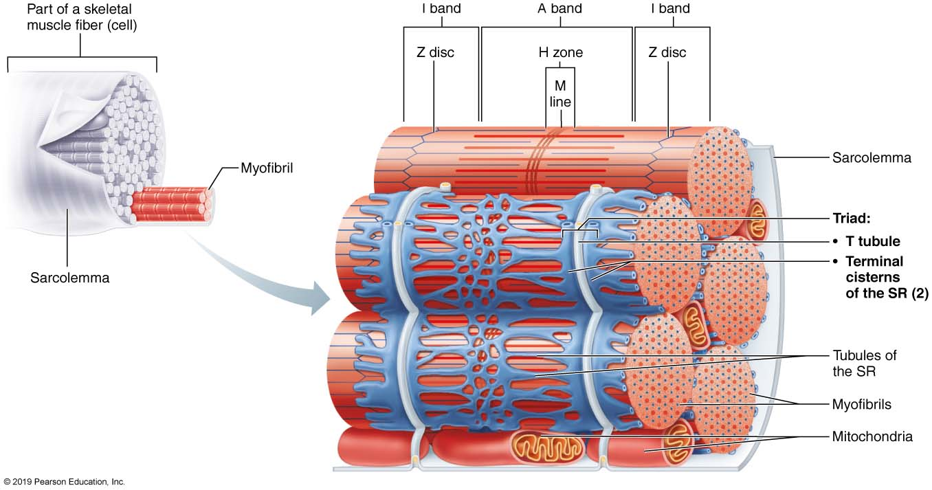
  Relationship of the Sarcoplasmic Reticulum and T Tubules to Myofibrils of Skeletal Muscle
Figure 9.5 Relationship of the sarcoplasmic reticulum and T tubules to myofibrils of skeletal muscle.

Slide 42
Sliding Filament Model of Contraction
(1 of 3)
Contraction: the activation of cross bridges to generate force
Shortening occurs when tension generated by cross bridges on thin filaments exceeds forces opposing shortening
Contraction ends when cross bridges become inactive

Slide 43
Sliding Filament Model of Contraction
(2 of 3)
In the relaxed state, thin and thick filaments overlap only slightly at ends of A band
Sliding filament model of contraction states that during contraction, thin filaments slide past thick filaments, causing actin and myosin to overlap more
  Neither thick nor thin filaments change length, just overlap more
When nervous system stimulates muscle fiber, myosin heads are allowed to bind to actin, forming cross bridges, which cause sliding (contraction) process to begin

Slide 44
Sliding Filament Model of Contraction
(3 of 3)
Cross bridge attachments form and break several times, each time pulling thin filaments a little closer toward center of sarcome in a ratcheting action
  Causes shortening of muscle fiber
Z discs are pulled toward M line
I bands shorten
Z discs become closer
H zones disappear
A bands move closer to each other

Slide 45
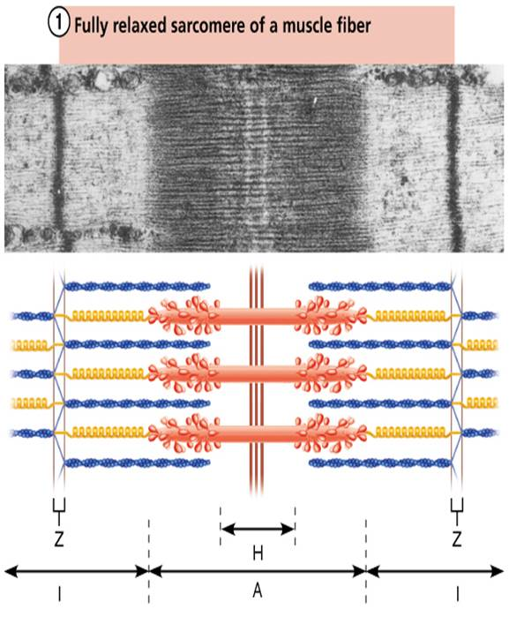
  Sliding Filament Model of Contraction
  (1 of 2)
Figure 9.6-1 Sliding filament model of contraction.

Slide 46
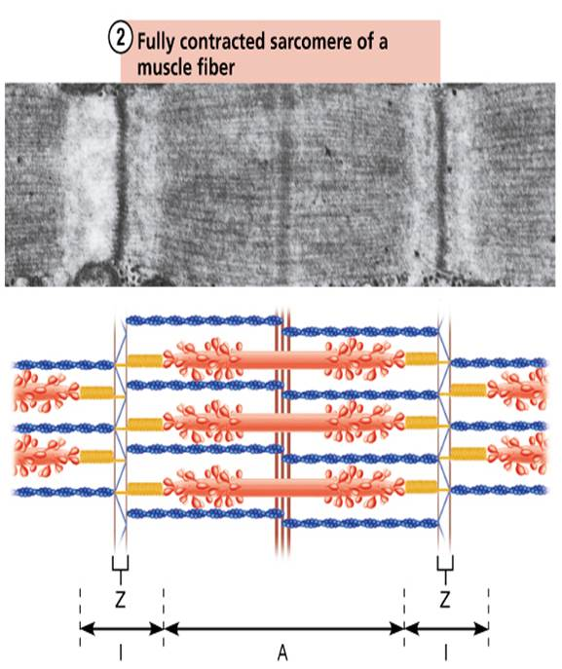
  Sliding Filament Model of Contraction
  (2 of 2)
Figure 9.6-2 Sliding filament model of contraction.

Slide 47
9.4 Muscle Fiber Contraction (2 of 2)
Background and Overview
Decision to move is activated by brain, signal is transmitted down spinal cord to motor neurons which then activate muscle fibers
Neurons and muscle cells are excitable cells capable of action potentials
  Excitable cells are capable of changing resting membrane potential voltages
AP crosses from neuron to muscle cell via the neurotransmitter acetylcholine (ACh)

Slide 48
  Background and Overview (1 of 4)
Ion Channels
  Play the major role in changing of membrane potentials
  Two classes of ion channels:
    Chemically gated ion channels – opened by chemical messengers such as neurotransmitters
      Example: ACh receptors on muscle cells
    Voltage-gated ion channels – open or close in response to voltage changes in membrane potential

Slide 49
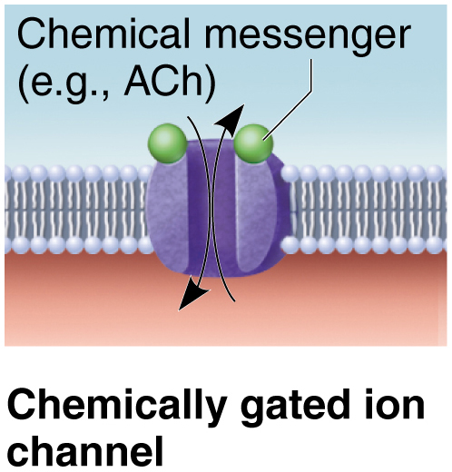
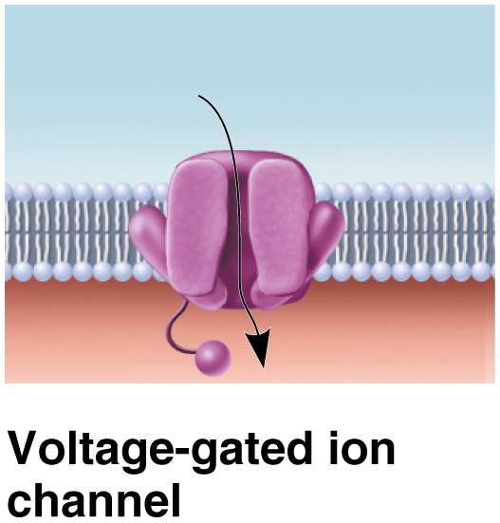
  “Chemically Gated Ion Channel” and “Voltage-Gated ion Channel”

Slide 50
Background and Overview (2 of 4)
Anatomy of Motor Neurons and the Neuromuscular Junction
  Skeletal muscles are stimulated by somatic motor neurons
  Axons (long, threadlike extensions of motor neurons) travel from central nervous system to skeletal muscle
  Each axon divides into many branches as it enters muscle
  Axon branches end on muscle fiber, forming neuromuscular junction or motor end plate
    Each muscle fiber has one neuromuscular junction with one motor neuron

Slide 51
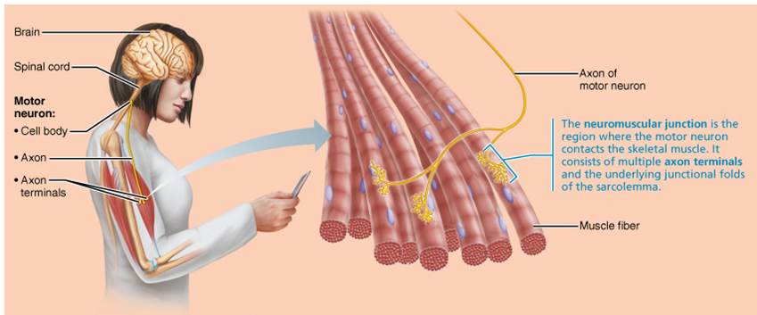
  Overview of Skeletal Muscle Contraction
  (1 of 3)
Figure 9.7 Overview of skeletal muscle contraction.

Slide 52
Background and Overview (3 of 4)
  Axon terminal (end of axon) and muscle fiber are separated by gel-filled space called synaptic cleft
  Stored within axon terminals are membrane-bound synaptic vesicles
    Synaptic vesicles contain neurotransmitter acetylcholine (ACh)
  Infoldings of sarcolemma, called junctional folds, contain millions of ACh receptors
  NMJ consists of axon terminals, synaptic cleft, and junctional folds

Slide 53
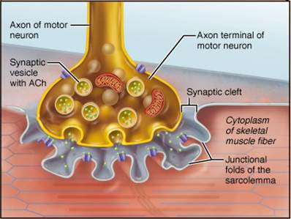
  Overview of Skeletal Muscle Contraction
  (2 of 3)
Figure 9.7 Overview of skeletal muscle contraction.

Slide 54
Background and Overview (4 of 4)
The Big Picture - Four steps must occur for skeletal muscle to contract:
  Events at neuromuscular junction
  Muscle fiber excitation
  Excitation-contraction coupling
  Cross bridge cycling

Slide 55
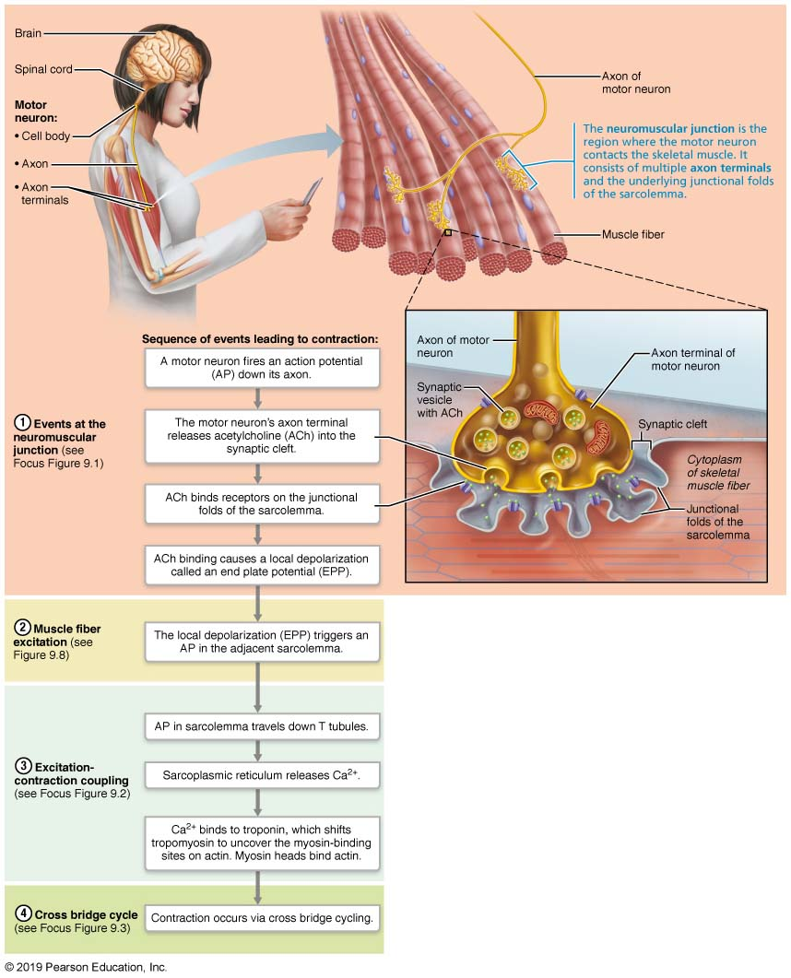
  Overview of Skeletal Muscle Contraction
  (3 of 3)
Figure 9.7 Overview of skeletal muscle contraction.

Slide 56
Events at the Neuromuscular Junction
AP arrives at axon terminal
Voltage-gated calcium channels open, calcium enters motor neuron
Calcium entry causes release of ACh neurotransmitter into synpatic cleft
ACh diffuses across to ACh receptors (Na⁺ chemical gates) on sarcolemma
ACh binding to receptors, opens gates, allowing Na⁺ to enter resulting in end plate potential
Acetylcholinesterase degrades ACh

Slide 57
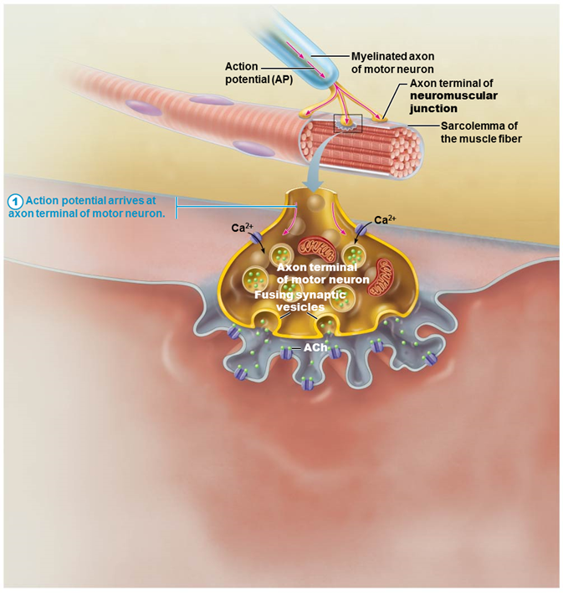
  When a Nerve Impulse Reaches a Neuromuscular Junction, Acetylcholine (ACh) is Released (1 of 6)
FOCUS FIGURE 9.1 Events at the Neuromuscular Junction

Slide 58
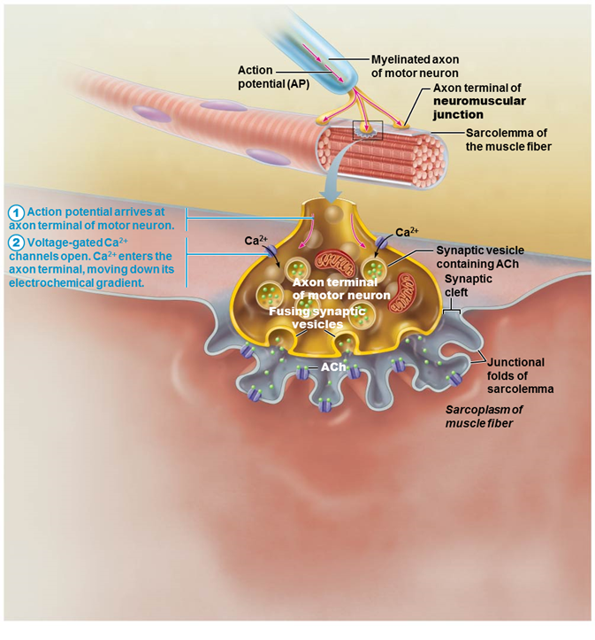
  When a Nerve Impulse Reaches a Neuromuscular Junction, Acetylcholine (ACh) is Released (2 of 6)
FOCUS FIGURE 9.1 Events at the Neuromuscular Junction

Slide 59
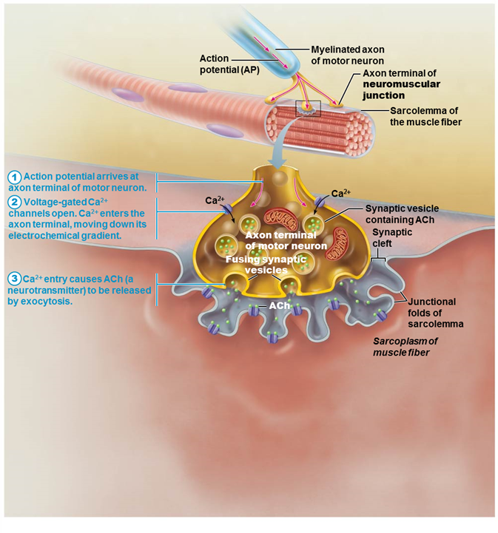
  When a Nerve Impulse Reaches a Neuromuscular Junction, Acetylcholine (ACh) is Released (3 of 6)
FOCUS FIGURE 9.1 Events at the Neuromuscular Junction

Slide 60
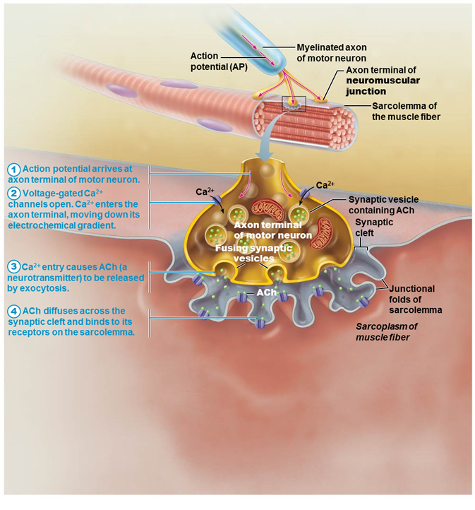
  When a Nerve Impulse Reaches a Neuromuscular Junction, Acetylcholine (ACh) is Released (4 of 6)
FOCUS FIGURE 9.1 Events at the Neuromuscular Junction

Slide 61
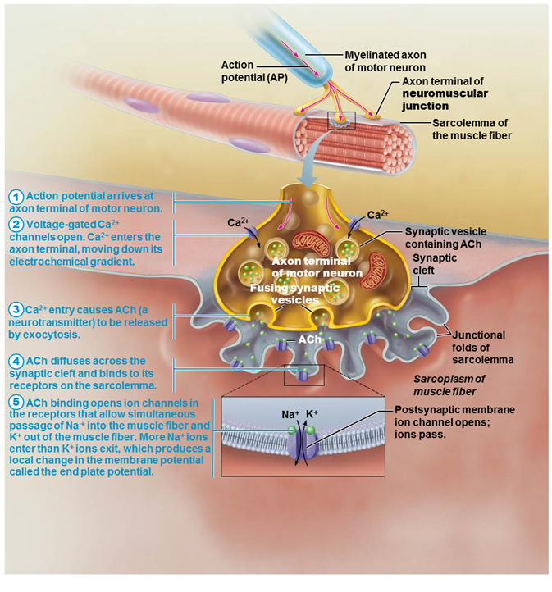
  When a Nerve Impulse Reaches a Neuromuscular Junction, Acetylcholine (ACh) is Released (5 of 6)
FOCUS FIGURE 9.1 Events at the Neuromuscular Junction

Slide 62
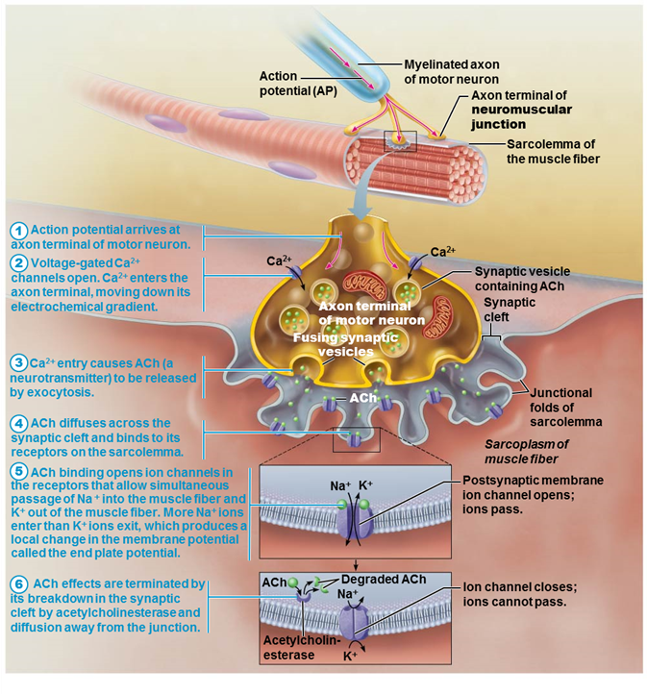
  When a Nerve Impulse Reaches a Neuromuscular Junction, Acetylcholine (ACh) is Released (6 of 6)
FOCUS FIGURE 9.1 Events at the Neuromuscular Junction

Slide 63
A&P Flix: Events at the Neuromuscular Junction
Click here to view ADA compliant Animation:
Events at the Neuromuscular Junction
https://mediaplayer.pearsoncmg.com/assets/apf-events-at-the-neuromuscular-junction

Slide 64
  Clinical – Homeostatic Imbalance 9.2
Many toxins, drugs, and diseases interfere with events at the neuromuscular junction
  Example: myasthenia gravis: disease characterized by drooping upper eyelids, difficulty swallowing and talking, and generalized muscle weakness
  Involves shortage of Ach receptors because person’s ACh receptors are attacked by own antibodies
  Suggests this is an autoimmune disease

Slide 65
  Generation of an Action Potential Across the Sarcolemma (1 of 4)
Resting sarcolemma is polarized, meaning a voltage exists across membrane
  Inside of cell is negative compared to outside
Action potential is caused by changes in electrical charges
Occurs in three steps
  Generation of end plate potential
  Depolarization
  Repolarization

Slide 66
  Generation of an Action Potential Across the Sarcolemma (2 of 4)
End plate potential
  ACh released from motor neuron binds to ACh receptors on sarcolemma
  Causes chemically gated ion channels (ligands) on sarcolemma to open
  Na⁺ diffuses into muscle fiber
    Some K⁺ diffuses outward, but not much
  Because Na⁺ diffuses in, interior of sarcolemma becomes less negative (more positive)
  Results in local depolarization called end plate potential

Slide 67
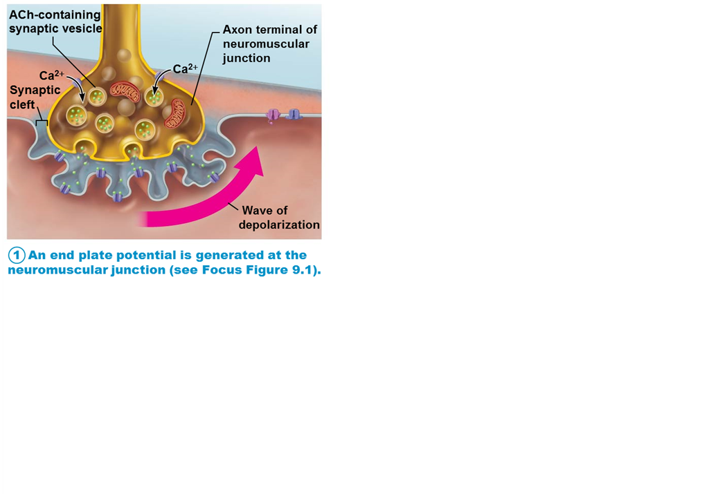
  Summary of Events in the Generation and Propagation of an Action Potential in a Skeletal Muscle Fiber (1 of 3)
Figure 9.8 Summary of events in the generation and propagation of an action potential in a skeletal muscle fiber.

Slide 68
Generation of an Action Potential Across the Sarcolemma (3 of 4)
Depolarization: generation and propagation of an action potential (AP)
  If end plate potential causes enough change in membrane voltage to reach critical level called threshold, voltage-gated Na⁺ channels in membrane will open
  Large influx of Na⁺ through channels into cell triggers AP that is unstoppable and will lead to muscle fiber contraction
  AP spreads across sarcolemma from one voltage-gated Na⁺ channel to next one in adjacent areas, causing that area to depolarize

Slide 69
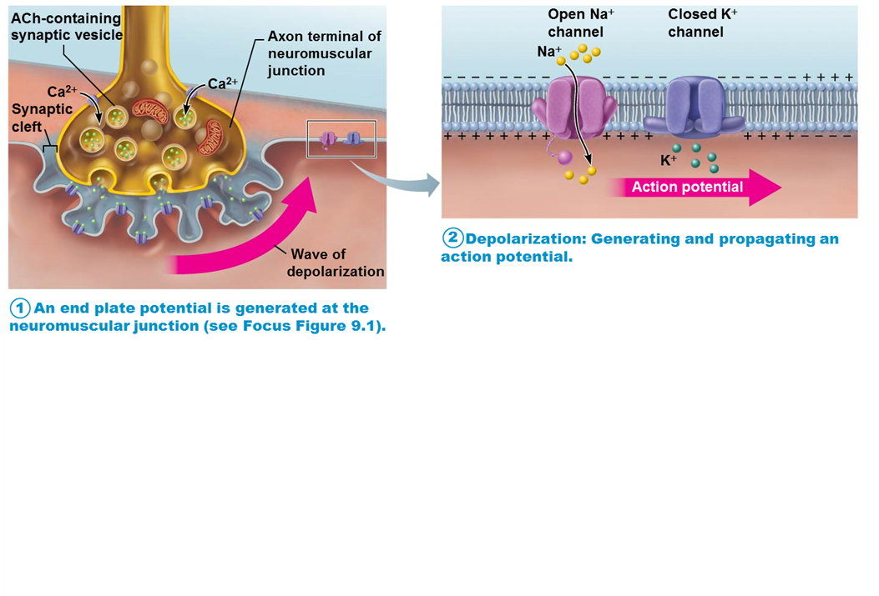
  Summary of Events in the Generation and Propagation of an Action Potential in a Skeletal Muscle Fiber (2 of 3)
Figure 9.8 Summary of events in the generation and propagation of an action potential in a skeletal muscle fiber.

Slide 70
Generation of an Action Potential Across the Sarcolemma (4 of 4)
Repolarization: restoration of resting conditions
  Na⁺ voltage-gated channels close, and voltage-gated K⁺ channels open
  K⁺ efflux out of cell rapidly brings cell back to initial resting membrane voltage
  Refractory period: muscle fiber cannot be stimulated for a specific amount of time, until repolarization is complete
  Ionic conditions of resting state are restored by Na⁺-K⁺ pump
    Na⁺ that came into cell is pumped back out, and K⁺ that flowed outside is pumped back into cell

Slide 71
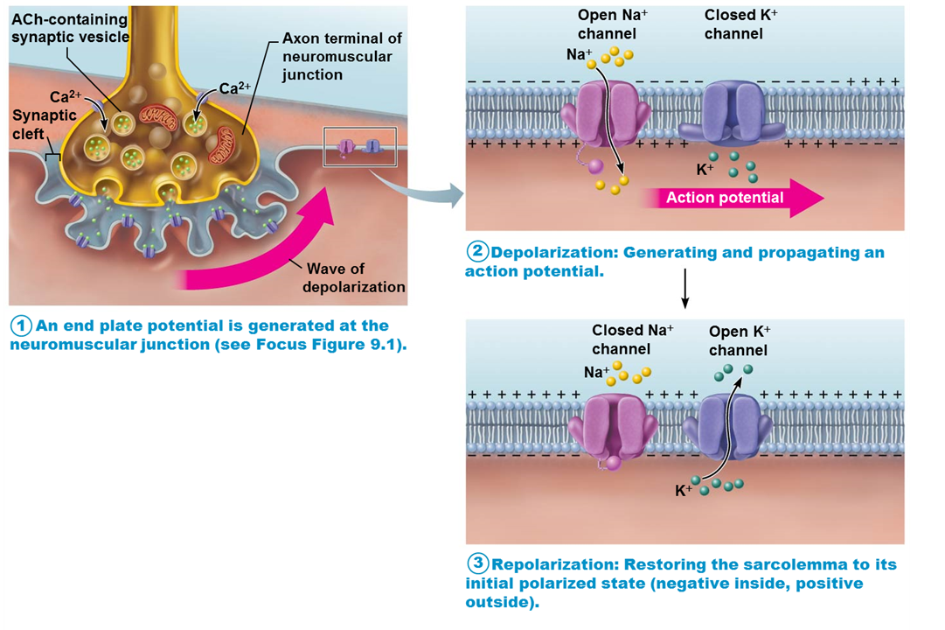
  Summary of Events in the Generation and Propagation of an Action Potential in a Skeletal Muscle Fiber (3 of 3)
Figure 9.8 Summary of events in the generation and propagation of an action potential in a skeletal muscle fiber.

Slide 72
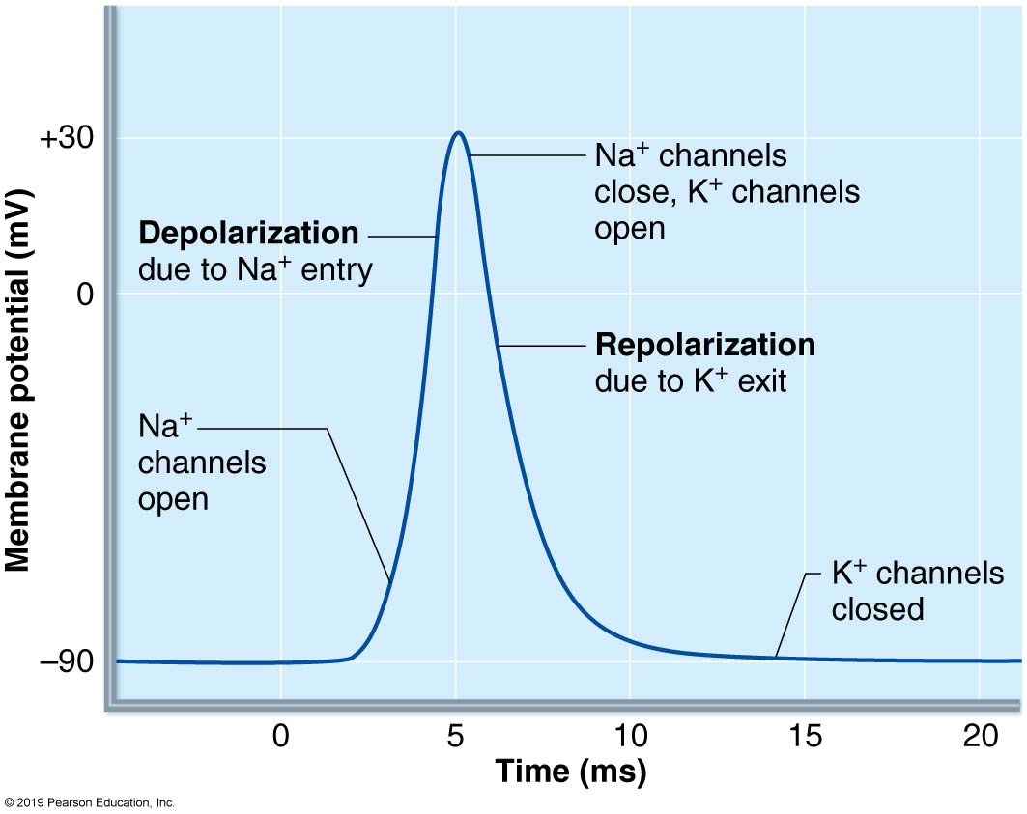
  Action Potential Tracing Indicates Changes in Na⁺ and K⁺ ion Channels
Figure 9.9 Recording of an action potential (AP) in a muscle fiber.

Slide 73
Excitation-Contraction (E-C) Coupling
Excitation-contraction (E-C) coupling: events that transmit AP along sarcolemma (excitation) are coupled to sliding of myofilaments (contraction)
AP is propagated along sarcolemma and down into T tubules, where voltage-sensitive proteins in tubules stimulate Ca²⁺ release from SR
  Ca²⁺ release leads to contraction
AP is brief and ends before contraction is seen

Slide 74
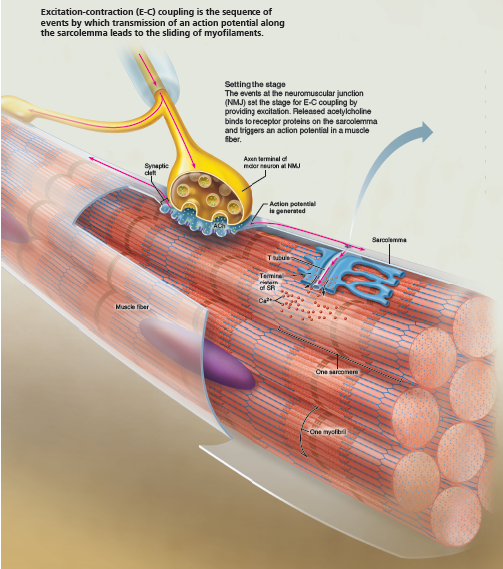
  Excitation-Contraction (E-C) Coupling is the Sequence of Events by Which Transmission of an Action Potential Along the Sarcolemma Leads to the Sliding of Myofilaments (1 of 3)
FOCUS FIGURE 9.2 Excitation-Contraction Coupling

Slide 75
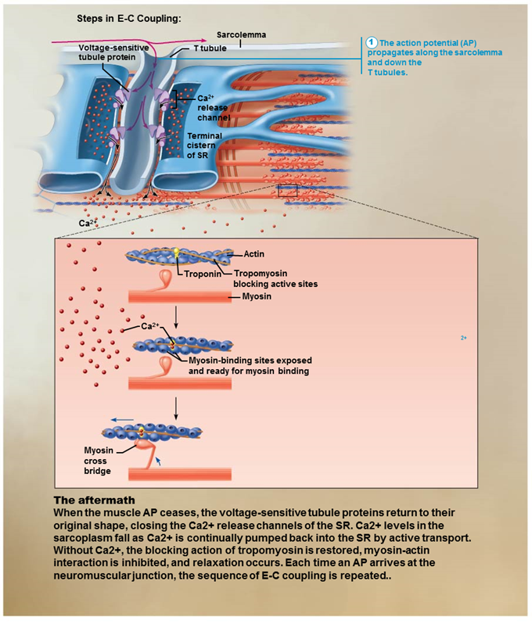
  Excitation-Contraction (E-C) Coupling is the Sequence of Events by Which Transmission of an Action Potential Along the Sarcolemma Leads to the Sliding of Myofilaments (2 of 3)
FOCUS FIGURE 9.2 Excitation-Contraction Coupling

Slide 76
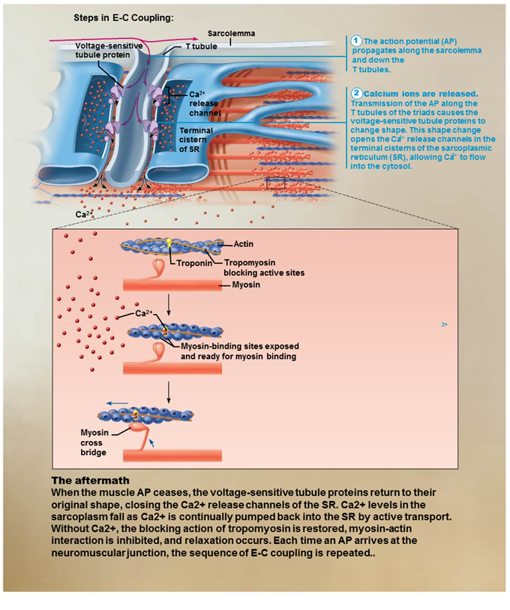
  Excitation-Contraction (E-C) Coupling is the Sequence of Events by Which Transmission of an Action Potential Along the Sarcolemma Leads to the Sliding of Myofilaments (3 of 3)
FOCUS FIGURE 9.2 Excitation-Contraction Coupling

Slide 77
A&P Flix: Excitation-Contraction Coupling
Click here to view ADA compliant Animation:
Excitation-Contraction Coupling
https://mediaplayer.pearsoncmg.com/assets/apf-excitation-contraction-coupling

Slide 78
  Muscle Fiber Contraction: Cross Bridge Cycling (1 of 3)
At low intracellular Ca²⁺ concentration:
  Tropomyosin blocks active sites on actin
  Myosin heads cannot attach to actin
  Muscle fiber remains relaxed
Voltage-sensitive proteins in T tubules change shape, causing sarcoplasmic reticulum (SR) to release Ca²⁺ to cytosol

Slide 79
  Muscle Fiber Contraction: Cross Bridge Cycling (2 of 3)
At higher intracellular Ca²⁺ concentrations, Ca²⁺ binds to troponin
Troponin changes shape and moves tropomyosin away from myosin-binding sites
Myosin heads is then allowed to bind to actin, forming cross bridge
Cycling is initiated, causing sarcomere shortening and muscle contraction
When nervous stimulation ceases, Ca²⁺ is pumped back into SR, and contraction ends

Slide 80
  Muscle Fiber Contraction: Cross Bridge Cycling (3 of 3)
Four steps of the cross bridge cycle
  Cross bridge formation: high-energy myosin head attaches to actin thin filament active site
  Working (power) stroke: myosin head pivots and pulls thin filament toward M line
  Cross bridge detachment: ATP attaches to myosin head, causing cross bridge to detach
  Cocking of myosin head: energy from hydrolysis of ATP “cocks” myosin head into high-energy state
    This energy will be used for power stroke in next cross bridge cycle

Slide 81
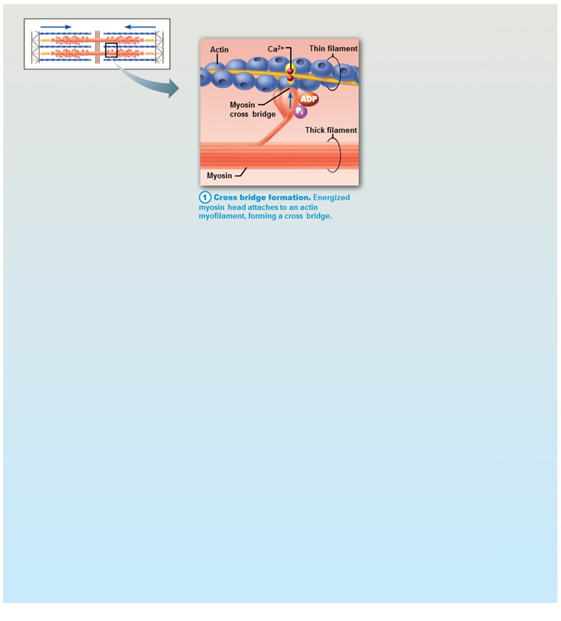
  The Cross Bridge Cycle is the Series of Events During Which Myosin Heads Pull Thin Filaments Toward the Center of the Sarcomere (1 of 4)
FOCUS FIGURE 9.3 Cross Bridge Cycle

Slide 82
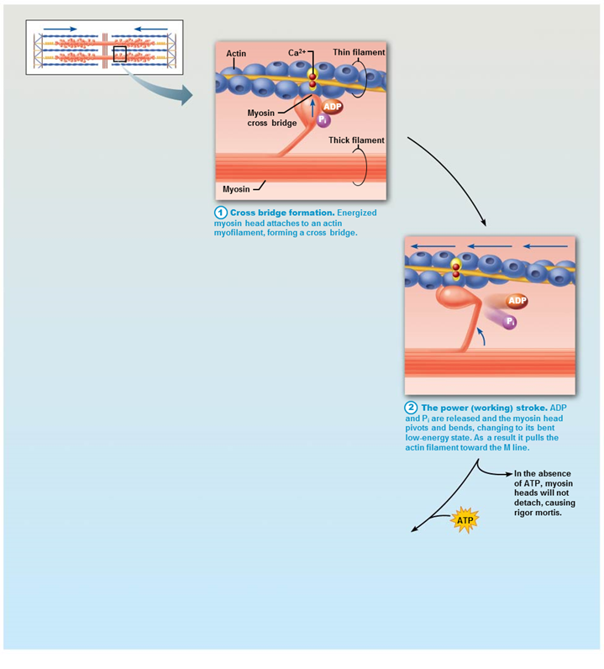
  The Cross Bridge Cycle is the Series of Events During Which Myosin Heads Pull Thin Filaments Toward the Center of the Sarcomere (2 of 4)
FOCUS FIGURE 9.3 Cross Bridge Cycle

Slide 83
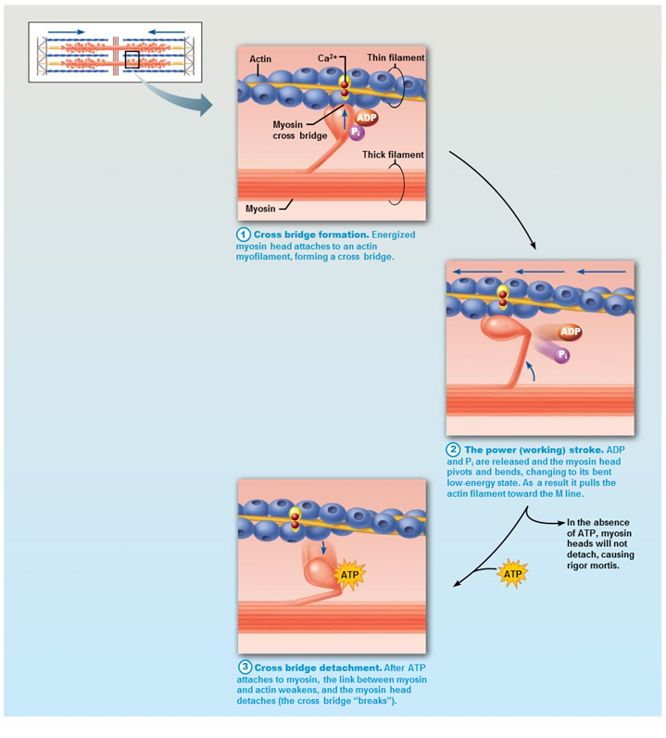
  The Cross Bridge Cycle is the Series of Events During
  Which Myosin Heads Pull Thin Filaments Toward the
  Center of the Sarcomere (3 of 4)
FOCUS FIGURE 9.3 Cross Bridge Cycle

Slide 84
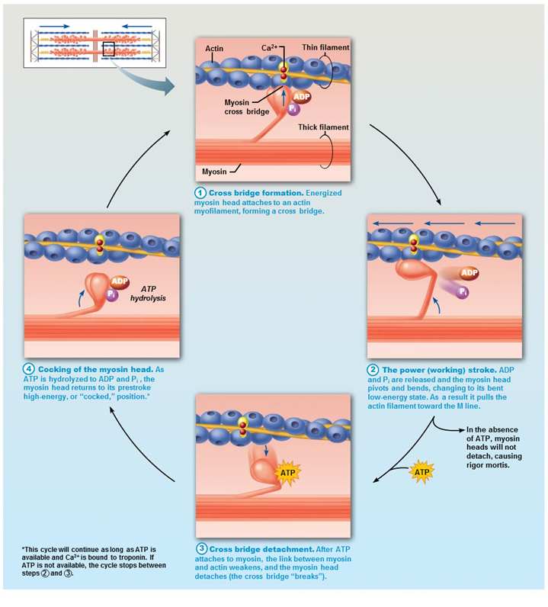
  The Cross Bridge Cycle is the Series of Events During Which Myosin Heads Pull Thin Filaments Toward the Center of the Sarcomere (4 of 4)
FOCUS FIGURE 9.3 Cross Bridge Cycle

Slide 85
A&P Flix: Cross Bridge Cycle
Click here to view ADA compliant Animation:
Cross Bridge Cycle
https://mediaplayer.pearsoncmg.com/assets/apf-cross-bridge-cycle

Slide 86
  Clinical – Homeostatic Imbalance 9.3
Rigor mortis
  3–4 hours after death, muscles begin to stiffen
    Peak rigidity occurs about 12 hours postmortem
  Intracellular calcium levels increase because ATP is no longer being synthesized, so calcium cannot be pumped back into SR
    Results in cross bridge formation
  ATP is also needed for cross bridge detachment
    Results in myosin head staying bound to actin, causing constant state of contraction
  Muscles stay contracted until muscle proteins break down, causing myosin to release

Slide 87
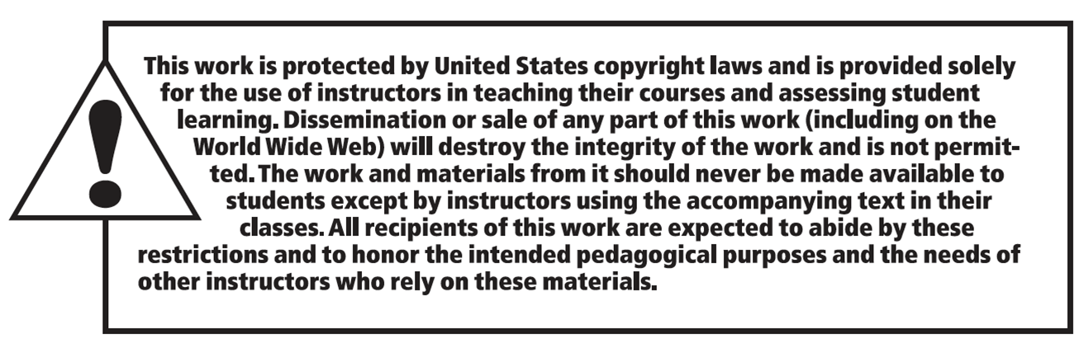
Copyright

